Slide 1
Determining the Optimal Number of Vowel Clusters in a Wide Range of Fundamental Frequencies using Unsupervised Learning
MSc Thesis Defense
Simon Frischknecht
September 16, 2021

Slide 2
Table of Contents
Introduction
Speech Data and MFCC
Clustering Methods
Cluster Validation Techniques
Implementation and Evaluation
Conclusion

Slide 3
Introduction

Slide 4
Introduction
For humans, the higher the fundamental frequency (fo), vowels become less intelligible
Recognition of corner vowels (a, i, u) up to around 1 kHz fo
Goal of this thesis: Use machine learning algorithms to see how they solve this task
In particular: apply clustering algorithms to groups vowels

Slide 5
Speech Data and MFCC

Slide 6
Vowel Speech Data
Eight isolated Standard German vowels (a, e, i, o, u, ä, ö, ü)
Recorded by four professional female actresses
Data comes from larger corpus
Wide range of fundamental frequencies (fo)
Restrict to 10 fo levels 220, 330, 440, 523, 587, 659, 698, 784, 880, 988 Hz

Slide 7
Mel-Frequency Cepstral Coefficients (MFCCs)
MFCCs are a numeric representation of speech signals
It is a standard in many modern speech recognition systems
Input for clustering algorithms
It is based on several transformations:
Discrete Fourier Transform
Mel scale
Discrete Cosine Transform

Slide 8
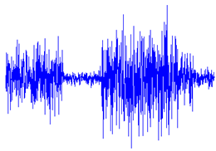
MFCC Generation
Sampling
Framing
Window
function
Logarithm
Mel scale
Fourier transform
DCT
MFCC

Slide 9
Clustering Methods

Slide 10
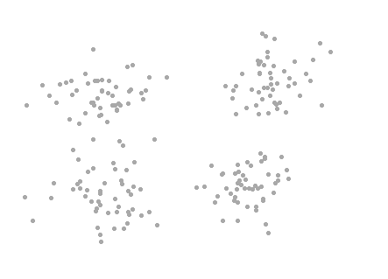
Clustering Methods
Clustering methods are unsupervised learning algorithms
No labels are used (in contrast to supervised learning)
These algorithms have the goal of finding groups in a dataset:
“Observations in the same group should be as similar as possible, and observations in different groups should be as dissimilar from each other as possible.”
Big challenge: how many clusters are there?

Slide 11
Clustering Methods
List of used clustering algorithms:
k-Means
Gaussian Mixture Model
Hierarchical Clustering
Spectral Clustering
Mean Shift
DBSCAN
Affinity Propagation

Slide 12
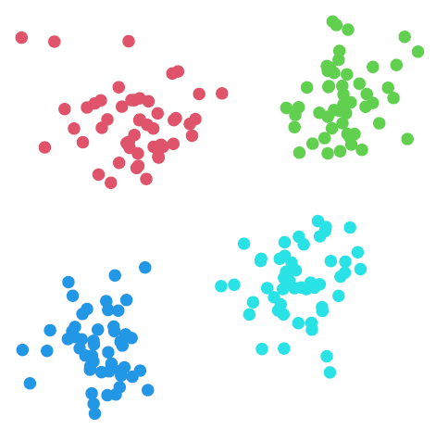
K-Means
Simple iterative algorithm
Computationally fast
Solves non-convex optimization problem
Finds different solutions based on initialization and number of iterations
Needs to define the number of clusters k a priori

Slide 13
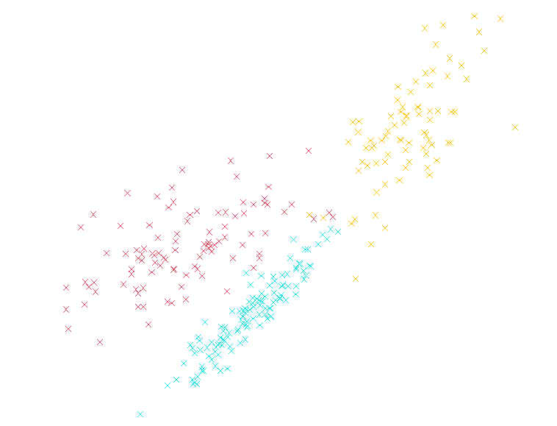
Gaussian Mixture Model (GMM)
K-means can be seen as a special case of a GMM
It is a probabilistic technique that assumes normally distributed clusters
High flexibility, can easily overfit (Bias-variance tradeoff)
Computationally expensive (estimate covariance matrices)
Needs to define the number of clusters k a priori

Slide 14
Mean Shift
Different to k-means and GMM
Clustering method based on kernel density estimation
Two parameters: kernel function and bandwidth
Find local maxima of estimated density
No need to define the number of clusters k
Notes:
Bandwidth h controls bias-variance tradeoff -> find h e.g. by cross-validation, but there is no clear way how to handle this in practical applications for clustering
https://scikit-learn.org/0.19/modules/generated/sklearn.cluster.estimate_bandwidth.html -> how sklearn does estimate h

Slide 15
Cluster Validation Techniques

Slide 16
Clustering Validation Techniques
Often needed to find optimal number of clusters
Internal Evaluation
Do not make use of the true labels
More realistic for most real-world applications
Analyzed in thesis: Davies-Bouldin Index, Calinski-Harabasz Index, Dunn Index, Silhouette Index
External Evaluation
Make use of the ground truth
Potential to find optimal results
Analyzed in thesis: Rand Index, Fowlkes-Mallows Index, Mutual Information, V-Measure
Some clustering algorithms estimate the optimal number of clusters by itself

Slide 17
Implementation and Evaluation

Slide 18
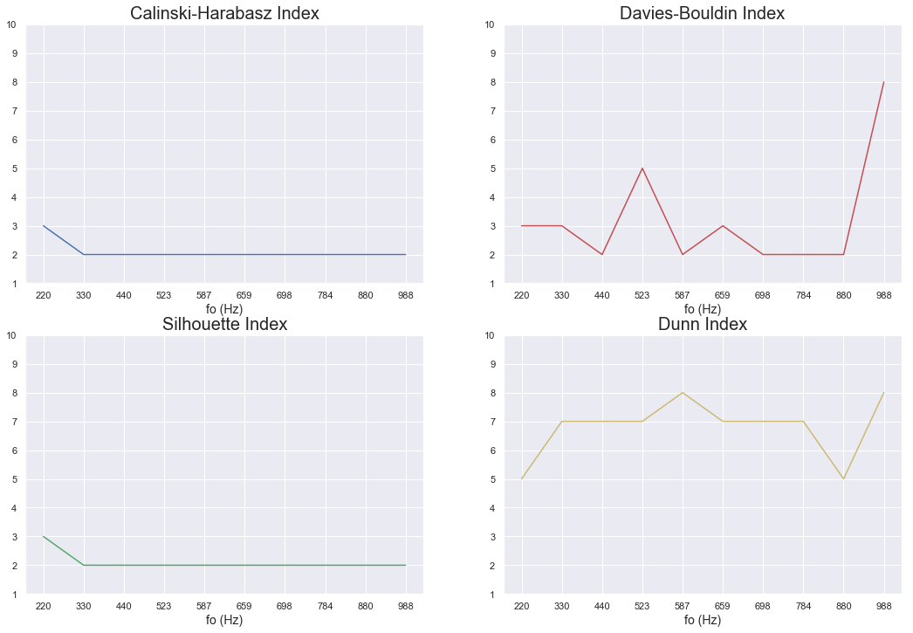
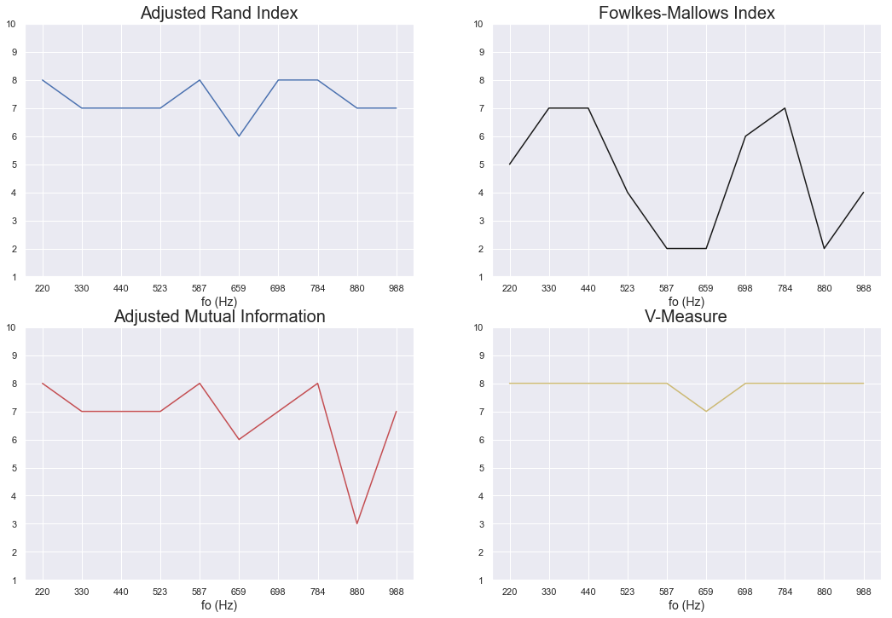
K-Means
Internal Evaluation
External Evaluation

Slide 19
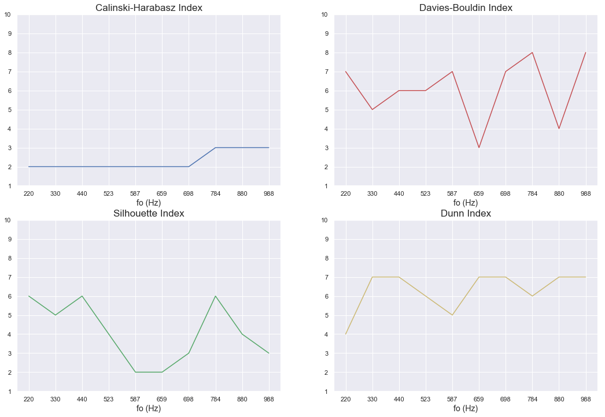
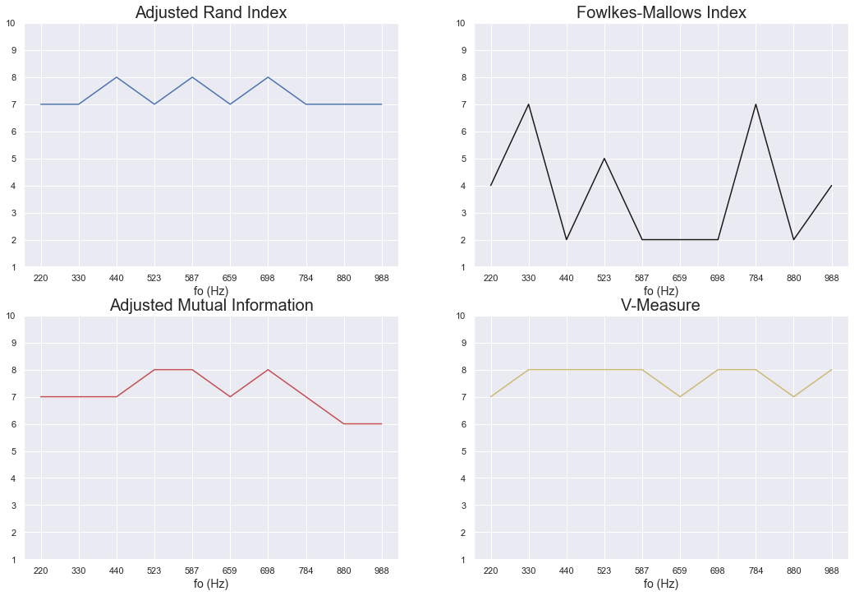
Gaussian Mixture Model
Internal Evaluation
External Evaluation

Slide 20
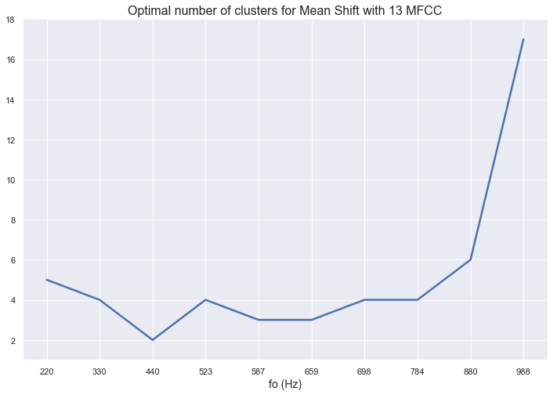
Mean Shift

Slide 21
Conclusion

Slide 22
Conclusion
Seven clustering methods analyzed
No “best” clustering algorithm
Clustering results depend on validation criterions
Exception: mean shift, affinity propagation and DBSCAN estimate clusters on its own
Internal evaluation criterions frequently underestimate the true number of clusters
External validation methods partially suggest the correct number of groups
fo has no significant influence on the results
Notes:
>>>>>>>>>> Cluster algorithms are not so relevant, but much more which validation criterion that are used, especially external perform the best

Slide 23
It was fun to work on this topic!

Slide 24
Thank you for your attention!

Slide 25
References
Friedrichs, D., Maurer, D., & Dellwo, V. (2015). The phonological function of vowels is maintained at fundamental frequencies up to 880 Hz. The Journal of the Acoustical Society of America, 138(1), EL36-EL42.
Friedrichs, D., Maurer, D., Rosen, S., & Dellwo, V. (2017). Vowel recognition at fundamental frequencies up to 1 kHz reveals point vowels as acoustic landmarks. The Journal of the Acoustical Society of America, 142(2), 1025–1033.
Kathiresan, T., Maurer, D., & Dellwo, V. (2019). Highly spectrally undersampled vowels can be classified by machines without supervision. The Journal of the Acoustical Society of America, 146(1), EL1-EL7.

Slide 26
Appendix

Slide 27
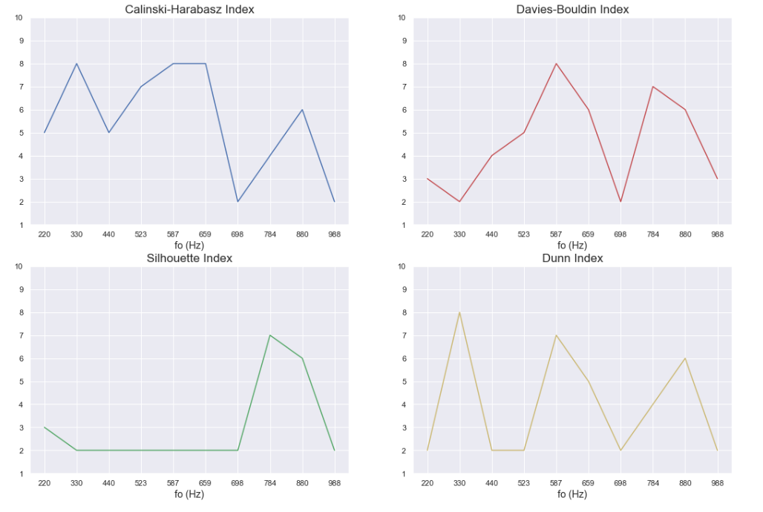
Hierarchical Clustering (Internal)

Slide 28
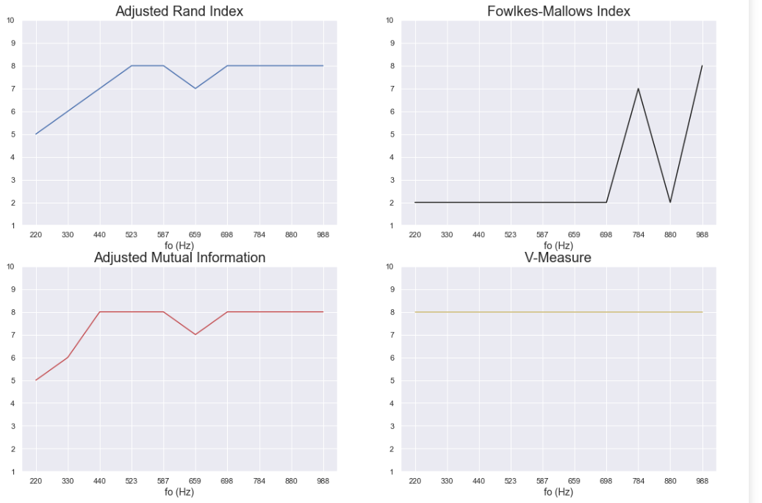
Hierarchical Clustering (Exernal)

Slide 29
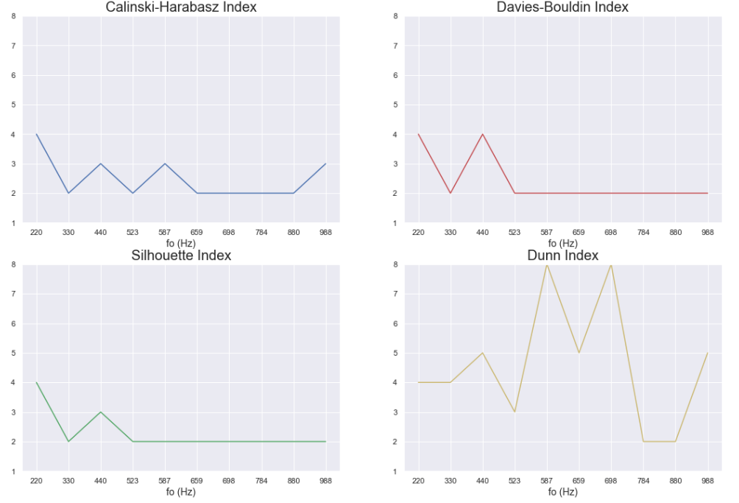
Spectral Clustering (Internal)

Slide 30
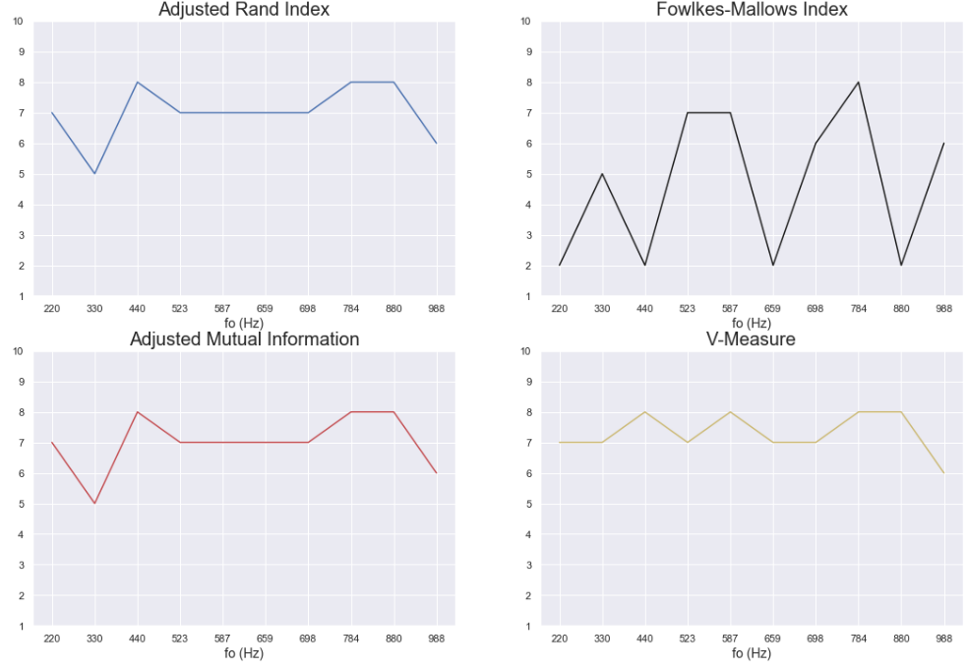
Spectral Clustering (External)

Slide 31
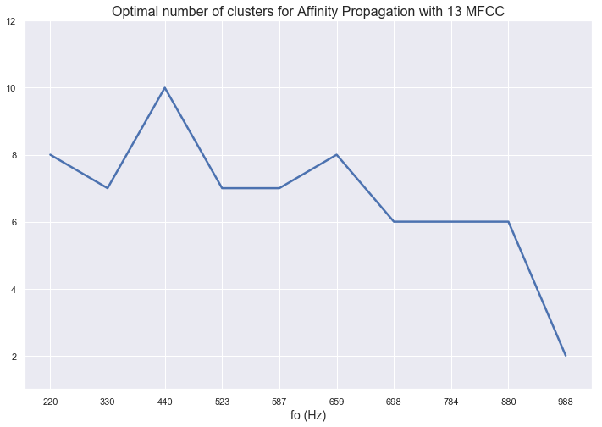
Affinity Propagation

Slide 32
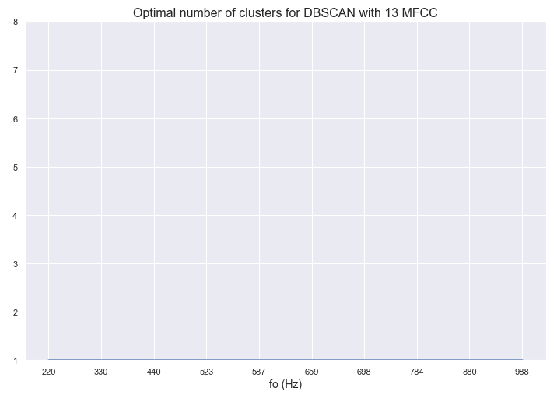
DBSCAN (no validation criterions)

Slide 33
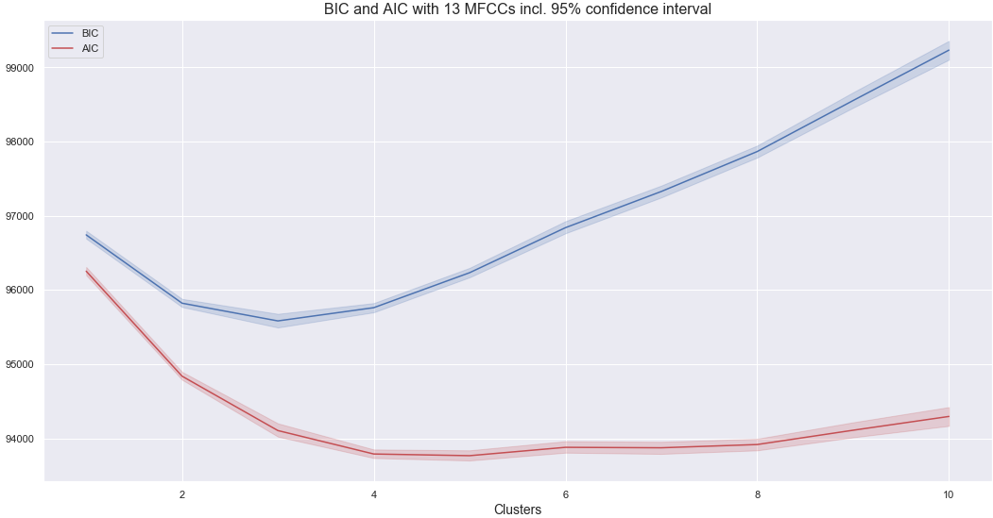
GMM (BIC, AIC)

