Slide 1
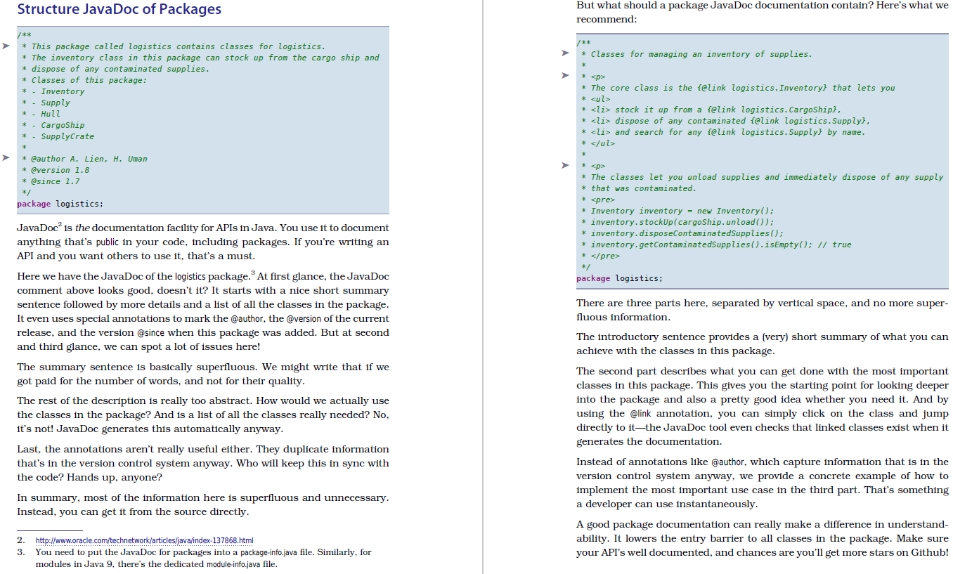
Actionable
Name
Bad Code
Better Code
Problem Description
Solution Description

