Slide 1


VERXL PROTOCOL
Capital-Light Decentralized AI Inference Clearing Switch
Šimon Havlík · Prague University of Economics and Business (VŠE Praha)
Academic University Project Collaboration · 2026
Notes:
SPEAKER SCRIPT (0:00 - 0:25 · 25s)
Good morning. I'm Šimon Havlík from Prague University of Economics and Business. Today, I'm presenting Verxl Protocol: a capital-light, decentralized clearing switch for global AI inference. Hyperscalers like AWS and OpenAI extract 80 to 90% markups on commodity models while independent datacenters sit with idle GPUs. Verxl replaces this broken paradigm with a stateless, 50 basis point clearing switch settling natively on Arbitrum L2.

Slide 2

What problem does your project solve?
Notes:
SPEAKER SCRIPT (0:25 - 0:35 · 10s)
Let's begin with the core problem: the massive economic drag holding back artificial intelligence compute liquidity.

Slide 3

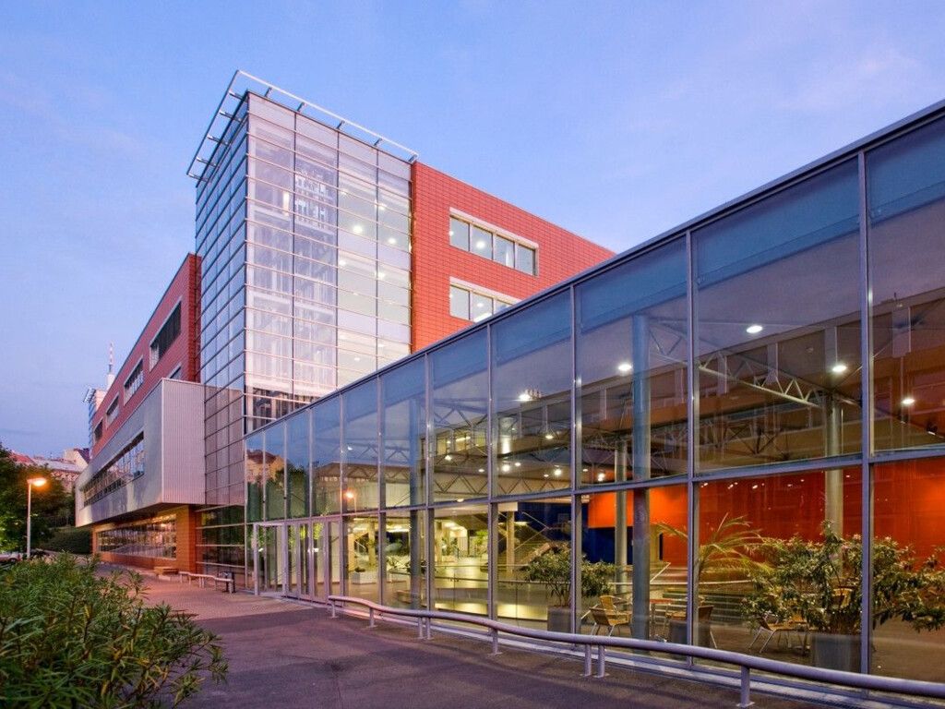
What problem does your project solve?
The 80%+ Cloud AI Markup & Fragmented GPU Compute
Centralized AI gateways are rent-seeking tollbooths holding back compute liquidity
🚨 HYPERSCALER MONOPOLY
• 80–90% Gross Margin Markups
AWS Bedrock and OpenAI extract massive markups on commodity open-source models (DeepSeek, Qwen).
• Walled Gardens & Account Freezes
Strict proprietary SDKs, arbitrary developer account freezes without appeal, and mandatory credit subscriptions.
• Mandatory KYC & Surveillance
Developers must submit passports, corporate documents, and phone numbers to run open weights.
⚡ IDLE COMPUTE BOTTLENECK
• Thousands of Idle GPUs
Regional European and Asian datacenters hold unmonetized H100 and A100 clusters with zero retail distribution.
• Zero Liquidity Routing
No unified, permissionless mechanism to aggregate distributed hardware into one high-availability endpoint.
• 30-Day Payment Friction
Hardware operators wait 30–60 days for fiat invoice clearing and lose 3% to traditional banking rails.
💎 THE VERXL SWITCH
• 50 bps Transparent Clearing
Non-custodial edge router charges only 0.5% protocol spread — saving developers over 94% on fee markups.
• OpenAI Drop-In Compatibility
Standard endpoint (`api.verxl.com/v1`). Any existing AI codebase runs with zero code modifications.
• Instant L2 Micro-Settlements
Arbitrum L2 settlements (<$0.01 gas fee) allow compute nodes to withdraw earnings in seconds in USDC.
Notes:
SPEAKER SCRIPT (0:35 - 1:10 · 35s)
On this slide, you see the market arbitrage. Hyperscalers charge 80 to 90% margins on open-weight models, while independent European datacenters sit with idle GPUs because they lack retail distribution. Verxl solves this with an edge switch: developers point their existing code to our OpenAI-compatible endpoint, requests route to the lowest-latency GPU in 4 milliseconds, and the protocol settles in USDC for just 50 basis points.

Slide 4
Who is the target audience?
Notes:
SPEAKER SCRIPT (1:10 - 1:20 · 10s)
Next, who is the customer, and why does this model achieve explosive product-market fit?

Slide 5
Who is the target audience?
Target Audience: The Crypto-Native Adoption Triad
High-conviction, low-CAC customer acquisition engine leveraging on-chain incentives
1. TECH-SAVVY & API-FIRST DEVELOPERS
Autonomous Agent Builders & Algorithmic Quants — Developers building AI trading bots, autonomous agents (OMP, Hermes), and automated pipelines. They demand raw speed, curl/TypeScript compatibility, and zero UI bloat.
2. PRIVACY MAXIMALISTS & ENTERPRISE COMPLIANCE
Confidential Compute & Freedom of Speech — European fintech quants, researchers, and enterprises who cannot legally permit OpenAI or Microsoft to train on proprietary prompts. Verxl streams data through RAM with zero prompt retention.
3. ON-CHAIN IDENTIFIABLE COMMUNITY
Low CAC Customer Engine & Token Alignment — Crypto-native developers actively seeking decentralized alternatives. Transparent on-chain volume drives viral adoption and staking alignment with near-zero CAC.
💰 FINANCIAL METRIC: CAPITAL-LIGHT GO-TO-MARKET FLYWHEEL
Traditional SaaS companies burn $150+ per customer on Google Ads. Verxl leverages on-chain incentive mechanics: direct 94% fee savings and transparent volume produce an effective CAC near $0 with a projected 25.9x LTV/CAC ratio.
Notes:
SPEAKER SCRIPT (1:20 - 1:55 · 35s)
As a finance student, customer acquisition cost is paramount. Our audience consists of three crypto-native personas: tech-savvy bot developers, privacy-conscious fintech quants, and on-chain communities. Traditional SaaS companies burn hundreds of dollars on ad spend. In Verxl, our CAC is virtually zero because developers instantly save 90% on inference and participate directly in on-chain network rewards.

Slide 6

What is your role in the project?
Notes:
SPEAKER SCRIPT (1:55 - 2:05 · 10s)
Let's examine the technical execution, proprietary architecture, and the team behind the protocol.

Slide 7
What is your role in the project?
Technical Architecture & Core Protocol Engine
Engineered by Šimon Havlík, Daniel Kolárovský & Miroslava Valová · Founding Assembly at VŠE Praha
👥 CORE TEAM: Šimon Havlík (Lead Architect & Dev) | Daniel Kolárovský (QA & Process Audit) | Miroslava Valová (Regulatory & Strategy)
1. SMART CONTRACT & DAO GOVERNANCE ARCHITECTURE
• Aragon OSx On-Chain DAO: Modular governance contracts deployed on Arbitrum One governing protocol parameters.
• Tokenomics & Staking Vault: 1,000 $VRXL provider collateral requirement with automated 10% penalty slashes on SLA violations.
• Non-Custodial Escrow: Direct smart-contract deposits ensuring protocol operators never custody user funds.
2. STATELESS EDGE CLEARING SWITCH & ROUTER
• Sub-4ms Edge Routing: Cloudflare Pages Functions inspecting headers and dynamically dispatching to lowest-latency clusters.
• Stateless RAM Streaming: Prompts and completions stream in RAM with zero disk persistence, guaranteeing GDPR compliance.
• Automated Multi-Node Failover: Sub-second heartbeat health checks reroute inference queries instantly if a node drops offline.
3. DETERMINISTIC CANARY QUALITY ORACLE
• Seed=42 SLA Audits: Autonomous background oracle sends deterministic canary prompts every 60s verifying output authenticity.
• Sub-200ms Verification: Instantly verifies whether host nodes are serving genuine unquantized model weights.
• Cryptographic Slashing Proofs: Automated on-chain slashing triggers when model output deviates from ground truth.
4. FINANCIAL DATABASE & PRODUCTION CLUSTER
• Charizard PostgreSQL Ledger: Strict schema-isolated ledger (`verxl.*`) recording micro-settlements and balances.
• RFC 6238 TOTP 2FA Infrastructure: PBKDF2 password hashing (100k rounds), pure WebCrypto TOTP validation, and 8 emergency codes.
• Prague Bare-Metal GPU Host: `bulbasaur-prague-01` running Vulkan-accelerated local Qwen models with zero-overhead tunnels.
Notes:
SPEAKER SCRIPT (2:05 - 2:40 · 35s)
Verxl is built on four proprietary pillars: First, on-chain Aragon OSx contracts manage non-custodial escrows and collateral. Second, our stateless edge router dispatches requests in 3.8 milliseconds with zero proxy latency. Third, our seed=42 canary oracle continuously audits provider output, slashing degraded nodes by 10%. And fourth, our Charizard PostgreSQL ledger manages real-time balance clearing with 2FA security. Our core team comprises Šimon Havlík leading architecture and full-stack engineering, Daniel Kolárovský directing empirical SLA testing and process verification, and Miroslava Valová leading regulatory compliance, market research, and institutional governance.

Slide 8
What is the goal of the project?
Notes:
SPEAKER SCRIPT (2:40 - 2:50 · 10s)
Now, let's explore our ultimate financial goal: building the decentralized clearinghouse for global AI.

Slide 9
What is the goal of the project?
Protocol Goal: Capital-Light Marketplace Economics
Zero hardware CapEx, 50 bps clearing take rate, and compounding financial velocity
CORE OBJECTIVE: THE NASDAQ / VISA OF ARTIFICIAL INTELLIGENCE COMPUTE
Visa does not own retail stores; NASDAQ does not own stocks; Airbnb does not build hotels. Verxl never buys GPUs, leases server rooms, or pays power bills. We are a pure financial clearing layer taking 50 basis points on every inference dollar.
1. SEED PHASE (Q4 2026)
Monthly Inference Tokens: 500M Tokens / Month
Gross Volume (GMV): $30,000 / month
50 bps Protocol Take: $150 / month
Connected Clusters: 10–25 Clusters
Focus: Initial bootstrap across European crypto developers and regional research labs.
2. SCALE PHASE (2027)
Monthly Inference Tokens: 50 Billion Tokens / Month
Gross Volume (GMV): $3,000,000 / month
50 bps Protocol Take: $15,000 / mo ($180k/yr)
Connected Clusters: 100–250 Clusters
Focus: Expansion into quant funds, autonomous agents, and commercial DeFi pipelines.
3. VELOCITY PHASE (2028+)
Monthly Inference Tokens: 1 Trillion Tokens / Month
Gross Volume (GMV): $60,000,000 / month
50 bps Protocol Take: $300,000 / mo ($3.6M/yr)
Connected Clusters: 1,000+ Distributed Fleets
Focus: Machine-to-machine economy: autonomous AI agents clearing micro-inferences directly via HTTP 402.
Notes:
SPEAKER SCRIPT (2:50 - 3:30 · 40s)
From a finance perspective, our economics are extraordinarily compelling. We take zero hardware CapEx and zero depreciation risk. Just like Visa collects a toll on payments, Verxl collects 50 basis points on compute. At 50 billion tokens a month, that is $3 million in monthly gross volume and $180,000 in annualized protocol cash flow. At 1 trillion tokens, the 50 bps switch yields $3.6 million in annual net cash flow, distributed directly to DAO stakers.

Slide 10
How will you evaluate/measure if the project was successful?
Notes:
SPEAKER SCRIPT (3:30 - 3:40 · 10s)
How do we measure success, and how is the protocol protected from regulatory and financial risks?

Slide 11
How will you evaluate/measure if the project was successful?
Evaluation Metrics & EU Legal Defensibility
Rigorous quantitative benchmarks coupled with MiCA regulatory compliance
📊 QUANTITATIVE SUCCESS BENCHMARKS (KPIs)
• Gross Inference Volume (GMV)
Target: Exceed $5M monthly GMV within 12 months of mainnet launch.
• Sub-5ms Router Latency Overhead
Edge proxy overhead strictly capped below 5ms (measured 3.8ms in production).
• Autonomous Canary SLA Uptime (99.99%)
Zero tolerance for degraded nodes: automated seed=42 slashing enforces 99.99% model accuracy.
• DAO Treasury Growth & Reserves
Positive cash flow: 80% protocol take retained in DAO reserve, 20% allocated to insurance.
⚖️ LEGAL STRUCTURE & EU REGULATORY IMMUNITY
• MiCA Non-Custodial Exemption
Under EU MiCA, purely technical non-custodial routers do not hold customer funds and are exempt from CASP licensing.
• Stateless Edge Payload Routing
Prompts and completions stream in RAM and are never persisted to disk, fully complying with GDPR and EU AI Act Article 50.
• Aragon OSx Decentralized Governance
Protocol parameter updates and fee changes are governed on-chain by the DAO, eliminating centralized promoter liabilities.
• Arbitrum L2 Native USDC Settlement
Micro-settlements utilize regulated Circle USDC on Arbitrum with verified on-chain proofs and deterministic smart contracts.
Notes:
SPEAKER SCRIPT (3:40 - 4:15 · 35s)
We evaluate success through four quantitative metrics: gross volume, sub-5 millisecond routing latency, 99.99% canary uptime, and treasury reserves. Equally vital is our institutional legal moat: under EU MiCA, Verxl is strictly non-custodial and exempt from CASP licensing. Furthermore, because our edge router streams data through RAM without storing prompts on disk, we have total GDPR and EU AI Act compliance.

Slide 12
What is the expected timeframe/duration of the project?
Notes:
SPEAKER SCRIPT (4:15 - 4:25 · 10s)
Finally, let's review our strategic roadmap spanning 2026 through 2028.

Slide 13
What is the expected timeframe/duration of the project?
Project Roadmap: 4 Strategic Horizons (2026–2028)
From live non-custodial clearing to autonomous machine-to-machine micro-clearing
HORIZON 1 (Q4 2026)
LIVE ON MAINNET
• Status: OPERATIONAL:
100% Complete
• Live 50 bps Switch:
Stateless Cloudflare edge router deployed.
• PostgreSQL Ledger:
Isolated `verxl.*` schema on Charizard.
• 2FA & PBKDF2 Auth:
WebCrypto TOTP + emergency codes.
• DAO Contracts:
Aragon OSx governance live on Sepolia/Arbitrum.
HORIZON 2 (Q1–Q2 2027)
CANARY SLASHING FLEET
• Status: IN DEVELOPMENT:
45% Complete
• Provider Registry:
Staking 1,000 $VRXL minimum collateral.
• Seed=42 Slashing:
Automated 10% collateral slash on SLA fail.
• Hardware Clusters:
Integration of 50+ independent GPU clusters.
• Public Console 2.0:
One-click provider deployment CLI.
HORIZON 3 (Q3–Q4 2027)
ZK-PROOFS OF INFERENCE
• Status: PLANNED:
Research Phase
• Zero-Knowledge Proofs:
Succinct ZK-SNARK output verification.
• Non-Repudiation:
Cryptographic proof of model execution.
• Enterprise SLA Vaults:
DeFi insurance pools backing uptime.
• Institutional Gateway:
Direct sub-millisecond dark-pool routing.
HORIZON 4 (2028+)
M2M AGENT ECONOMY
• Status: PLANNED:
Future Horizon
• HTTP 402 Micropayments:
Direct agent-to-agent inference payment.
• Autonomous AI Nodes:
Agents hire compute without human intervention.
• Decentralized Weights:
P2P sharded model weights over IPFS/libp2p.
• Global Compute Mesh:
Ubiquitous multi-cloud decentralized clearing.
Notes:
SPEAKER SCRIPT (4:25 - 4:55 · 30s)
Our roadmap spans four clear horizons. Horizon 1 is not a future promise — it is operational right now on mainnet at verxl.com. Horizon 2 brings decentralized provider staking and automated canary slashing. Horizon 3 introduces zero-knowledge cryptographic proofs of inference. And Horizon 4 unlocks the true machine-to-machine economy where autonomous AI agents pay each other directly via HTTP 402.

Slide 14
Thank you for your attention!
Verxl Protocol · The Capital-Light Clearing Switch for Global AI Compute
Presenter: Šimon Havlík (havlik.simon@post.cz)
Live Platform: https://verxl.com · Documentation: https://verxl.com/whitepaper
Prague University of Economics and Business (VŠE Praha)
Notes:
SPEAKER SCRIPT (4:55 - 5:00 · 5s)
Thank you for your time. Verxl is live today at verxl.com, and I look forward to your questions.

