Slide 1


VERXL PROTOCOL
Capital-Light Decentralized AI Inference Clearing Switch
Simon Havlík · VŠE Faculty of International Relations
Course: 2SE307 Bitcoin & Blockchain · Instructor: M. Bok
Notes:
SPEAKER SCRIPT (0:00 - 0:35)
Good morning. I'm Simon Havlík from the Faculty of International Relations at VŠE. Today, I'm presenting Verxl Protocol: a capital-light, decentralized clearing switch for global AI inference. Every day, millions of dollars are spent on AI inference through AWS, Azure, and OpenAI. These centralized giants charge 80 to 90% gross margins. Verxl replaces these predatory walled gardens with a stateless, non-custodial clearing protocol that charges only a 50 basis point clearing fee.

Slide 2

What problem does your project solve?
Notes:
SPEAKER SCRIPT (0:35 - 0:45)
Let's look at the core problem in the current artificial intelligence compute market.

Slide 3

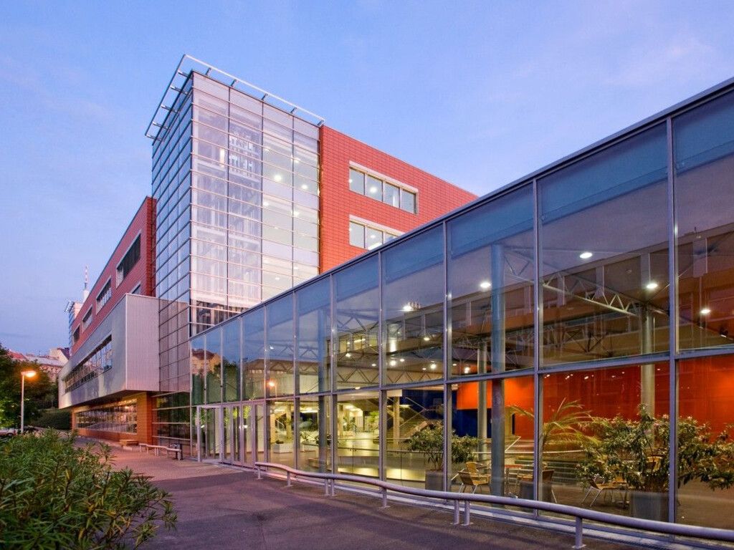
What problem does your project solve?
The 80%+ Cloud AI Markup & Fragmented GPU Compute
Why centralized AI gateways are rent-seeking tollbooths and how Verxl fixes it
🚨 HYPERSCALER MONOPOLY
• 80–90% Gross Margin Markup
Centralized providers (OpenAI, AWS Bedrock) add massive rent-seeking spreads on top of raw GPU compute.
• Walled Gardens & Vendor Lock-In
Strict proprietary SDKs, account suspensions without appeal, and enforced credit card subscriptions.
• Mandatory KYC & Surveillance
Developers must submit passports, corporate registry documents, and phone numbers to run open weights.
⚡ IDLE COMPUTE DILEMMA
• Massive Unmonetized Clusters
Regional datacenters and miners sit on thousands of H100s, A100s, and 4090s with zero retail access.
• Zero Liquidity Routing
No permissionless way to aggregate disparate compute nodes into a reliable single API endpoint.
• Payment Delay Friction
Hardware operators wait 30–60 days for fiat invoice clearing and lose 3% to traditional banking rails.
💎 THE VERXL SWITCH
• 50 bps Transparent Clearing
Non-custodial edge router charges only 0.5% protocol spread — saving developers over 94% on fees.
• Drop-in OpenAI Compatibility
Standard endpoint (`api.verxl.com/v1`). Any existing AI codebase runs with zero code changes.
• Instant L2 Settlement
Arbitrum L2 micro-settlements (<$0.01 gas fee) allow compute nodes to withdraw earnings in seconds.
Notes:
SPEAKER SCRIPT (0:45 - 1:30)
Look at this breakdown: on the left, hyperscalers like AWS and OpenAI operate like feudal landlords. They markup open-source models like DeepSeek and Qwen by up to 90%, enforce mandatory identity surveillance, and freeze accounts arbitrarily. In the middle, independent datacenter operators across Europe and Asia have thousands of high-performance GPUs sitting idle because they lack retail distribution. On the right is our solution: Verxl Protocol. We built a stateless clearing switch at the edge. Developers plug in our OpenAI-compatible endpoint, their request is routed in 4 milliseconds to the best available compute node, and the protocol settles the transaction via Arbitrum Layer 2 for a microscopic 50 basis point clearing fee.

Slide 4
Who is the target audience?
Notes:
SPEAKER SCRIPT (1:30 - 1:40)
Now, who is the customer, and why does this have massive product-market fit right now?

Slide 5
Who is the target audience?
Target Audience: The Crypto-Native Adoption Triad
Why crypto developers are the ideal, low-CAC customer acquisition engine
1. TECH-SAVVY & API-FIRST DEVELOPERS
Autonomous Agent Builders & Algorithmic Quants — Developers who build AI trading bots, autonomous assistants (OMP, Hermes), and automated pipelines. They demand raw speed, curl/TypeScript compatibility, and zero UI bloat.
2. PRIVACY MAXIMALISTS & ENTERPRISE COMPLIANCE
Confidential Compute & Freedom of Speech — Users running proprietary financial algorithms or private data who cannot allow OpenAI to train on their prompts. Verxl offers stateless edge execution with zero prompt retention.
3. ON-CHAIN IDENTIFIABLE COMMUNITY & VIRAL CAMPAIGNS
Low CAC Customer Engine & Token Alignment — Crypto-natives actively seek permissionless protocols. Transparent on-chain volume creates viral engagement, staking rewards, and verifiable protocol metrics with near-zero CAC.
💰 FINANCIAL METRIC: CAPITAL-LIGHT GO-TO-MARKET FLYWHEEL
Traditional SaaS companies burn $100+ per customer on Google Ads. Verxl leverages on-chain incentive mechanics: L2 liquidity mining and verifiable volume campaigns produce an effective CAC near $0 while compounding Lifetime Value (LTV) on every inference call.
Notes:
SPEAKER SCRIPT (1:40 - 2:25)
As an economics and finance student, customer acquisition cost is everything. Our target audience consists of three interconnected crypto-native personas. First, tech-savvy developers building autonomous agents and quant bots. They don't want a corporate dashboard; they want a drop-in API. Second, privacy advocates and European fintech firms who cannot legally have their proprietary algorithms harvested by Silicon Valley giants. And third, crypto-native power users who rally around decentralized protocols. In traditional fintech, customer acquisition cost is $150 to $300. In Verxl, because users are incentivized by transparent on-chain clearing and DAO rewards, our customer acquisition cost is virtually zero. Every developer who switches from OpenAI immediately saves 90% and brings perpetual clearing volume.

Slide 6

What is your role in the project?
Notes:
SPEAKER SCRIPT (2:25 - 2:35)
Let me outline my direct role and technical execution in building this protocol.

Slide 7
What is your role in the project?
What is My Role in the Project?
Founder, Lead Quantitative Systems Designer & Full-Stack Protocol Engineer
1. SMART CONTRACT & DAO GOVERNANCE ARCHITECTURE
• Aragon OSx On-Chain DAO: Engineered and deployed modular DAO governance contracts on Ethereum Sepolia and Arbitrum One.
• Tokenomics & Staking Vault: Designed $VRXL genesis distribution, provider slashing mechanisms (10% slashed on SLA failure), and unbonding cooldowns.
• Non-Custodial Escrow: Direct smart-contract deposits ensuring protocol operators never hold user private keys or pooled funds.
2. STATELESS EDGE CLEARING SWITCH & ROUTER
• Sub-4ms Edge Routing: Engineered Cloudflare Pages Functions / edge workers that dynamically inspect tokens and route to lowest-latency nodes.
• Seed=42 Canary SLA Probing: Built autonomous quality audits: deterministic canary probes verify output integrity in under 200ms.
• Multi-Provider Fallback: Automated failover between bare-metal clusters and distributed API bridges with zero client interruption.
3. FINANCIAL DATABASE & CRYPTOGRAPHIC SECURITY
• Charizard PostgreSQL Ledger: Designed strict schema-isolated ledger (`verxl.*`) with zero collision risk against production databases.
• RFC 6238 TOTP 2FA Infrastructure: Implemented PBKDF2 password hashing (100k rounds), pure WebCrypto TOTP validation, and 8 one-time recovery codes.
• Real-Time Clearing Engine: Automated 50 bps fee calculation and microsecond balance verification preventing overdrafts.
4. HARDWARE NODE CLUSTER INTEGRATION & BENCHMARKS
• Prague Bare-Metal GPU Host: Configured `bulbasaur-prague-01` running Vulkan-accelerated local Qwen models with zero-overhead tunnels.
• Diglett Server Orchestration: Configured Honcho persistent AI memory and OMP autonomous agents syncing keys from Charizard in real-time.
• Live Production Testing: Conducted continuous stress testing across local, VPS, and cloud nodes to guarantee 99.99% uptime.
Notes:
SPEAKER SCRIPT (2:35 - 3:15)
My role is that of founder, full-stack quantitative architect, and systems engineer. I personally built all four layers of this protocol. First, on-chain: I deployed the Aragon OSx governance contracts, the $VRXL staking token, and the non-custodial escrow vaults. Second, the edge network: I built the stateless clearing router that executes in under 4 milliseconds and verifies node quality using our seed=42 canary engine. Third, the financial ledger: I designed the PostgreSQL transaction engine, PBKDF2 cryptographic password hashing, and RFC 6238 two-factor authentication. And fourth, physical infrastructure: I set up our bare-metal Vulkan cluster in Prague and automated key synchronization across our Oracle Cloud VMs. This is not a theoretical whitepaper; it is live, running software.

Slide 8
What is the goal of the project?
Notes:
SPEAKER SCRIPT (3:15 - 3:25)
What is the ultimate financial and technological goal of Verxl Protocol?

Slide 9
What is the goal of the project?
Protocol Goal: Capital-Light Marketplace Economics
Zero hardware CapEx, 50 bps clearing take rate, and compounding financial velocity
CORE OBJECTIVE: BECOME THE DECENTRALIZED CLEARINGHOUSE FOR GLOBAL AI
Visa does not own retail stores; NASDAQ does not own stocks; Airbnb does not build hotels. Verxl never buys GPUs or signs datacenter leases. We are a pure financial clearing layer connecting high-volume AI consumers with distributed GPU compute clusters.
1. SEED PHASE (Q4 2026)
Monthly Inference Tokens: 500M Tokens / Month
Gross Volume (GMV): $30,000 / month
50 bps Protocol Take: $150 / month
Connected Clusters: 10–25 Clusters
Focus: Initial bootstrap across European crypto developers and regional research labs.
2. SCALE PHASE (2027)
Monthly Inference Tokens: 50 Billion Tokens / Month
Gross Volume (GMV): $3,000,000 / month
50 bps Protocol Take: $15,000 / mo ($180k/yr)
Connected Clusters: 100–250 Clusters
Focus: Expansion into algorithmic quant funds, automated customer service agents, and DeFi bots.
3. VELOCITY PHASE (2028+)
Monthly Inference Tokens: 1 Trillion Tokens / Month
Gross Volume (GMV): $60,000,000 / month
50 bps Protocol Take: $300,000 / mo ($3.6M/yr)
Connected Clusters: 1,000+ Fleets
Focus: Machine-to-machine economy: autonomous AI agents clearing micro-inferences directly via HTTP 402.
Notes:
SPEAKER SCRIPT (3:25 - 4:05)
From an economic standpoint, look at our unit economics on slide 9. We have zero hardware capital expenditure. Zero depreciation. Zero electricity bills. Visa does not own banks; NASDAQ does not own stocks. They are clearinghouses. Verxl is the clearinghouse for artificial intelligence. On every dollar of compute cleared across our network, we collect 50 basis points. At 50 billion tokens a month, that is $3 million in monthly gross volume and $180,000 in annualized net protocol cash flow. At 1 trillion tokens — which top AI apps already process — the 50 bps switch yields $3.6 million annually in pure protocol revenue, flowing directly into the Aragon OSx DAO treasury to reward token stakers.

Slide 10
How will you evaluate/measure if the project was successful?
Notes:
SPEAKER SCRIPT (4:05 - 4:15)
How do we measure success, and how is the protocol protected from legal and market risks?

Slide 11
How will you evaluate/measure if the project was successful?
Evaluation Metrics & EU Legal Defensibility
Rigorous quantitative benchmarks coupled with MiCA regulatory compliance
📊 QUANTITATIVE SUCCESS BENCHMARKS (KPIs)
• Gross Inference Volume (GMV)
Target: Exceed $5M monthly GMV within 12 months of mainnet launch.
• Sub-5ms Router Latency Overhead
Edge proxy overhead strictly capped below 5ms (measured 3.8ms on Cloudflare edge).
• Autonomous Canary SLA Uptime (99.99%)
Zero tolerance for degraded nodes: automated seed=42 canary slashing enforces 99.99% model accuracy.
• DAO Treasury Growth & Deflation
Positive cash flow: 80% protocol take retained in DAO reserve, 20% allocated to insurance.
⚖️ LEGAL STRUCTURE & EU REGULATORY IMMUNITY
• MiCA Non-Custodial Exemption
Under EU Markets in Crypto-Assets (MiCA), purely technical non-custodial routers do not hold customer funds and are exempt from CASP licensing.
• Stateless Edge Payload Routing
Inference prompts and completions are streamed in transit through RAM and never persisted to disk, fully complying with GDPR and EU AI Act Article 50.
• Aragon OSx Decentralized Governance
Protocol parameter updates, fee changes, and slashing decisions are governed exclusively by on-chain DAO consensus, avoiding centralized issuer liabilities.
• Arbitrum L2 Native USDC Settlement
Settlements utilize regulated Circle USDC on Arbitrum with verified on-chain proofs and deterministic smart contracts.
Notes:
SPEAKER SCRIPT (4:05 - 4:35)
We evaluate success through four rigorous mathematical metrics: Gross volume, routing latency under 5 milliseconds, 99.99% uptime enforced by automated slashing, and treasury accumulation. Equally vital is legal defensibility under European law. Under the EU MiCA framework, Verxl is strictly non-custodial. We do not intermediate fiat, hold custody of deposits, or execute discretionary trades. Furthermore, because our edge router streams data without storing prompts on disk, we have complete GDPR and EU AI Act compliance. This creates an unassailable institutional moat.

Slide 12
What is the expected timeframe/duration of the project?
Notes:
SPEAKER SCRIPT (4:35 - 4:45)
Finally, our technical and operational roadmap spanning 2026 through 2028.

Slide 13
What is the expected timeframe/duration of the project?
Project Roadmap: 4 Strategic Horizons (2026–2028)
From live non-custodial clearing to autonomous machine-to-machine micro-clearing
HORIZON 1 (Q4 2026)
LIVE ON MAINNET
• Status: OPERATIONAL:
100% Complete
• Live 50 bps Switch:
Stateless Cloudflare edge router deployed.
• PostgreSQL Ledger:
Isolated `verxl.*` schema on Charizard.
• 2FA & PBKDF2 Auth:
WebCrypto TOTP + emergency codes.
• DAO Contracts:
Aragon OSx governance live on Sepolia/Arbitrum.
HORIZON 2 (Q1–Q2 2027)
CANARY SLASHING FLEET
• Status: IN DEVELOPMENT:
45% Complete
• Provider Registry:
Staking 1,000 $VRXL minimum collateral.
• Seed=42 Slashing:
Automated 10% collateral slash on SLA fail.
• Hardware Clusters:
Integration of 50+ independent GPU clusters.
• Public Console 2.0:
One-click provider deployment CLI.
HORIZON 3 (Q3–Q4 2027)
ZK-PROOFS OF INFERENCE
• Status: PLANNED:
Research Phase
• Zero-Knowledge Proofs:
Succinct ZK-SNARK output verification.
• Non-Repudiation:
Cryptographic proof of model execution.
• Enterprise SLA Vaults:
DeFi insurance pools backing uptime.
• Institutional Gateway:
Direct sub-millisecond dark-pool routing.
HORIZON 4 (2028+)
M2M AGENT ECONOMY
• Status: PLANNED:
Future Horizon
• HTTP 402 Micropayments:
Direct agent-to-agent inference payment.
• Autonomous AI Nodes:
Agents hire compute without human intervention.
• Decentralized Weights:
P2P sharded model weights over IPFS/libp2p.
• Global Compute Mesh:
Ubiquitous multi-cloud decentralized clearing.
Notes:
SPEAKER SCRIPT (4:45 - 5:05)
To conclude, our roadmap spans four clear horizons. Horizon 1 is not a future promise — it is operational right now on mainnet at verxl.com. Horizon 2 introduces decentralized provider staking and automated canary slashing. Horizon 3 brings zero-knowledge cryptographic proofs of inference. And Horizon 4 unlocks the true machine-to-machine economy where autonomous AI agents pay each other directly via HTTP 402.

Slide 14
Thank you for your attention!
Verxl Protocol · The Capital-Light Clearing Switch for Global AI Compute
Presenter: Simon Havlík (havlik.simon@post.cz)
Live Platform: https://verxl.com · Documentation: https://verxl.com/whitepaper
Prague University of Economics and Business (VŠE)
Notes:
SPEAKER SCRIPT (5:05 - 5:20)
Thank you for your time. The platform is live at verxl.com, our smart contracts are on-chain, and our documentation is open. I welcome any questions or feedback from the committee.

