Slide 1
Test Data Generation for Covering Business Rules

Slide 2
Purpose
Test cases ought to fully exercise the business rules of an application under test
Exercising a business rule requires carefully crafted test scenarios and relevant test data
Humans may make mistakes in identifying test scenarios and sufficient test data for exercising those scenarios
Lapses in testing do show up in the form of field defects
Can we automatically generate adequate test data for covering business rules?

Slide 3
Example: Rules from a Billing Application
Compute Invoice Total
  Rule: The “Balance Type” of a customer affects how invoice total is computed; it can be one of the following
    None: The customer's account will not hold a balance; instead all charges accrued in an order will be included in the next invoice
    Credit: The customer's account may accrue charges up to the set credit limit. Charges will automatically be paid from the users credit pool until the set limit is reached. Users are responsible for paying their credit debt as well as any overages
Add Item to Order
  Rule: If the customer is Canadian, and an item is added to the purchase order, GST (goods and service tax) of 6% is automatically added

Slide 4
What is Test Data?
    Credit Limit: The customer's account may accrue charges up to the set credit limit. Charges will automatically be paid from the users credit pool until the set limit is reached. Users are responsible for paying their credit debt as well as any overages
Customer Balance Type | Customer Credit Limit | Order Total | Verification
Credit | > 0 | > Customer.creditLimit | Invoice.total = Order.total - Customer.creditLimit
Customer Balance Type | Customer Credit Limit | Order Total | Verification
Credit | $100 | $150 | Invoice.total = $50
?

Slide 5
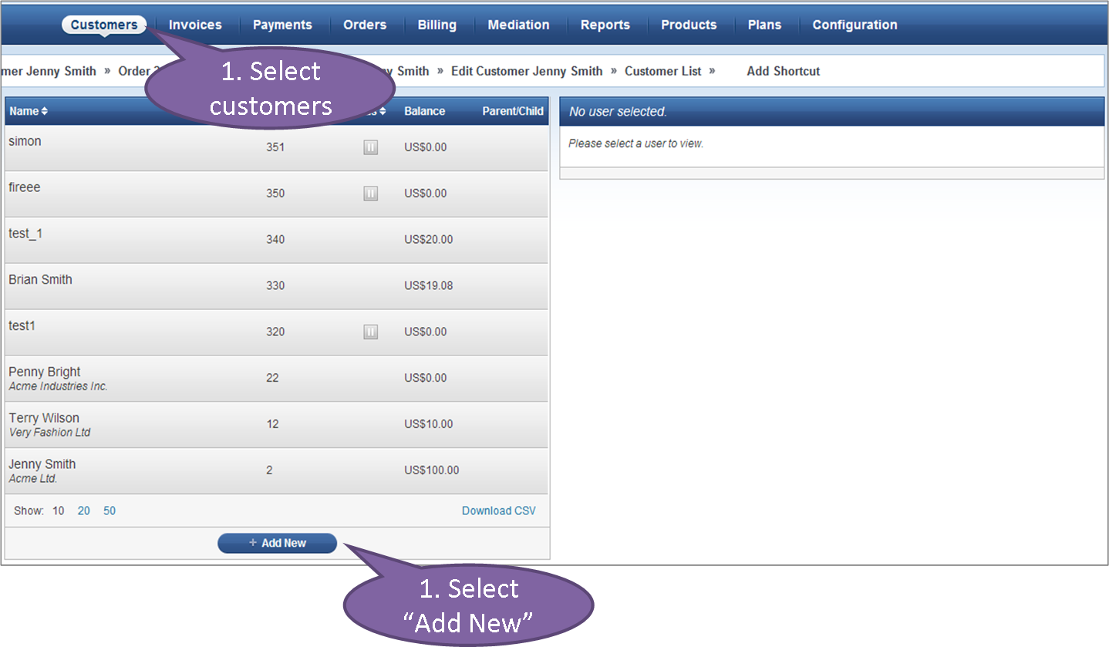
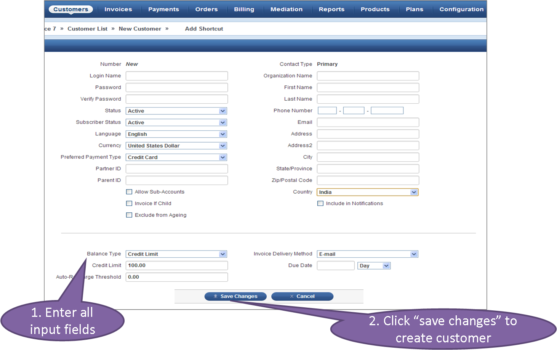
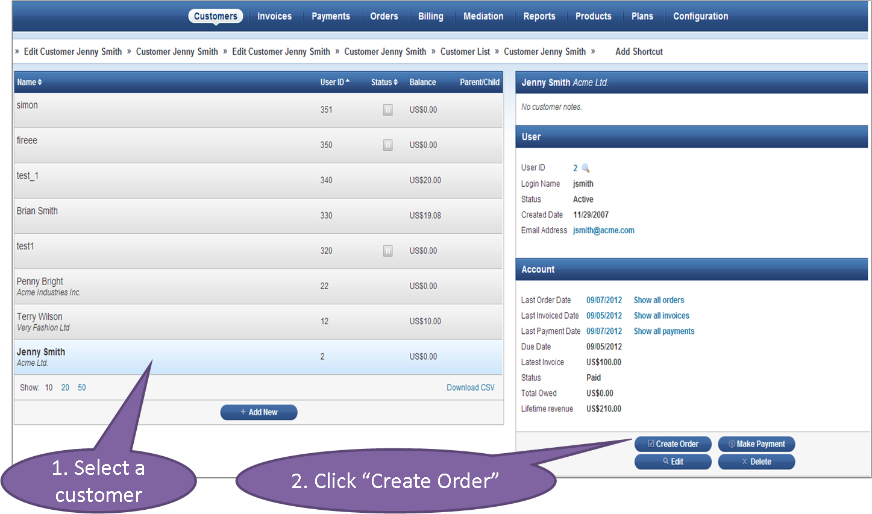
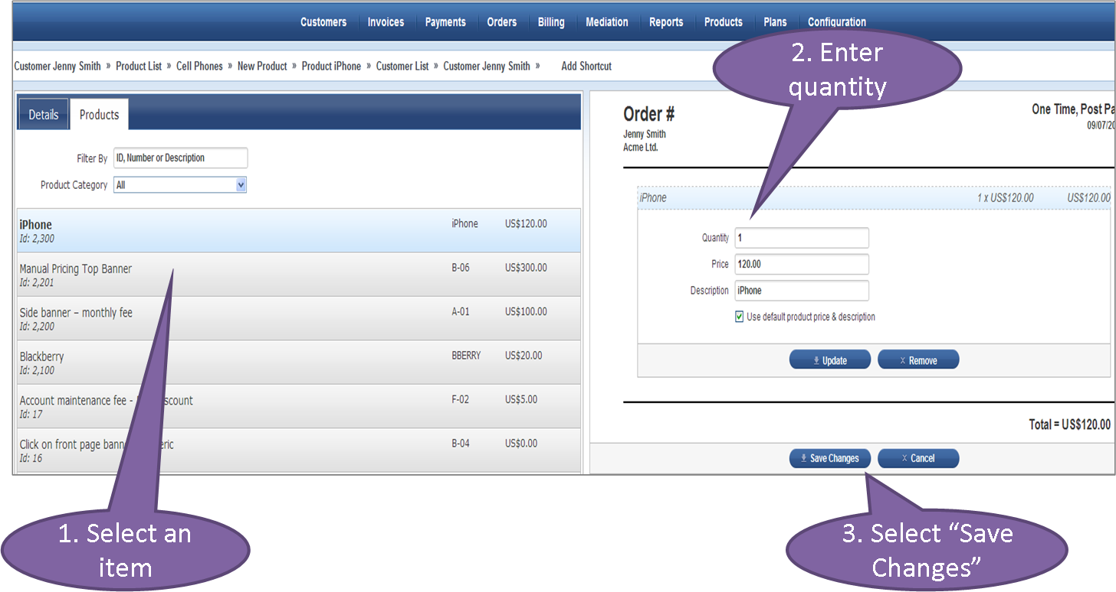
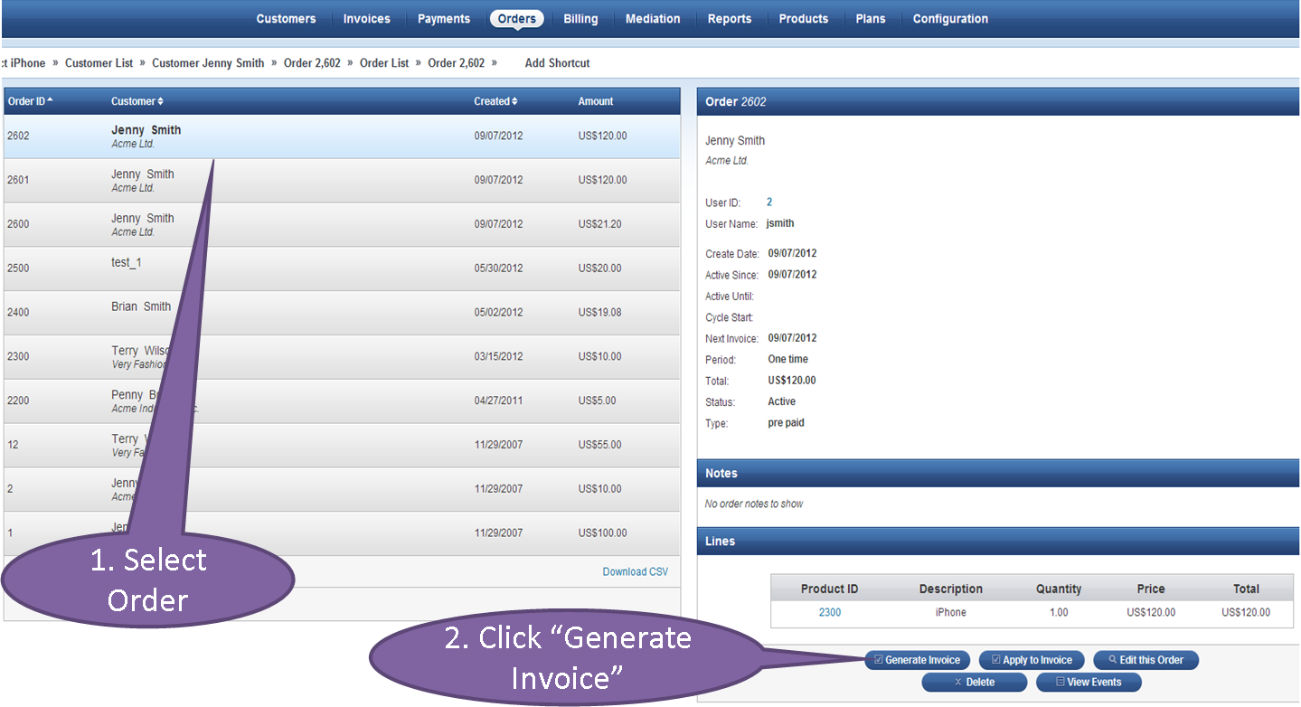
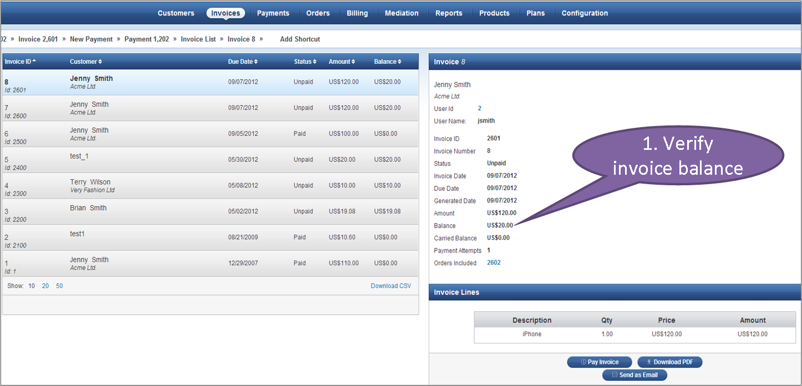
Flow Needed to be Covered in JBilling
1. Create Customer
2. Enter Customer Details
3. Create Order for Customer
4. Add Item to Order
5. Generate Invoice
6. Verify Invoice Total

Slide 6
Example: Life Insurance Premium Computation
Instant term life insurance can be bought from the age of 18 years to 75 years.
There are four types of terms available: 10 years, 15 years, 20 years, and 30 years. 30 year term is not available in Washington.
Premium rates for life insurance are typically based on factors such as age, sex, height, and weight, health status, including whether or not you smoke, and participation in high-risk activities or occupations. Following are the basic premium computation rules. The premium shown is payable per month:
· Base premium for any state, age of 18 years, coverage of $100000, no smoking, health status as excellent, gender as male, and 10 years term is 10$
· Base premium for any state, age of 18 years, coverage of $100000, no smoking, health status as excellent, gender as female is 9$
· If the insured has smoking habit, add 7$ to the base premium.
· If the insured health status is fair, add 5$ to the base premium.
· For addition of each 5 years to the term, add 5$ to the base premium
· For addition of each $50000 to the term, add 2$ to the base premium
· Following are the ranges of age and their affect on premium
  o Between 30 to 40, add $1 to the base premium
  o Between 40 to 50, add $2 to the base premium
  o Between 50 to 60, add $4 to the base premium
  o Between 60 to 70, add $8 to the base premium
  Between 70 to 75, add $10 to the base premium
https://www.metlife.com/individual/insurance/life-insurance/quote.html#termlife
https://www.metlife.com/individual/insurance/life-insurance/index.html#types

Slide 7
Operation-Level Modeling
Reason in terms of the main operations and entities in the system
For each operation
  Create a CTD model: identify the relevant attributes, their values, and restrictions
  Specify the input, created, and modified entities
For the JBilling business rules, the relevant operations are
  Compute Invoice Total
  Add Item to Order
  Create Order
  Create Customer

Slide 8
Rule Modeling
Post-condition
Precondition
Add Item to Order
Input Order ord, Item item
Modifies ord.total
ord.cust.country = Canada
ord.total = ord.total + item.value * 1.06
ord.cust.country ≠ Canada
ord.total = ord.total + item.value
Precondition
Post-condition
If Precondition holds before the operation, post condition must hold
after the operation
The two preconditions are disjoint

Slide 9
Rule Modeling
Compute Invoice Total
Input Invoice inv
Modifies inv.total, inv.ord.cust.creditLimit
inv.ord.cust.balanceType = None ⋀
inv.ord.Total > 0
inv.total = inv.ord.total
inv.total = 0 ⋀
inv.ord.cust.creditLimit =
inv.ord.cust.creditLimit – inv.ord.total
inv.ord.cust.balanceType = Credit ⋀
inv.ord.cust.creditLimit ≥ inv.ord.total
inv.ord.cust.creditLimit = 0 ⋀
inv.total = inv.ord.total –
inv.ord.cust.creditLimit
inv.ord.cust.balanceType = Credit ⋀
inv.ord.cust.creditLimit < inv.ord.total

Slide 10
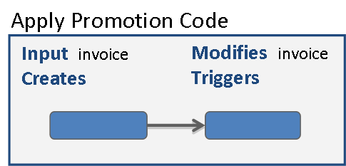
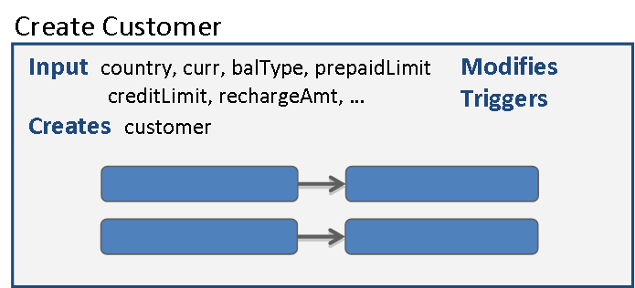
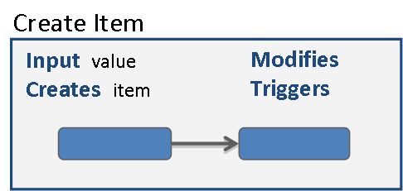
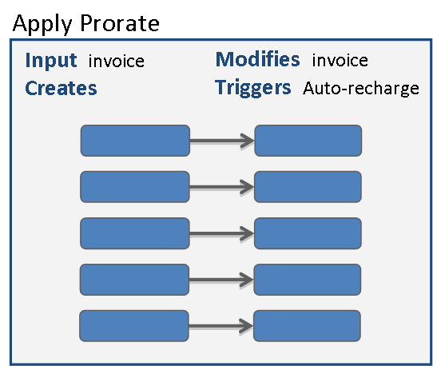
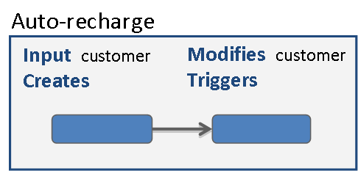
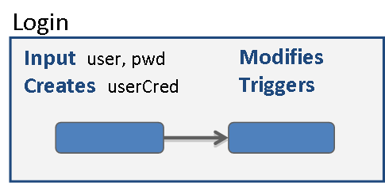
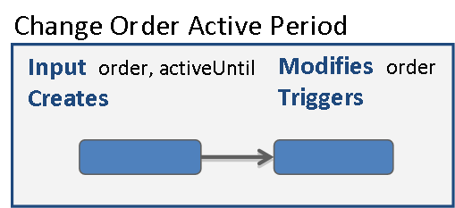
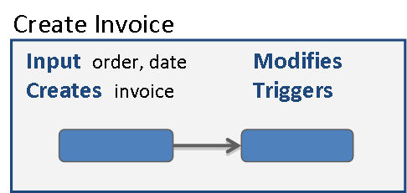
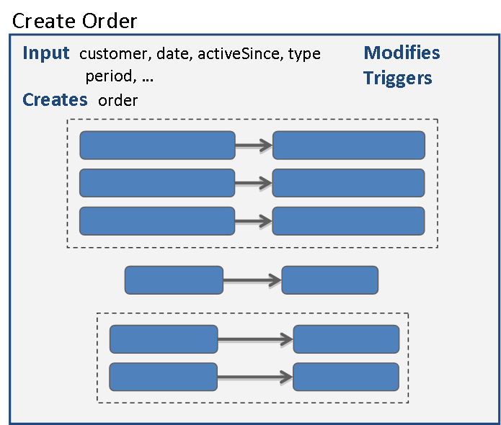
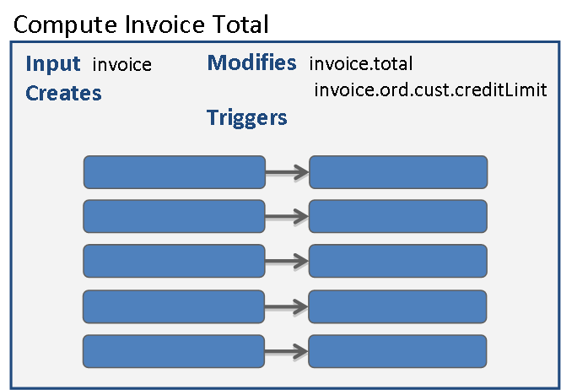
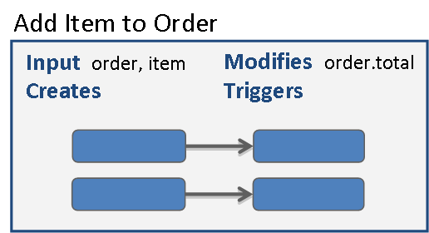
Chaining Operations from a Set of Operations

Slide 11
Backward Analysis: Algorithm Overview
Given a pre-post pair (i.e., a rule), performs backward analysis to express the precondition of the rule in terms of user inputs
  the initial precondition is the target condition
Includes three main steps
  Search: searches for relevant operations (and pre-post pairs) that creates/modifies system inputs in the target condition
  Bind: binds entities in target condition with entities in post conditions of relevant pre-post pairs
  Solve: uses constraint solver to identify values for user inputs (if exists) that satisfy the generated formula via backward analysis
These three steps may be repeated several times to find a solution that includes
  values for user inputs
  a high-level sequence of operations

Slide 12
Backward Analysis
Create Customer
Input: BalanceType btype, CreditLimit credit, Country ctry, Creates: Customer cust
cust.balanceType = btype ⋀
cust.creditLimit = credit ⋀
cust.country = ctry
True
Create Order
Bind: cust = cust1
Add Item to Order
Input: Customer cust1, Creates: Order ord
Input: Order ord, Item item, Modifies: ord.total
ord.cust = cust1 ⋀
ord.total = 0
…
…
True
…
…
Create Invoice
Bind: ord = ord1
System inputs
Input: Order ord1, Creates: Invoice inv
Order ord1
True
inv.ord = ord1
Bind: inv = inv1
System inputs
Compute Invoice Total
Input: Invoice inv1
Invoice inv1
inv1.ord.cust.balanceType = Credit ⋀
inv1.ord.total > 0 ⋀
inv1.ord.cust.creditLimit < inv1.ord.total
inv1.ord.cust.creditLimit = 0 ⋀
inv1.total = inv1.ord.total –
inv1.ord.cust.creditLimit

Slide 13
Backward Analysis: Solve
Generates formula (including bindings) from the exercised path
Uses a constraint solver to identify solution for user inputs
High-level Sequence
of Operations
Generated Formula
∃ btype, ∃ credit, ∃ ctry (
cust.balanceType = btype ⋀
cust.creditLimit = credit ⋀
cust.country = ctry ⋀
cust = cust1 ⋀
ord.cust = cust1 ⋀
ord.total = 0 ⋀
ord = ord1 ⋀
inv.ord = ord1 ⋀
inv = inv1 ⋀
inv1.ord.cust.balanceType = Credit ⋀
inv1.ord.total > 0 ⋀
inv1.ord.cust.creditLimit < inv.ord.total )
Create Customer
Create Order
Create Invoice
Compute Invoice Total
Solver does not find a solution

Slide 14
Backward Analysis: Backtracking
Create Customer
Create Item
Input: BalanceType btype, CreditLimit credit, Country ctry, Creates: Customer cust
…
…
Create Customer
cust.balanceType = btype ⋀
cust.creditLimit = credit ⋀
cust.country = ctry
True
…
…
Create Order
…
…
Create Order
Bind: cust = cust1
Add Item to Order
Input: Customer cust1, Creates: Order ord
Input: Order ord, Item item, Modifies: ord.total
ord.cust = cust1 ⋀
ord.Total = 0
ord.cust.country
≠Canada
ord.total = ord.total
+ item.value
True
Create Invoice
Bind: ord = ord1
Bind: ord = ord1
System inputs
Input: Order ord1, Creates: Invoice inv
Order ord1
True
inv.ord = ord1
Bind: inv = inv1
System inputs
Compute Invoice Total
Input: Invoice inv1
Invoice inv1
inv1.ord.cust.balanceType = Credit ⋀
inv1.ord.total > 0 ⋀
inv1.ord.cust.creditLimit < inv1.ord.total
inv1.ord.cust.creditLimit = 0 ⋀
inv1.total = inv1.ord.total –
inv1.ord.cust.creditLimit

Slide 15
Backward Analysis: Solve
Generates formula (including bindings) from the exercised path
Uses constraint solver to identify solution for user inputs
High-level Sequence
of Operations
Generated Formula
∃ btype, ∃ credit , ∃ value, ∃ ctry (
item.value = value ⋀
cust.balanceType = btype ⋀
cust.creditLimit = credit ⋀
cust.country = ctry ⋀
cust = cust1 ⋀
ord.cust = cust1 ⋀ ord.Total = 0 ⋀
ord = ord1 ⋀
item = item1 ⋀
ord1.cust.country ≠Canada ⋀
ord2.total = ord1.total + item1.value ⋀
ord2 = ord3 ⋀
inv.ord = ord3 ⋀
inv = inv1 ⋀
inv.ord.cust.balanceType = Credit ⋀
inv.ord.total > 0 ⋀
inv.ord.cust.creditLimit < inv.ord.total )
Create Item
Create Customer
Create Order
Add item to Order
Create Invoice
Compute Invoice Total
Solver computes solution: btype = Credit, credit = 100, value = 120, ctry = India

Slide 16
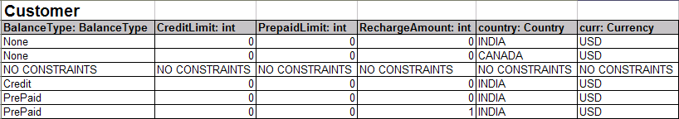
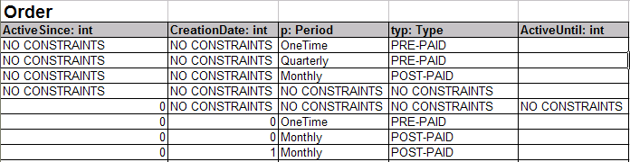
Output: Test Data
Master and transactional data: consolidated data required for a set of business rules
  Different types of customer records
  Different types of orders

Slide 17
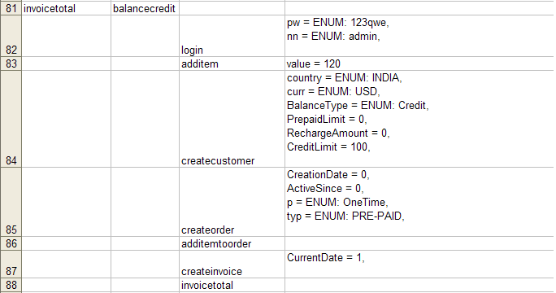
Output: Sequence of Operations
High-level sequence of operations that need to be performed to cover a rule
This sequence can guide the creation of flows

Slide 18
Comparison with CTD

Slide 19
Comparison with CTD Modeling
CTD modeling involves
  Identifying important parameters and their relevant values
  Identifying restrictions: invalid combinations of parameter-value pairs
    Combining different Credit Limit and Order Total values with Balance Type “None” is invalid
    There is no interaction between Country of Residence and the other parameters, so their combinations need not be considered
A global CTD model for the entire application could be constructed, but such a model would have many restrictions
Customer Country of Residence | Customer Balance Type | Customer Credit Limit | Order Total
Canada | None | 0 | ≤ Customer.CreditLimit
Other | Credit | > 0 | = Customer.CreditLimit

Slide 20
Comparison with CTD Modeling
“Operations with Pre-Post Pairs” Modeling | CTD-Style Modeling
A post-condition specifies expected behavior; therefore, it can serve as a test oracle | Expected behavior is not modeled, so there is no obvious test oracle for a set of parameter-value pairs computed by CTD
Operation-level pre-post modeling enables mechanical inference of sequences of operations that satisfy a target condition | A “flat” parameter-value modeling does not permit the inference of operation sequences
Because combinations of parameters are not considered, restrictions need not be specified. However, in specifying a rule, all (and only the necessary) variables must be considered | The specification of restrictions may be tedious to provide when there are many invalid combinations
Operation inputs/outputs are real parameters, not artificial parameters introduced to model conditions (e.g., whether a field has a value) | Many temporary (artificial) parameters may have to be introduced; the number of modeled parameters may be significantly more than the number of fields

Slide 21
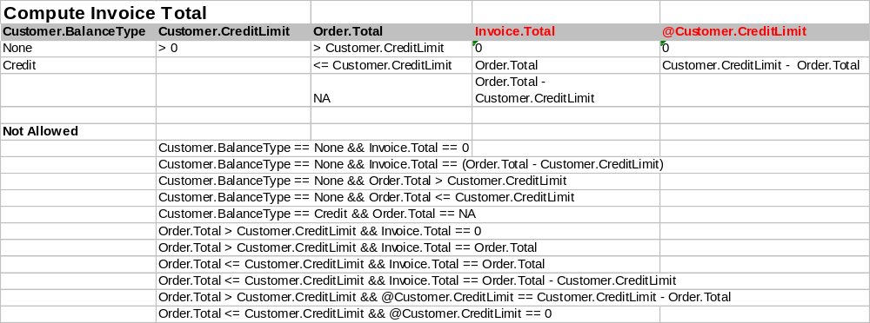
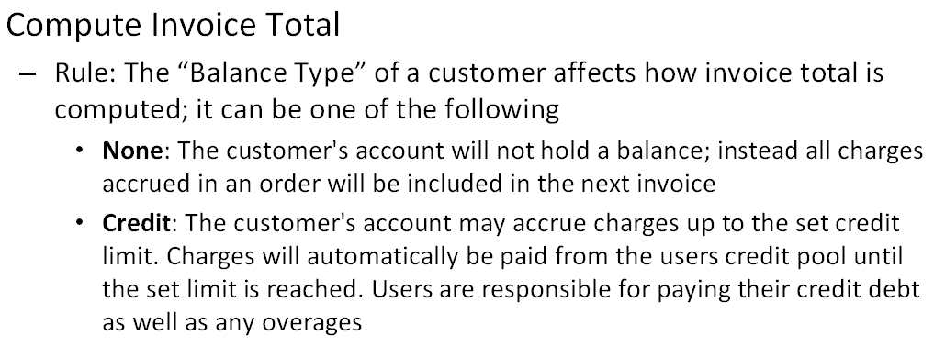
CTD Model for “Compute Invoice Total”
Input Attributes
Output Attributes

Slide 22
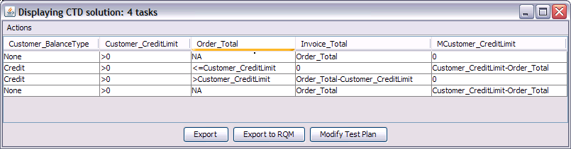
CTD Solution for “Compute Invoice Total”

Slide 23
What Does it take to Generate an Executable Test Script to Cover a Row?

Slide 24
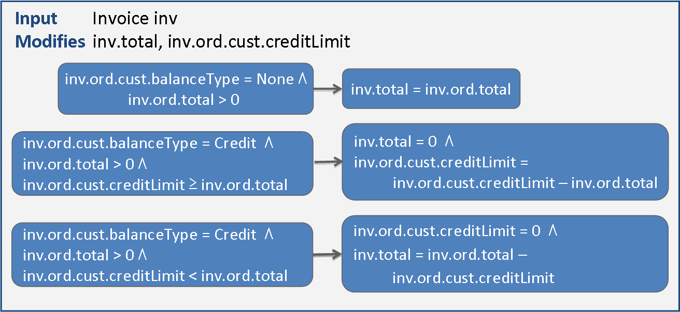
An Alternate to Restrictions
Model precondition-postcondition pairs with an operation
Models expected behavior instead of restricted behavior, but captures the same information as CTD restrictions
Given a set of pre-post pairs (along with attributes and values), we can generate the restrictions automatically
This helps in automatically chaining operations …
Precondition
Postcondition

Slide 25
Technical Details

Slide 26
Two Major Challenges
Data Generation: How to generate pertinent data to exercise the business rule?
Flow Generation: How to generate test flow to navigate through the application for exercising the business rule?

Slide 27
Rules as Operations
We define rules in the context of operations
An operation is an action that alters system state at some level of granularity. State could be
  persistent state, e.g. databases
  Session state
  cookies?

Slide 28
Operations
Operations can
  Create new entities or modify existing entities (side-effects)
  Can be parallel (independent) or can be sequential with dependencies
  Triggered manually or by another operation
Each operation
  Defines inputs and outputs (both created and modified)
  Inputs can be either user inputs, session or database state as well
  Includes a set of pre-post conditions of the form { {p1} O {q1}, {p2} O {q2}, … }
    p’s and q’s represent pre and post-conditions, resp.
    {p1} O {q1} indicates that when the operation “O” is invoked with the pre-condition “p1”, “O” ensures the post-condition “q1”
    Pre-post pairs can be grouped together with disjoint pre-conditions (mutually exclusive), groups help to avoid generating infeasible conditions
Notes:
For inputs such as session states (for example, admin should be logged in), our system automatically finds another operation which ensures the post-condition that admin should be logged in.

Slide 29
An Example Application: JBilling
Includes four main entities
  Customer
  Item
  Order: purchase orders are generated based on items that are bought by a customer
  Invoice: an invoice is generated for each order

Slide 30
An Example Application: JBilling
Entity | Operation | Inputs / outputs | Pre-Post pairs
Order | Add an item to order | Inputs: Order ord, Item itm Outputs: Created: none Modified: Order.Total | (1) Pre: ord.cust.Country == CANADA Post: ord^{M}.Total == ord.Total + itm.Value * 1.06
Invoice | Compute invoice total | Inputs: Invoice inv Outputs: Created: none Modified: Invoice (Total) | (1) Pre: inv.ord.cust.BalanceType == None Post: inv.Total == inv.ord.Total (2) Pre: inv.ord.cust.BalanceType == Credit Post: inv.Total == inv.ord.Total – inv.ord.cust.CreditLimit
*Operations exist for creating each entity are shown in the next slide

Slide 31
An Example Application: JBilling
Entity | Operation | Inputs / Outputs | Pre-Post pairs
Customer | Create customer | Inputs: String name,String country, BalanceType btype Outputs: Created: Customer cust Modified: none | (1) Pre: TRUE Post: cust.Name == name cust.Country == country cust.BalanceType == btype
Item | Create a new item | Inputs: String name, int code Outputs: Created: Item itm Modified: none | (1) Pre: TRUE Post: itm.Name == name itm.Code == code
Order | Create a new order | Inputs: Customer cust, Type typ Outputs: Created: Order ord Modified: none | (1) Pre: TRUE Post: ord.Customer == cust ord.Total == 0 ord.Type == typ
Invoice | Create a new invoice | Inputs: Order ord Outputs: Created: Invoice inv Modified: none | (1) Pre: ord.Type == Pre-paid Post: inv != null (2) Pre: ord.Type == Post-paid Λ ord.nextInvoice < currentDate Post: inv == null (3) Pre: ord.Type == Post-paid Λ ord.nextInvoice > currentDate Post: inv != null

Slide 32
Two Major Challenges
Data Generation: How to generate pertinent data to exercise the business rule?
Flow Generation: How to generate test flow to navigate through the application for exercising the business rule?

Slide 33
Test Data Generation Problem
Goal: generate test data that covers all pre-post pairs in all operations
To cover a pre-post pair of an operation:
  Get the pre-condition of the pre-post pair and express the pre-condition with user inputs and other operations
Backward Substitution Problem:
  Given a target condition (such as pre-condition of a pre-post pair) and an operation, infer the pre-condition for the operation, such that the operation ensures the target condition
  Repeat these steps until pre-condition under analysis is expressed with user inputs

Slide 34
Example
Compute Invoice Total
Operation Name
Selected Pre-post pair for backward substitution
Inferred Pre-condition
Inputs: Invoice inv
Outputs:
Created: none
Modified: Invoice (Total)
Pre: inv.ord.cust.BalanceType == None
Post: inv.Total == inv.ord.Total
btype == None && typ == Pre-Paid
Create customer
Pre: TRUE
Post: cust.Name == name, cust.Country == country, cust.BalanceType == btype
cust.BalanceType == None && typ == Pre-Paid
Create new Order
Pre: TRUE
Post: ord.Customer == cust, ord.Total == 0, ord.Type == typ
ord.cust.BalanceType == None && ord.Type == Pre-Paid
Create a new Invoice
Pre: ord.Type == Pre-paid
Post: inv != null
inv.ord == ord
inv.ord.cust.BalanceType == None
Compute Invoice Total
Pre: inv.ord.cust.BalanceType == None
Post: inv.Total == inv.ord.Total

Slide 35
Generating Data for a Pre-Post Pair
Compute Invoice Total
Inputs: Invoice inv
Outputs:
Created: none
Modified: Invoice (Total)
Pre: inv.ord.cust.BalanceType == None
Post: inv.Total == inv.ord.Total
Final Inferred pre-condition for covering pre-post condition:
btype == None && typ == Pre-Paid
Apply constraint solver to solve constraints and generate data
Techniques that need more analysis (more details in later slides)
  Backtracking
  Backward substitution

Slide 36

Approach Overview
Operation
Modeler
CFG
Builder
Test Data
Generator

Slide 37
Operation Modeler
Interacts with a tester and assists in modeling operations
Gives continues feedback in refining the models via verifying modeled operations using a set of properties, defined at two different levels:
  Group-level properties
Properties are verified via constraint solving
  Operation-level properties

Slide 38
Semantic Checking of the Model
Statically analyze the model to detect incompleteness or inconsistency; guide the user in refining the model
Property 1: All preconditions in a group must be disjoint
Property 2: The preconditions in a group should specify the complete behavior
a > 0
…
The preconditions in this group are not disjoint; consequently, the behavior for values of a in the range [1, 9] is ambiguous
a < 10
…
a < 5
…
The preconditions in this group are incomplete: the behavior for values of a in the range [5, 10] is undefined
a > 10
…

Slide 39
Semantic Checking of the Model
Property 3: All postconditions in a group must assert values for the same set of variables
Property 4: If the two preconditions hold, the corresponding postconditions must be compatible
type = C
creditLimit = … ⋀ total = …
The postcondition for “type = P” does not specify a condition on creditLimit
type = P
total = …
a < 5
type = 1
If both preconditions are true, the value of type is ambiguous
b > 10
type = 2

Slide 40
Semantic Checking of the Model
Property 5: There should be no data dependence from a postcondition to a precondition of the same operation
a < 5
type = 1
type = 1
rate = 10
type = 2
rate = 15

Slide 41
Group-level properties (1)
Non-ambiguity property: All pre-conditions with in a group should be disjoint
  Ensures that different pairs describe about different behaviors
  Can be verified by ensuring that conjunction of any two pre-conditions is infeasible
  Example: The two conditions “P1: a > 0, P2: a >= 10” are not disjoint. This can be verified by checking whether there is a solution for the constraint: ((a > 0 ) Λ (a >= 10))

Slide 42
Group-level properties (2)
Restricted completeness: Pre-conditions within a group should describe complete behavior
  Ensures that complete behavior of the system is described (atleast) for the variables involved. Also helps to ensure that no fall through branches in the CFG built in later phases.
  Can be verified by checking the negation of disjunctions of all pre-conditions
  Example: The two conditions “P1: a > 0, P2: a <= -10” are incomplete. This can be identified by solving the condition !((a > 0 ) V (a <= -10)

Slide 43
Group-level properties (3)
Post-condition uniform ness: All post-conditions within a group should have the same variables
  Ensures that choosing any pre-post pair would cause the affect on the same variable
  Different post-conditions can set the same state to a variable
  NOT YET IMPLEMENTED. Needs to think more whether this is required or not

Slide 44
Operation-level properties (1)
Compatibility: If pre-conditions of two pairs hold together then their post-conditions should also be compatible (should not be disjoint)
  Violation of this property can indicate some error in the specification
  Also, helps to identify groups within the operation
a > 0
b >= 20
total == 0
total == 20
Here, both pre-conditions are compatible (not disjoint), but post-conditions are disjoint. Since for the second pair, “a” is unrestricted, so “a” can have value such as “10”, leading to an ambiguity about the value assigned to “total”. Following are two correct alternatives:
a > 0
a <= 0 && b >= 20
a > 0 && b < 20
b >= 20
total == 0
total == 20
total == 0
total == 20

Slide 45
Operation-level properties (1)
Compatibility: If pre-conditions of two pairs hold together then their post-conditions should also be compatible (should not be disjoint)
  Violation of this property can indicate some error in the specification
  Also, helps to identify groups within the operation
a > 0
b >= 20
total == 0
total == 20
Here, both pre-conditions are compatible (not disjoint), but post-conditions are disjoint. Since for the second pair, “a” is unrestricted, so “a” can have value such as “10”, leading to an ambiguity about the value assigned to “total”.
Another solution is to define ordering among these two pre-post pairs. In that scenario, the output is not unpredictable.

Slide 46
Operation-level properties (2)
Data-dependency: Within an operation, there should not be any dependency between a post-condition of one pair and the pre-condition of another pair
  Helps to ensure that there exist no ordering among pre-post pairs
In case of dependency, split an operation into multiple operations and add an edge between operations to represent a sequencing constraint
  Example: “Generate Invoice” operation has three sub-operations
    Create Invoice
    Compute Total
    Apply prorate

Slide 47
Operation-level properties (3)
Inputs-Outputs:
  Any variable appearing in input should be part of atleast one pre-condition
  Any variable appearing in output (created or modified) should be a part of atleast one post-condition
  Ensures two main properties:
    All inputs are relevant to the operation
    Each output is created or modified by atleast one post-condition

Slide 48
Approach Overview
Operation
Modeler
CFG
Builder
Test Data
Generator

Slide 49
CFG Builder
Constructs control-flow graph for each operation amenable for test-generation algorithm via backward substitution analysis
Combines different operations based on their Input/Output relations to form a inter-operation CFG
  Helps to generate data and sequence for covering pre-post pairs by exercising different flows

Slide 50
CFG of an Operation
G1
{P1} S {Q1}
{P2} S {Q2}
{P3} S {Q3}
{P4} S {Q4}
{P5} S {Q5}
{P6} S {Q6}
{P7} S {Q7}
G1
P2
P3
P4
G2
G2
Q2
Q3
Q4
G3
CFG for Group G2
G3
Groups can be placed in an order. All orders are semantically equivalent
Full CFG for the operation

Slide 51
Inter-operation CFG
Constructed by adding edges between operations based on their input/output relations
  can be constructed initially or incrementally on demand
Few edges can already be specified by user
  edges representing sequencing constraints
  edges representing triggering constraints

Slide 52
Approach Overview
Operation
Modeler
CFG
Builder
Test Data
Generator

Slide 53
Test Data Generator
Input:
  A model of the system in the form of global CFG (suitable type checked)
  A target pre-post pair within an operation
Output:
  Necessary data for covering the pre-post pair
  Sequence of operations

Slide 54
Algorithm Overview
pathFinder(sequence, neededInputs, constraint) {
if (neededInputs.isEmpty()) {
sol = solve(constraint)
return satisfied(sol) ? sequence : null
}
else {
Set preds = getPredecessors(sequence.last,neededInputs)
for (op in preds) {
Set targetRules = getTargetRules(op,neededInputs)
Constraint bindings = makeBindings(op.created,op.modified,neededinputs)
Constraint preCondiitions = and(targetRules.preConditions)
Constraint postConditions = and(targetRules.postConditions)
Set newInputs = neededInputs - op.created + op.inputs
newConstraint = and(bindings,preConditions,postConditions, constraint)
np = pathFinder(sequence.extend(op), newInputs, newConstraint)
if (np != null)
return np
}
}

Slide 55
getPredecessors function
getPredecessors(p,neededInputs) returns a either singleton set if p is in a sequence or the smallest set including:
1) All operations creating currently needed inputs
2) Operations modifying entities appearing in the constraint (too coarse?)
3) Operations triggering p

Slide 56
getTargetRules function
getTargetRules(op,neededInputs) - The set of rules relevant to the current path
1) Constructor rules (precondtion = TRUE)
2) Rules where variables in the post-conditions overlap with current condition?
3) ???

Slide 57
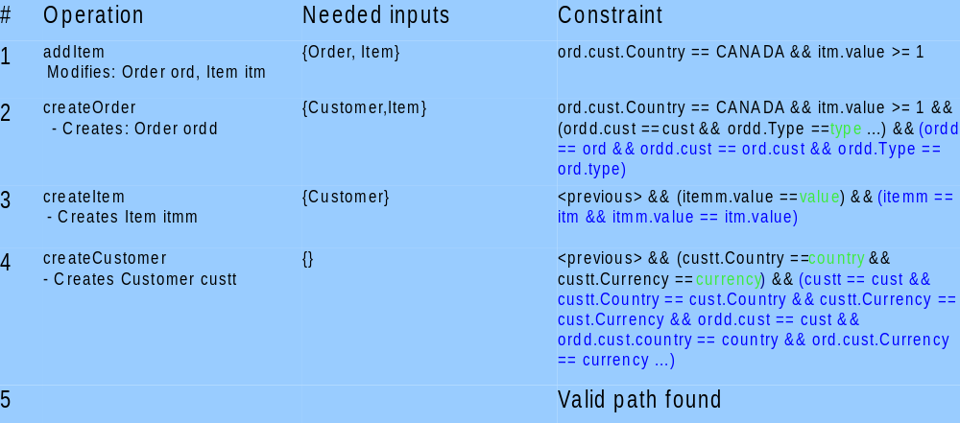
Binding Example

Slide 58
Binding in Detail
The algorithm keeps track of unbound identifiers and their associated type
This includes “field references”
Moves “backwards substitution” to the solver
Question: How to handle multiple instances of same entity?

Slide 59
Two Major Challenges
Data Generation: How to generate pertinent data to exercise the business rule?
Flow Generation: How to generate test flow to navigate through the application for exercising the business rule?

Slide 60
Test Flow Generation Problem
Goal: generate test flow (in the application) that exercises sequence of operations identified for covering a pre-post pair
Inputs:
  user maps fields of entities with inputable UI elements (such as text boxes)
  user maps each operation with labels of UI elements that need to be explored for executing the operation
Flow Generation Problem:
  Given UI elements that need to be explored, identify a path in the application that explores those UI elements
    Enter test data generated in the previous phase
    Ensure that post-conditions hold during exploration

Slide 61
Mapping of UI Elements
Create a new order
Mapping of inputable UI Elements:
typ → order_builder_page.Type
Mandatory Elements:
order_builder_page.Period
Mapping of operation:
explored(customer_list_page.CreateOrder) ∧
explored(order_builder_page.SaveChanges)
Inputs: Customer cust, Type typ
Outputs:
Created: Order ord
Modified: none
Pre: TRUE
Post: ord.Customer == cust
ord.Total == 0
ord.Type == typ
“typ” is mapped to a combo box “Type” in page “order_builder_page”
  When “type” combo box is encountered in order_builder_page, value of “typ” variable should be entered
Mandatory elements: Elements that require data for carrying out the operation, however does not influence the business rules. System needs to automatically enter a non-empty value for these elements
Operation is mapped to the buttons in pages that need to be explored
Notes:
For some operations such as auto-recharge, mapping of operation may not be required. It may be left empty.. Also some operations may not be realizable through user interface and needs executing the SQL queries directly. Such things can be handled via custom functions. Also, to carry the flow, some of the fields (such as customer’s name or email or address) in the page are mandatory. To successfully execute the operation, one has to model such aspects during flow-level modeling. However, the values chosen for these fields may not affect the post-conditions of the operation.

Slide 62
More Technical Details

Slide 63
Rules as Operations: Open Issues
How to ensure the correctness of pre-post pairs in an operation?
How to ensure the completeness of pre-post pairs in an operation?
How to define semantics of an operation?
  Example 1: If pre-conditions of two pairs hold together then their post-conditions should also be compatible (should not be mutually exclusive)
  For pre-post pairs in a group (mutually exclusive), all post-conditions should be on the same variables. Eg. Q2, Q3, and Q4 should be on the same variables in the following operation
  No data-dependency among pre-post pairs
  If an operation modifies a variable, is it modifying on all paths of the presumed program?
  Would pre conditions are complete? Are there any fall-through branches in the graph? It can
{P1} S {Q1}
{P2} S {Q2}
{P3} S {Q3}
{P4} S {Q4}
{P5} S {Q5}
{P6} S {Q6}
{P7} S {Q7}
Notes:
Following slides are based on more complex rules defined in JBilling-Rules.xls

Slide 64
Rules as Operations: Open Issues
How to define semantics of an operation (cond..)?
  Example 1: If pre-conditions of two pairs hold together then their post-conditions should also be compatible (should not be mutually exclusive)
  For pre-post pairs in a group (mutually exclusive), all post-conditions should be on the same variables. Eg. Q2, Q3, and Q4 should be on the same variables in the following operation
  No data-dependency among pre-post pairs
  If an operation modifies a variable, is it modifying on all paths of the presumed program?
{P1} S {Q1}
{P2} S {Q2}
{P3} S {Q3}
{P4} S {Q4}
{P5} S {Q5}
{P6} S {Q6}
{P7} S {Q7}
Notes:
Following slides are based on more complex rules defined in JBilling-Rules.xls

Slide 65
Correctness of Pre-post pairs?
Pre: typ == Pre-paid
Post: ord.Period == OneTime
ord.nextInvoice == CreationDate
Pre: typ != Pre-paid && p == Monthly
Post: ord.Period == p
ord.nextInvoice == CreationDate + 1 month
Pre: typ != Pre-paid && p == Quarterly
Post: ord.Period == p
ord.nextInvoice == CreationDate + 3 months
Pre: typ == Pre-paid
Post: ord.Period == OneTime
Pre: typ != Pre-paid
Post: ord.Period == p
Pre: p == OneTime
Post: ord.NextInvoice == CreationDate
Pre: p == Monthly
Post: ord.NextInvoice == CreationDate + 1 month
Pre: p == Quarterly
Post: ord.NextInvoice == CreationDate + 3 months
Correct
Wrong: allows an incorrect post-condition with inputs “typ == pre-paid” and “p == Monthly”

Slide 66
Example Operation: Create an Empty Order
TRUE
typ == Pre-paid
p == OneTime
p == Monthly
p == Quarterly
ActiveSince
== null
ActiveSince
!= null
ord.Period == p
ord.Type == typ
ord.Status == Active
….
ord.Period
== OneTime
ord.NextInvoice
== CreationDate
ord.NextInvoice
== CreationDate
+ 1 month
ord.NextInvoice
== CreationDate
+ 3 months
ord.ActiveSince
== CreationDate
ord.ActiveSince
== ActiveSince
Example operation with pre-post pairs, grouped together with disjoint pre-conditions
Notes:
TODO: What is the notion of coverage? Easy: Cover all pre-post pairs. Cover all possible combinations of pre-post pairs in each operation. Difficult: Cover all paths with all combinations of pre-post pairs

Slide 67
Example Operation: Generate an Invoice
Create an empty invoice
Operations with dependencies
Compute total via customer
Apply pro-rata for the customer
Auto-recharge prepaid limit

Slide 68
Backtracking Example
Infeasible: (typ == Prepaid) && (typ != Prepaid)
typ == Prepaid && ord.Total > 0 && cust.BalanceType == "None" && p == Monthly && typ != prepaid && ord.activeUntil < ord.nextInvoice && ord.activeUntil + 30 > inv.ord.nextInvoice
Create Empty Order
1
2
3
4
5
6
ord.Status == Active && ord.Type == Prepaid && ord.Total > 0 && ord.cust.BalanceType == "None" && ord.period == Monthly && ord.activeUntil < inv.ord.nextInvoice && ord.activeUntil + 30 > inv.ord.nextInvoice
Create Empty Invoice
Post-conditions of 2 and 4 create invoice (inv != null). Choosing post-condition 2
1
2
3
4
ord.Total > 0 && inv.ord.cust.BalanceType == "None" && inv.ord.period == Monthly && inv.ord.activeUntil < inv.ord.nextInvoice && inv.ord.activeUntil + 30 > inv.ord.nextInvoice
Compute Total
Post-conditions of 1, 3, and 5, modify inv.Total. Choosing post-condition 1
1
2
3
4
5
Inv.Total > 0 && inv.ord.period == Monthly && inv.ord.activeUntil < inv.ord.nextInvoice && inv.ord.activeUntil + 30 > inv.ord.nextInvoice
Apply prorata
1
2
3
4
5
Notes:
1. After “Create Empty Invoice”, system can non-deterministically choose either “Create Empty Order” or “Add an item to the order”
2. To improve scalability, do not propagate the conditions on system input variables, and as and when they appear, solve them for concrete values
3. What if the user does not properly specify all variables that are being modified by the transaction. Basically about the complete
4. When none of the post-conditions

Slide 69
Backtracking (in create empty invoice)
ord.activeUntil is not defined by any post-condition. How to deal with this?
typ == Postpaid && (creationDate + 1 month) < CurrentDate && ord.Total > 0 && cust.BalanceType == "None" && p == Monthly && typ != Prepaid && ord.activeUntil < (creationDate + 1 month) && ord.activeUntil + 30 > (creationDate + 1 month)
Create Empty Order
1
2
3
4
5
6
ord.Status == Active && ord.Type == Postpaid && ord.nextInvoice < CurrentDate && ord.Total > 0 && ord.cust.BalanceType == "None" && ord.period == Monthly && ord.activeUntil < ord.nextInvoice && ord.activeUntil + 30 > ord.nextInvoice
Create Empty Invoice
Post-conditions of 2 and 4 create invoice (inv != null). Choosing post-condition 4
1
2
3
4
ord.Total > 0 && inv.ord.cust.BalanceType == "None" && inv.ord.period == Monthly && inv.ord.activeUntil < inv.ord.nextInvoice && inv.ord.activeUntil + 30 > inv.ord.nextInvoice
Compute Total
Post-conditions of 1, 3, and 5, modify inv.Total. Choosing post-condition 1
1
2
3
4
5
Inv.Total > 0 && inv.ord.period == Monthly && inv.ord.activeUntil < inv.ord.nextInvoice && inv.ord.activeUntil + 30 > inv.ord.nextInvoice
Apply prorata
1
2
3
4
5

Slide 70
Backtracking Challenges

Slide 71
Cebu-Pacific: SimplifiedModel
Creates
Create Fund
Passenger
Fund
create Fund
Modifies
delayFlight
create Ticket
rebook
Partial
addSector1
Ticket
partial
Cancellation
Sample Solution Required to cover a rule in “Rebook Partial”
Sector sec = makeSector();
PassengerFund pf = CreateFund();
Ticket ticket_1 = createTicket (pf);
Ticket ticket_2 = addSector1(sec, pf, ticket_1);
Ticket ticket_3 = rebookPartial(pf, ticket_2);
addSector2
Fly Part
fly Part
Sector
make Sector
Notes:
TODO: What is the notion of coverage? Easy: Cover all pre-post pairs. Cover all possible combinations of pre-post pairs in each operation. Difficult: Cover all paths with all combinations of pre-post pairs

