Slide 1
Rule R₄
r_{4.1}
r_{4.2}
r_{4.3}
Rule R₅
r_{5.1}
r_{5.2}

Slide 2
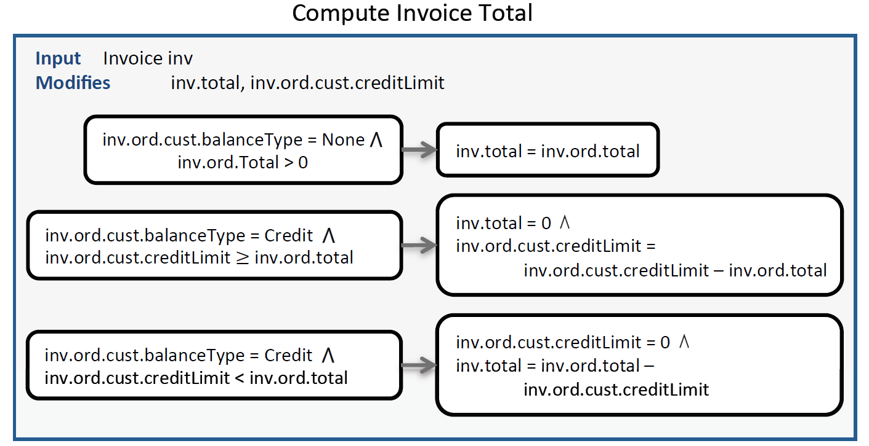

Slide 3
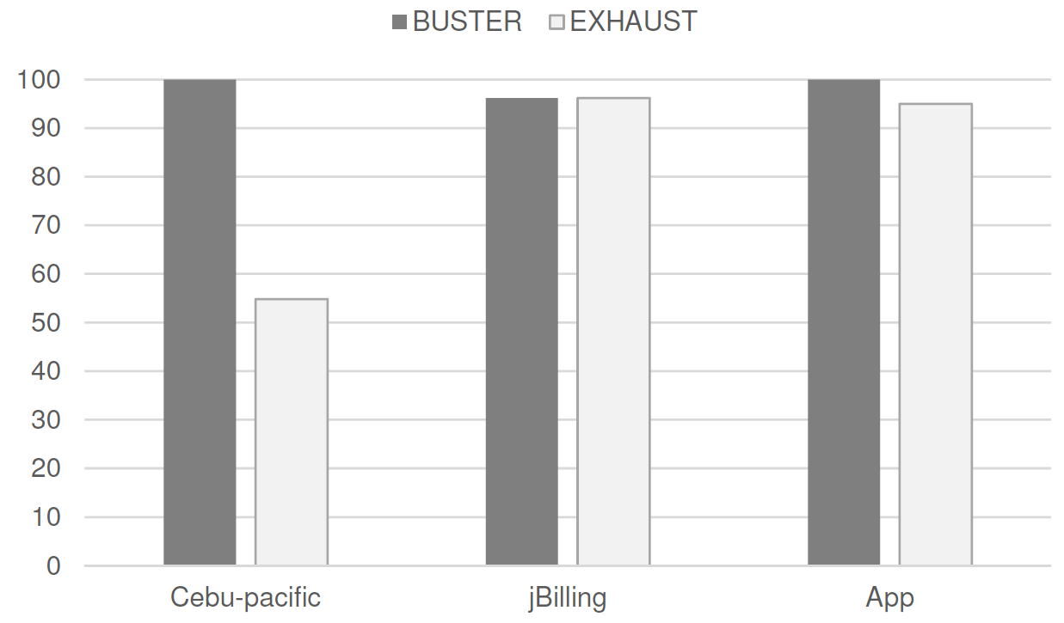

Slide 4
Add Credit
Limit
Create
Item
Item
Add Item
To Order
Create
Customer
Customer
Create
Order
Order
creates entity
Generate
Invoice
reads entity
Invoice
modifies entity

