Slide 1



A Window into LA Animal Shelters
DUELISTS UNITED
Lisa Cheng ▪ Simon Hua ▪ Pearl Liang
Chris Pulido ▪ Brandon Yu
STATS 101C Final Project

Slide 2

Overview
Splitting data
Explore data with Excel
Creating new predictors by scraping external data
Boosting and randomForest
Problems we encountered

Slide 3



Missing Information Can Be Good
Species | Adoption | Euthanasia | Other
CAT | 26.91% | 58.36% | 14.74%
DOG | 37.93% | 26.48% | 35.60%
Dog Type | Adoption | Euthanasia | Other
Breed Not Present / Color Not Present | 35.56% | 24.10% | 40.34%
Breed Not Present / Color Present | 35.06% | 30.51% | 34.43%
Breed Present / Color Not Present | 41.63% | 21.89% | 36.48%
Breed Present / Color Present | 42.28% | 25.22% | 32.50%

Slide 4
Splitting Training Data
Training Data
Dogs
Cats
Breed
Color
No Breed
Color
Color Present
No Color Present
Breed
No Color
No Breed
No Color

Slide 5



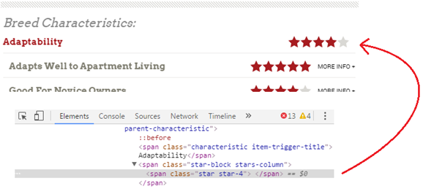

External Data
Considered median income for each zip code, dog breed characteristics, proximity to other shelters, and more.
Some external data was easy to obtain, but others were not…

Slide 6

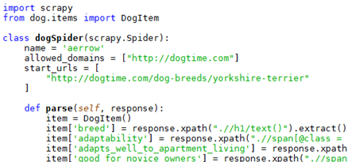
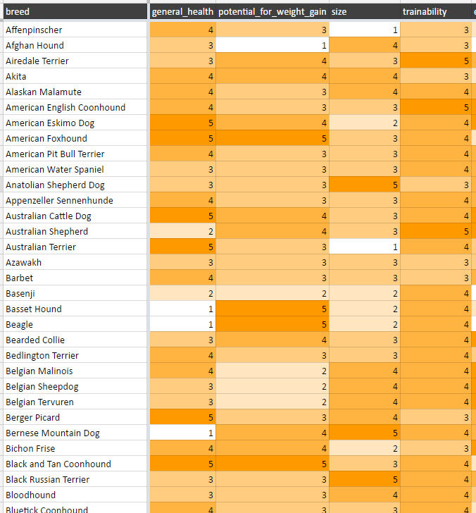
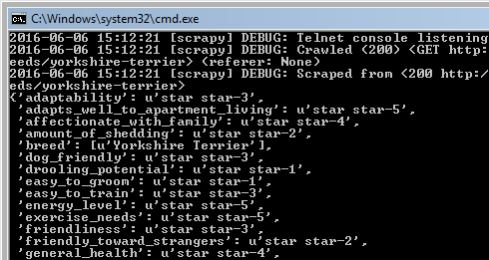
External Data
Web scraping makes getting external data very fast and easy.

Slide 7

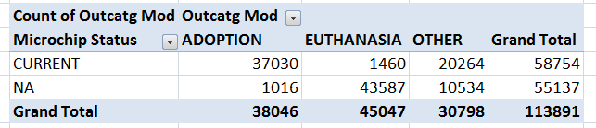

Using Excel to Explore Layers of Interaction
Field List
Simple Table
Fields in Table

Slide 8
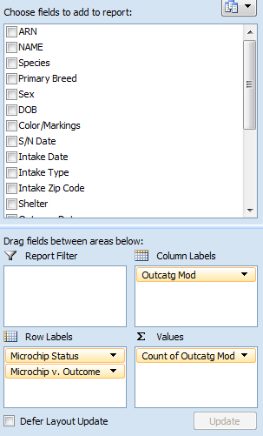
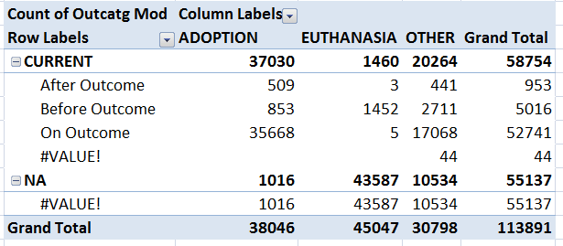

Adding Complexity
Adding additional layer

Slide 9
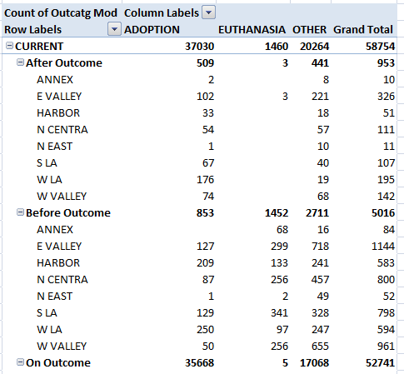
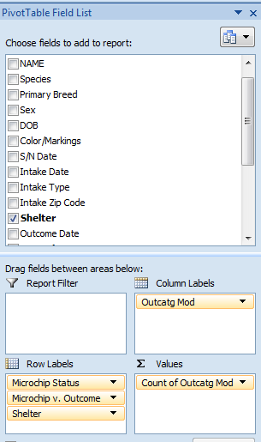
Can Add Even More
Shelter layer

Slide 10
XGBoost and Psych
Dummy Coding for AKC Classification
ARN | Indicator | AKC Class
A0009893 | Breed Present/Color Present | Working
A0010158 | Breed Present/Color Not Present | Working
A0024956 | Breed Present/Color Present | Sporting
A0026164 | Breed Present/Color Present | Herding
A0037180 | Breed Present/Color Present | Working
A0040877 | Breed Present/Color Present | Herding
A0041138 | Breed Present/Color Present | Sporting
A0046704 | CAT | CAT
A0049236 | Breed Present/Color Not Present | Herding
A0053081 | Breed Present/Color Present | Herding
A0054674 | CAT | CAT
ARN | Indicator | AKC Class
A0009893 | Breed Present/Color Present | Working
A0024956 | Breed Present/Color Present | Sporting
A0026164 | Breed Present/Color Present | Herding
A0037180 | Breed Present/Color Present | Working
A0040877 | Breed Present/Color Present | Herding
A0041138 | Breed Present/Color Present | Sporting
A0053081 | Breed Present/Color Present | Herding

Slide 11

Dummy Coding
library(psych)
AKC_factor <- dummy.code(breed_color_train$AKC.Class)
AKC Class
Working
Sporting
Herding
Working
Herding
Sporting
Herding
Herding | Sporting | Working
0 | 0 | 1
0 | 1 | 0
1 | 0 | 0
0 | 0 | 1
1 | 0 | 0
0 | 1 | 0
1 | 0 | 0

Slide 12
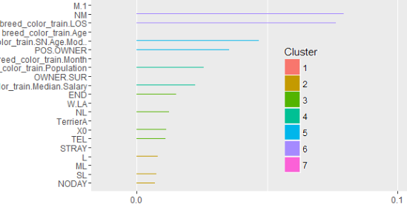

XGBoost and Psych
We tinkered around with the XGBoost parameters and settled on:
nround = 3000, eta = 0.01, max.depth = 6
We also ran a feature importance graph to see the relative strength of each predictor.

Slide 13


Ensemble Modeling With randomForest
The boosting model was working well, but our score started to plateau even with new predictors.
We found that running multiple models and synthesizing the results can improve predictive accuracy.
We chose randomForest because it is more robust to overfitting and complements boosting well.
After trying multiple weights, we found the optimal weights were 0.67(boosting) and 0.33(randomForest).

Slide 14

Problems We Encountered
Lots of NAs
Split the data
Used mean substitution for Age and Length of Stay
- Not all breeds had an AKC classification
Had to infer based on the breed’s characteristics

