Slide 1
MASTER PRODUCTION DECK
SAM4 explainer video
Voiceover · Visual description · Element sketches per scene
90 seconds · 11 scenes · 50 visual elements
Samotics · February 2026 · Confidential

Slide 2
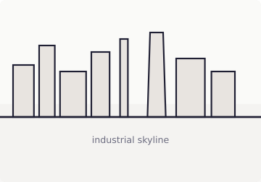
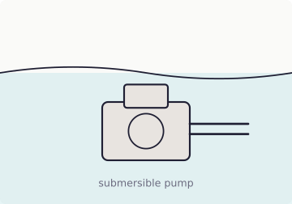
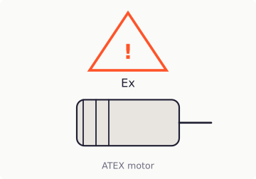
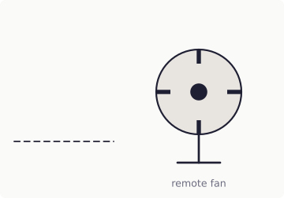
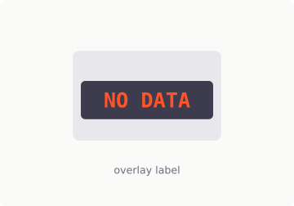
SCENE 1
The reliability blind spot
0–8s
VOICEOVER
VISUAL ELEMENTS
Many critical assets operate where people cannot easily go. Submerged. Hazardous. Remote. Without physical access, they remain unmonitored.
Industrial landscape
Submersible pump
ATEX motor
VISUAL DESCRIPTION
Wide industrial landscape — panoramic, muted palette. Three asset silhouettes: submersible pump, motor in Ex zone, remote fan. Assets fade to grey → 'NO DATA' label appears on each.
Remote fan
'NO DATA' label
5 elements
Scene 1 of 11
SAM4 Explainer · Master Deck

Slide 3
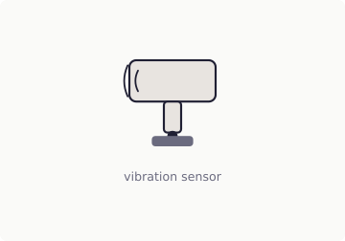
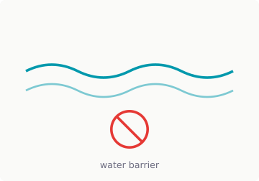
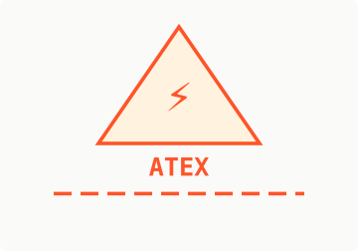
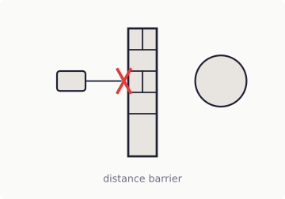

SCENE 2
Why traditional monitoring stops
8–16s
VOICEOVER
VISUAL ELEMENTS
Condition monitoring depends on sensors mounted on the machine. When a machine cannot be reached, continuous data does not exist.
Vibration sensor
Water barrier
ATEX barrier
VISUAL DESCRIPTION
Attempt to place vibration sensor on asset. Blocked by: water, ATEX barrier, physical wall / distance. Red 'X' or barrier animation for each.
Distance barrier
Block icon
5 elements
Scene 2 of 11
SAM4 Explainer · Master Deck

Slide 4
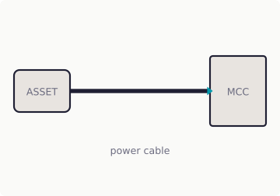
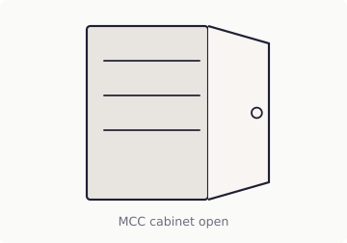
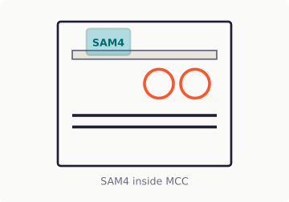
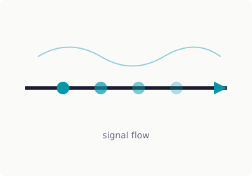
SCENE 3
The architectural shift
16–26s
VOICEOVER
VISUAL ELEMENTS
SAM4 changes the measurement point. Not on the asset — in the Motor Control Cabinet. Where electrical power is already available.
VISUAL DESCRIPTION
Power cable
MCC cabinet
Camera travels along power cable from asset → MCC. MCC cabinet door opens — SAM4 hardware visible inside. Electrical signal visualised flowing through cable.
4 elements
SAM4 hardware
Signal flow
Scene 3 of 11
SAM4 Explainer · Master Deck

Slide 5

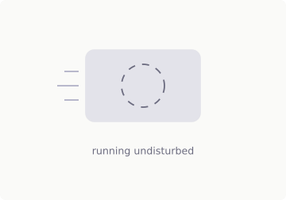
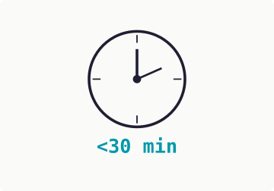
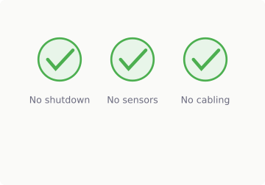
SCENE 4
Cabinet-based deployment
26–32s
VOICEOVER
VISUAL ELEMENTS
Installation happens once, in the MCC. No sensors on the machine. No modifications to the process.
VISUAL DESCRIPTION
Current clamps
Running asset
Clean installation — current clamps in cabinet. Asset keeps running undisturbed in background. Clock '<30 min' + three check marks.
4 elements
Clock <30min
Zero-disruption checks
Scene 4 of 11
SAM4 Explainer · Master Deck

Slide 6
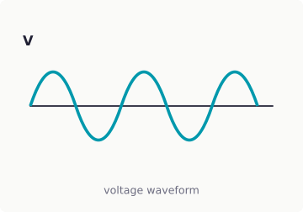
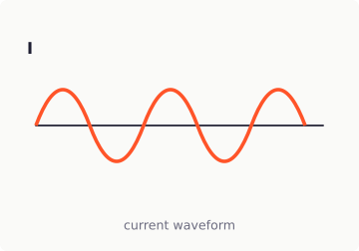
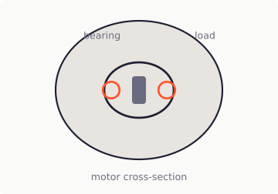
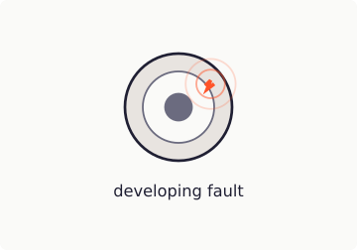
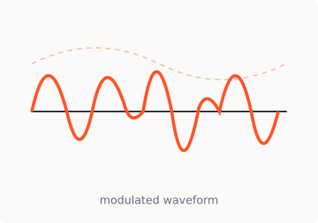
SCENE 5
What SAM4 measures
32–44s
VOICEOVER
VISUAL ELEMENTS
Every rotating system leaves a signature in its electrical signal. Voltage and current reflect the behaviour of the motor, the driven equipment, and the process. The motor becomes the sensor.
Voltage wave
Current wave
Motor cross-section
VISUAL DESCRIPTION
Voltage + current sine waves — clean, normal. Motor cross-section: bearing, coupling, load. Developing fault → waveform becomes modulated.
Fault indicator
Modulated wave
5 elements
Scene 5 of 11
SAM4 Explainer · Master Deck

Slide 7
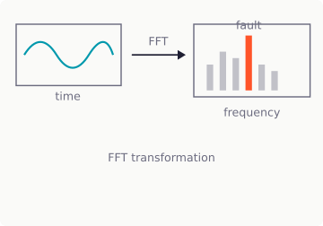
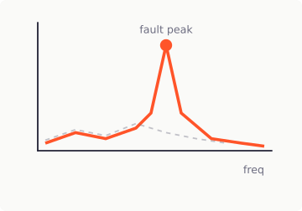
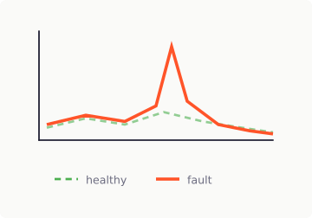
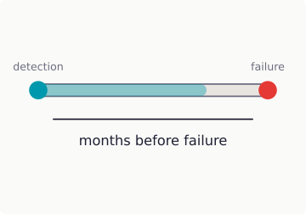
SCENE 6
Fault physics — credibility moment
44–56s
VOICEOVER
VISUAL ELEMENTS
As mechanical conditions change, they create distinct patterns in the electrical waveform. These patterns appear as specific frequencies, long before a failure becomes visible.
VISUAL DESCRIPTION
FFT animation
Fault spectrum
Time-domain waveform transforms into frequency spectrum (FFT). Fault frequency peak appears and grows — highlighted in orange. Normal baseline vs. developing fault colour-coded. Timeline: 'months before failure'.
4 elements
Baseline overlay
Timeline bar
Scene 6 of 11
SAM4 Explainer · Master Deck

Slide 8
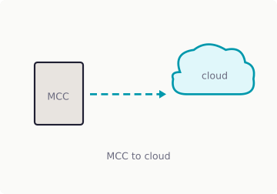
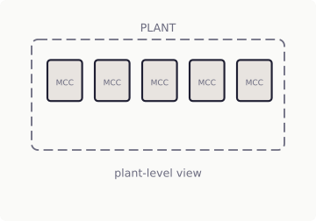
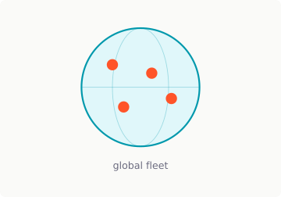
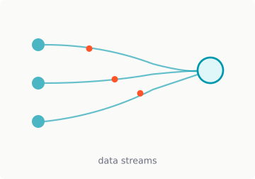
SCENE 7
Continuous monitoring at scale
56–66s
VOICEOVER
VISUAL ELEMENTS
SAM4 monitors continuously. Across one asset, one plant, or an entire fleet. Data flows automatically to the analytics engine.
VISUAL DESCRIPTION
MCC → cloud
Plant view
Signal flows: single MCC → cloud. Zoom out: multiple MCCs across one plant. Zoom out: multiple plants on global map.
4 elements
Global map
Data streams
Scene 7 of 11
SAM4 Explainer · Master Deck

Slide 9
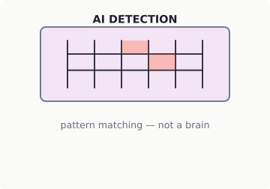


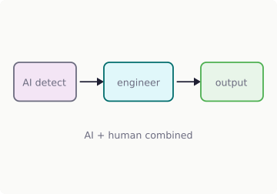
SCENE 8
AI detection + reliability expertise
66–82s
VOICEOVER
VISUAL ELEMENTS
AI models detect developing faults. Samotics reliability engineers validate and diagnose them. No in-house ESA expertise required.
VISUAL DESCRIPTION
AI detection
Anomaly flag
TOP: Automated detection engine — algorithm, pattern matching, anomaly flag. BOTTOM: Samotics reliability engineer reviewing diagnosis. Arrow connecting both → combined output.
4 elements
Engineer
AI → engineer → output
Scene 8 of 11
SAM4 Explainer · Master Deck

Slide 10
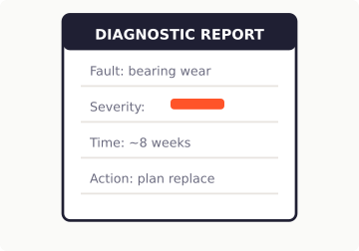
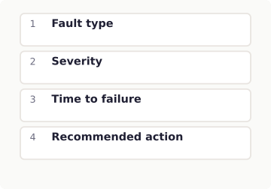
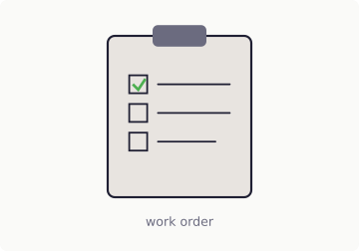
SCENE 9
The output that matters
82–98s
VOICEOVER
VISUAL ELEMENTS
You do not receive raw data. You receive a clear diagnosis. Fault type. Severity. Time to functional failure. And a recommended action.
VISUAL DESCRIPTION
Structured notification / report — NOT a dashboard. Four fields appear sequentially: Fault → Severity → Time → Action. Clean, structured — like a maintenance report.
Diagnostic report
Four fields
3 elements
Work order
Scene 9 of 11
SAM4 Explainer · Master Deck

Slide 11
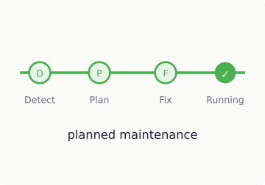
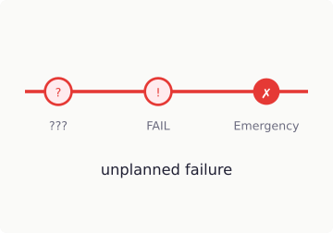
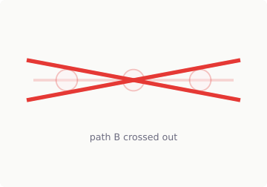
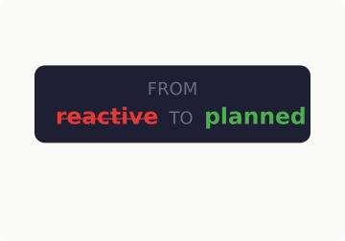
SCENE 10
Operational impact
98–112s
VOICEOVER
VISUAL ELEMENTS
This creates time. Time to plan. Time to schedule. Time to intervene without disrupting production. From reactive maintenance to planned reliability.
VISUAL DESCRIPTION
Path A (planned)
Path B (reactive)
Two parallel timelines: Path A (green): detect → plan → fix → running. Path B (red): no detection → failure → emergency. Path B fades out / crosses out.
4 elements
Path B fade
Key message
Scene 10 of 11
SAM4 Explainer · Master Deck

Slide 12
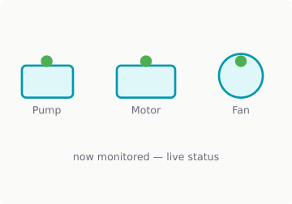
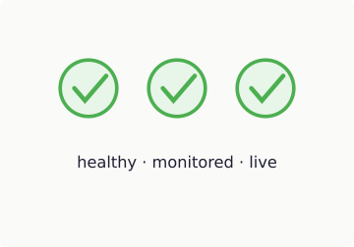

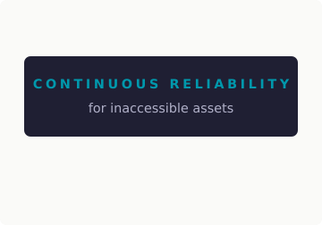
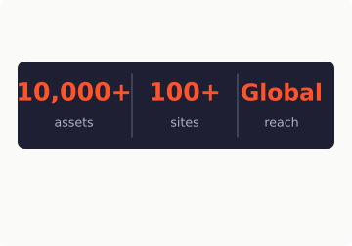
SCENE 11
Category lock — closing
112–120s
VOICEOVER
VISUAL ELEMENTS
Assets that were previously impossible to monitor become continuously visible.
SAM4. Continuous reliability for inaccessible assets.
Assets monitored
Health icons
SAM4 logo
VISUAL DESCRIPTION
Return to Scene 1 assets — now lit up with live status. Data flowing, health indicators active (green). END FRAME: SAM4 logo + tagline + optional stats.
Tagline
Stats strip
5 elements
Scene 11 of 11
SAM4 Explainer · Master Deck

