Slide 1
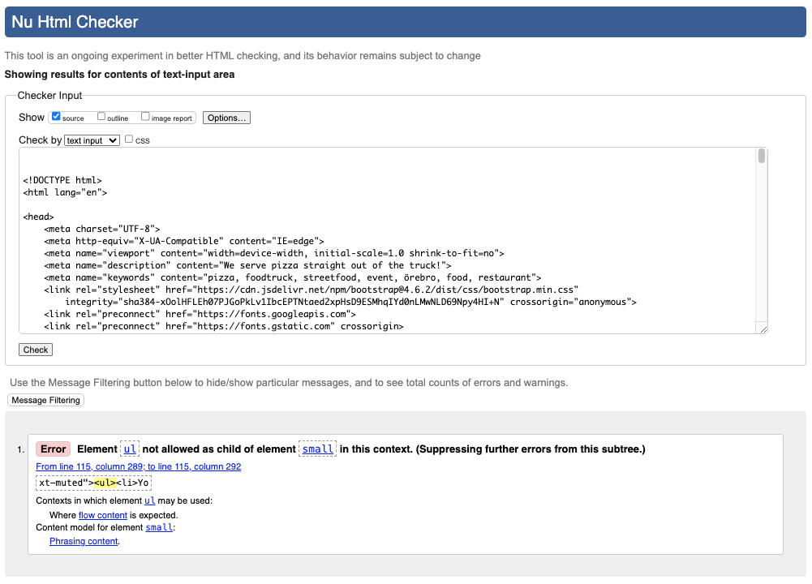
HTML Validation
password_change.html
Error:
The error is located within the Django form.

Slide 2
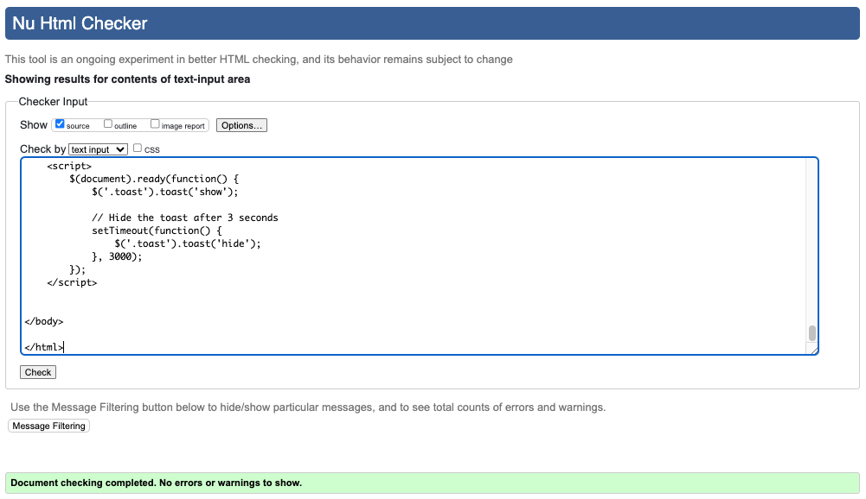
HTML Validation
login.html

Slide 3
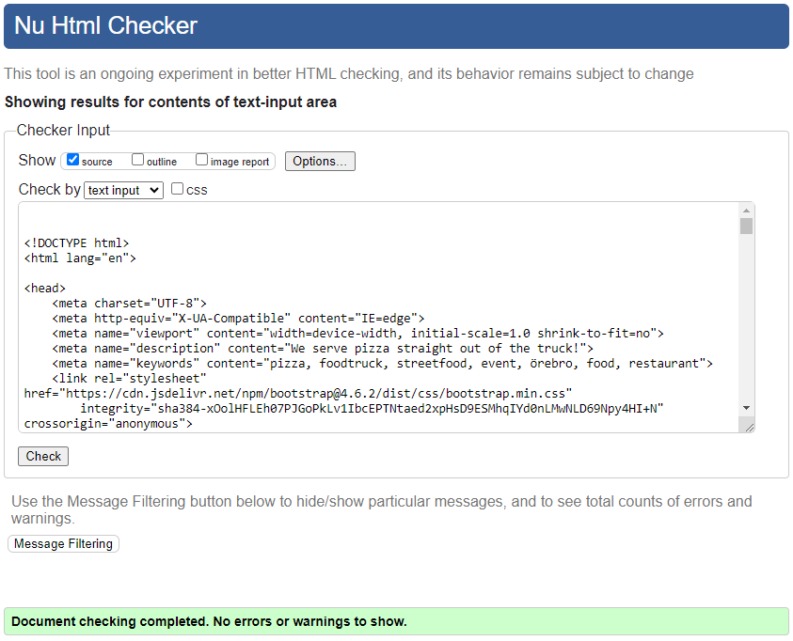
HTML Validation
logout.html

Slide 4
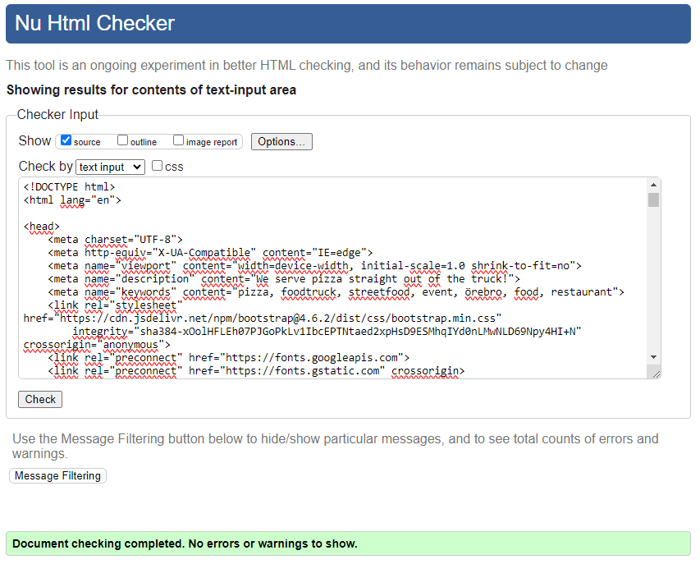
HTML Validation
index.html

Slide 5
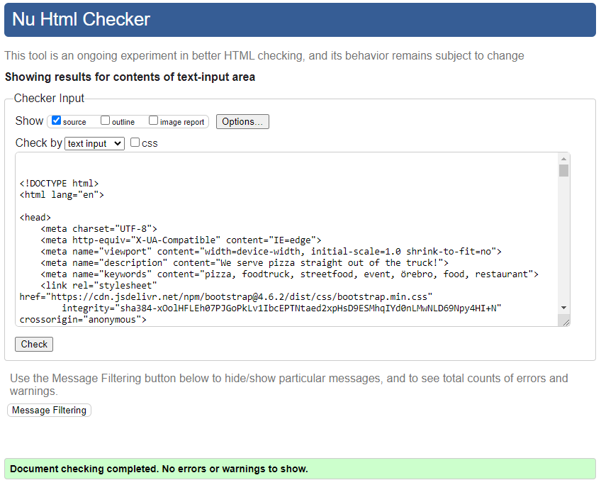
HTML Validation
review.html

Slide 6
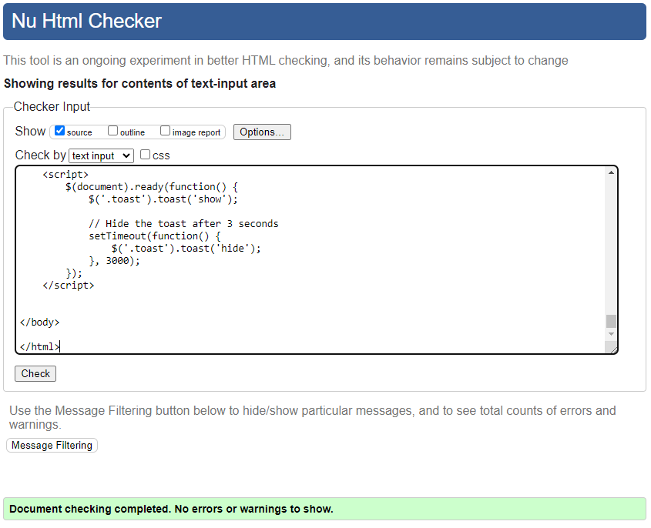
HTML Validation
events.html

Slide 7
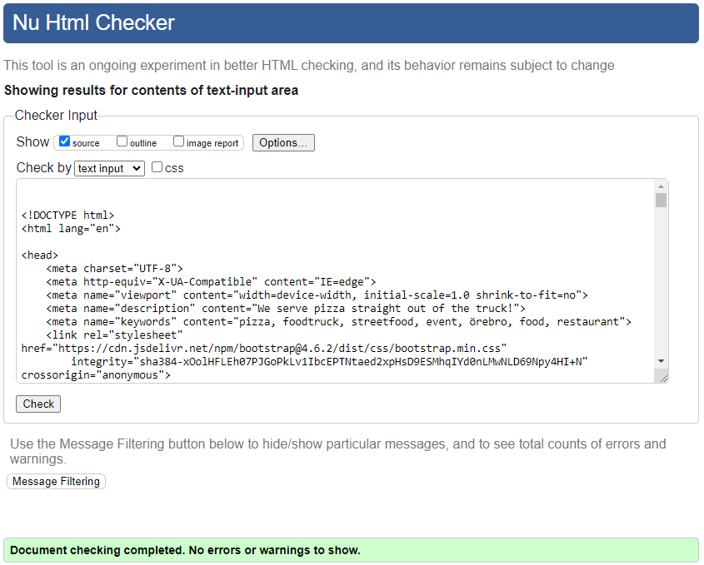
HTML Validation
profile.html

Slide 8
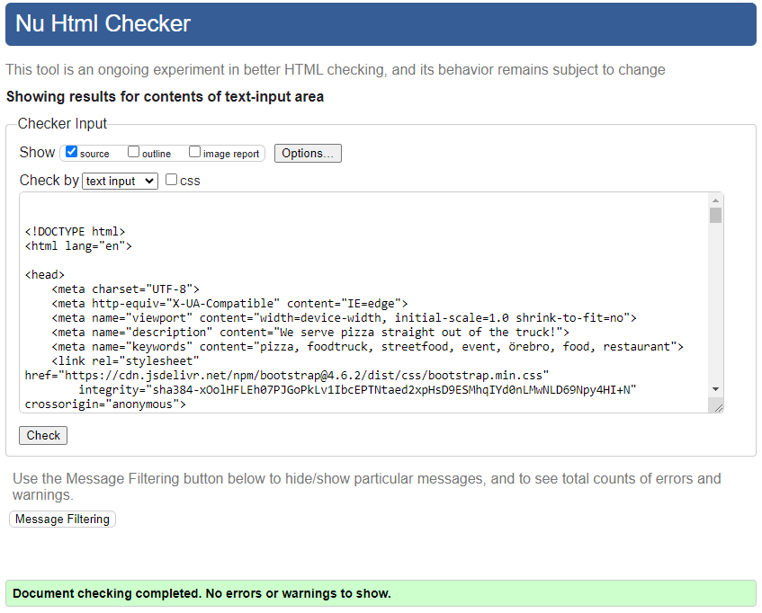
HTML Validation
booking_list.html

Slide 9

HTML Validation
new_booking.html

Slide 10
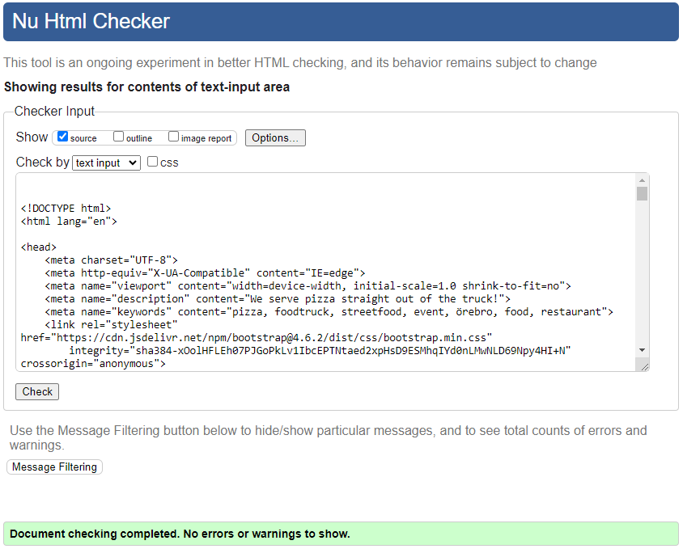
HTML Validation
staff_list.html

