Slide 1
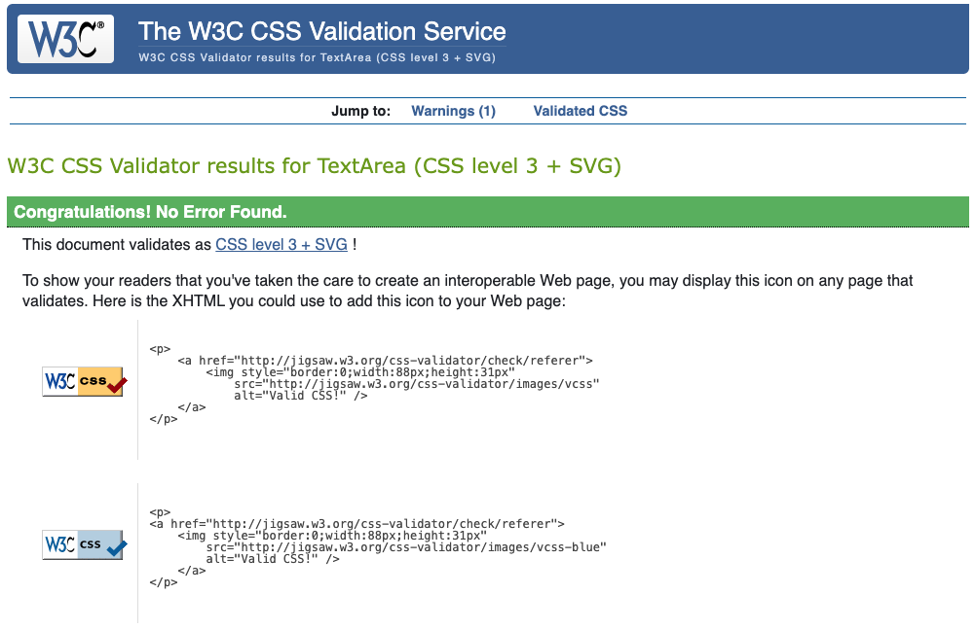
CSS Validation
Result

Slide 2
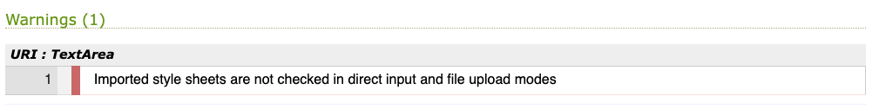
CSS Validation
Warning

