Slide 1
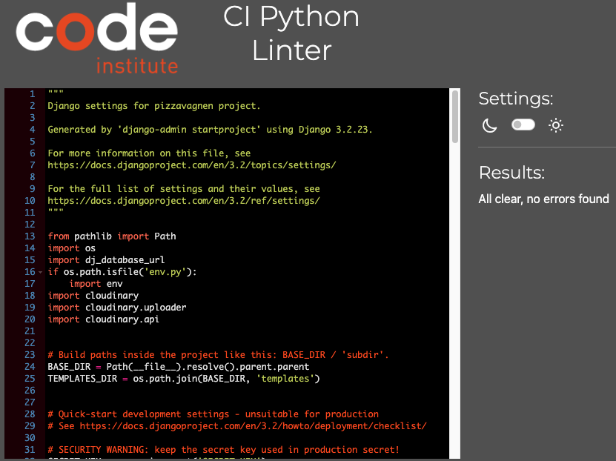
Python Validation
Pizzavagnen/settings

Slide 2
Python Validation
Pizzavagnen/urls

Slide 3
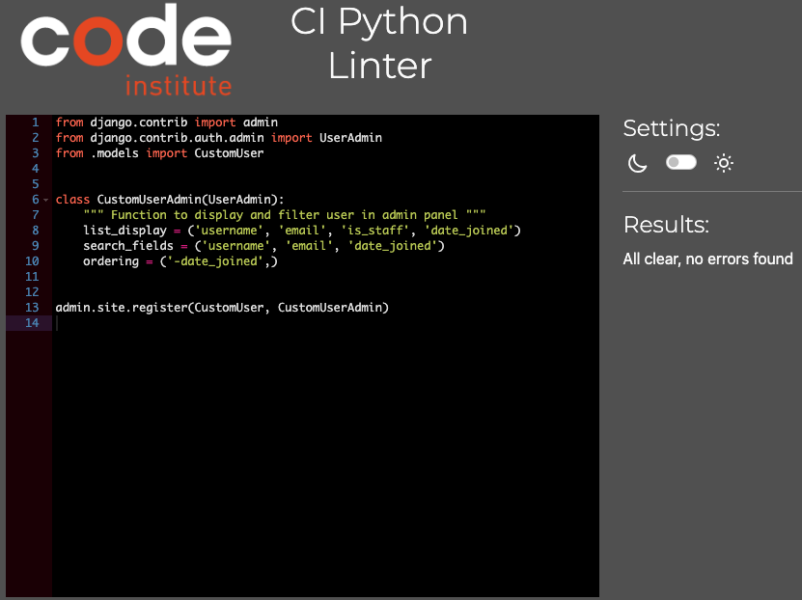
Python Validation
user/admin

Slide 4
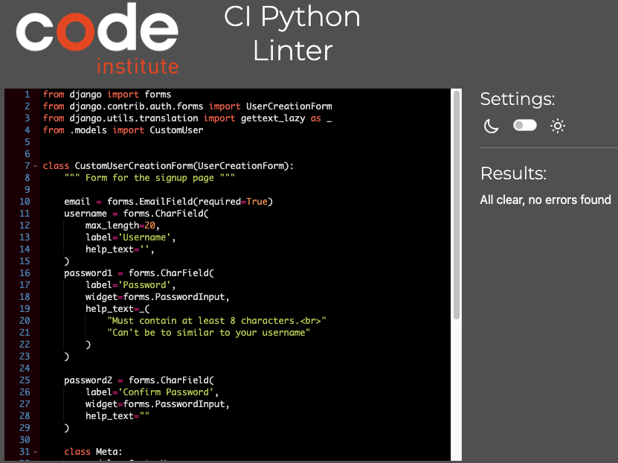
Python Validation
user/forms

Slide 5
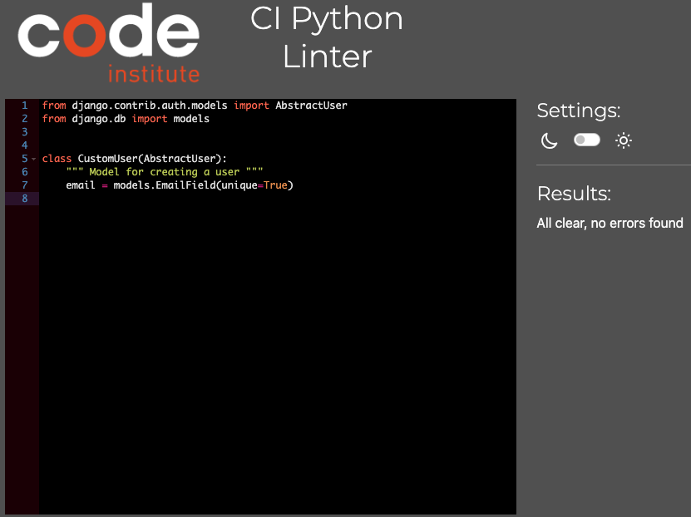
Python Validation
user/models

Slide 6
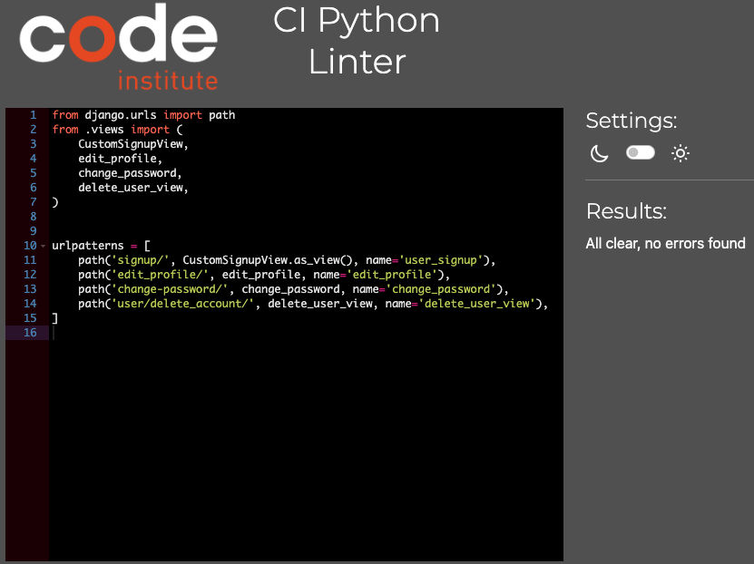
Python Validation
user/urls

Slide 7
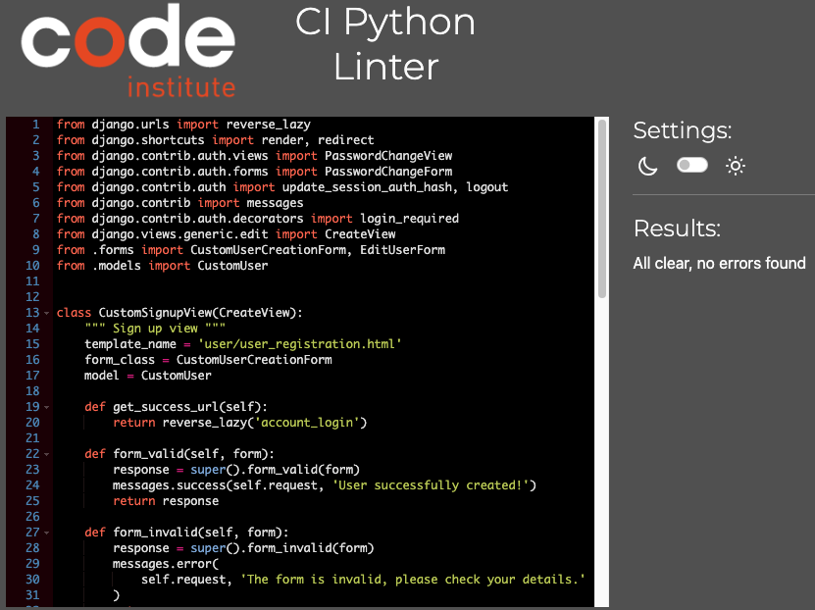
Python Validation
user/views

Slide 8
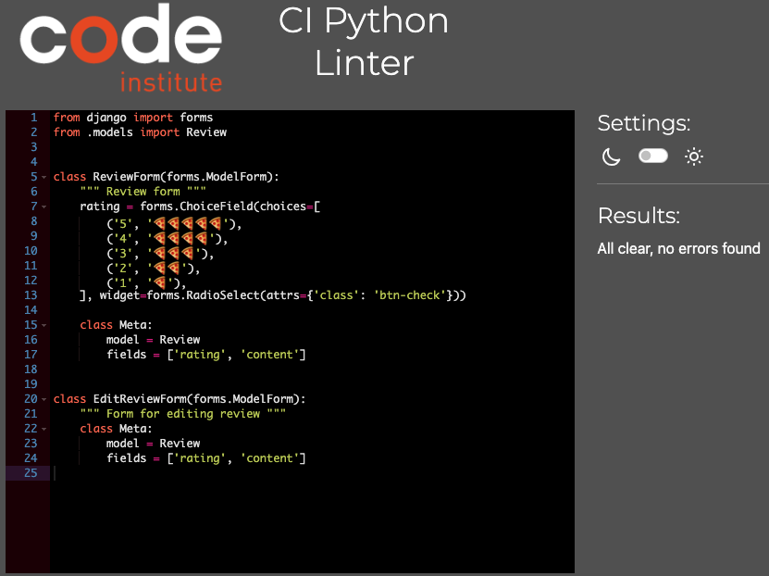
Python Validation
review/forms

Slide 9
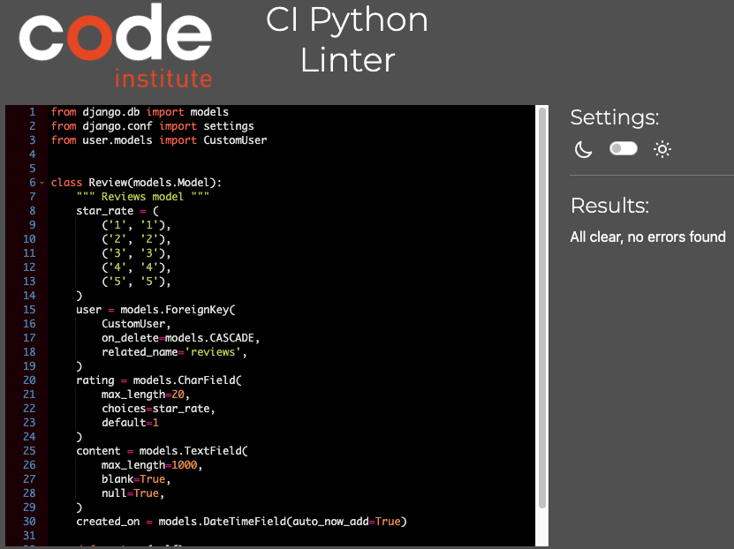
Python Validation
review/models

Slide 10
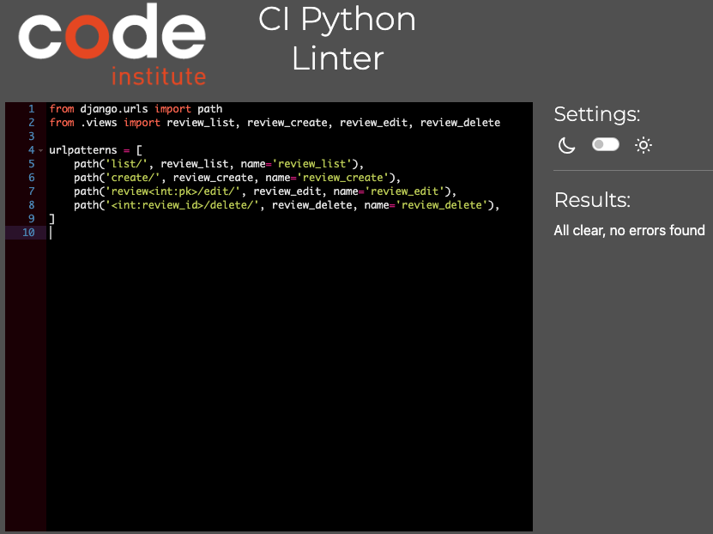
Python Validation
review/urls

Slide 11
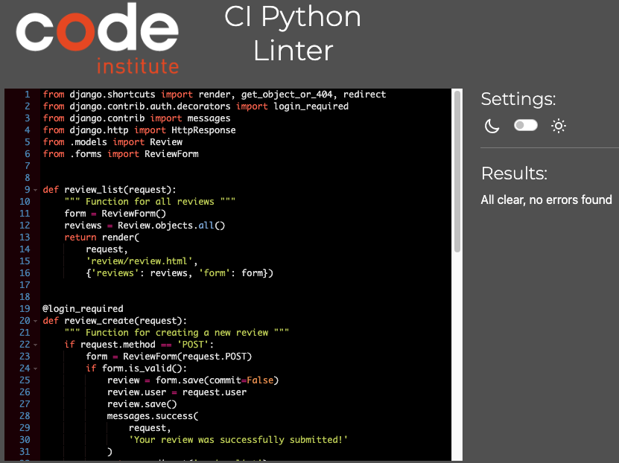
Python Validation
review/views

Slide 12
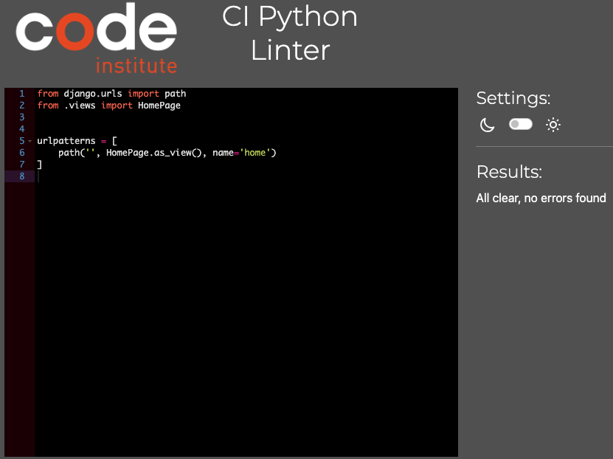
Python Validation
home/urls

Slide 13
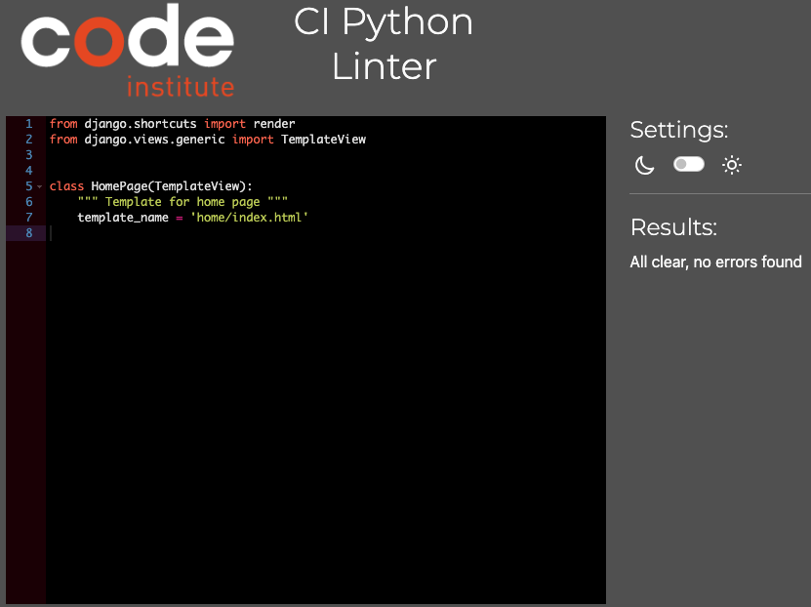
Python Validation
home/views

Slide 14
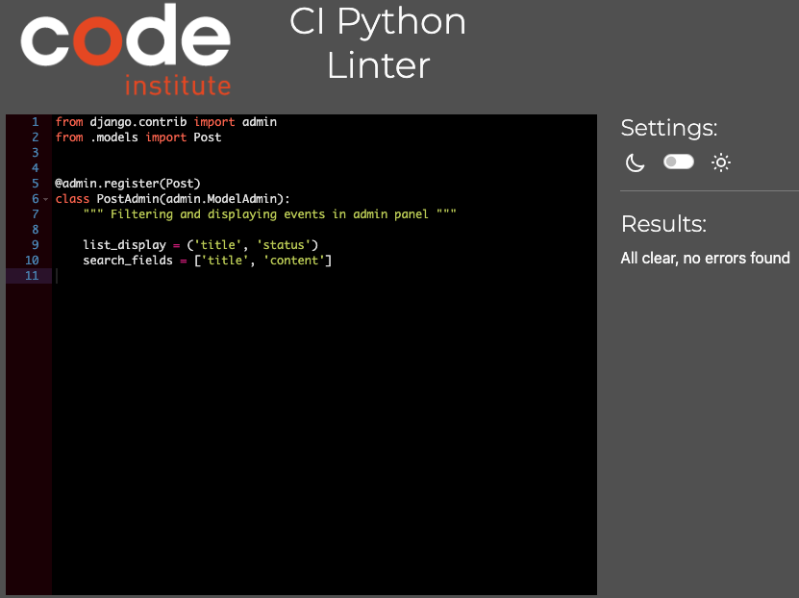
Python Validation
events/admin

Slide 15
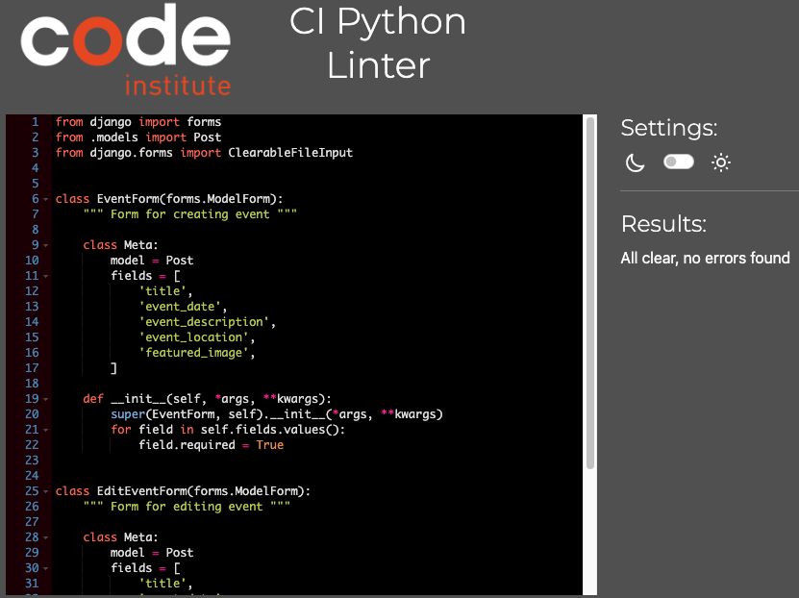
Python Validation
events/forms

Slide 16
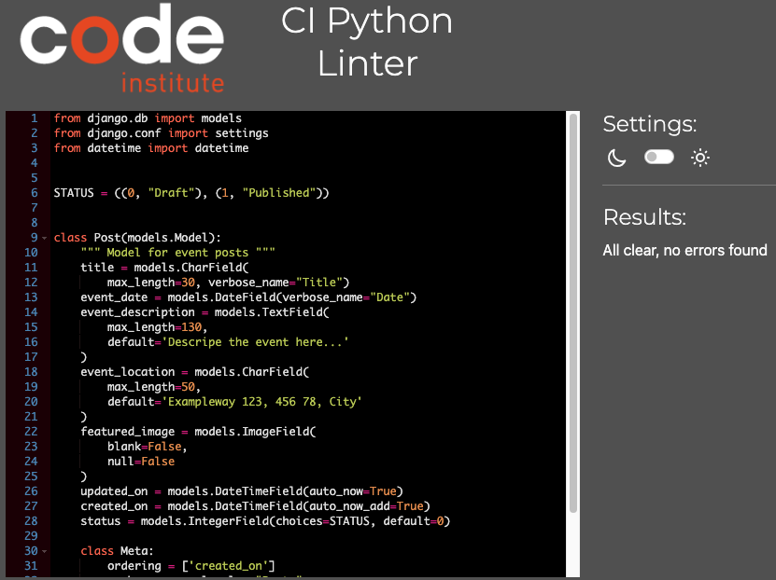
Python Validation
events/models

Slide 17
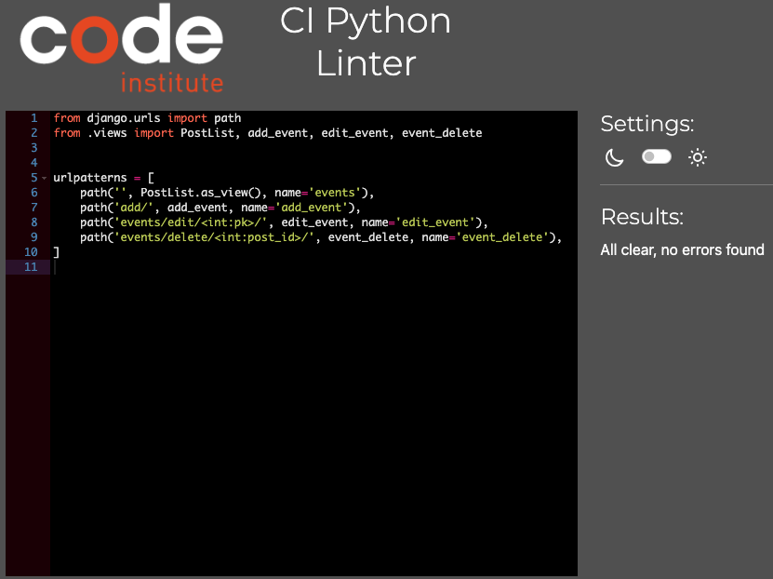
Python Validation
events/urls

Slide 18
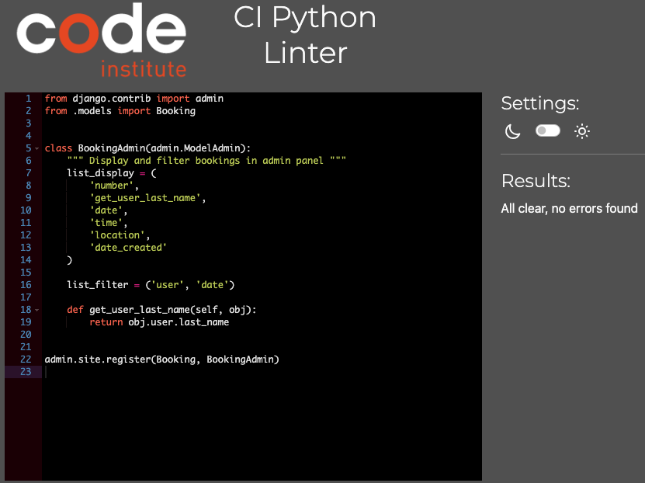
Python Validation
booking/admin

Slide 19
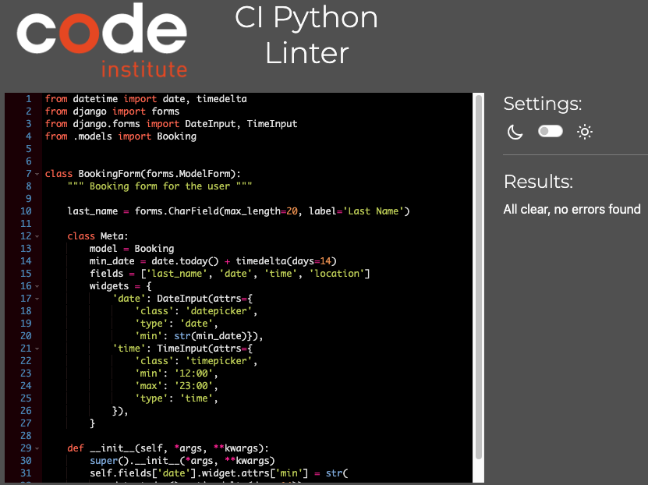
Python Validation
booking/forms

Slide 20
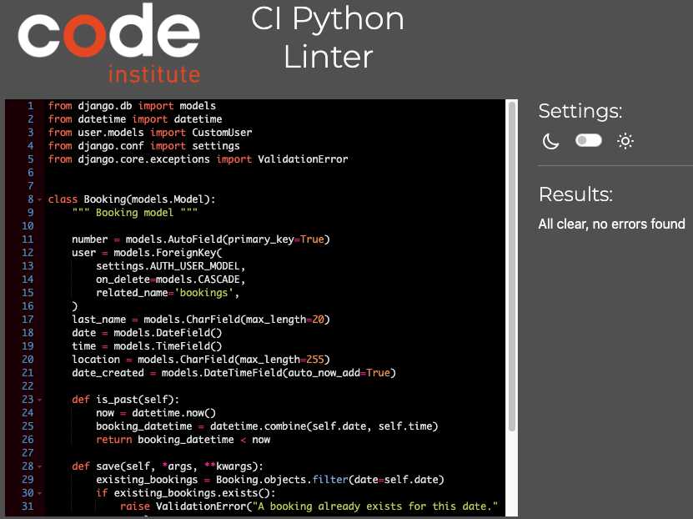
Python Validation
booking/models

Slide 21
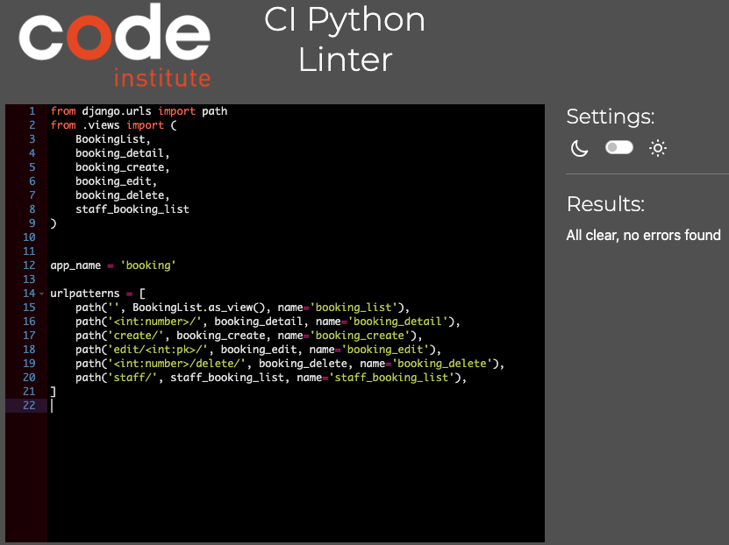
Python Validation
booking/urls

Slide 22
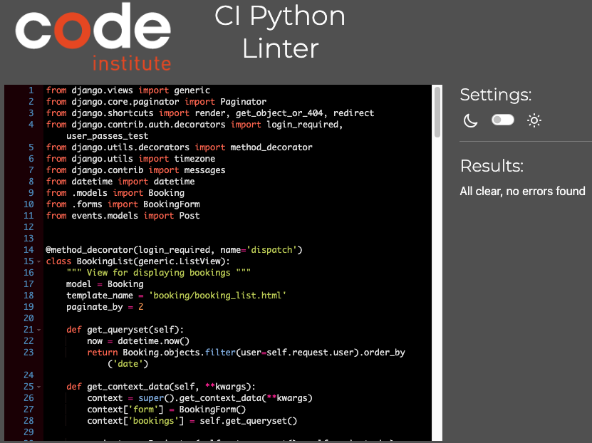
Python Validation
booking/views

