Slide 1

Five Guys
Concert Tracker

Slide 2
What Does Our Software Do?
We record the pertinent information associated with attending a concert, in order to spark the memory of the user of a real life experience they had and have now recorded.

Slide 3

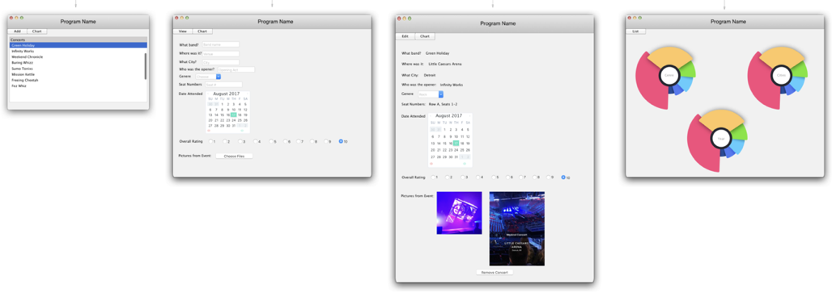
Concept

Slide 4
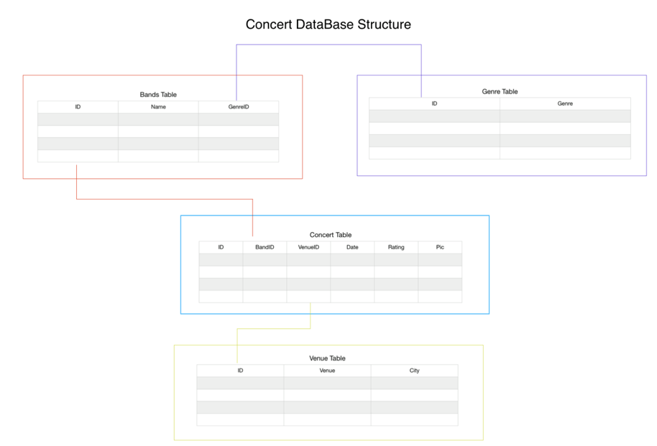
Concept

Slide 5
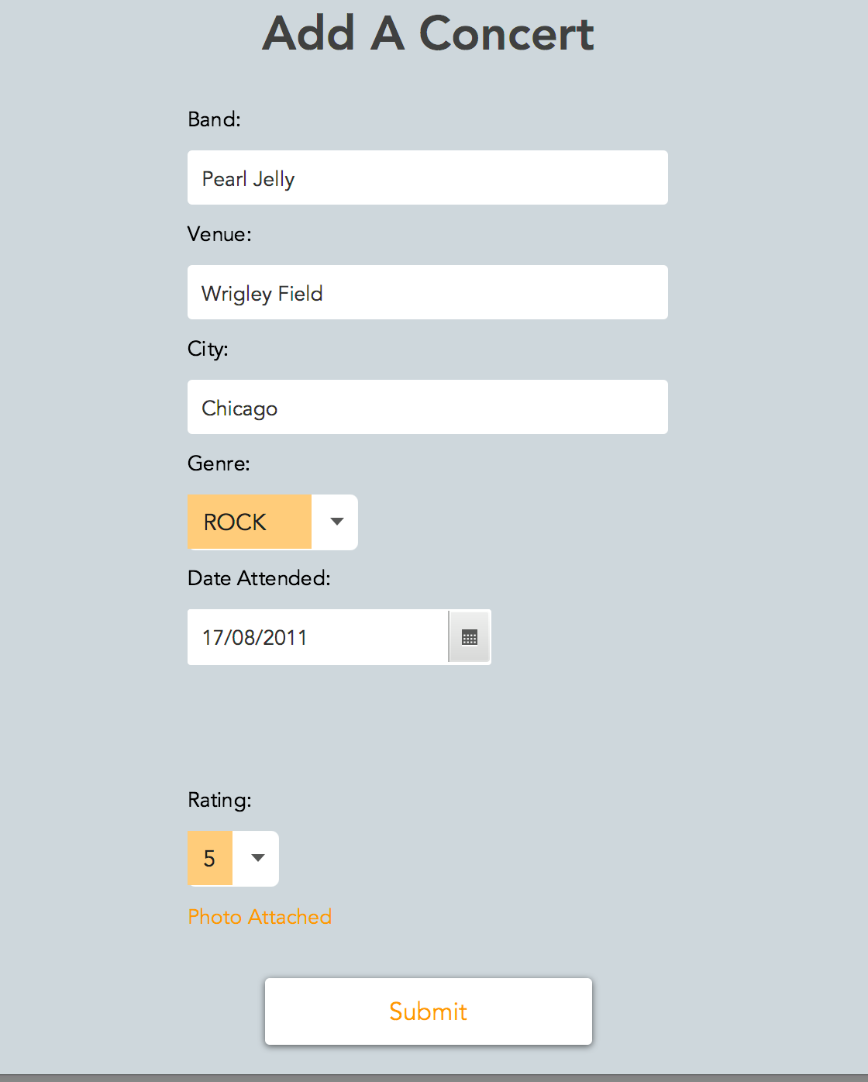
Add Concert Tab

Slide 6
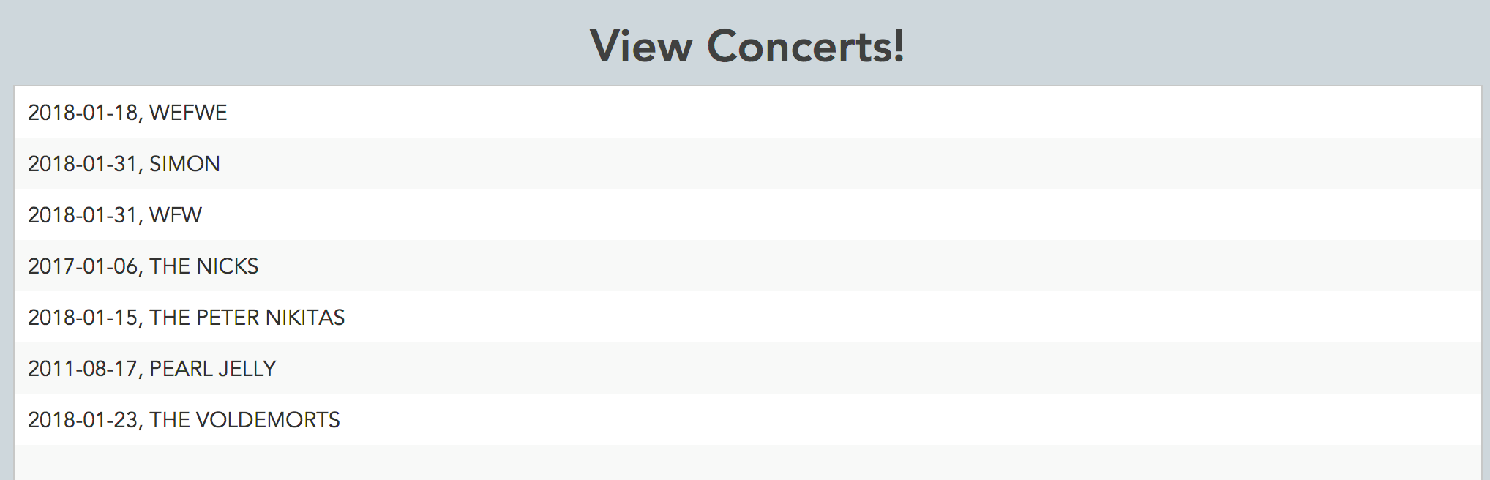
View Concert Tab

Slide 7
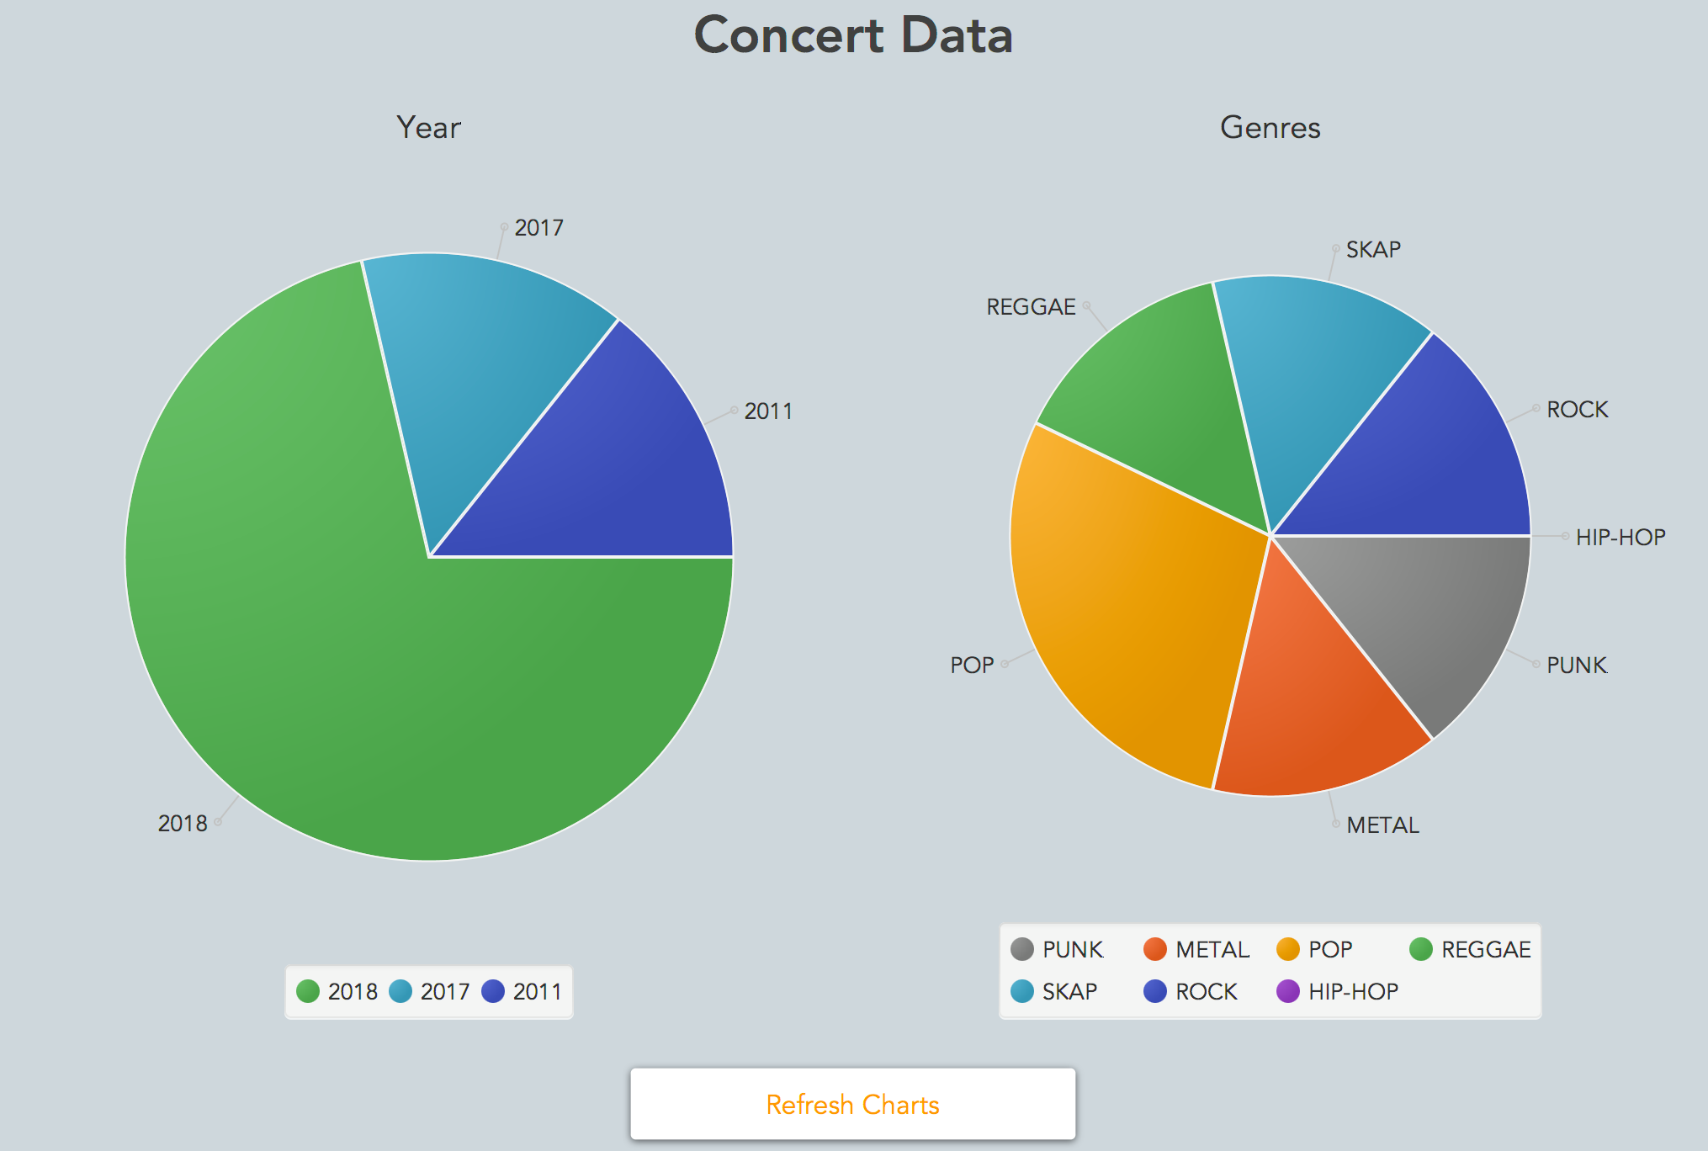
Chart Tab

Slide 8
Final Product
We believe based on the design phase to now we have completed our goals and developed a fully functional piece of software modeled after our design.
The only apparent changes were the dropping of a few fields including: Seat Numbers, and Parties Attended.
These fields were left out based on functionality and crowding of the form and not for technical reasons.
Based upon the Minimum Viable Product design process and procedure we took we were able to meet our goals and build a well rounded fully functional piece of software in which we made little to no compromises on.

Slide 9
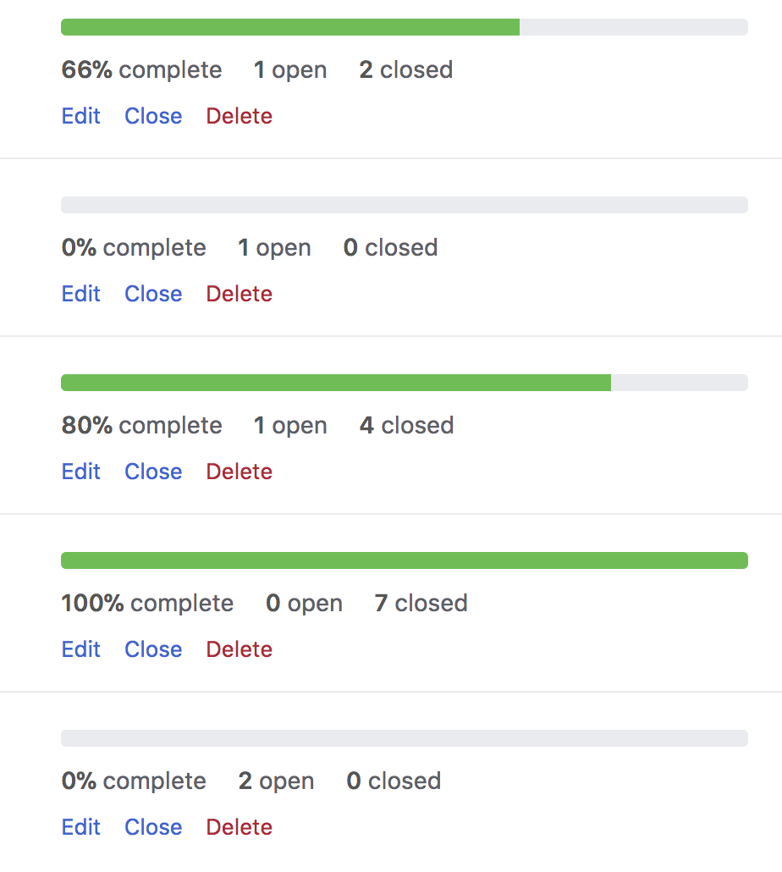
Development Process
We started with a 2 week design process of both front and back end.
We then continued the two week sprint theme throughout assigning issues and completing milestones by their allotted time.
We tried to assign and create issues as they arose and became relevant to the projects success.

Slide 10
Development Process
Database Simon, Jose
Core Pages Nick, Carmen, Adam
Database Design, Credits/Help, Queries & Charts Simon, Jose, Carmen
CSS Carmen, Adam
Visuals Nick, Carmen, Adam
Setup
Simon, Jose, Carmen

Slide 11
Technology Choices
Agile Development methods and practice.
Sketch for UI design and development, as well as mapping out database.
PHPMyAdmin for database testing and tracking as well as testing and relationship status/testing.
MYSQL Connector.

Slide 12
Jose & Simon
Issues | Solutions
Querying of multiple databases in 3NF while building and controlling those objects throughout the project. | We drew and designed the flow of data which would help us to visualize the flow of data as well as the queries and methods needed to be in place to fit the software's control of data.
Using a blob to store photos. | Inserting a BLOB directly into our database seemed like less of a chore on paper, but in turn actually turned to be very time consuming and constraining
Designing, figuring and implementing database structure | This we owe a lot to Darren as he set us off with a lesson and in the right direction. As well Nick helped with some very distinct queries we ran into. The database was a learning experience in which we encountered problems until the very end i.e. CASCADE delete on our relational tables on update and remove

Slide 13
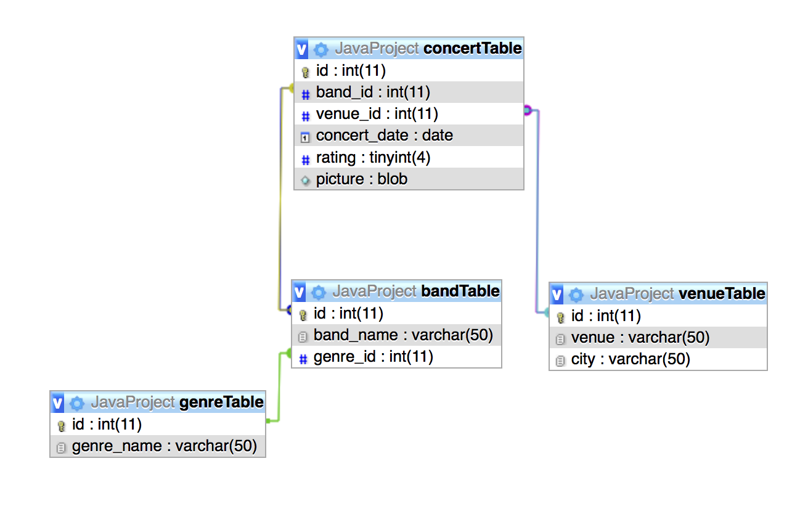
Jose & Simon

Slide 14
Carmen
Issues | Solutions
Display values to a listview | When populating the list view from the database. It kept giving me the object reference number instead of the name. Due to the silly mistake it costed me some time but it was fixed with a simple toString to the class files
Passing objects to another class | Trying to figure out how to pass an ID of the object was difficult. I was able to create a global static int variable and assign the id of the object being clicked. I created an instance of the current class hosting the listview to the SingleConcertView and assigned that in to the Concert object being created.
Figuring out FX-CSS | When designing the application it was diffuclt at first using FX-css as it was slightly different from css. But after research and practice it became a breeze

Slide 15
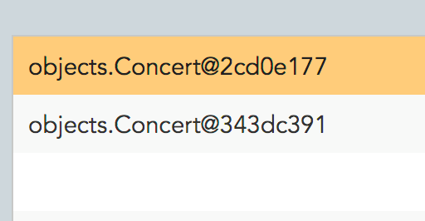
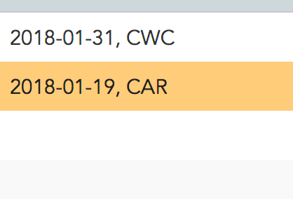
Carmen
toString method

Slide 16
Adam
Issues | Solutions
Bugs with controlsfx where it would delete the library and prevent me from running the application | To solve it I just removed the external library from the project.
Animations | Choosing the correct things to animate, as well as a minor branch issue.
Finding a colorscheme | I ended up asking my group members for opinions on it and got help from my group with the colors.

Slide 17
Nick
Issues | Solutions
ControlsFX | ControlsFX added a big issue to our project causing our libraries to disappear and broke our staging branch causing us to manually fix each branch and make sure their all compatible and remove all references to ControlsFX
SplashScreen | Getting the text at bottom to update and loop through an observable ArrayList.

Slide 18
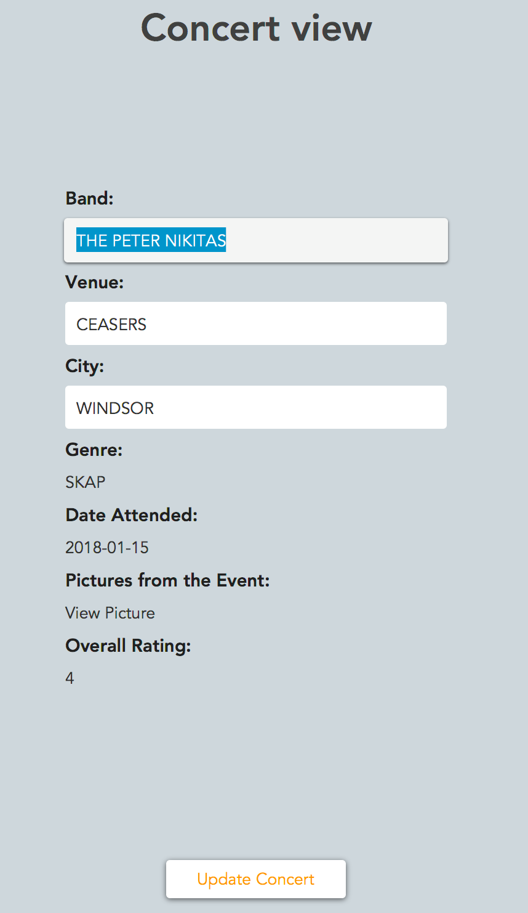
Nick

Slide 19
Group Problems
We had an implemented library which ruined our .classpath files.
This essentially muted our git repo we could not work on it for almost 3 weeks other than individually.
We also had a .gitignore which was adding to our .bin files
This had a similar result which halted our git abilities.
Upon overcoming these with the help of Cai and some of our own gitignore’s and classpath re routing we were back in business.
These issues took such a large chunk of time away from us and made it very stressful in regards to deadlines and testing of code.

Slide 20
DEMO

Slide 21
Thank you for Listening
Special Thanks to:
Darren and Nick for the Database Help!!!!!!!!!!!
Cai for Fixing Git multiple times.

