Slide 1
A-math Polynomial
Simon Julian Lauw
Full Info > simonjulianl.github.io

Slide 2
Table of Contents
Review
Polynomial and Identity
Long Division

Slide 3
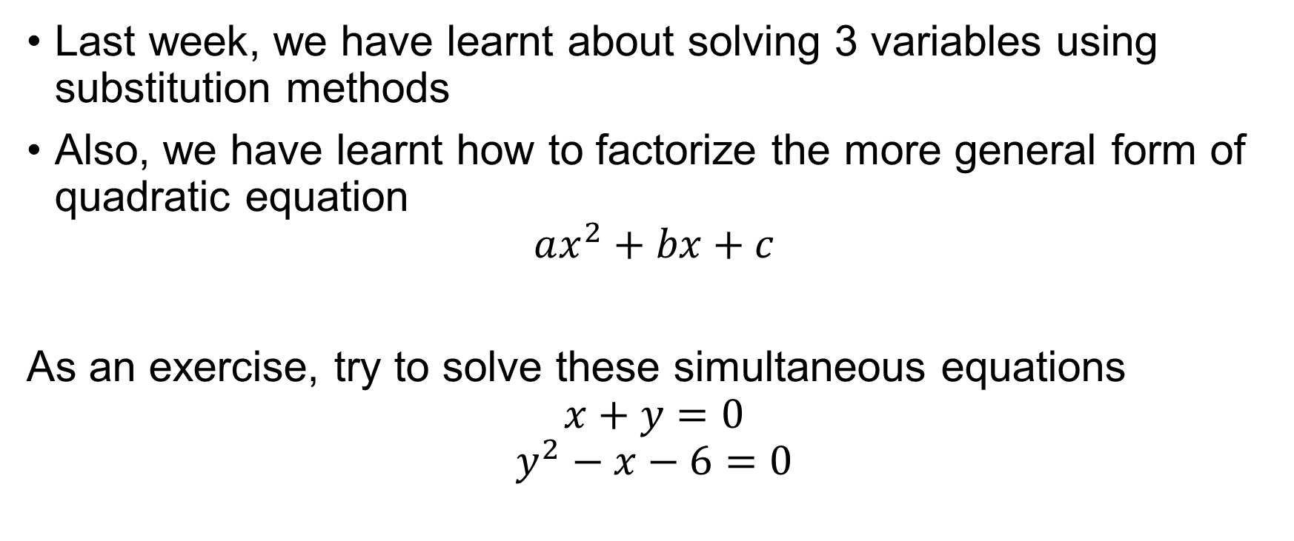
Review
Last week, we have learnt about solving 3 variables using substitution methods
Also, we have learnt how to factorize the more general form of quadratic equation
$$ax^{2}+bx+c$$
As an exercise, try to solve these simultaneous equations
$$x+y=0$$
$$y^{2}−x−6=0$$
Notes:
Y = 2 or y = 3

Slide 4
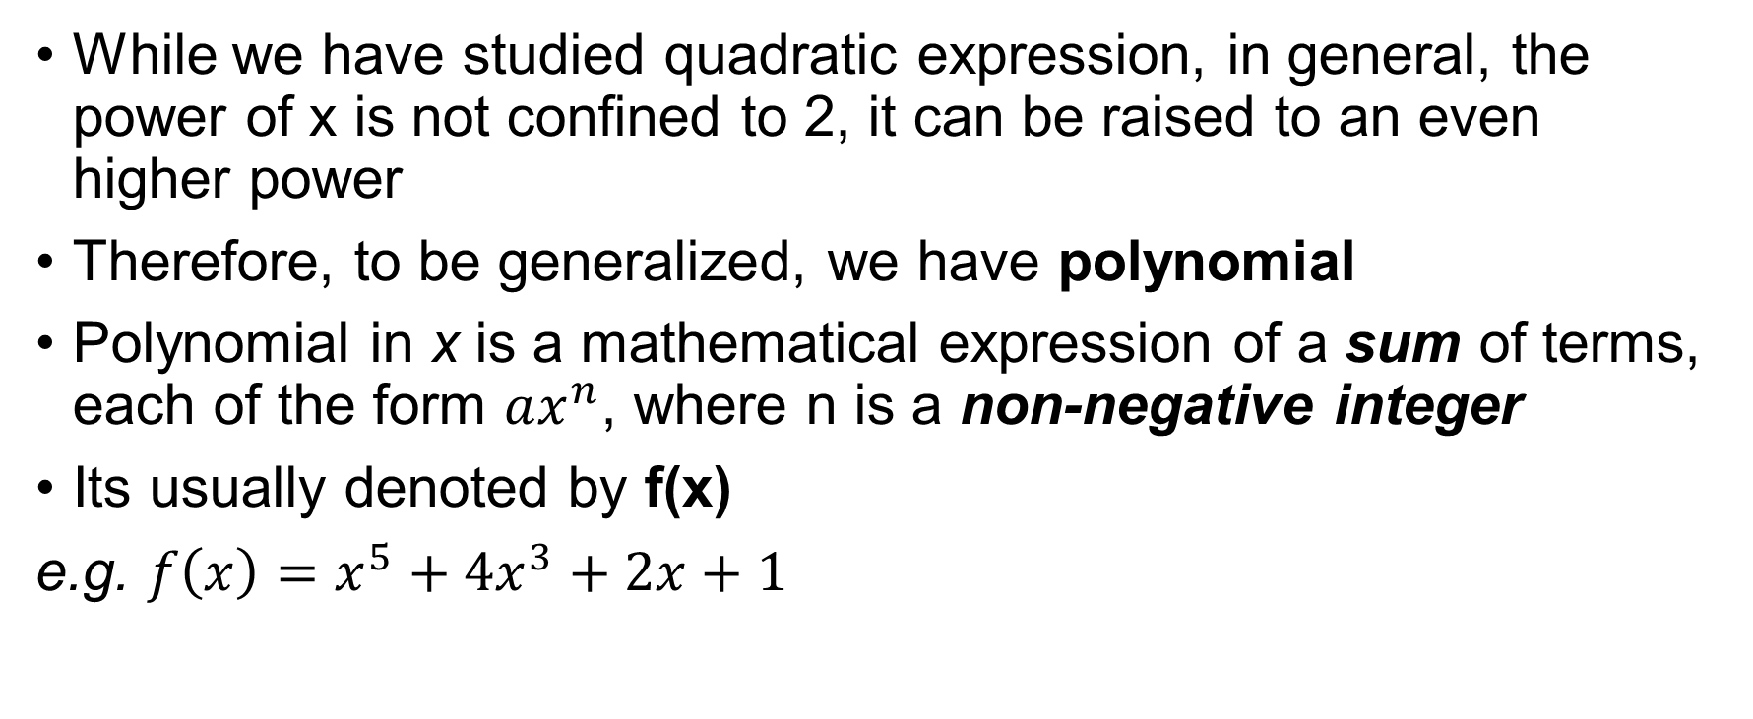
Polynomial
While we have studied quadratic expression, in general, the power of x is not confined to 2, it can be raised to an even higher power
Therefore, to be generalized, we have polynomial
Polynomial in x is a mathematical expression of a sum of terms, each of the form $ax^{n}$, where n is a non-negative integer
Its usually denoted by f(x)
e.g. $f\left(x\right)=x^{5}+4x^{3}+2x+1$

Slide 5

Check your understanding
Which of the followings is/are polynomial(s)
1. $x^{3}+2x+5$
2. $6x^{4}−1$
3. $1$
4. $\frac{1}{x}$
5. $x+x^{\frac{2}{3}}$

Slide 6
Identities in polynomial
An identity is an equation which the expression of the LHS is equal to the expression on the RHS
To find the unknown constants in an identity,
You can substitute special values of x
By comparing coefficients

Slide 7
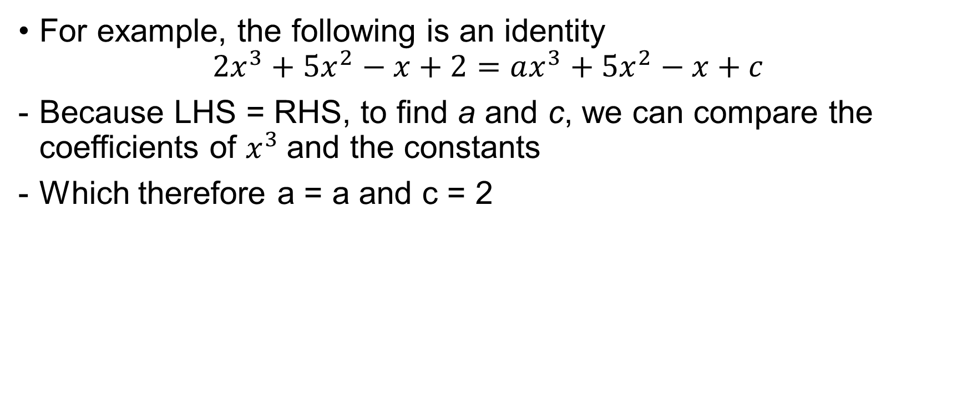
Identities in polynomial
For example, the following is an identity
$$2x^{3}+5x^{2}−x+2=ax^{3}+5x^{2}−x+c$$
Because LHS = RHS, to find a and c, we can compare the coefficients of $x^{3}$and the constants
Which therefore a = a and c = 2

Slide 8
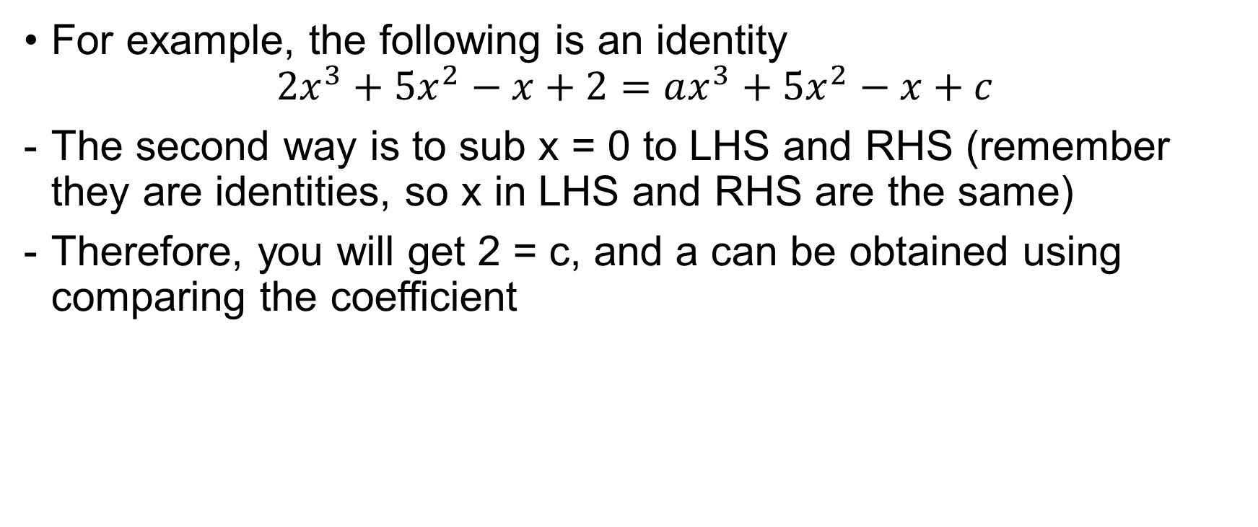
Identities in polynomial
For example, the following is an identity
$$2x^{3}+5x^{2}−x+2=ax^{3}+5x^{2}−x+c$$
The second way is to sub x = 0 to LHS and RHS (remember they are identities, so x in LHS and RHS are the same)
Therefore, you will get 2 = c, and a can be obtained using comparing the coefficient

Slide 9
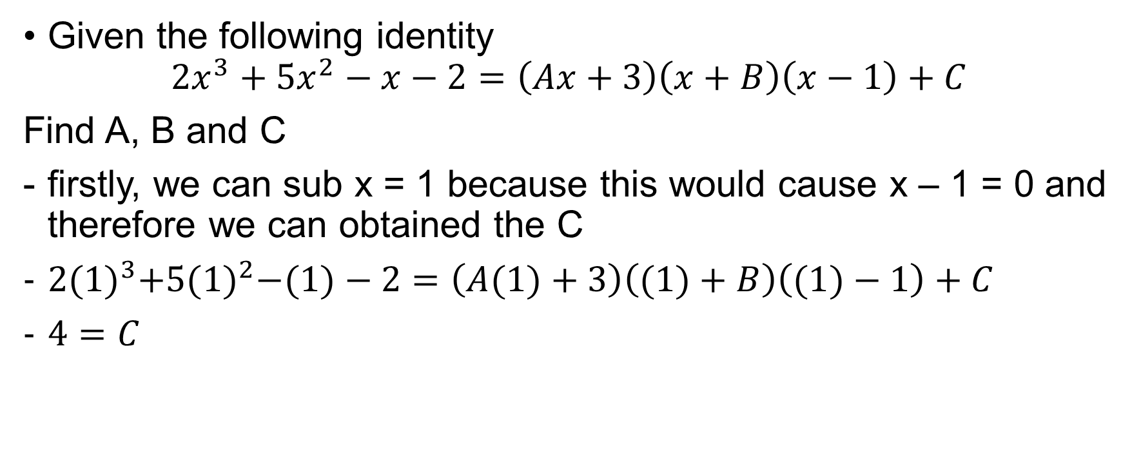
Another harder example
Given the following identity
$$2x^{3}+5x^{2}−x−2=\left(Ax+3\right)\left(x+B\right)\left(x−1\right)+C$$
Find A, B and C
firstly, we can sub x = 1 because this would cause x – 1 = 0 and therefore we can obtained the C
$2{(1)}^{3}+5{(1)}^{2}−(1)−2=\left(A(1)+3\right)\left((1)+B\right)\left((1)−1\right)+C$
$4=C$

Slide 10
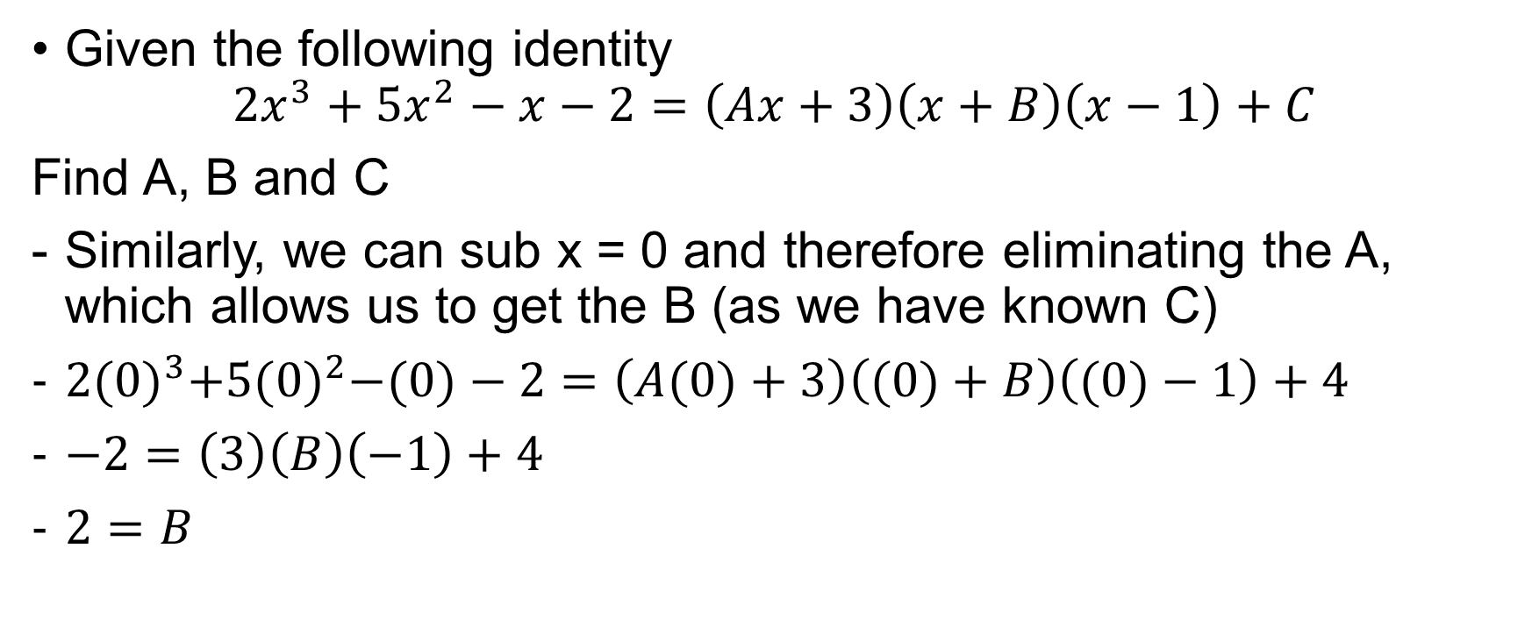
Another harder example
Given the following identity
$$2x^{3}+5x^{2}−x−2=\left(Ax+3\right)\left(x+B\right)\left(x−1\right)+C$$
Find A, B and C
Similarly, we can sub x = 0 and therefore eliminating the A, which allows us to get the B (as we have known C)
$2{(0)}^{3}+5{(0)}^{2}−(0)−2=\left(A(0)+3\right)\left((0)+B\right)\left((0)−1\right)+4$
$−2=\left(3\right)\left(B\right)\left(−1\right)+4$
$2=B$

Slide 11
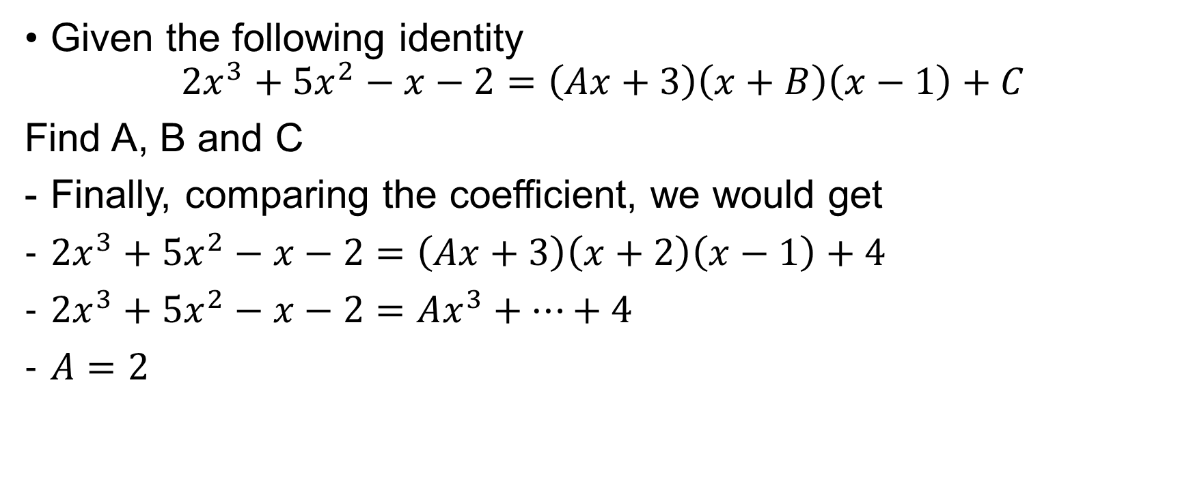
Another harder example
Given the following identity
$$2x^{3}+5x^{2}−x−2=\left(Ax+3\right)\left(x+B\right)\left(x−1\right)+C$$
Find A, B and C
Finally, comparing the coefficient, we would get
$2x^{3}+5x^{2}−x−2=\left(Ax+3\right)\left(x+2\right)\left(x−1\right)+4$
$2x^{3}+5x^{2}−x−2=Ax^{3}+…+4$
$A=2$

Slide 12
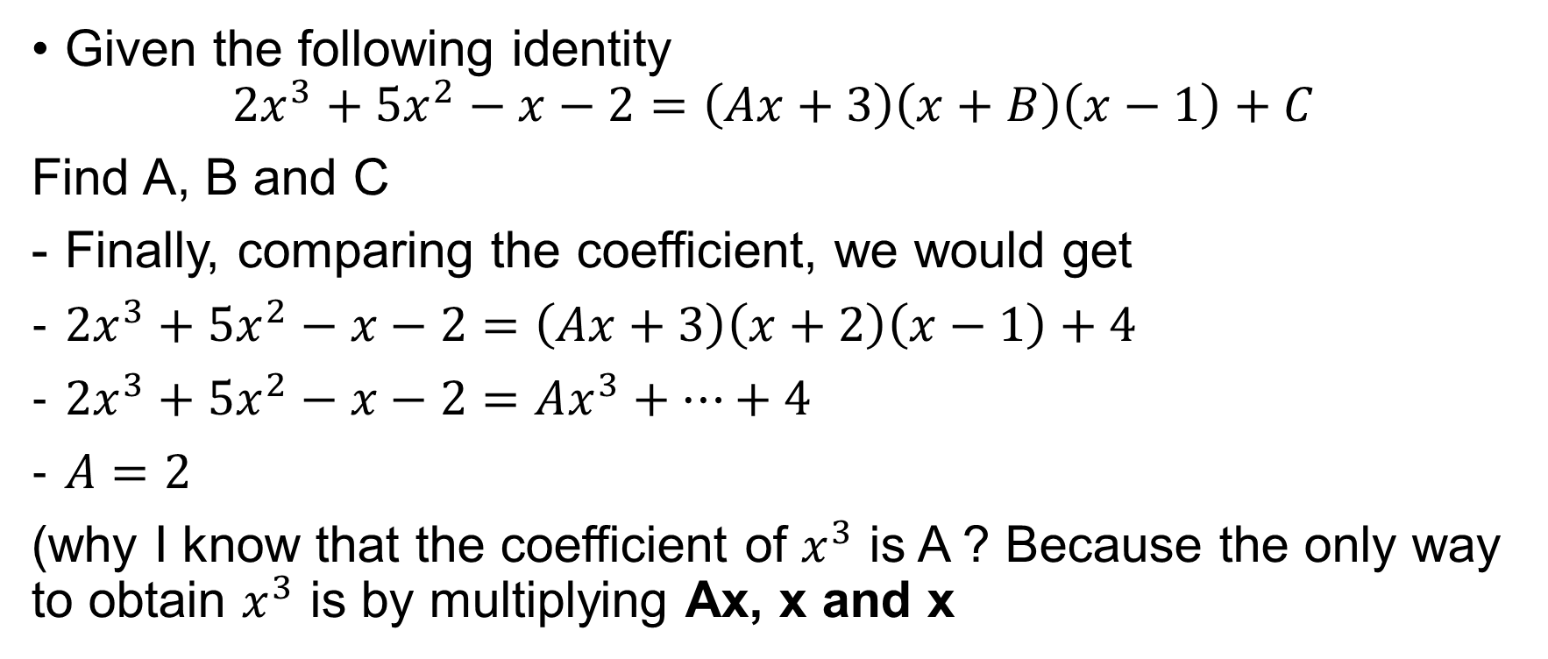
Another harder example
Given the following identity
$$2x^{3}+5x^{2}−x−2=\left(Ax+3\right)\left(x+B\right)\left(x−1\right)+C$$
Find A, B and C
Finally, comparing the coefficient, we would get
$2x^{3}+5x^{2}−x−2=\left(Ax+3\right)\left(x+2\right)\left(x−1\right)+4$
$2x^{3}+5x^{2}−x−2=Ax^{3}+…+4$
$A=2$
(why I know that the coefficient of $x^{3}$ is A ? Because the only way to obtain $x^{3}$ is by multiplying Ax, x and x

Slide 13
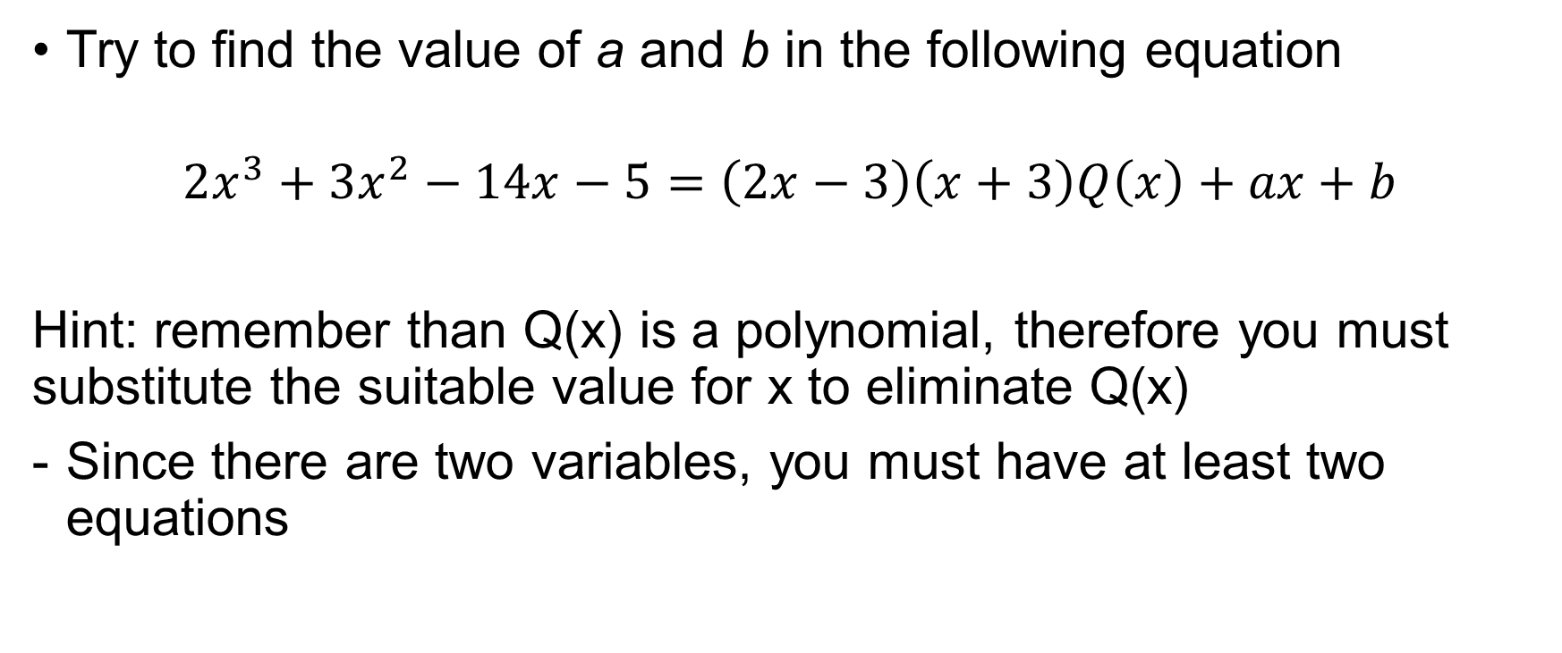
Exercises
Try to find the value of a and b in the following equation
$$2x^{3}+3x^{2}−14x−5=\left(2x−3\right)\left(x+3\right)Q\left(x\right)+ax+b$$
Hint: remember than Q(x) is a polynomial, therefore you must substitute the suitable value for x to eliminate Q(x)
Since there are two variables, you must have at least two equations
Notes:
A = -5, b = -5

Slide 14

More exercises
Given $4x^{2}−6x+9=A\left(x−1\right)\left(2x+1\right)+B\left(x−1\right)+C$
Find the values of A, B and C
- Again here, try to substitute with the suitable values for x
Notes:
A = 2, b = -4 , c = 7

Slide 15
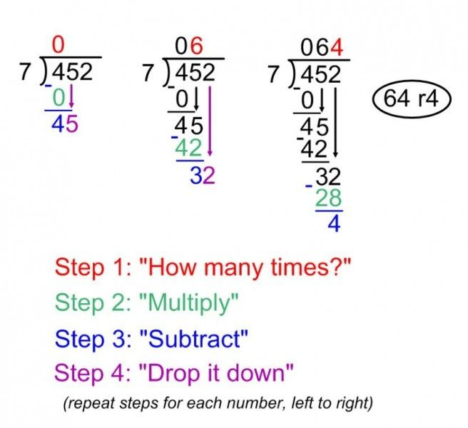
Long Division (Polynomial)
When you are in primary school, how do you usually do division? I bet you are using this repeated division method! (not using calculator like now)

Slide 16
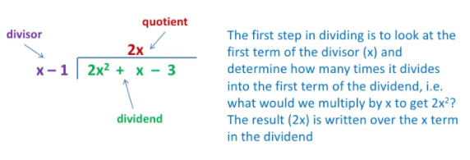
Long division
Actually, this long division idea is extensible even to algebra!

Slide 17
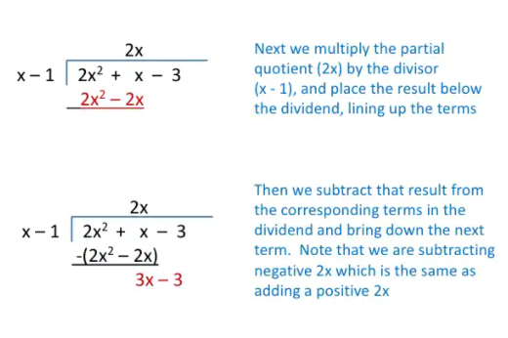
Long Division

Slide 18
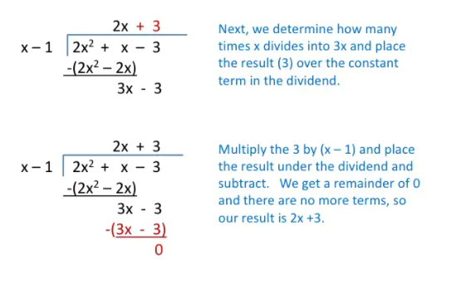
Long Division

Slide 19
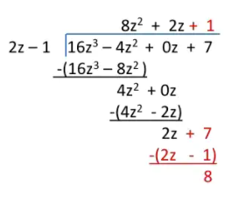
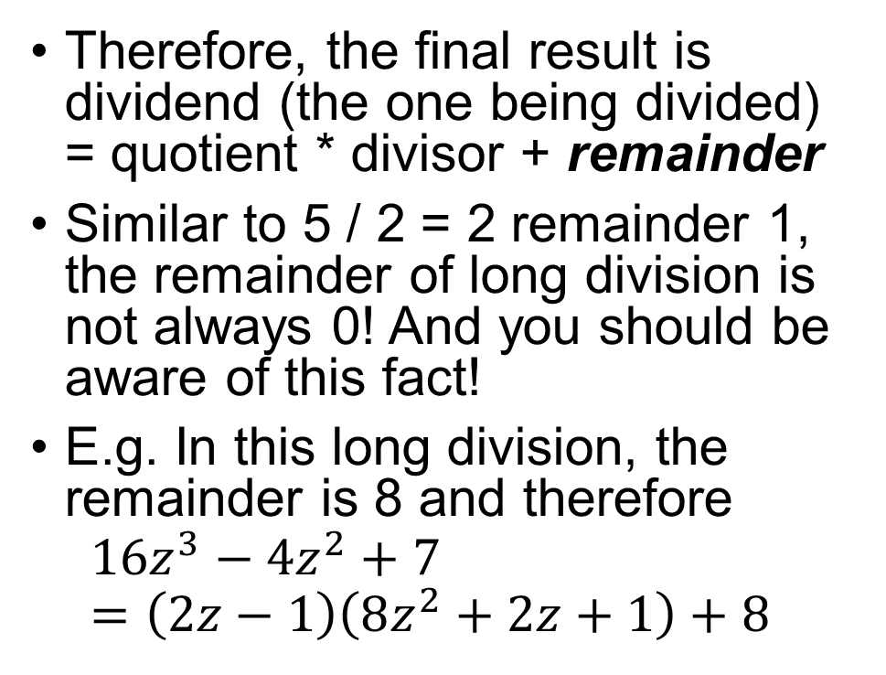
Long Division
Therefore, the final result is dividend (the one being divided) = quotient * divisor + remainder
Similar to 5 / 2 = 2 remainder 1, the remainder of long division is not always 0! And you should be aware of this fact!
E.g. In this long division, the remainder is 8 and therefore
$$16z^{3}−4z^{2}+7=\left(2z−1\right)\left(8z^{2}+2z+1\right)+8$$

Slide 20

Exercise
Do the following long division
$3x^{3}+4x^{2}−6x+3 divided by x −1$
$2x^{3}+3x^{2}−x+1 divided by x −2$
$−5x^{5}−1 divided by 5x+5$
Notes:
Quotient = 3x^2 + 7x +1, remainder = 4
Quotient = 2x^2 - x +1, remainder =-1
Quotient = -x^4 + x^3 –x^2 + x - 1, remainder =4

