Slide 1

A-math Reminder and Factor Theorem
Simon Julian Lauw
Full Info > simonjulianl.github.io

Slide 2
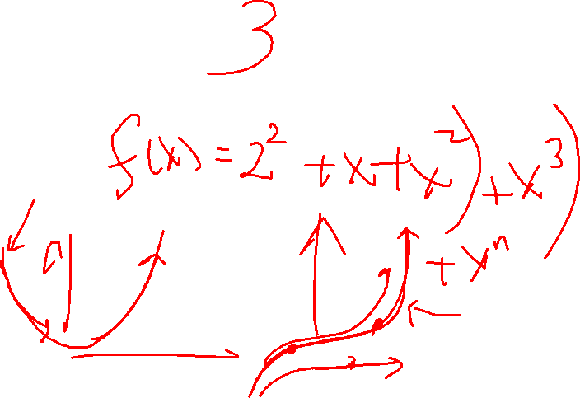
Table of Contents
Remainder Theorem
Factor Theorem
Exercise

Slide 3
Recap
Last week, we have studied about :
Polynomial
- Polynomial is just a function where it can be expressed as sums of ax^{n} where a is the real coefficient and n, the power of x, must be a non-negative integer (meaning 0,1, 2,.. )
Long Division
- Long division is just an extension of division method that you have in primary and secondary school. But in A-Math, we would like to incorporate algebra into the long divisions (instead of just 5 / 2 or just 23423 / 5)

Slide 4
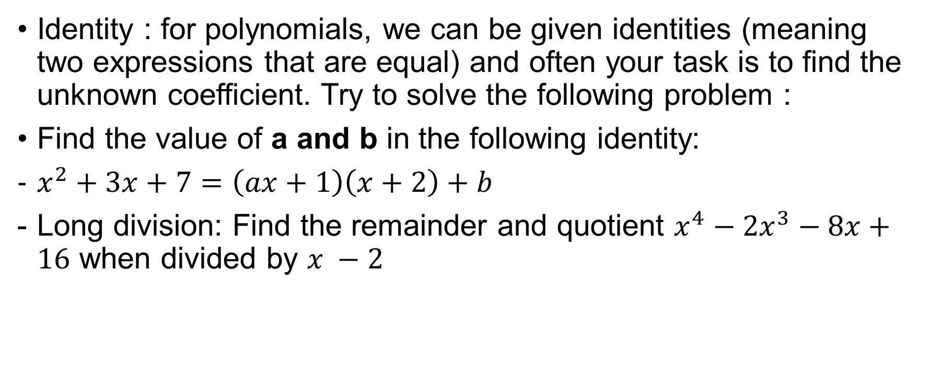
Recap Questions
Identity : for polynomials, we can be given identities (meaning two expressions that are equal) and often your task is to find the unknown coefficient. Try to solve the following problem :
Find the value of a and b in the following identity:
$x^{2}+3x+7=\left(ax+1\right)\left(x+2\right)+b$
Long division: Find the remainder and quotient $x^{4}−2x^{3}−8x+16$ when divided by $x −2$
Notes:
B = 5 , a = 1
Remainder = 0, quotient = x^3 – 8

Slide 5
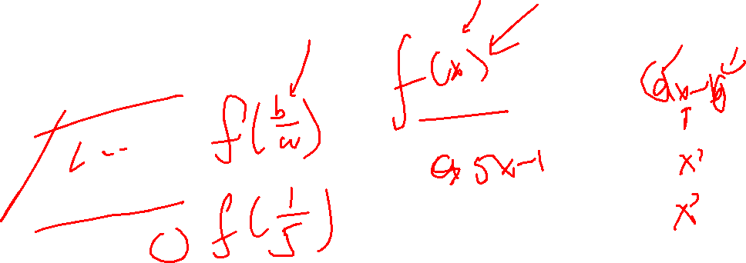
Remainder Theorem
This theorem states that when a polynomial f(x) is divided by ax – b where a and b are just constants
The remainder is f(b/a)
Why ?

Slide 6
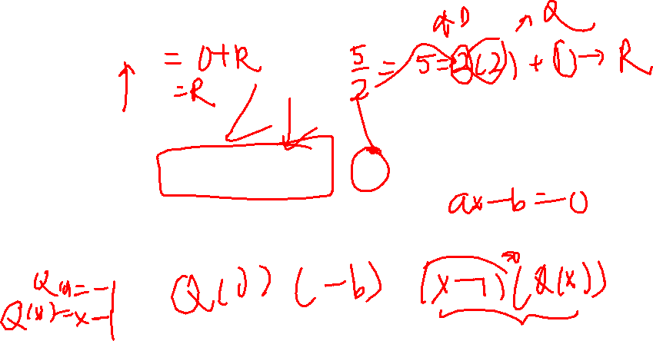
Remainder Theorem
This theorem states that when a polynomial f(x) is divided by ax – b where a and b are just constants
The remainder is f(b/a)
Why ?
Because recall your long division, if I can divide f(x) by ax-b, meaning I can write f(x) = Q(x)(ax –b) + R where Q(x) is the quotient and R is the remainder
This is similar to 5 / 3 = 1(3) + 2 where 1 is the quotient and 2 is the remainder

Slide 7
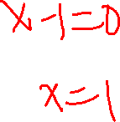
Remainder Theorem
Therefore, similar with steps and techniques in identities that we often use, we would try to find the remainder by making
(ax – b) = 0
Solving the equation, x = b/a
Therefore, f(b/a) = Q(b/a)(0) + R
Hence f(b/a) = R where R is the remainder

Slide 8

Remainder Theorem
Practical example
Find the remainder when $f\left(x\right)=x^{3}−2x^{3}+3x−1$is divided by $x−1$

Slide 9
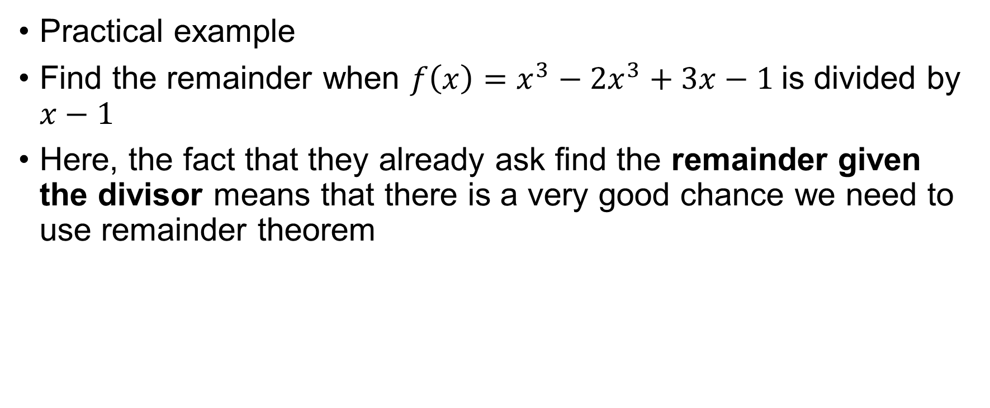
Remainder Theorem
Practical example
Find the remainder when $f\left(x\right)=x^{3}−2x^{3}+3x−1$is divided by $x−1$
Here, the fact that they already ask find the remainder given the divisor means that there is a very good chance we need to use remainder theorem

Slide 10
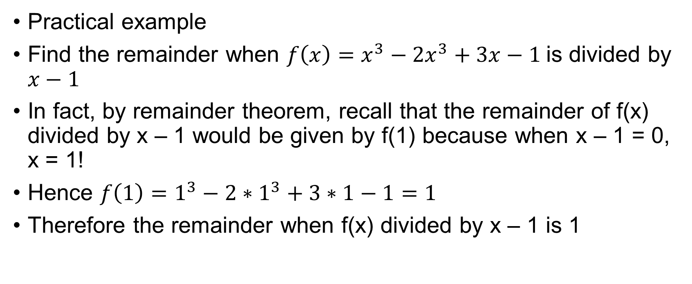
Remainder Theorem
Practical example
Find the remainder when $f\left(x\right)=x^{3}−2x^{3}+3x−1$is divided by $x−1$
In fact, by remainder theorem, recall that the remainder of f(x) divided by x – 1 would be given by f(1) because when x – 1 = 0, x = 1!
Hence ${f\left(1\right)=1}^{3}−2∗1^{3}+3∗1−1=1$
Therefore the remainder when f(x) divided by x – 1 is 1

Slide 11
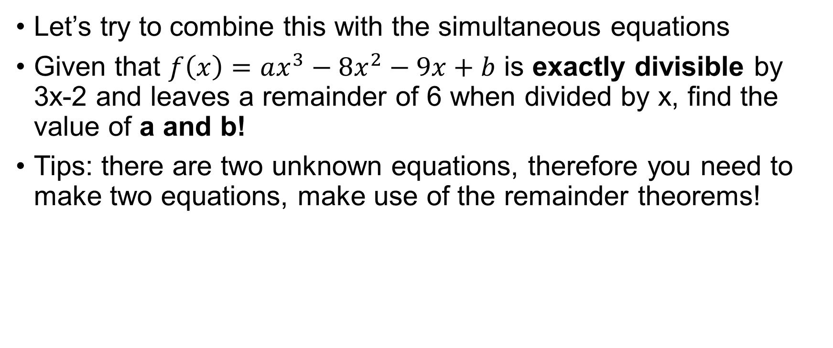
Remainder Theorem Exercise
Let’s try to combine this with the simultaneous equations
Given that $f\left(x\right)=ax^{3}−8x^{2}−9x+b$ is exactly divisible by 3x-2 and leaves a remainder of 6 when divided by x, find the value of a and b!
Tips: there are two unknown equations, therefore you need to make two equations, make use of the remainder theorems!
Notes:
When x = 2/3 , 8a + 27b = 258
When x = 0, b =6 , sub b to first eqn, we have a = 12

Slide 12
Factor Theorem
Another powerful theorem that is an extension of remainder theorem is factor theorem
recall that a factor just means that ax – b completely divides f(x), which has the same notion as 2 and 3 is the factor of 6
It says that if (ax – b) is the factor of f(x), then f(b/a) = 0
Why ?
Because if it completely divides f(x), the remainder must be 0

Slide 13
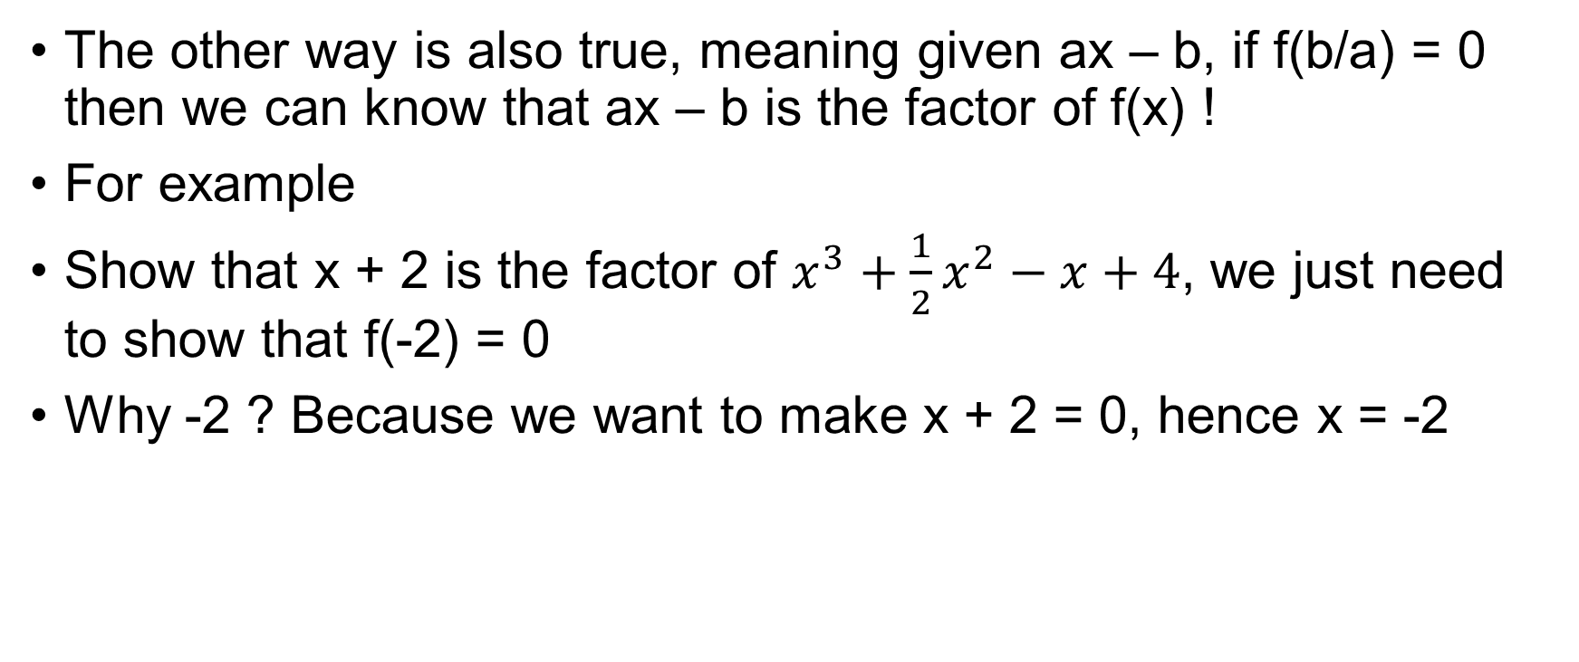
Factor Theorem
The other way is also true, meaning given ax – b, if f(b/a) = 0 then we can know that ax – b is the factor of f(x) !
For example
Show that x + 2 is the factor of $x^{3}+\frac{1}{2}x^{2}−x+4$, we just need to show that f(-2) = 0
Why -2 ? Because we want to make x + 2 = 0, hence x = -2

Slide 14
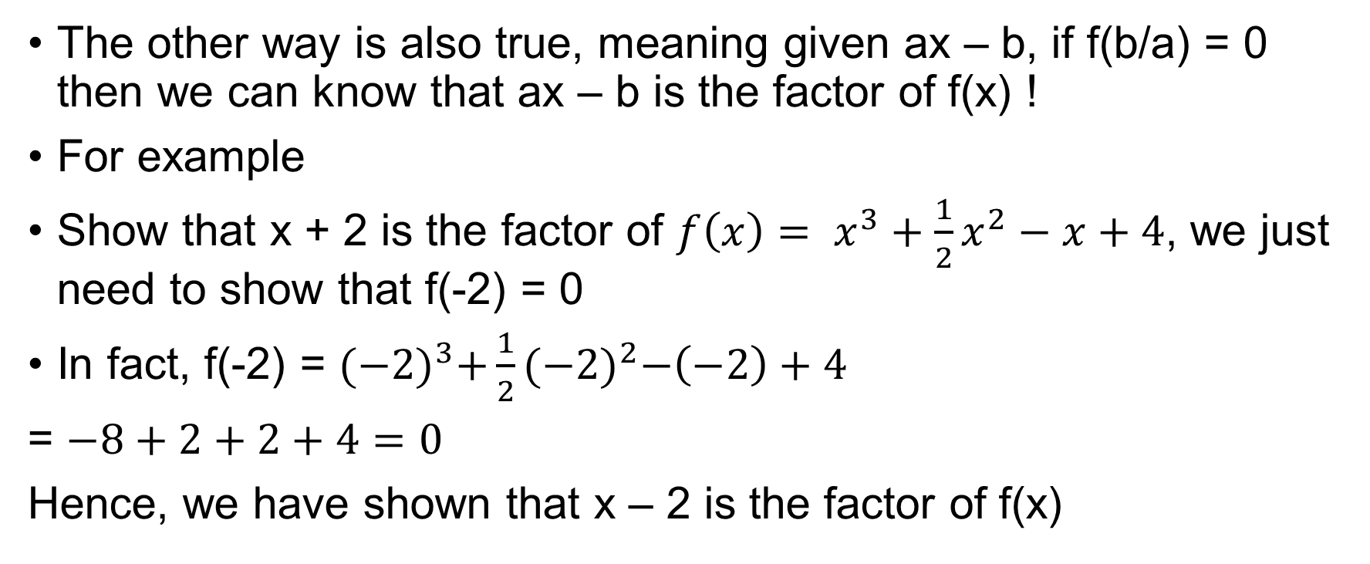
Factor Theorem
The other way is also true, meaning given ax – b, if f(b/a) = 0 then we can know that ax – b is the factor of f(x) !
For example
Show that x + 2 is the factor of ${f\left(x\right)= x}^{3}+\frac{1}{2}x^{2}−x+4$, we just need to show that f(-2) = 0
In fact, f(-2) = ${(−2)}^{3}+\frac{1}{2}{(−2)}^{2}−\left(−2\right)+4$
= $−8+2+2+4=0$
Hence, we have shown that x – 2 is the factor of f(x)

Slide 15
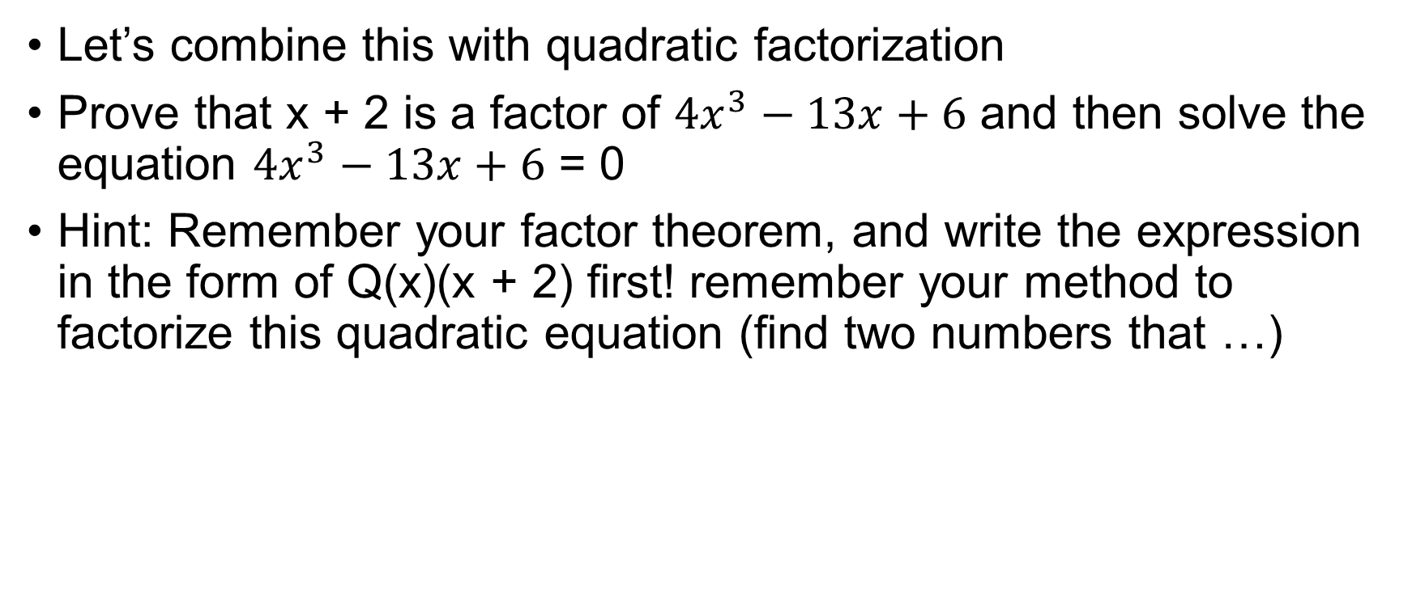
Factor Theorem Exercise
Let’s combine this with quadratic factorization
Prove that x + 2 is a factor of $4x^{3}−13x+6$ and then solve the equation $4x^{3}−13x+6$ = 0
Hint: Remember your factor theorem, and write the expression in the form of Q(x)(x + 2) first! remember your method to factorize this quadratic equation (find two numbers that …)
Notes:
X = -2, ½ or 3/2

