Slide 1
CS1101S Studio Session Week 8 Mutable Data / Robot
Simon Julian Lauw
Full Info > simonjulianl.github.io
4 October 2021

Slide 2
Table of Contents
State
Mutable data

Slide 3
First things first
Is there anything that you want to discuss from the lecture (or anything that you are not sure yet) ?
Have fun with the robots after this guys!
You guys might need to spend extra time meeting each other to clear up some missions and quests (or competitions if you want)

Slide 4
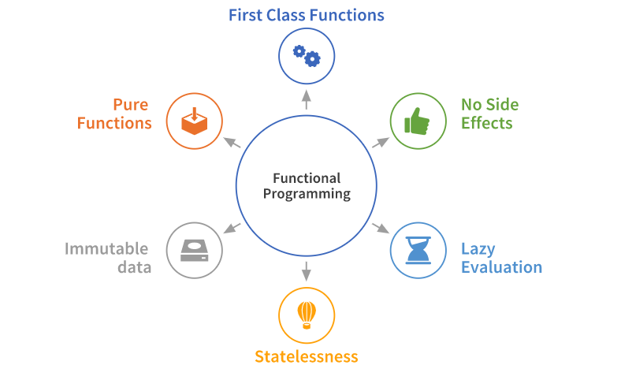
Source and Functional Programming
So far (Source v1 and v2), what you have been doing its called pure functional programming
Stateless
Pure Functions
Immutable Data
No Side Effect, etc

Slide 5

But there are other programming paradigms

Slide 6
Stateful Programming Paradigm
Previously, we can only use the constant declaration to declare a name:
const x = 10;
x = 11; //error – reassignment does not work!
Now, we have variable declaration “let”
let name = expression
Note:
From Source 3 onwards, function parameters are variable

Slide 7
Stateful Programming Paradigm
Imagine you have a bank account that has $1,000 inside it
You withdraw $100 yesterday, you withdraw $100 again today
withdraw(100) //return 900
withdraw(100) //return 800
Observe that each withdraw/function call returns a different value, we say this kind of function has “memory” (state).
It remembers something from the past, and usually each function has a “side-effect” (it modifies some state variable outside its local environment)
E.g. https://share.sourceacademy.nus.edu.sg/simonexample1

Slide 8
Variable assignment (lecture)
Pros
Allows us to create objects with state.
Allows us to achieve objects that can behave differently in different time.
Cons
Harder to reason the program, harder to debug and verify correctness
Substitution model no longer works (why ?) – need a more powerful model (Environment model)

Slide 9
Mutable Data
And therefore, as we can reassign our variables, we have mutable data!
and yup, all the data until now is called immutable data => mutable means liable to change (Oxford Dictionary)
For our simplest data structure pair, we have
set_head(p, x)
Changes head of pair p to x
set_tail(p, x)
Changes tail of pair p to x

Slide 10
Mutable Data
It affects the how the box and pointer diagram a lot
https://share.sourceacademy.nus.edu.sg/mutablelistsimon
List of examples :
Changing head of a list also changes the item in another list
A list whose tail points to itself
A pointing map

Slide 11


Slide 12
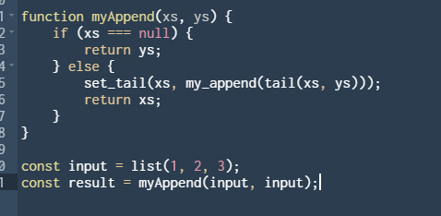
Exercises
Draw the box and pointer for the following code

Slide 13
Some brief intro into LEGO programming
It teaches you to do modular design (creating functions that asks the robot to perform certain actions)
It may require calibration and understanding in physics and math (gravity, friction, acceleration) or you can do it the hardcore way (by feeling)
It also teaches you how to break down your thoughts into steps (giving precise instruction to the robots of what it should do sequentially)

