Slide 1
CS1101S Studio Session Week 9 Environment Model / Robot
Simon Julian Lauw
Full Info > simonjulianl.github.io
11 October 2021

Slide 2
Table of Contents
Summary of Environment Model
Robot Time

Slide 3
First thing first
Hope you guys are satisfied with your midterms, if not there are still RA2, PE and Final assessments where you can still regain your marks!
Are there any questions (from lecture, midterms, etc) that you want me to address in this tutorial ?
This tutorial would be another fun session again with most of the time would be spent on finishing the robot mission (depending on how fast we can finish the material here)

Slide 4
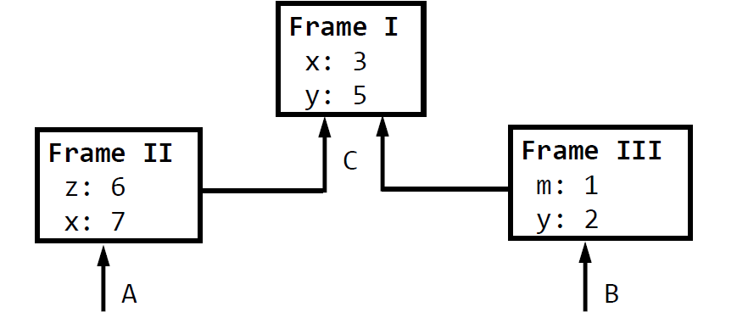
Summary of environment model

Slide 5
Summary
The most important rule in this new model is :
Start from the current environment, search recursively upwards (from the environment its extending from) any variable that you want to find!
- Some trick: after you draw all the boxes, just list out all the constants and variables to be assigned later (so you don’t forget that they need to be assigned later)

Slide 6
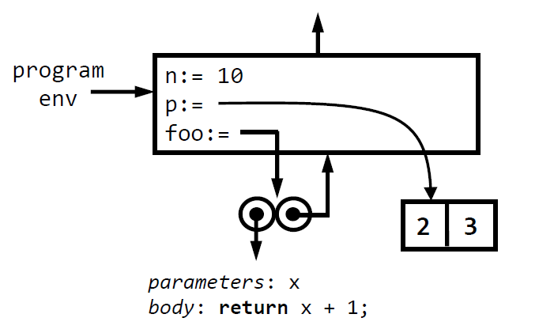
Check your understanding from lecture
Name all the name bindings and their types that are present here

Slide 7
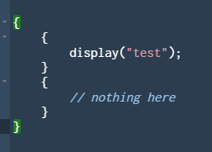
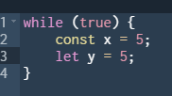

Just some details
For constants, use :=
for variables, use :
Remember that parameters are just variables!
Evaluating a block { }, including if-else, while, for loop, and random {} blocks statement extends the environment by adding a new frame

Slide 8
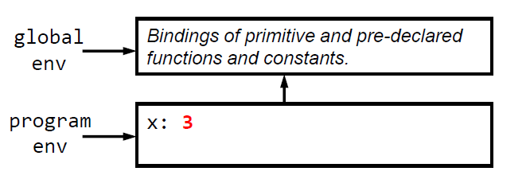
More details
Don’t forget to draw the global env
Label the program env!

Slide 9
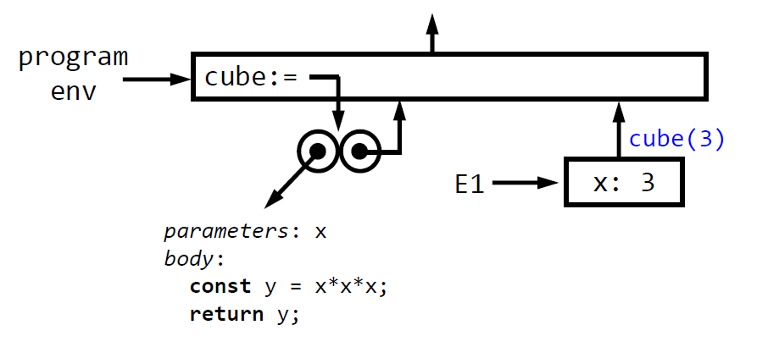
More details
All functions are converted into lambdas => they are constant (those two balls flying around)
Remember to write the parameters and body!
Every function application extends from the environment pointer by the right ball (don’t be confused if there are a lot of balls, just follow the arrows)

Slide 10
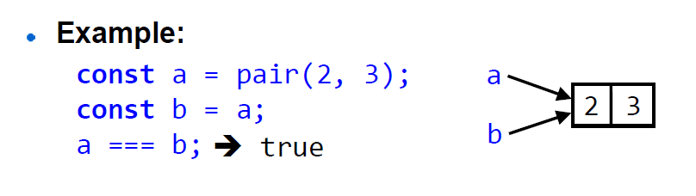
More details
For data structure such as pairs and list, draw them outside the environment (the square) because they are stored in another memory in the computer called Heap
Also, more importantly, assigning pair/list are just assigning pointers, but primitives such as Numbers are copied directly!!

Slide 11
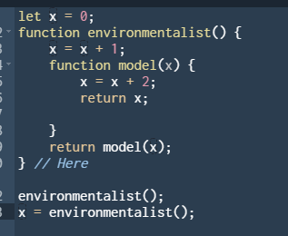
Exercises
Draw the environment model representation of the execution of the following function

Slide 12
Have fun with your robot now!

