Slide 1
CS1101S Studio Session Week 11 Stream
Simon Julian Lauw
Full Info > simonjulianl.github.io
25 October 2021

Slide 2
Table of Contents
Searching and Sorting
Stream
Memoization

Slide 3
First Thing First
Hope your RA2 went well and you only have 1 more week of material which is about Metacircular Evaluator (MCE), the last week will be used for either revision of specialization path (you can choose 1 out of the 3 paths available such as concurrent, programming language, etc)
And you can choose not to come for the Lecture in the last week too and revise your own material (the last week is really optional)

Slide 4
Stream
Back to the basic, what is the definition of stream ?

Slide 5
Stream
Back to the basic, what is the definition of stream ?
Either null, or a pair where the head is a data and the tail is a nullary function returning a stream (lazy evaluation)

Slide 6

Stream
Back to the basic, what is the definition of stream ?
Either null, or a pair where the head is a data and the tail is a nullary function returning a stream (lazy evaluation)
Check your understanding of lazy evaluation, what is the difference between these two

Slide 7
Reiterate what you have learnt before
List is very similar to stream in almost every aspect, except that Stream is lazily evaluated and List is eagerly evaluated
Lazy evaluation means that you don’t need to evaluate the body of the function until you need it (because a function is already evaluated on its own as a lambda object, it is a type on its own)

Slide 8
Similar Methods (Full docs is here)
Stream Method | List Method
stream_tail | tail
stream_head | head
stream_map | map
is_stream | is_list
stream_reverse | reverse
stream_append | append
Etc… | Etc..

Slide 9
Consequences
Therefore, the result of being able to delay your evaluation until you need it, is that you can have infinite list (because you don’t need to evaluate everything, you just have the head, and the tail just contains the nullary function)
However, being able to have infinite list would result in more complex expressions, such as generating infinite sequence and some very clever examples from the lecture (such as fibs)

Slide 10
Unique Example for stream
Generating the sequence for power (a, a², a⁴, a⁸, …)
Link : https://share.sourceacademy.nus.edu.sg/sequencepower
The idea
Stream 1 :
Stream 2 :
Result : 2 (initial value, and the result stored in constant called integers)
Other advanced examples, you should refer to the ones presented in the lectures!

Slide 11
Generating the sequence of power
The idea (by the virtue that mult_stream take integers)
Stream 1 : 2
Stream 2 : 2
Result : 2 4

Slide 12
Generating the sequence of power
The idea (by the virtue that mult_stream take integers)
Stream 1 : 2
Stream 2 : 2
Result : 2 4
Next :
Stream 1 : 2 4
Stream 2 : 2 4
Result : 2 4 8 , … (and so on and so forth)

Slide 13
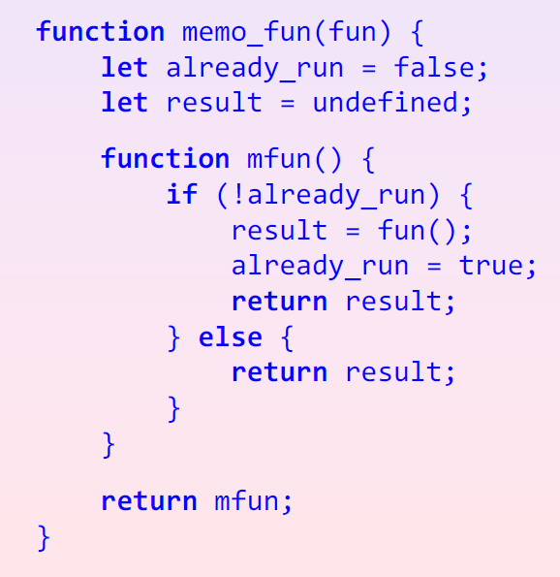
Stream Memoization
Personally, I would highly recommend you put this into the cheat sheet because it’s very hard to memorize and code during exam, but to understand how this works, lets draw the env model when memo_fun(fun) is called

Slide 14
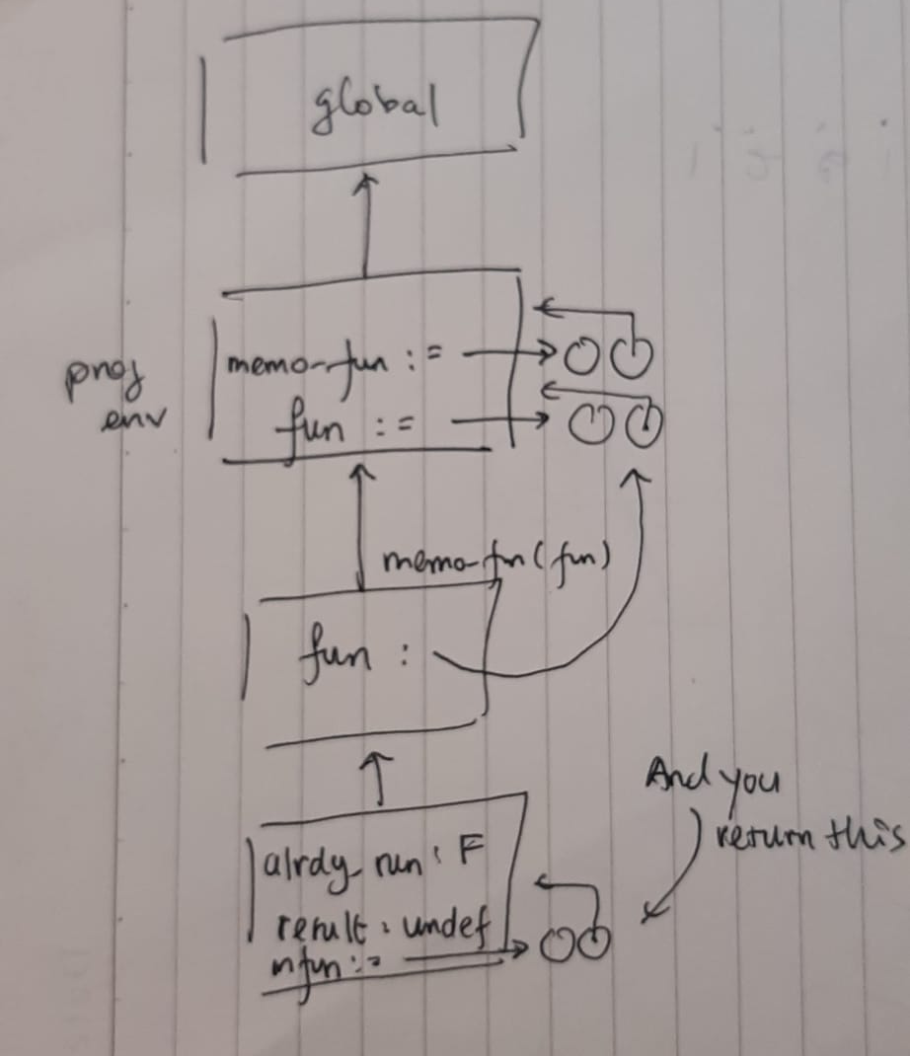
Memoization Applying memo_fun

Slide 15
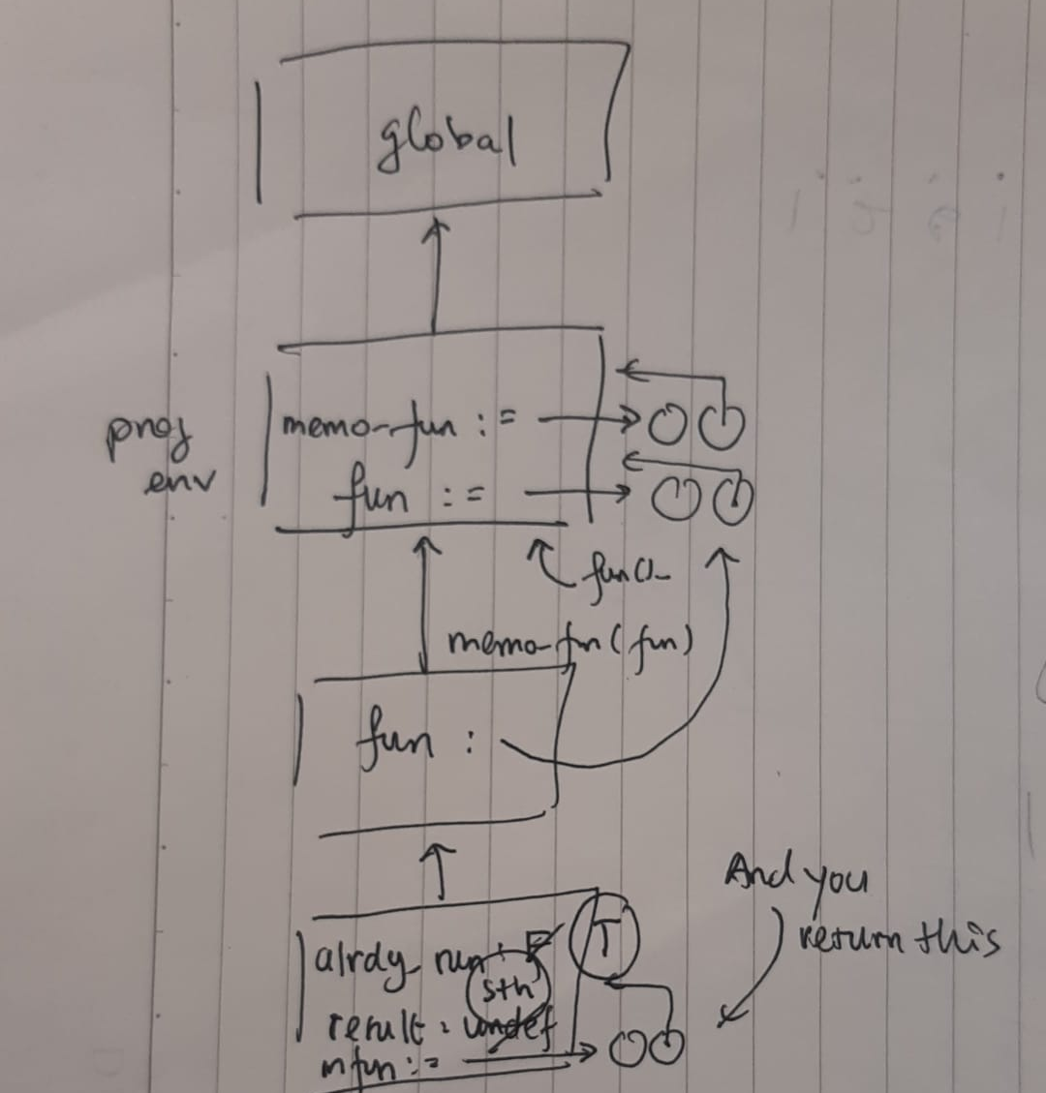
Memoization After calling mfun

Slide 16
Memoization, Applying fun()

Slide 17
Memoization, Mutate already_run Variable

Slide 18
Memoization, Store the result

Slide 19
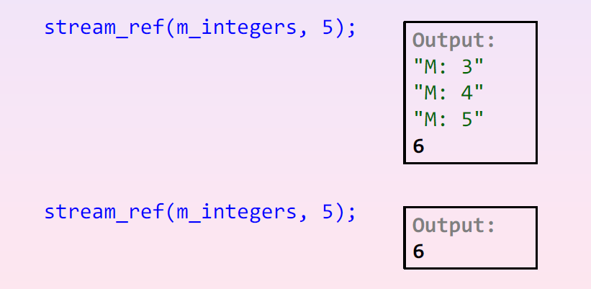
Exercise
What then will happen in I call mfun again for the second time ? How will the environment model drawn before can explain the memorized behaviors as shown in this code snippets ?
Assume that m_integers is memorized integers generated from stream

Slide 20
Studio Sheet

