Slide 1
CS1101S Studio Session Week 12 Metacircular Evaluator
Simon Julian Lauw
Full Info > simonjulianl.github.io
1 November 2021

Slide 2
Table of Contents
Key Idea in Programming
Studio Sheet
Metacircular Evaluator

Slide 3
Key Idea
The most fundamental idea in CS1101S and you will carry this over in your entire journey in CS!
Every software that is every created, might that be your programming language, the evaluator, compiler, etc is just another PROGRAM
The only part in your computer that is not a PROGRAM is your hardware!

Slide 4
Implications
If your programming language itself is a program, there must be another program to evaluate it!
It can be written in another language, or written on its own language which is called Metacircular evaluator
Just some examples
Python is initially implemented using C, and its compiler its called CPython
Kotlin is written in Java as its initial implementation, and its compiled into bytecode and executed by JVM (Java Virtual Machine)

Slide 5
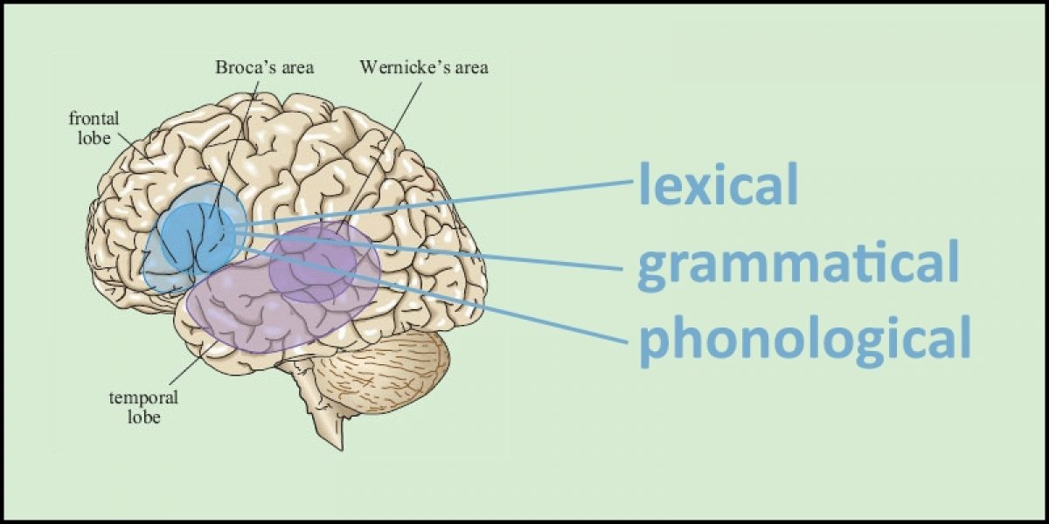

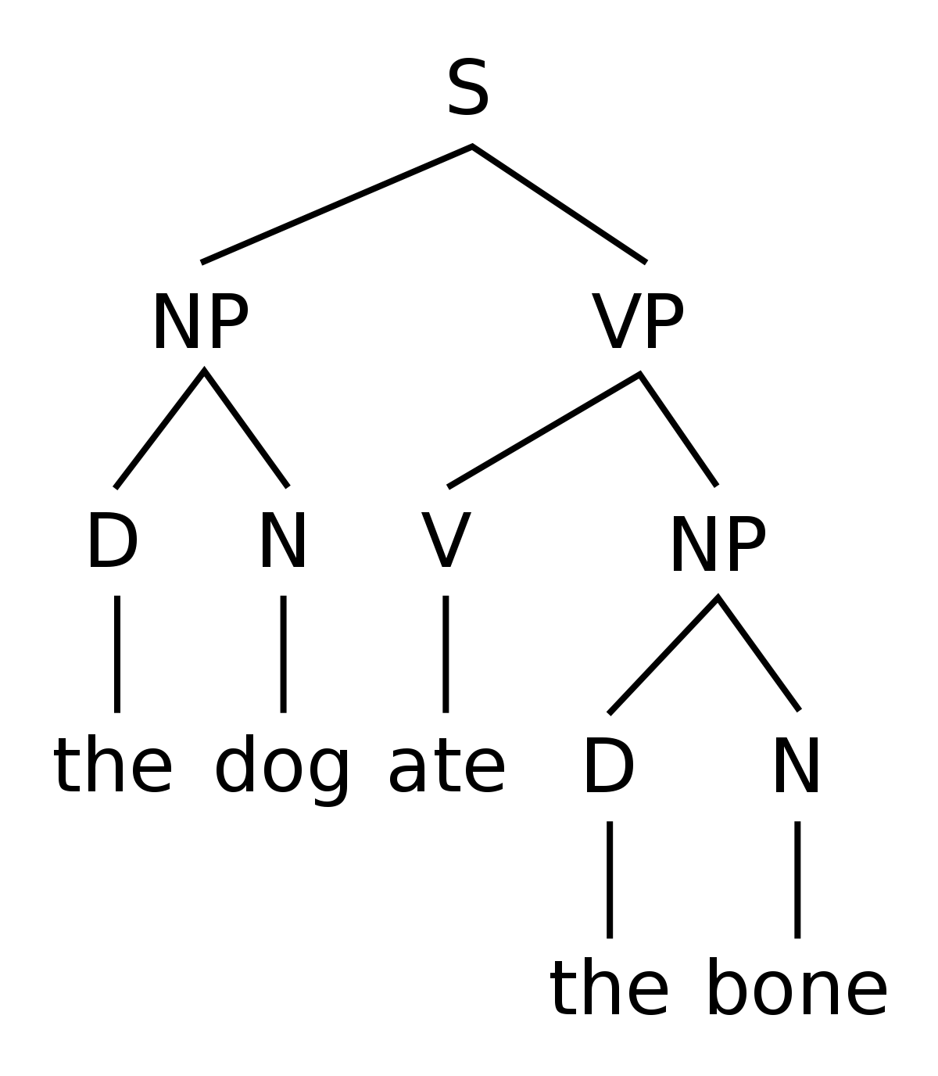
High Level View of Programming Language
Programming Language therefore just like any other human’s languages, needs a “brain” to process it
Evaluate and Apply
Sentence
Parse
English Syntax Tree
Understanding / Idea

Slide 6
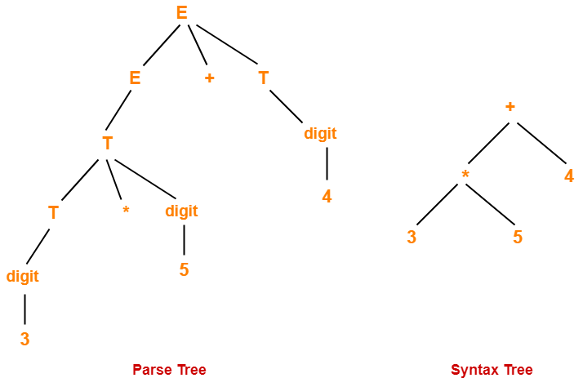
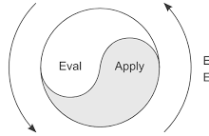
High Level View of Programming Language
Programming Language therefore just like any other human’s languages, needs a “brain” to process it
Evaluate and Apply
Code
Parse
Result

Slide 7
Understanding MCE
Some inspirational talks
Often, we never ask “Why” and “How” enough in our lives, including me! (I am still very green in this field)
We take many things for granted, and one very easy example is how we understand languages (we rarely ask why “I ate an apple” is a valid sentence and I can understand it but not “I an apple ate”)

Slide 8
Understanding MCE
Some inspirational talks
I just believe, CS is actually an attempt by us to understand our world better (and so are all the majors). But CS is more focused on those areas where things that can be “computed”.
Therefore the more you ask “Why/How” and try to understand the stuffs that we might take for granted, the deeper the insights that we would get from CS degree! I believe that’s how you can maximize your learning during your 4 years journey in CS!

Slide 9
Understanding MCE
MCE is a very complicated code (but its still much simpler compared to how your brain evaluates a sentence hopefully)
Therefore, there are tools that you have learnt along the way to master MCE
Abstraction : understand what the code is doing without any need to look at the implementation!
Code as if you only know the header of the code!
Just care about the parts that you are supposed to care! => Therefore I also don’t know what the entire MCE is doing
Understand Source!, the better you understand the environment model, the better which parts you are supposed to care and what abstractions that you need to make

Slide 10
Example
MCE : https://share.sourceacademy.nus.edu.sg/simonmce
We shall play around with the code, and just try the MCE
Some ideas :
Redefining the meaning of Null and Undefined
Assigning an operator a new meaning

Slide 11
Lazy Evaluation
Clarification
Thunk is just the Scheme / Source term for lambda object
It is a way to delay evaluation which is very similar to Stream and you should know this by now ( instead of const x = 3 + 5; you can delay it using const x = () => 3 + 5; )

Slide 12
Ending Question From Brief11
Can you make a Meta circular evaluator truly meta-circular ? i.e. Can you get a MCE to evaluate itself ?
Ans : I don’t know and I don’t wanna dive into this territory as my knowledge of programming language is rather limited, but if you are interested about programming language, I suggest you to take
CS2104 : Intro to programming Language
CS4215 : Programming Language Implementation
These modules would help you to understand programming language better!

Slide 13
Studio Sheet

