Slide 1
A-math Simultaneous Equations
Simon Julian Lauw
Full Info > simonjulianl.github.io

Slide 2
Table of Contents
More Substitution Methods
Factorization
Exercise

Slide 3
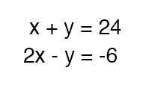
Review
In general, we need n equations to solve n variables, this is called simultaneous equations
For example, to solve these equations with two variables, we can use substitution method / elimination method

Slide 4
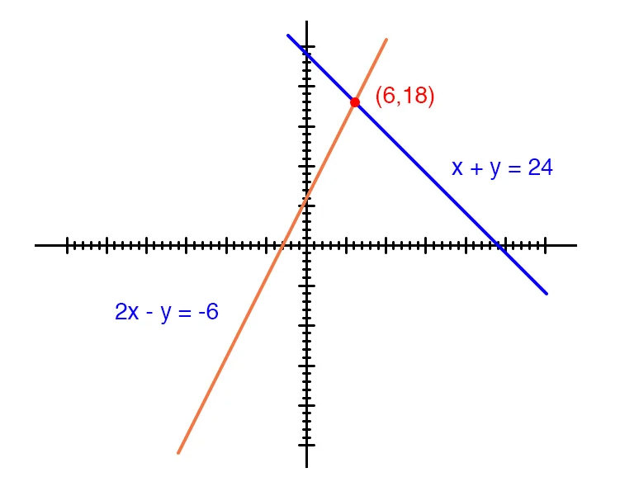
Review
Graphically, we need two equations because we need that exact point where the x and y satisfies both equations, consider this graph.
2x – y = -6 only represents a line (meaning infinite combination of x and y)
So is x + y = 24, therefore we need both lines to intersect to give you the exact solution (because the point lies in both lines)

Slide 5
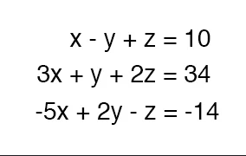
Simultaneous Equations
Last time, we have solved equations with 2 variables, how about 3 variables ?
Consider this

Slide 6
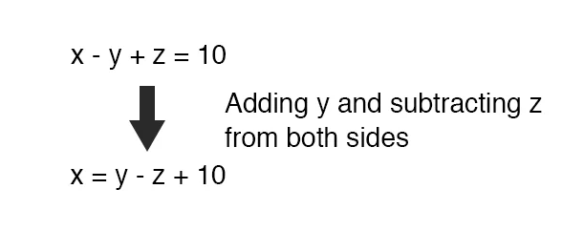
Steps to solve
There are many ways to solve this, but using substitution method is much easier
Firstly,

Slide 7
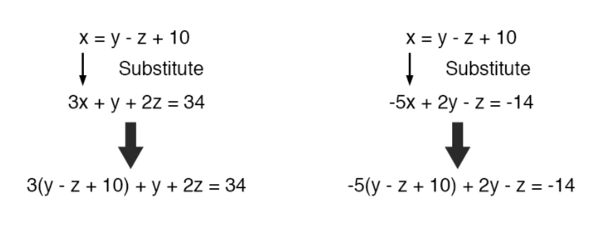
Steps to Solve
We need to reduce the equations (since we can sub x into the other two equations, we will have the other two equations in 2 variables only)

Slide 8
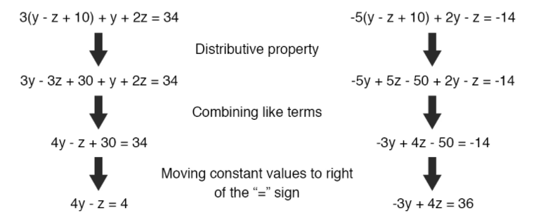
Steps to Solve
After substituting, reduce the equations

Slide 9
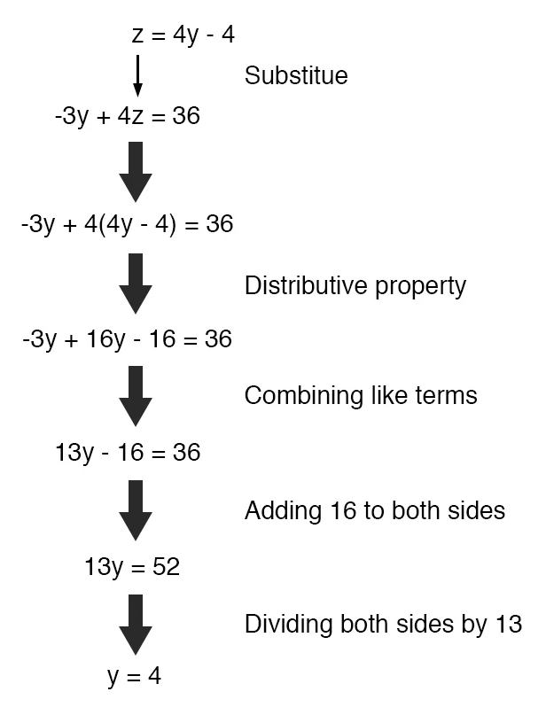
Steps to solve
From here, you can use substitution method or elimination method to solve the equations (I use substitution method in this case)
Sub the y to the known equation to get z and x respectively

Slide 10
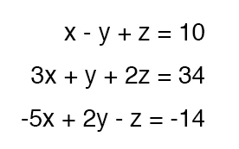
Exercise
Solve these simultaneous equations

Slide 11
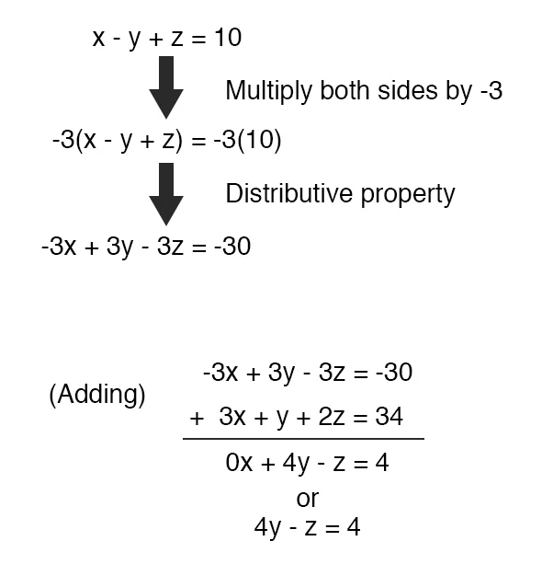
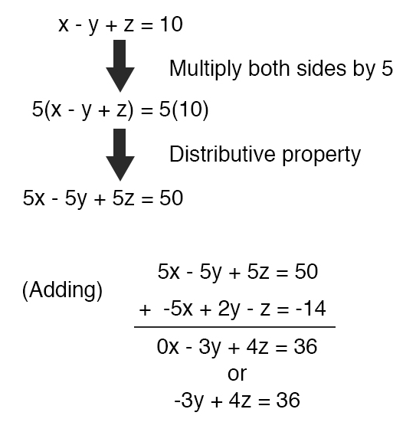
Answer

Slide 12
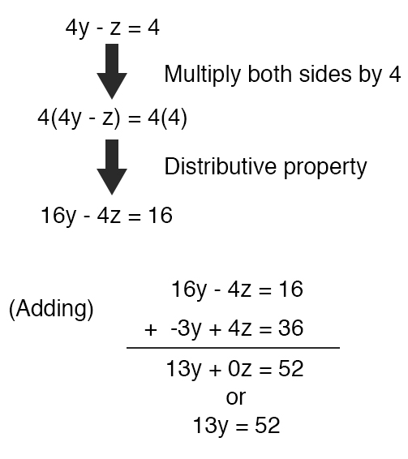
Answer
From here, solve the other 2 simplified simultaneous equations using substitution method or elimination method

Slide 13
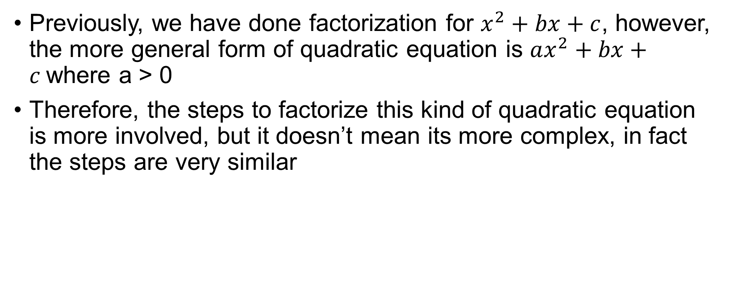
Factorization
Previously, we have done factorization for $x^{2}+bx+c$, however, the more general form of quadratic equation is $ax^{2}+bx+c$where a > 0
Therefore, the steps to factorize this kind of quadratic equation is more involved, but it doesn’t mean its more complex, in fact the steps are very similar

Slide 14
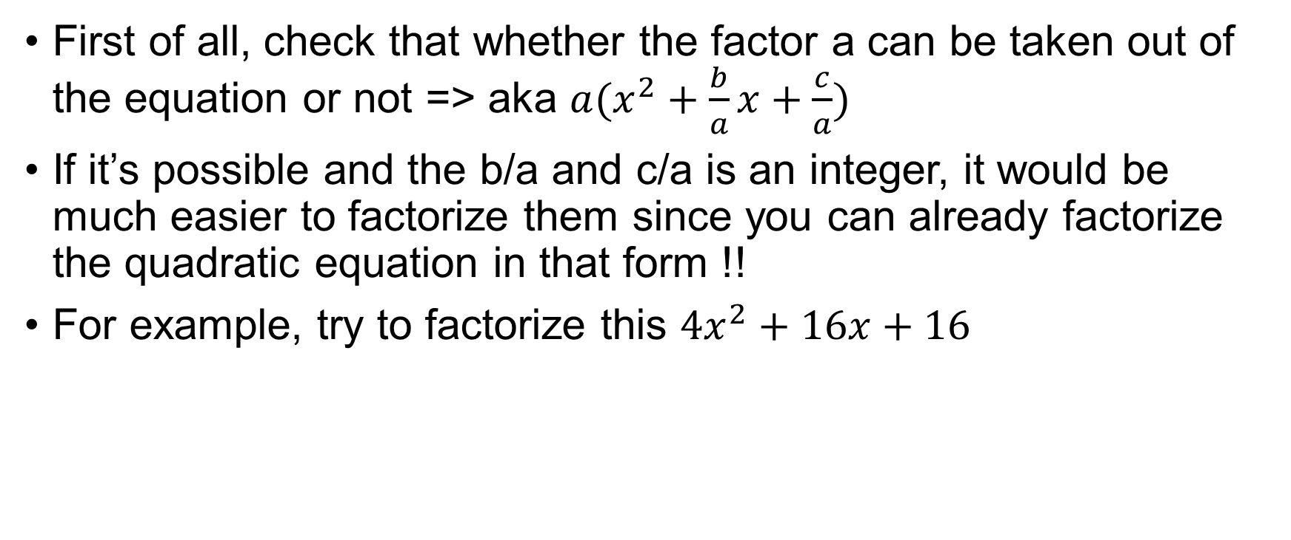
Factorization
First of all, check that whether the factor a can be taken out of the equation or not => aka $a(x^{2}+\frac{b}{a}x+\frac{c}{a})$
If it’s possible and the b/a and c/a is an integer, it would be much easier to factorize them since you can already factorize the quadratic equation in that form !!
For example, try to factorize this $4x^{2}+16x+16$

Slide 15
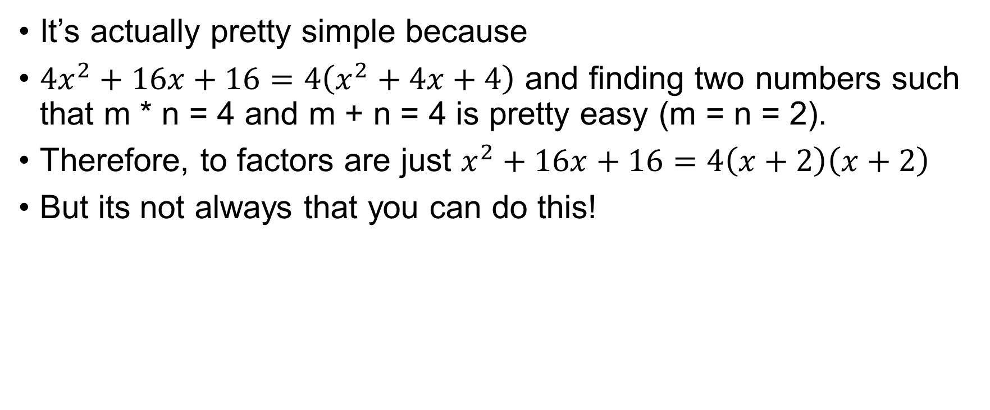
Factorization
It’s actually pretty simple because
$4x^{2}+16x+16=4\left(x^{2}+4x+4\right)$ and finding two numbers such that m * n = 4 and m + n = 4 is pretty easy (m = n = 2).
Therefore, to factors are just $x^{2}+16x+16=4\left(x+2\right)\left(x+2\right)$
But its not always that you can do this!

Slide 16
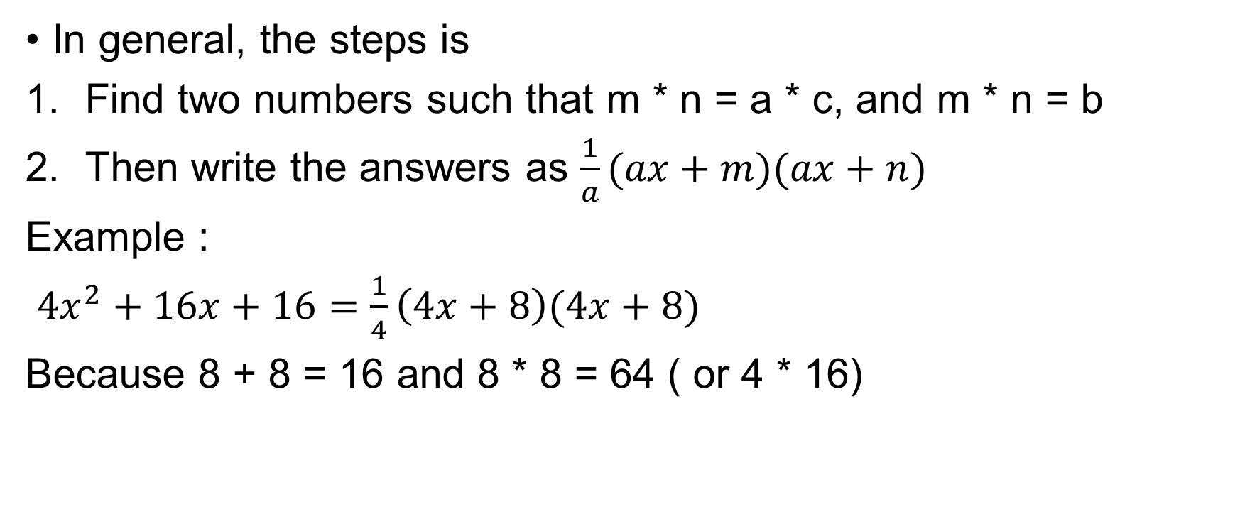
Factorization
In general, the steps is
Find two numbers such that m * n = a * c, and m * n = b
Then write the answers as $\frac{1}{a}(ax+m)(ax+n)$
Example :
$4x^{2}+16x+16=\frac{1}{4}\left(4x+8\right)(4x+8)$
Because 8 + 8 = 16 and 8 * 8 = 64 ( or 4 * 16)

Slide 17
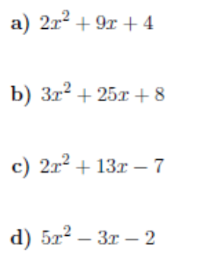
Exercises

Slide 18
Exercises
Ans
(2x + 1)(x + 4)
(x + 8)(3x + 1)
(2x – 1)(x + 7)
(x – 1)(5x + 2)

