Slide 1
CS1101S Studio Session Week 13 Summary
Simon Julian Lauw
Full Info > simonjulianl.github.io
8 November 2021

Slide 2
Table of Contents
CS1101S Roadmap
QnA
Review

Slide 3
CS1101S Road Map
Elements of Programming
Abstraction + Lazy Evaluation
State
MCE + Advanced Topic
Primitive Expressions.
Naming and Functional Abstraction (HOF)
Environment
Apply and Eval cycle
Operator combination
Data Abstraction
Mutable Data
Concurrent, Logic, Register Machine Programming
Predicate and Conditional Expression
Lazy Evaluation (Stream)
Techniques and Analysis
Substitution Model
Order of Growth
Wishful Thinking
Recursive and Iterative Process
Environment Model

Slide 4
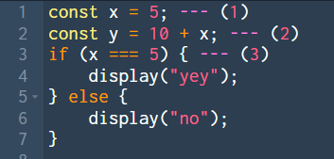
Elements of Programming
They are just fundamental components that every programming language should have
1. Primitive Expressions
2. Operator Combinations
3. Predicate and conditional Expression (Control Structure)

Slide 5

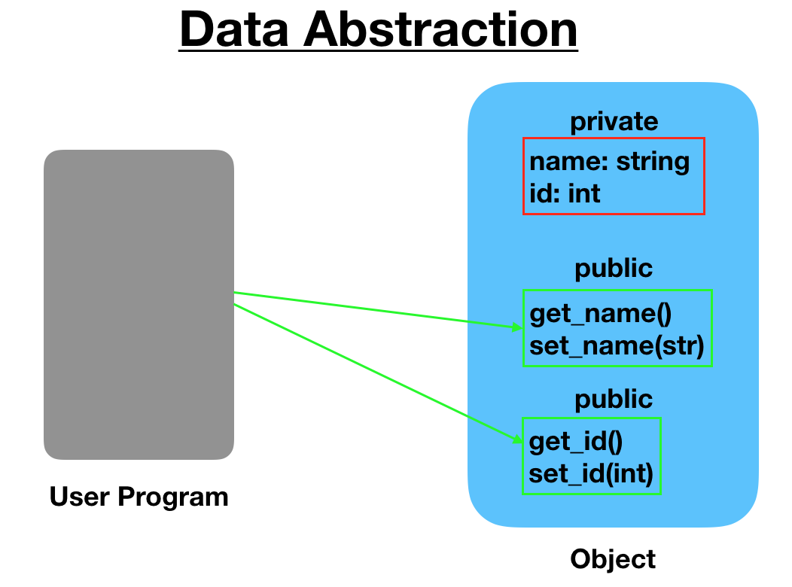
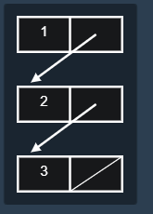
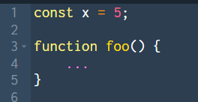
Abstraction and Lazy Evaluation
Naming and Functional Abstraction
Higher Order Function
Crazier examples => See Functional Expressionism
Data Abstraction
List and Stream

Slide 6

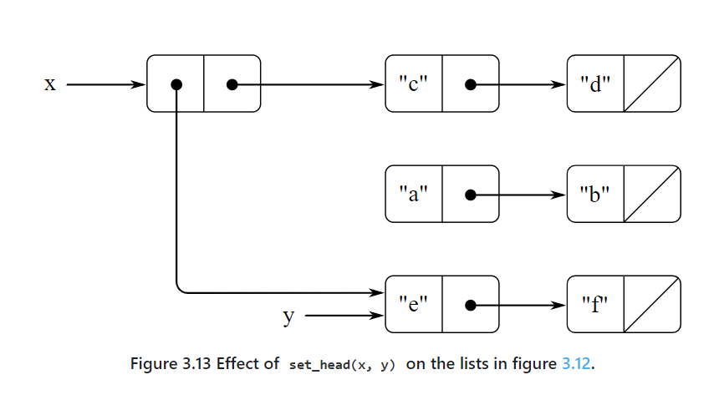
Stateful Programming
Mutable Data
Mutating Data Structure
Use Box and Pointer Diagram

Slide 7
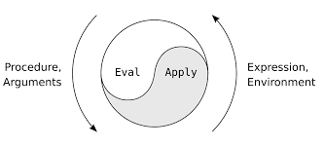
Metacircular Evaluator
Core of any programming language, evaluate the expression, apply the functions and repeat!

Slide 8
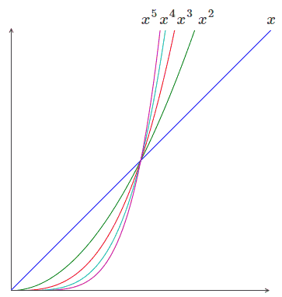

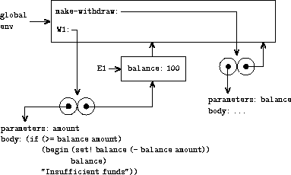
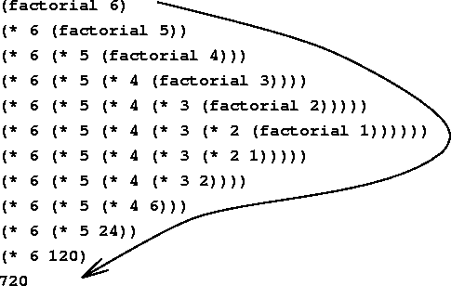
Techniques and Analysis
Order of Growth
Wishful Thinking
Environment Model
Recursive and Iterative Process

Slide 9
Where to go from here ?
NUS Computer Science Specializations => Choose them wisely, especially if you want to take FYP in the future
Y1S2 - Y2S1
Compulsory mods : CS2030S (Prog methodology II), CS2040S (Data Structure and Algo), CS2103T (Soft Eng), CS2100 (Computer Organisation), CS2106 (OS), CS2109S (NEW! -> AI and ML), CS3230
Y1S2 Summer
Find something that you wanna do! Upskill yourself
CVWO, Orbital CP2106, Internship, CCA (DSC, NUS GDG, SIC, etc)
Recommended Mods to take (at least, I think these mods should be compulsory instead)
Database : CS2102
Networking : CS2105
Notes:
https://www.comp.nus.edu.sg/programmes/ug/focus/

Slide 10
Good Luck for your PA and Finals, and See you again in future mods (as students or TA)

