Slide 1
CS1101S Studio Session Week 6 List and Tree Processing
Simon Julian Lauw
Full Info > simonjulianl.github.io
13 September 2021
Acknowledgement (for his inspiring slides):
Niu Yunpeng

Slide 2
Table of Contents
Admin
List Processing
Continuation Passing Style (CPS)
Exercises
Map, Reduce, Accumulate

Slide 3
Admin
Mastery Check 1 is coming!
Mastery check is an oral test
Communicate your computational processes
Please finish it before recess week
Rationale : so you know what you know and what you don’t know (pretty philosophical)
It covers :
Scope and Lexical Scoping (Review your RA)
Higher-order function
Sub model and iterative/recursive processes

Slide 4
Admin
You can do it as many times as you want! (so don’t worry if you haven’t mastered it fully by the first attempt)
Just prepare yourself as much as possible and convince me that you really understand the topics
That means, prepare to answer my questions

Slide 5
List Processing
If you still have doubts about wishful thinking at this point, please ask me or revise it!
Rationale : you can do it your way, but time is always of the constraint during exam. Wishful thinking is really a way to come up with a solution really fast (if you practise)
But, again, if you are more convenient with other methods. Please continue to do so (because maybe thinking in terms of recursion or induction is unintuitive for you)
Just do a lot of practices, there are a lot of examples in lecture, so please check them out

Slide 6
Continuation Passing Style
This is a very difficult topic, and I doubt it will be tested but it’s good to have a general understanding about it
Actually, CPS, strictly speaking is just a style of programming where the control is passed as an argument
What I mean by control is actually how do you want to continue the program after a certain point of execution (it’s similar like supplying a function to continue the function body)
We need an example for sure

Slide 7
CPS
Normally we do programming in a very direct way (as in all the operations can be combined into a statement, and the continuation is implicit)
For example,
If 1 + 1 / 2 * 3; How will the language choose to do the / or * first ? It’s all dependent on the implementation of the language and you as a user of this language has no power (at least in this statement) to determine the order of evaluation

Slide 8
CPS
However, in CPS, we have the power to do so, by explicitly saying what should be the continuation after a certain operation
Direct : 1 + 1 / 2 * 3;
CPS :
(1 + 1, continue the result with something)
(1 + 1, x => (x / 2, continue with something)) // here x would refer to result of 1 + 1
(1 + 1, x => (x / 2, y => y * 3)))
The summary is, CPS is just a way for you to define your own continuation!

Slide 9
CPS In Lecture
Because we can pass the continuation as an argument (instead of waiting it to be evaluated as deferred operation, one side-effect of CPS is that it can convert a recursive process into an iterative process)
Let’s look at the example from lecture

Slide 10
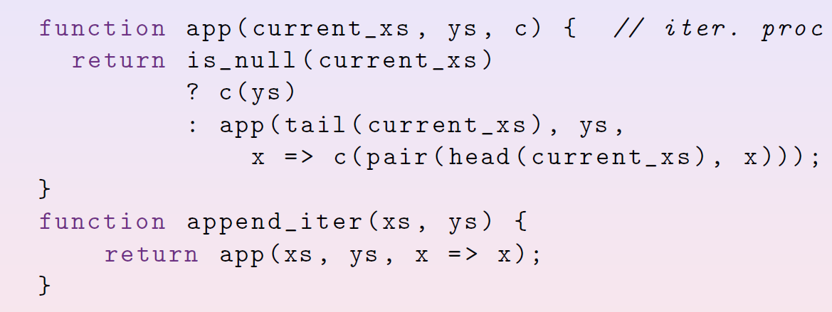
CPS
You can read this like : if current_xs is empty, we want to continue the function with the continuation c and the result ys (from current stage of evaluation)

Slide 11
CPS
We will supply these two as arguments for the app function that would solve the app problem, then the result of app with those arguments would be continued later as x! and c is applied because it’s how we want to continue this function
Continue current func

Slide 12
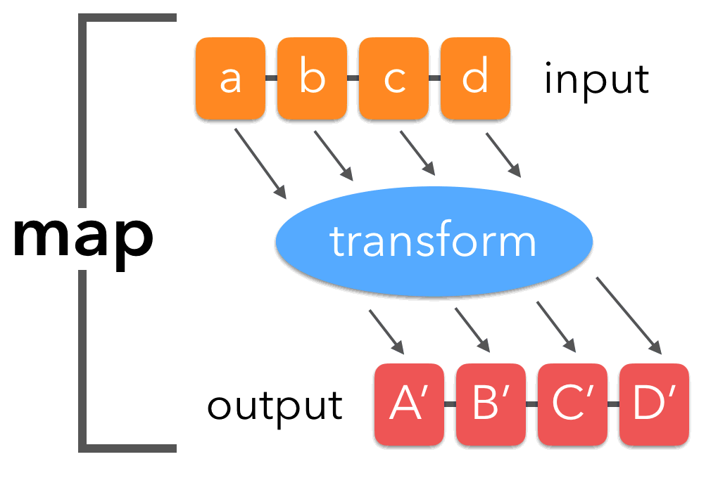
Basic of functional programming (Demo)
Map

Slide 13
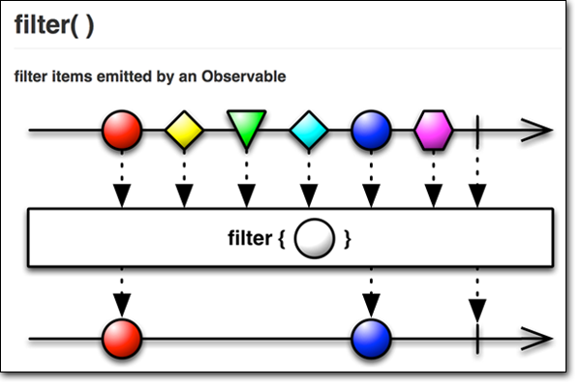
Basic of functional programming (Demo)
Filter

Slide 14
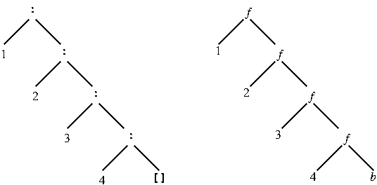
Basic of functional programming (Demo)
Accumulate

Slide 15
Tree
It’s a list, where each element is either a data / another tree (Please remember this definition)
Data / A Tree
Data / A Tree
Data / A Tree
Null

Slide 16
Studio Sheet

Slide 17
Tips
You can use the tree that I showed you before to help you visualize
Qn 3 requires wishful thinking, don’t draw the recursion tree yourself (unless you are very brave)
For in-class sheets
There are many ways to do it, so just explore them!
For qn 2 and 3, I encourage wishful thinking very badly, but not a must

