Slide 1
CS1101S Studio Session Week 7 Revision
Simon Julian Lauw
Full Info > simonjulianl.github.io
21 September 2021

Slide 2
Table of Contents
Iterative Process
Order of Growth
Extra Questions

Slide 3
Admin
Midterm is coming
If you have not revised for it, please do it asap!
If you have doubts, please consult me or pm me, or just ask in the group!
Just some tips, just try to get as much marks as you can and don’t get stuck on the hard questions (meaning the median won’t be that high too)
And midterm is hard! So be prepared for it

Slide 4
Iterative Process
Iterative Process
No deferred operations (that’s all)
And usually, that means you need to accumulate the result into some sort of arguments
Conceptually, for example when we do summation
Recursively, sum(n) = n + sum(n – 1)
If you unfold the summation, you get
5 + 4 + 3 + sum(2) but 5 + 4 + 3 is something that you can compute without waiting for sum(2)
These intermediate summations can be computed into an argument, and that’s how iterative process works

Slide 5
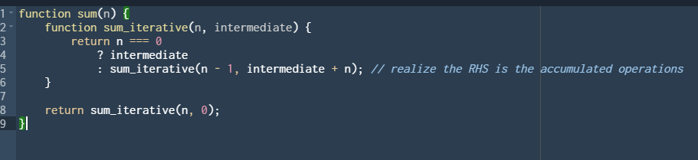
Iterative Process
But generally, the interface is still sum(n) and there is no additional parameter to store our intermediary parameter
Therefore, we need a helper function to help us store those intermediate computations
For example

Slide 6
Iterative Process
In general, an iterative process would have
An extra parameter to store those accumulated results
When it reaches the base case, it just returns the accumulated result
Why do we need a helper function ? Because we don’t have enough parameter to store those accumulated result, so we need to introduce one in the helper function
AKA -> you are supposed to implement sum(n), not sum(n, accumulated)
But you need the accumulated parameter, and hence you introduce them (it really just to helps you), introduce them as you see them fit and there are no fix rules when you should have them and not

Slide 7

Order of Growth
First thing first, let me ask you a question
What do you understand by these notations

Slide 8

Order of Growth
State the big-O notation for these expressions
$3n^{2}+5n −100$
$log_{5}{n+\log{n ∗\log{n}} }$
$3x^{2}+8x\log{x }$
$n ∗\frac{1}{n}+\log{8 }$
$n+\log{n^{n}}$

Slide 9
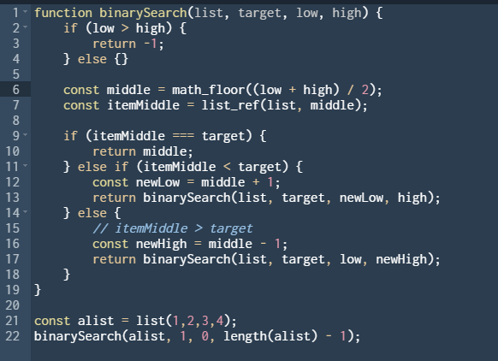
Order of Growth
Try to check your understanding, what is the time complexity of this function

Slide 10
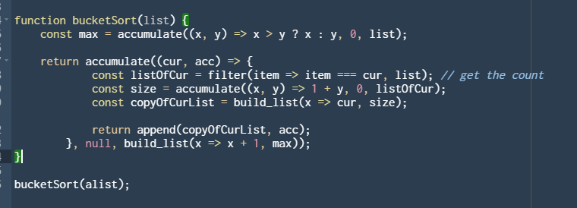
Order of Growth
What is the order of growth (time complexity and space complexity) of this function ?

Slide 11

Box and Pointer for map and accumulate
1. The key idea is, for map, try to iterate like a map, every iteration create a new node where the content of the node is specified by the function supplied to the map
2. For accumulate, unfortunately, you need to trace the code using the tree method that I have taught you before

Slide 12
Questions
If not, I have a list of questions for you guys to try and test your understanding

