Slide 1
CS1101S Studio Session Week 3 Substitution Model / Recursion / Order of Growth
Simon Julian Lauw
Full Info > simonjulianl.github.io
23 August 2021

Slide 2
Table of Contents
First Mission Feedback
Function
Order Reduction
Recursive vs Iterative Process
Studio Sheet

Slide 3
Before we start
How was your first 2 weeks in NUS ?
What other interesting activities that you have been doing, CCA, hall stuffs, etc ?
Questions of lecture and brief ? Especially about linear recursion of Fibonacci, seems interesting !

Slide 4
Feedback on Rune Trial
Variable naming : please use proper variable naming that people can instinctively understand, the problem with Source is that there is no type checking so if you name your variable x y z, you won’t know which one is the rune, which one is a number, etc
But also don’t make it too long, it makes the code very verbose
You can use multi-line comment like this btw => show demo (/** */ syntax instead of stacks of // lines)
Comments are good, but please format them so people can read it easily (don’t let the comments make the code harder too read, short comments are enough unless you are building a very complex program)

Slide 5
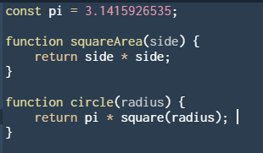
Function
A way to abstract out procedure / behaviours and treat is a black box (take an input and produce a certain output)
Example in Source

Slide 6
Good Abstraction
Modularity
break certain procedure into reusable blocks that can be reused > this also helps to minimize bugs in your code
Readability
Easy for others to read and understand
Maintainability
Comments, etc
write the code such that you can understand it again in the future
For me : just remember to write code that is easy to test and easy to understand, this will eventually lead to good code

Slide 7
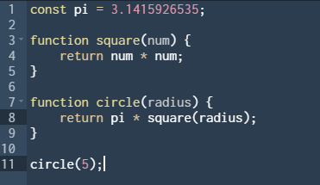
Function terminologies
Function definition (or declaration) => use the keyword function
Function application => apply the defined function by using its name and supply the necessary arguments

Slide 8
Function terminologies
Function definition (or declaration) => use the keyword function
Function application => apply the defined function by using its name and supply the necessary arguments

Slide 9
Function terminologies
Function definition (or declaration) => use the keyword function
Function application => apply the defined function by using its name and supply the necessary arguments

Slide 10
Function terminologies
A function definition consists of
Function name
Parameter list
Function body
A function application consists of
Name
Argument list
Notes:
Define what is parameter vs argument

Slide 11
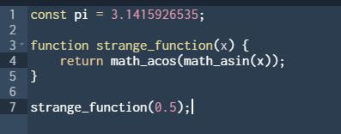
Check your understanding
What is the parameter ?
What is the arguments ?
Also what is `const pi = ….` called ?
Notes:
Parameter is x
Argument is 0.5
Constant Declaration

Slide 12
Order of reduction
Applicative order reduction (Source uses this)
Evaluate the operands first whenever being applied to an operator
Apply the function (Reduce and Apply)
Normal Order Reduction
Evaluate the operands only if their values are needed => be lazy
Expand and reduce

Slide 13
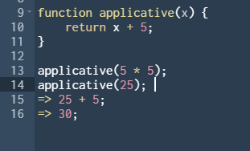
Order of reduction
Applicative Order Reduction

Slide 14
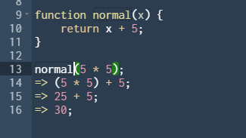
Order of reduction
Normal order reduction

Slide 15
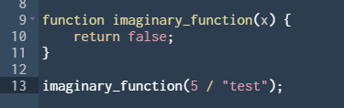
Check your understanding
Would this function run throwing error in Source if
Source uses applicative order reduction ?
Source uses normal order reduction ?
Notes:
No yes

Slide 16
Substitution Model
It is a mental model to help you to understand how program works => Stepper Tool
It just means to replace! Replace what ? Replace these :
Replace a function call by its function body
Replace formal parameters by actual arguments
Notes:
Explain the example

Slide 17
Recursive Process vs Iterative Process
Not to be confused with recursion
Recursive Process = deferred operations
Iterative Process = no deferred operations
Not all recursion gives recursive process! Recursion is just a means in a programming language to express the thinking process
Recursion is just a function that calls itself and actually you do this everyday in your life
Notes:
Explain how recursion works like a normal brain => for example counting money, dividing task, etc

Slide 18
Recursion
Recursive function has two most basic parts
Base case (when the function should stop calling itself)
Recursive call (which breaks down the problem into smaller problem)
Wishful thinking : you wish that your function works perfectly find and solve the bigger problem using the solved smaller problems

Slide 19
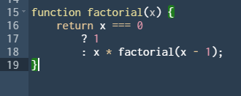
Recursion (Wishful Thinking)
You wish that factorial is correct, so if you can solve factorial of x – 1, you can solve factorial of x!

Slide 20
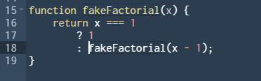
Check your understanding
Does this program give rise to an iterative or recursive process ?

Slide 21
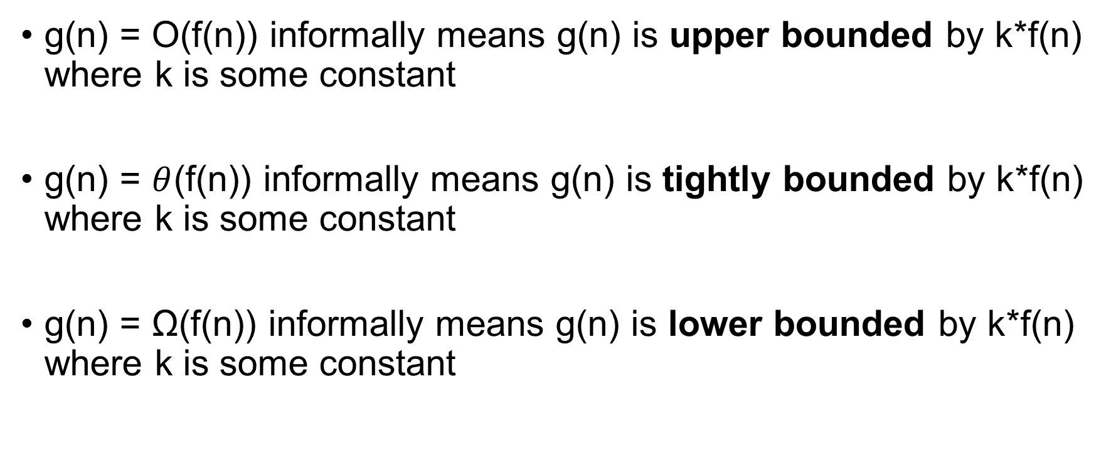
Order of Growth
g(n) = O(f(n)) informally means g(n) is upper bounded by k*f(n) where k is some constant
g(n) = $θ$(f(n)) informally means g(n) is tightly bounded by k*f(n) where k is some constant
g(n) = Ω(f(n)) informally means g(n) is lower bounded by k*f(n) where k is some constant

Slide 22
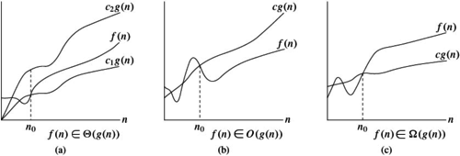
Picture

Slide 23
Space and Time Complexity
Common complexity = O(1) , O(log n), O(n), O(n log n), O(n²), O(2^{n})
Just need to take the highest term, for e.g. O(n² + 5n + 10) = O(n²)
Space Complexity (for now)
= total number of deferred operations
=/= total function calls
Time Complexity
= total number of operations done
= (roughly) function call * total time for 1 function call

Slide 24
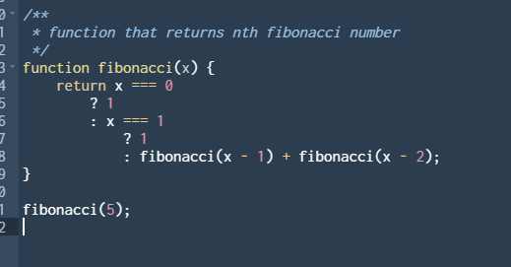
Check your understanding
What is the space complexity of this function in big-O notation?
What is the time complexity of this function in big-O notation ?

Slide 25
Studio Sheet

Slide 26
Some useful visualisation slides
https://docs.google.com/presentation/d/1hfhCGaY6RVL43qyG-UUdFmYrAvNYHhL8iH-YHnCdo5I/edit#slide=id.ge9f28fc128_0_794

