Slide 1
A-math Simultaneous Equations
Simon Julian Lauw
Full Info > simonjulianl.github.io

Slide 2
Table of Contents
Review
Simultaneous Equations
Exercise

Slide 3

Review
Before coming to class, it’s good if you can review on how to factorization of quadratic equation (meaning how to separate for example $x^{2}+2x+1=\left(x+1\right)\left(x+1\right)$)
I attach some of the picture for references for you to review

Slide 4
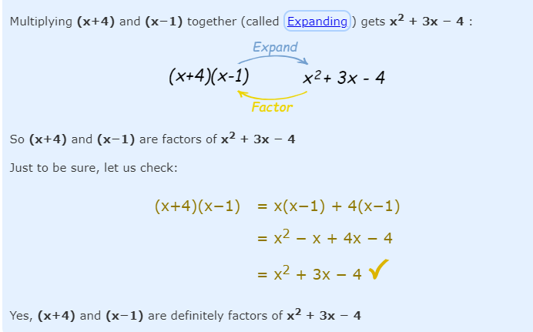
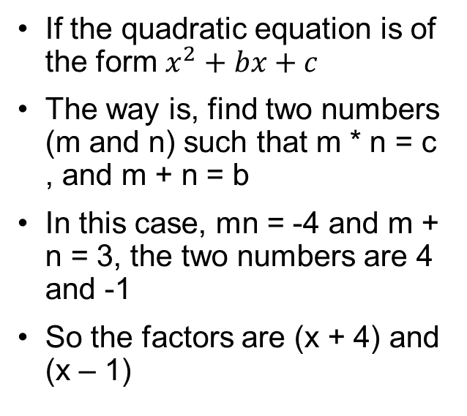
Factorization
If the quadratic equation is of the form $x^{2}+bx+c$
The way is, find two numbers (m and n) such that m * n = c , and m + n = b
In this case, mn = -4 and m + n = 3, the two numbers are 4 and -1
So the factors are (x + 4) and (x – 1)

Slide 5
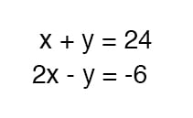
Motivation
Simultaneous equations are just a bunch of equations where they all must hold true
For example x + y = 2, x – y = 3
To solve these two equations, the x and y must satisfy both conditions
This called simultaneous equations (they must be simultaneously true)

Slide 6
Motivation
In fact, in real life, its almost impossible for you to model a stuff merely with a single variable without a set of equations
For example, lets say a factory in a car can only produce 100 vehicles (including cars and motorcycle)
Let C be cars, and M be motorcycle
Then C + M = 100
but we want the difference between cars and motorcycle be 10
C – M = 10

Slide 7
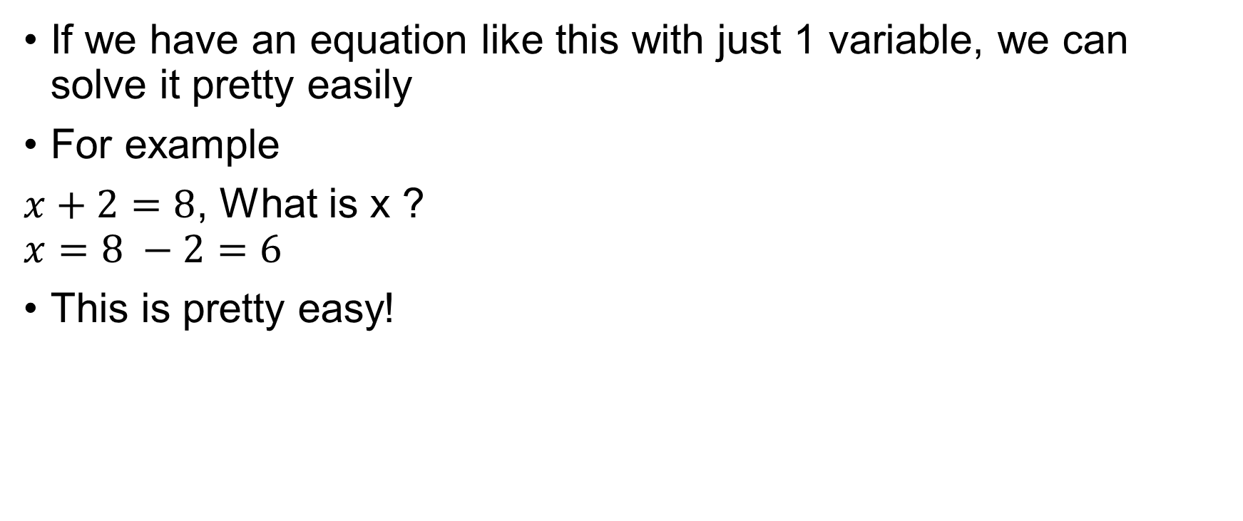
Simultaneous Equation
If we have an equation like this with just 1 variable, we can solve it pretty easily
For example
$x+2=8$, What is x ?
$$x=8 −2=6$$
This is pretty easy!

Slide 8
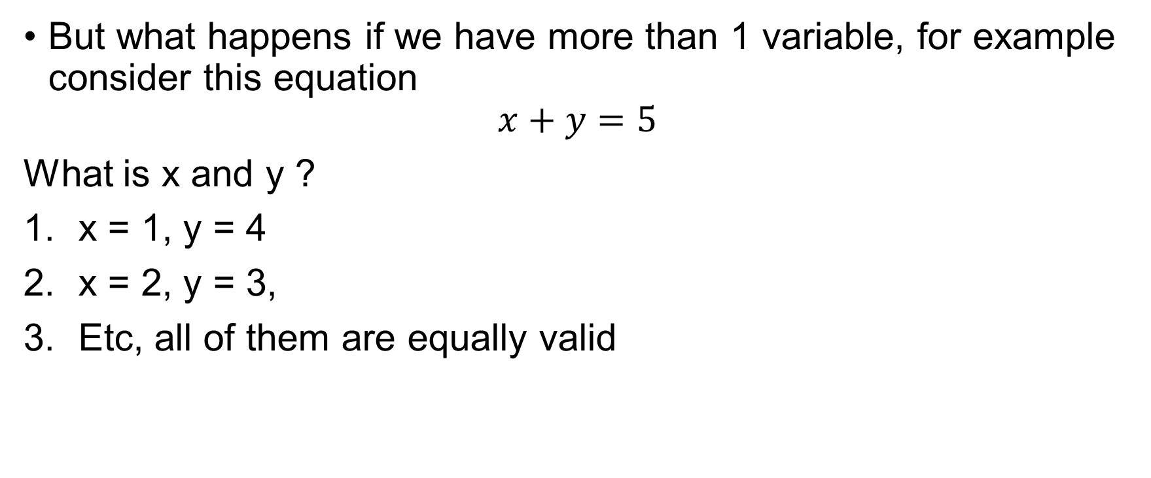
Simultaneous Equation
But what happens if we have more than 1 variable, for example consider this equation
$$x+y=5$$
What is x and y ?
x = 1, y = 4
x = 2, y = 3,
Etc, all of them are equally valid

Slide 9
Simultaneous equations
Therefore, the purpose of having a lot of equations, is to solve all of them to give us the exact value
In general, the rule of thumb is if you have n variables, you should have at least n equations

Slide 10
Elimination Method
We have the same number of y’s in each
A
2x – y = 1
+
B
3x + y = 9
5x
= 10
Divide both sides by 5
x
= 2
2 x 2 – y = 1
Substitute x = 2 in equation A
4 – y = 1
Answer
x = 2, y = 3
y = 3

Slide 11
Elimination Method
We have the same number of y’s in each
A
5x + y = 17
B
3x + y = 11
-
If we SUBTRACT the equations,
the y’s disappear
2x
= 6
Divide both sides by 2
x
= 3
5 x 3 + y = 17
Substitute x = 3 in equation A
15 + y = 17
Answer
x = 3, y = 2
y = 2

Slide 12
Elimination Method
A
2x + 3y = 9
B
2x + y = 7

Slide 13
Elimination Method
We have the same number of x’s in each
A
2x + 3y = 9
B
2x + y = 7
-
If we SUBTRACT the equations,
the x’s disappear
2y
= 2
Divide both sides by 2
y
= 1
2x + 3 = 9
Substitute y = 1 in equation A
2x = 6
Answer
x = 3, y = 1
x = 3

Slide 14
Elimination Method
A
4x - 3y = 14
B
+
2x + 3y = 16

Slide 15
Elimination Method
We have the same number of y’s in each
A
4x - 3y = 14
B
+
2x + 3y = 16
If we ADD the equations,
the y’s disappear
6x
= 30
Divide both sides by 6
x
= 5
20 – 3y = 14
Substitute x = 5 in equation A
3y = 6
Answer
x = 5, y = 2
y = 2

Slide 16
What if NOT same number of x’s or y’s?
A
3x + y = 10
If we multiply A by 2 we
get 2y in each
B
5x + 2y = 17
A
6x + 2y = 20
-
B
5x + 2y = 17
x
= 3
In B
5 x 3 + 2y = 17
Answer
x = 3, y = 1
15 + 2y = 17
y = 1

Slide 17
A
4x - 2y = 8
B
3x + 6y = 21
If we multiply A by 3 we
get 6y in each
A
12x - 6y = 24
+
B
3x + 6y = 21
15x
= 45
x = 3
In B
3 x 3 + 6y = 21
Answer
x = 3, y = 2
6y = 12
y = 2

Slide 18
A
3x + 7y = 26
B
5x + 2y = 24
A
15x + 35y = 130
-
B
15x + 6y = 72

Slide 19
A
3x + 7y = 26
B
5x + 2y = 24
Multiply A by 5 & B by 3,
we get 15x in each
A
15x + 35y = 130
-
B
15x + 6y = 72
Could multiply A by 2 & B
by 7 to get 14y in each
29y
= 58
y = 2
In B
5x + 2 x 2 = 24
Answer
x = 4, y = 2
5x = 20
x = 4

Slide 20
A
3x - 2y = 7
B
5x + 3y = 37
A
9x – 6y = 21
+
B
10x + 6y = 74

Slide 21
A
3x - 2y = 7
B
5x + 3y = 37
Multiply A by 3 & B by 2,
we get +6y & -6y
A
9x – 6y = 21
+
B
10x + 6y = 74
Could multiply A by 5 & B
by 3 to get 15x in each
19x
= 95
x = 5
In B
5 x 5 + 3y = 37
Answer
x = 5, y = 4
3y = 12
y = 4

Slide 22

Substitution method
Solve the following simultaneous equations
$2x−3y=−2$ – (1)
$y+4x=24$ – (2)

Slide 23
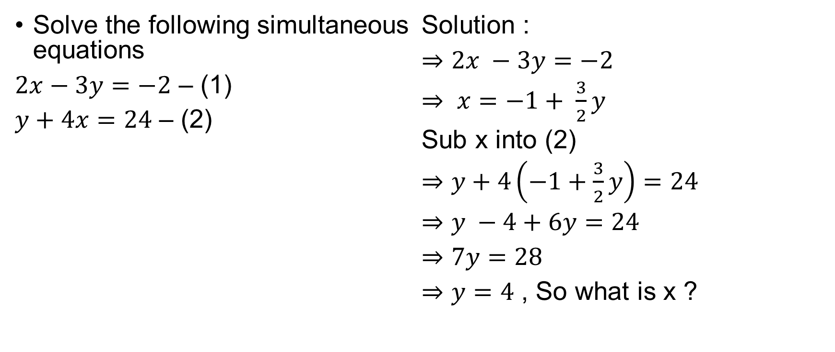
Substitution method
Solve the following simultaneous equations
$2x−3y=−2$ – (1)
$y+4x=24$ – (2)
Solution :
$⇒2x −3y=−2$
$⇒ x=−1+ \frac{3}{2}y$
Sub x into (2)
$⇒y+4\left(−1+\frac{3}{2}y\right)=24$
$⇒y −4+6y=24$
$⇒7y=28$
$⇒y=4$ , So what is x ?

Slide 24
Notes
Remember that all the given examples, all the x and y are linear (only have power of 1 like x and y)
In fact, its pretty common to have x and y raised to the power of n like y², x²
In this case, it’s much better to use the substitution model to solve the equation, which you will do in the following exercises

Slide 25
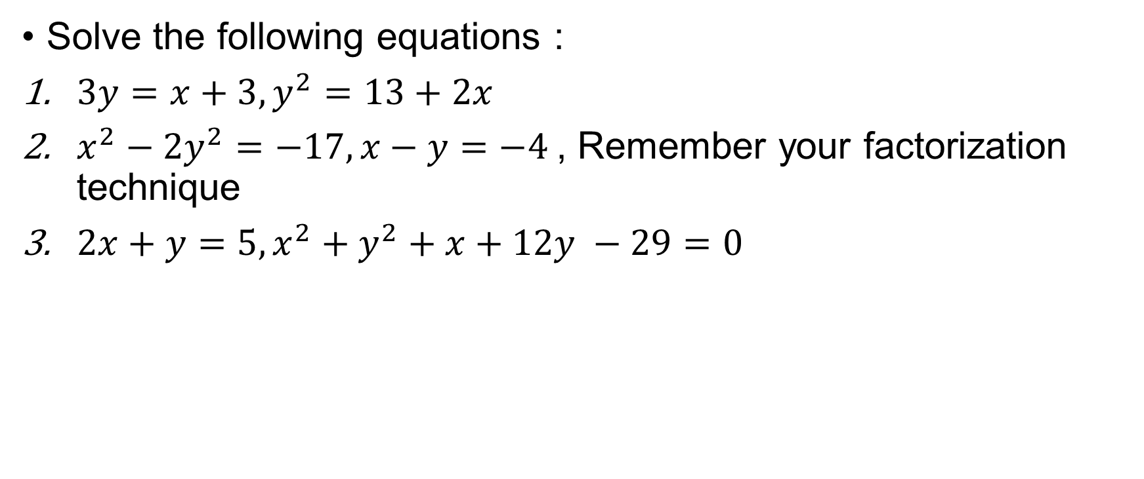
Exercises
Solve the following equations :
$3y=x+3, y^{2}=13+2x$
$x^{2}−2y^{2}=−17, x−y=−4$, Remember your factorization technique
$2x+y=5, x^{2}+y^{2}+x+12y −29=0$

