Slide 1
CS1101S Studio Session Week 10 Searching, Sorting, Memoization, Stream
Simon Julian Lauw
Full Info > simonjulianl.github.io
18 October 2021

Slide 2
Table of Contents
Searching and Sorting
Stream
Memoization

Slide 3
Regarding Your Mission Env Model
For question two, there is a line where twice(x => 2*x + 1) where twice is f => x => f(f(x))
You can look as twice as (f) => (lambda object) and therefore to return the lambda object, you need to create it first!
You need to be aware of these lambda objects as they are very tricky

Slide 4

For and While loop
First thing first, before we go into today’s material, let’s go through two new basic syntax that is almost present (AFAIK) in all complete programming languages
Firstly is for-loop, and in source, the syntax is

Slide 5
For loop
Initialization : initialize the variable, can be let i = 0; let head = pair(1,2); literally anything as long as you initialize something therez
Predicate : meaning as long as this predicate is true, execute the body
Increment/update : how to increment the counter / variable / anything, can be i = i + 1, head = tail(head), etc
Some examples : https://share.sourceacademy.nus.edu.sg/example

Slide 6
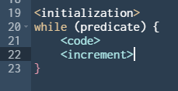
While Loop
While loop is just the more general for-loop statement, given
This is equivalent to (you can read this like an English statement)

Slide 7
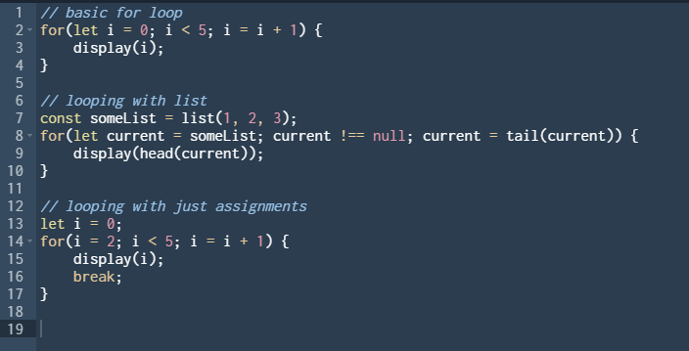
Exercises
Try to convert the codes that I show you before using while-loop, for convenience, the codes are pasted here

Slide 8
Searching
In CS1101S, you will be learning two most basic searches, known as linear/sequential search and binary search
Linear searching is very intuitive, given a list of books and you don’t have any information about the books, how will you find the book whose title is “SICP JS” ?

Slide 9
Searching
In CS1101S, you will be learning two most basic searches, known as linear/sequential search and binary search
Linear searching is very intuitive, given a list of books and you don’t have any information about the books, how will you find the book whose title is “SICP JS” ?
Well, usually people would just look at the title of each book one by one!

Slide 10
General Problem Solving Technique
The most rigorous way to search / to solve any problem that is given to you is to exploit the property of the input that is given to you
this is an important problem solving technique that people often forgets, given an input, try to understand the properties of the inputs! Don’t start to code until you really understand the problem

Slide 11
General Problem Solving Technique
For e.g. given a list of rabbits, find the biggest elephant in that list!
Ans : why bother to search ? You know its not there ! => O(1) solution
The fact is, even though this looks very trivial, many people often overlooks this fact and just jumping to code without knowing the items that they are given!

Slide 12
Binary Search
So here, based on the lecture, what is the property that is being exploited in the array such that we can use binary search ?

Slide 13
Binary Search
So here, based on the lecture, what is the property that is being exploited in the array such that we can use binary search ?
Ans : the array is sorted!
Let’s say the array is 1,2,3,4,5 and we are searching for -1, if we know that the first item is 1, is there any point to check the rest ?
No! because you know the rest must be bigger than 1 which is > -1 too

Slide 14
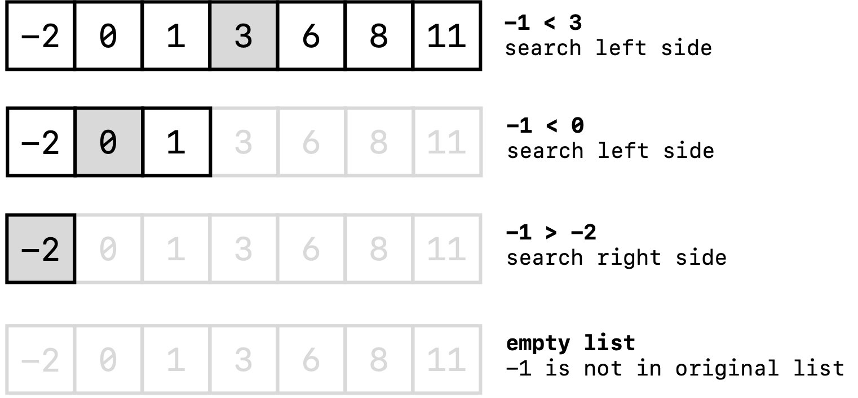
Binary Search
In a picture, given the sorted array in the first line, find -1

Slide 15
Sorting
There are 3 main sorting techniques taught in CS1101S
Selection Sort : find min item in unsorted part, put them in the sorted region
Insertion Sort : Iterate through the array, insert them in the correct part in the sorted portion
Merge Sort : recursively merge sort two smaller arrays, and merge these two sorted smaller arrays
The lecture is pretty comprehensive, but what I want to emphasize is that understand what’s the idea behind it (not memorizing the code)

Slide 16
Memoization
Memoization is just a way to improve performance of an algorithm
There are multiple ways to improve your algorithm, and the most usual way is to ask yourself this question : Are you doing repeated work ?

Slide 17
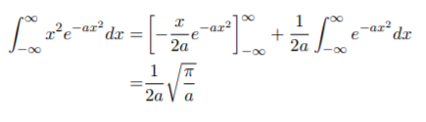
Memoization
Let’s use an analogy, if today I asked you to integrate this (this is called gaussian integration but not relevant), the point is you will integrate it for the first time because there is no answer yet!
Then tomorrow, I am asking you the same question again, will you calculate again ? Or just throw me the answer because you already know it ?
The point is, memoization is actually not really a fancy technique fundamentally, but there are a lot of tweaks that you can do to it!

Slide 18
Examples
Memoization is often used when you can break down the problems and the sub-problem is recalculated over and over
I will give you extra example not covered in the lecture (full list of problems here https://medium.com/techie-delight/top-50-dynamic-programming-practice-problems-4208fed71aa3)

Slide 19
Rick the Rabbit
Remember that Rick the Rabbit can jump (1 step), can skip (2 steps) and hop (3 steps), therefore how many ways we can reach level N ?
The observation here is that there are many repeated subproblems, for example
Ways(50) = ways(49) + ways(48) + ways(47), but when ways(49) = ways(48) + ways(47) + ways(46), Realize that you calculate ways(47) and ways(48) twice
The lesson is, you can memoize this!

Slide 20
Stream
It is an extension of list, where the head is the value and the tail is a nullary function that returns a stream
Similarly, there are corresponding list methods in stream such as stream_map, stream_filter, etc

Slide 21
Studio Sheet

