Slide 1
CS1101S Studio Session Week 2 Elements of Programming
Simon Julian Lauw
Full Info > simonjulianl.github.io
16 August 2021
Acknowledgement (for his inspiring slides):
Amadeus Aristo Winarto

Slide 2
Table of Contents
Computational Process
Primitives
Expression
Abstraction
Conditional

Slide 3
Computational Process
The point of learning Computer Science is to learn to express computational process and programming is just one way to do it (There’s also diagram, verbal communication, etc)
We prefer to have a more effective computational process
During programming, there are tools to help us communicate our computational process, and here that tool is Programming Language
It contains means of abstraction, control flow, etc

Slide 4
Primitives
The smallest constituent unit of a programming language
It is akin to an atom in chemistry (or quarks if you want to argue further but yeah you get the idea)
It can be evaluated within a single evaluation step: you either look up the value of a name, or take the literal value => hence variable names, numerals, booleans and strings are primitive expressions
For example :
1, 1.2, ‘test’, true are all primitives

Slide 5
Expression
Expression is just a combination of operators, operands, variables, etc that resolve to a value
It doesn’t need to contain all of them, but complex expressions (at least more than just primitives), they are called combinations.
One way to make combinations is using operators, and it’s called operator combination
For example, 1 + 2 and 5 are both expressions
In Source, expressions are not programs, you need to add semicolon to turn it into a program / expression statement (something that the machine can understand)
E.g. 1 + 2 is not a program, but 1 + 2; is

Slide 6
Expression
Arithmetic operators: +,−,×,÷,% (Remainder in Source, not really Modulo -> check your CS1231S for more info)
Comparison operators: >,<,≥,≤,===,!==
Boolean operators: &&,||,!
Conditional operators: <stmt-a> ? <stmt-b> : <stmt-c>
Take note of the precedence of operators during combination
Further reference : https://developer.mozilla.org/en-US/docs/Web/JavaScript/Reference/Operators/Operator_Precedence

Slide 7
Which of the following expressions are primitive?
Expressions that are not primitive are called ?
3
3.14159
7 + 2
5;
true
false
x
math_PI
Notes:
Pre-declared != primitive, so 3.14159 is primitive but not necessarily MATH_PI
Those that are not primitive are called ?

Slide 8
Which of the following are operators?
3
3.14159
7 + 2
x
+
false
/
math_PI
Op()
!
&&
%
Notes:
Binary vs unary operators
Functions are not operators

Slide 9
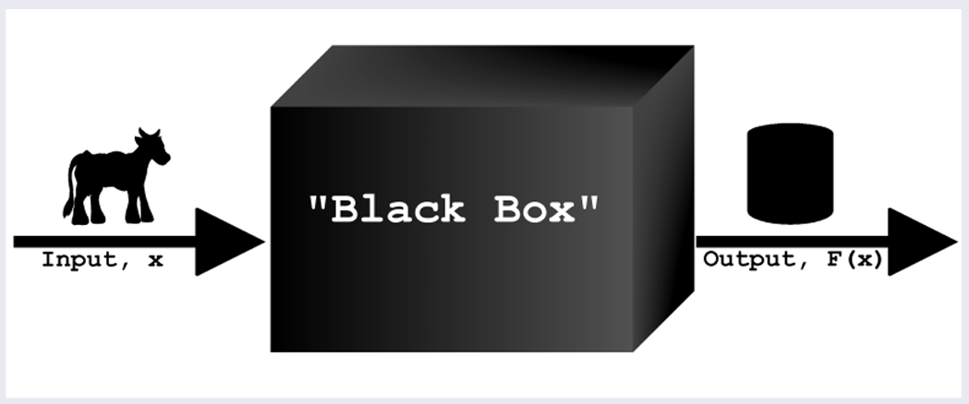
Abstraction

Slide 10
Abstraction
The main idea is to filter out unnecessary details for the users so that the users can focus on the bigger picture or what is necessary for him
For example, if I want to buy a food at a vending machine, I just need to insert my money, I don’t need to know how the money is being processed, or how my food is baked etc. I just care money => food
There are various level of abstractions, and the most simple one is naming using constant declaration
In Source, we can do this by using the syntax
const <name> = <value>;

Slide 11
Naming Abstraction
Purpose
naming allows us to give a user-friendly name to a piece of data in memory
since its inconvenient to remember and repeat all the values in all the places
It also allows us to care about the value (what vs how to generate the value). For example, if we want to get the value of pi, we can just call math_pi, but we don’t care how this math_pi generated! (Maybe using some fancy math methods or magic)

Slide 12
Functional Abstraction
Second level of abstraction is using functions to express a certain behaviour
For example
function square(x) { return x*x; } => as a user, I only care that this function can square a number, I don’t care how it squares the number (maybe using summation, etc)
In Source, declaring function can be done using the following syntax
function <name> { <body>; return <expression>; }

Slide 13
Conditional
Control flow of a program, you want your program to be able to express your if-else logic of your computational process
Predicate : function or expression that resolves to a Boolean value (true/false)
In Source, you can use
If (predicate) { <body>; } else { <alt body>; }
OR (ternary conditional operator) , ternary just means it takes 3 operands
predicate ? <body> : <alt body> ;

Slide 14
Tips to write a good program
You will have a lot of missions, quests, etc and also more programming modules are coming
It is good to write good programs from now!
Be correct : check for edge cases!
Be clear : write proper comments to help others understand!
Be elegant : follow the naming convention and style requirement!
Be effective : Design your program before you code it ! Think of what functions can be abstracted, what steps are you trying to convey!

Slide 15
Off we go to Studio Sheet!

