Slide 1

A-math Cubic Expression
Simon Julian Lauw
Full Info > simonjulianl.github.io

Slide 2
Table of Contents
Revision
Cubic Expression
Algebraic Fraction

Slide 3
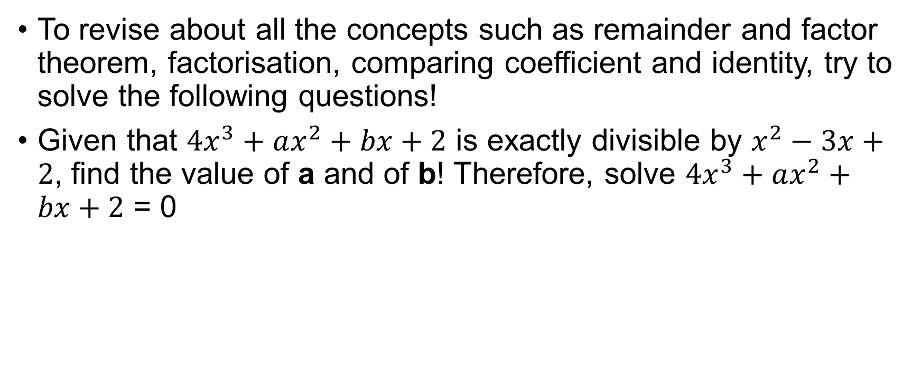
Revision
To revise about all the concepts such as remainder and factor theorem, factorisation, comparing coefficient and identity, try to solve the following questions!
Given that $4x^{3}+ax^{2}+bx+2$ is exactly divisible by $x^{2}−3x+2$, find the value of a and of b! Therefore, solve $4x^{3}+ax^{2}+bx+2$ = 0
Notes:
A = -11, b = 5
X = 1, 2 or -1/4

Slide 4

Cubic Expression
Previously, we have learnt a generic quadratic equation in the form of $ax^{2}+bx+c$, and now we want to make this even more complicated by introducing cubic equation in the form of $ax^{3}+bx^{2}+cx+d$

Slide 5
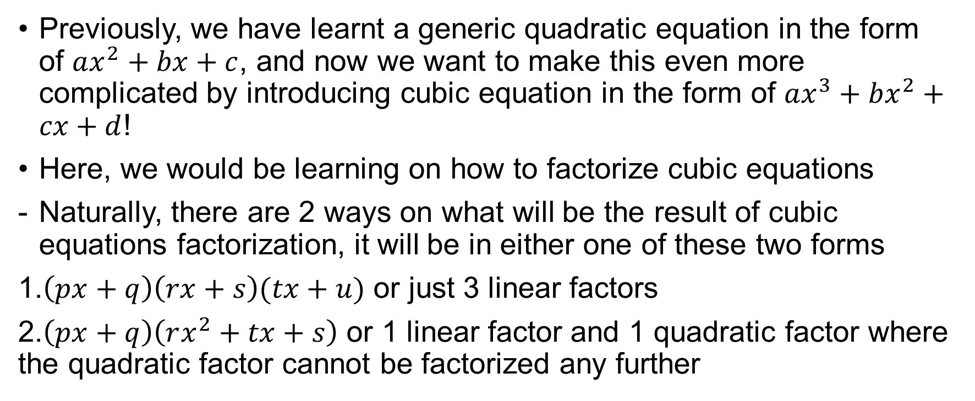
Cubic Expression
Previously, we have learnt a generic quadratic equation in the form of $ax^{2}+bx+c$, and now we want to make this even more complicated by introducing cubic equation in the form of $ax^{3}+bx^{2}+cx+d$!
Here, we would be learning on how to factorize cubic equations
Naturally, there are 2 ways on what will be the result of cubic equations factorization, it will be in either one of these two forms
1.$\left(px+q\right)\left(rx+s\right)(tx+u)$ or just 3 linear factors
2.$\left(px+q\right)\left(rx^{2}+tx+s\right)$ or 1 linear factor and 1 quadratic factor where the quadratic factor cannot be factorized any further

Slide 6
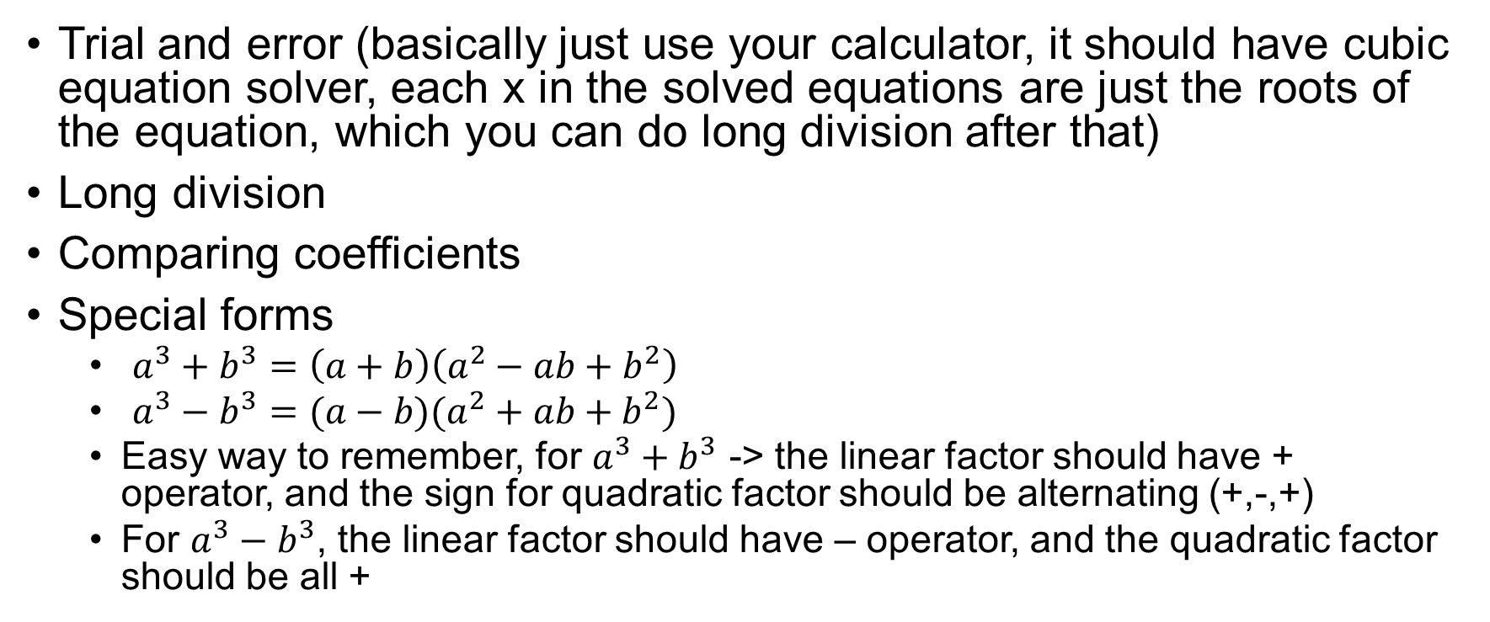
List of methods on factorising cubic expressions
Trial and error (basically just use your calculator, it should have cubic equation solver, each x in the solved equations are just the roots of the equation, which you can do long division after that)
Long division
Comparing coefficients
Special forms
$a^{3}+b^{3}=\left(a+b\right)\left(a^{2}−ab+b^{2}\right)$
$a^{3}−b^{3}=(a−b)(a^{2}+ab+b^{2})$
Easy way to remember, for $a^{3}+b^{3}$ -> the linear factor should have + operator, and the sign for quadratic factor should be alternating (+,-,+)
For $a^{3}−b^{3}$, the linear factor should have – operator, and the quadratic factor should be all +

Slide 7

Example on factorising using Trial and Error method
Solve the equation $2x^{3}+x^{2}−5x+2=0$

Slide 8
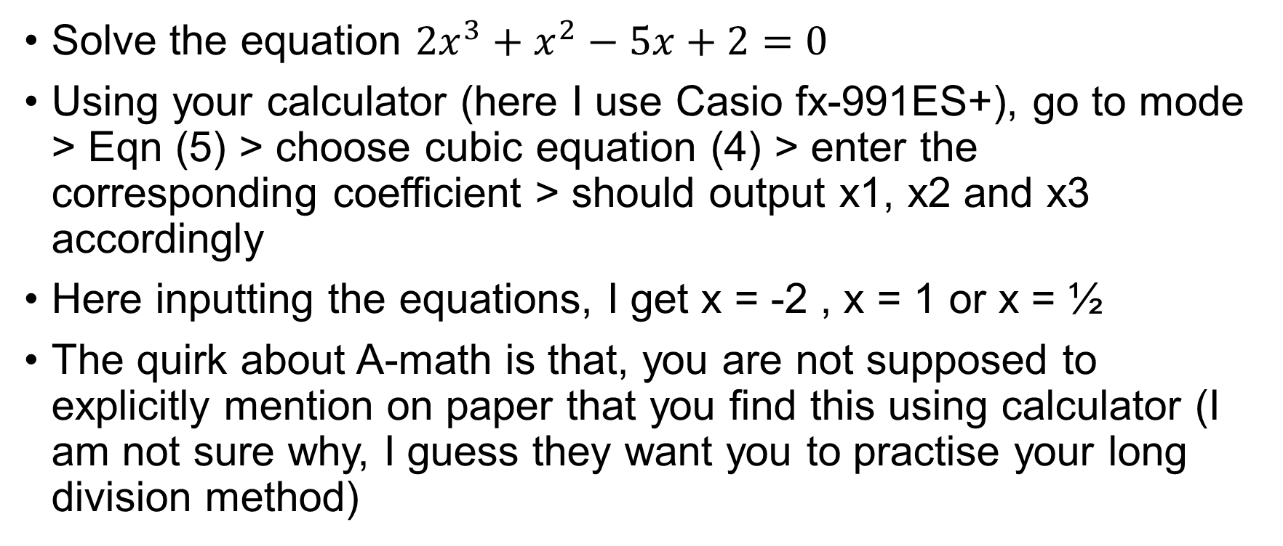
Example on factorising using Trial and Error method
Solve the equation $2x^{3}+x^{2}−5x+2=0$
Using your calculator (here I use Casio fx-991ES+), go to mode > Eqn (5) > choose cubic equation (4) > enter the corresponding coefficient > should output x1, x2 and x3 accordingly
Here inputting the equations, I get x = -2 , x = 1 or x = ½
The quirk about A-math is that, you are not supposed to explicitly mention on paper that you find this using calculator (I am not sure why, I guess they want you to practise your long division method)

Slide 9
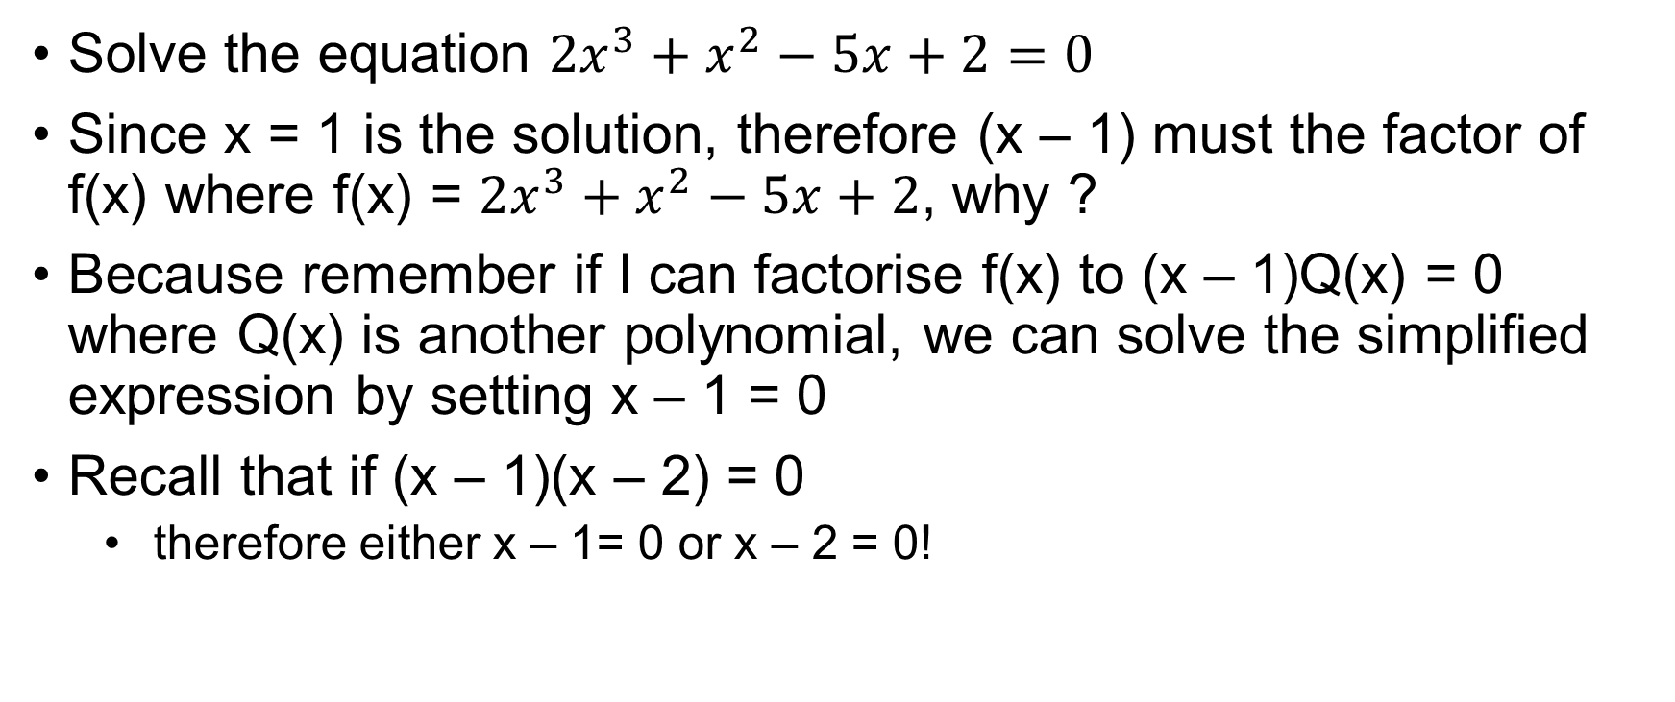
Example on factorising using Trial and Error method
Solve the equation $2x^{3}+x^{2}−5x+2=0$
Since x = 1 is the solution, therefore (x – 1) must the factor of f(x) where f(x) = $2x^{3}+x^{2}−5x+2$, why ?
Because remember if I can factorise f(x) to (x – 1)Q(x) = 0 where Q(x) is another polynomial, we can solve the simplified expression by setting x – 1 = 0
Recall that if (x – 1)(x – 2) = 0
therefore either x – 1= 0 or x – 2 = 0!

Slide 10
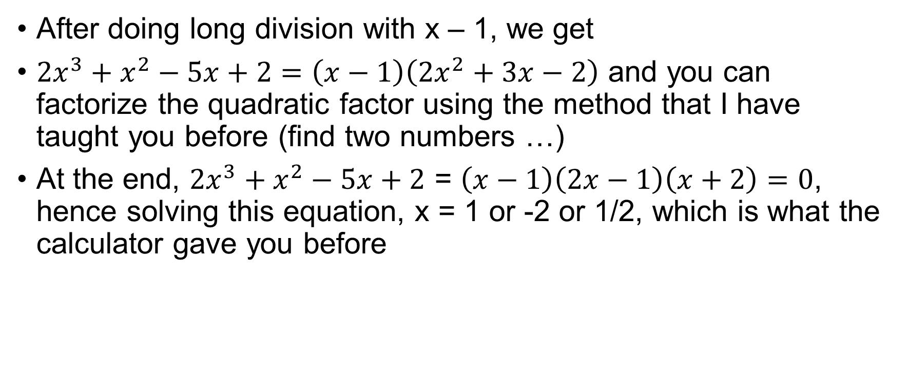
Example on factorising using Trial and Error method
After doing long division with x – 1, we get
$2x^{3}+x^{2}−5x+2=\left(x−1\right)\left(2x^{2}+3x−2\right)$ and you can factorize the quadratic factor using the method that I have taught you before (find two numbers …)
At the end, $2x^{3}+x^{2}−5x+2$ = $\left(x−1\right)\left(2x−1\right)\left(x+2\right)=0$, hence solving this equation, x = 1 or -2 or 1/2, which is what the calculator gave you before

Slide 11
Exercise
1. Solve the cubic equation x³ – 23x² + 142x – 120 = 0
2. Solve the cubic equation x³ – 6 x² + 11x – 6 = 0.
3. Solve the cubic equation x³ – 7x² + 4x + 12 = 0
Notes:
Therefore, x³ – 23x² + 142x – 120 = (x – 1) (x – 10) (x – 12)
Therefore, the solutions are x = 2, x= 1 and x =3.
Therefore x = –1, 2, 6

Slide 12
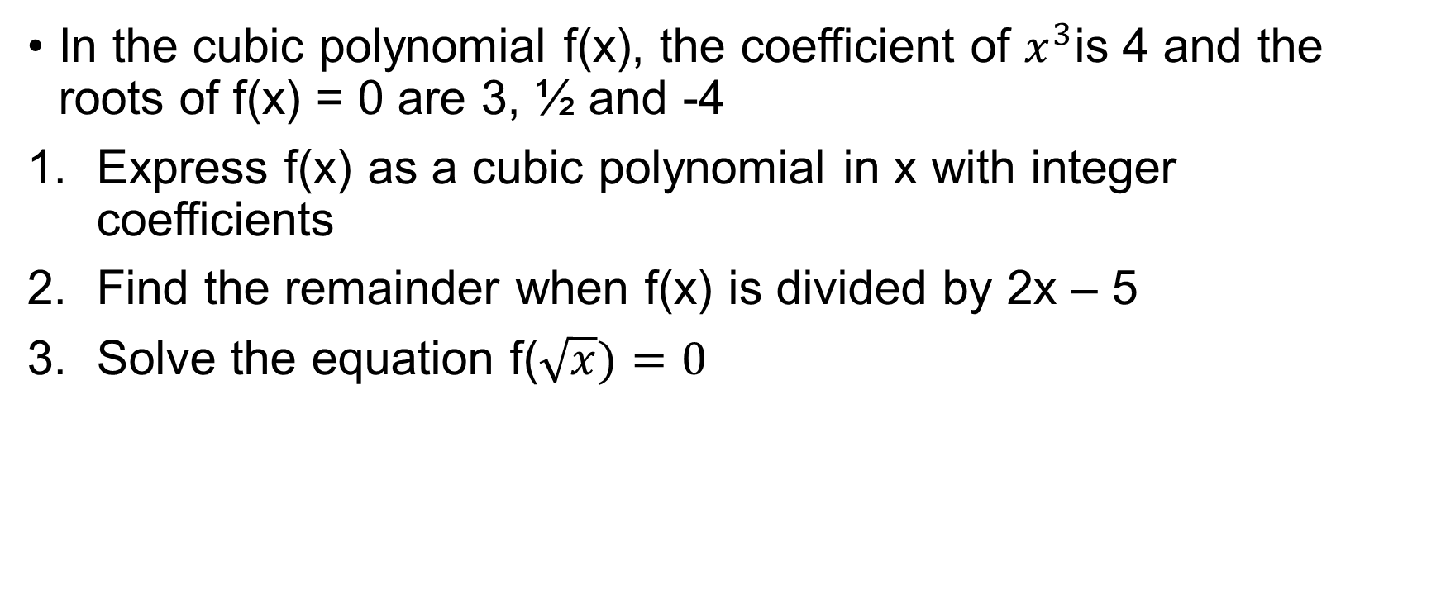
Exercise
In the cubic polynomial f(x), the coefficient of $x^{3}$is 4 and the roots of f(x) = 0 are 3, ½ and -4
Express f(x) as a cubic polynomial in x with integer coefficients
Find the remainder when f(x) is divided by 2x – 5
Solve the equation f($\sqrt{x})=0$
Notes:
4x^3 + 2x^2 – 50x + 24
-26
X = 9, x = ¼ or x^1/2 = -4 (hence no real solution for this)

