Slide 1
A-math Partial Fraction
Simon Julian Lauw
Full Info > simonjulianl.github.io

Slide 2
Table of Contents
Proper vs Improper Fractions
Partial Fractions
Exercise

Slide 3
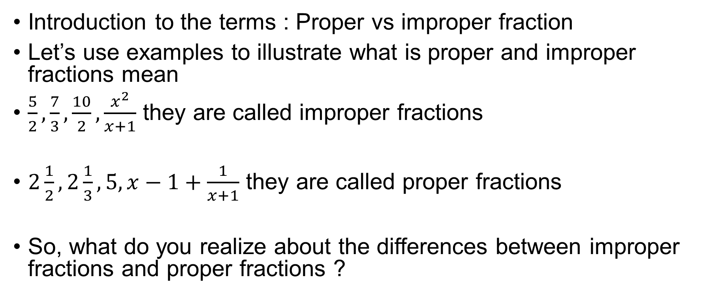
Fraction
Introduction to the terms : Proper vs improper fraction
Let’s use examples to illustrate what is proper and improper fractions mean
$\frac{5}{2},\frac{7}{3},\frac{10}{2},\frac{x^{2}}{x+1}$ they are called improper fractions
$2\frac{1}{2},2\frac{1}{3},5,x−1+\frac{1}{x+1}$ they are called proper fractions
So, what do you realize about the differences between improper fractions and proper fractions ?

Slide 4
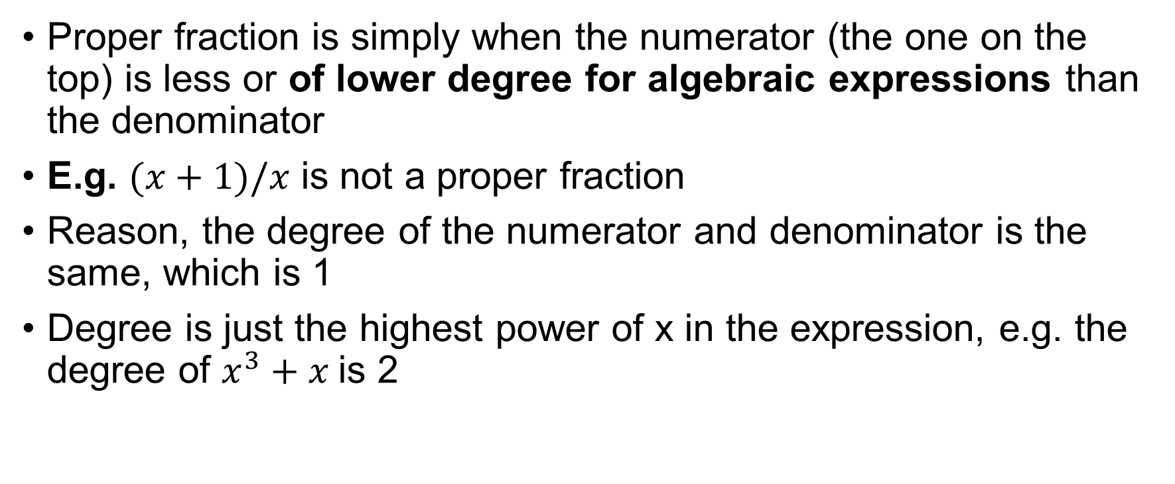
Fraction
Proper fraction is simply when the numerator (the one on the top) is less or of lower degree for algebraic expressions than the denominator
E.g. $(x+1)/x$ is not a proper fraction
Reason, the degree of the numerator and denominator is the same, which is 1
Degree is just the highest power of x in the expression, e.g. the degree of $x^{3}+x$is 2

Slide 5
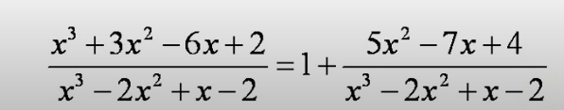
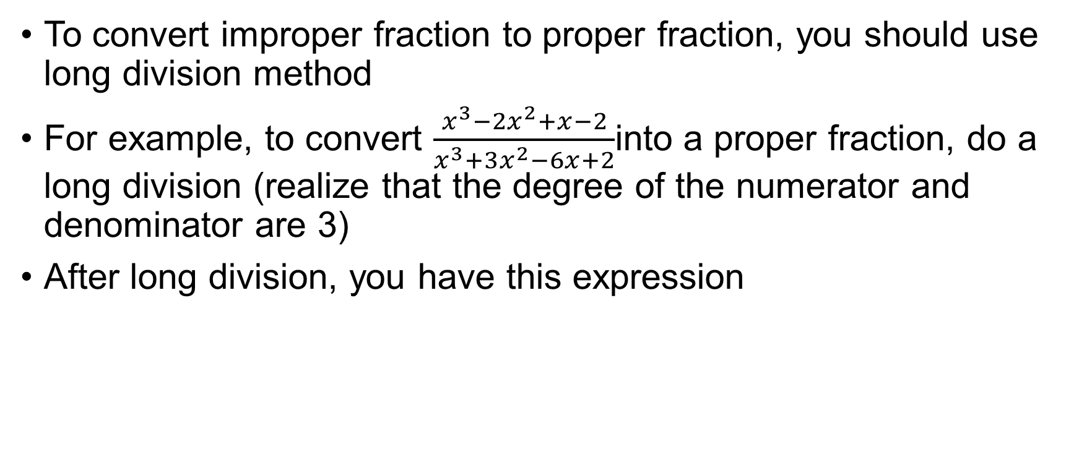
Converting Improper fraction to proper fraction
To convert improper fraction to proper fraction, you should use long division method
For example, to convert $\frac{x^{3}−2x^{2}+x−2}{x^{3}+3x^{2}−6x+2}$into a proper fraction, do a long division (realize that the degree of the numerator and denominator are 3)
After long division, you have this expression
remainder
quotient

Slide 6

Exercises
Try to convert this into proper fractions if they are improper!
$\frac{\left(2x^{3}−2x^{2}−24x−7\right)}{x^{2}−x−12}$
$\frac{\left(24x−7\right)}{x^{2}−x−12}$
$\frac{x^{4}+9}{x^{3}+3x}$
$\frac{x^{3}+9}{x^{3}+3x}$
Notes:
Q = 2x, R = -7
Proper
Q = x, R = -3x^2 + 9
Q = 1, R = -3x + 9

Slide 7
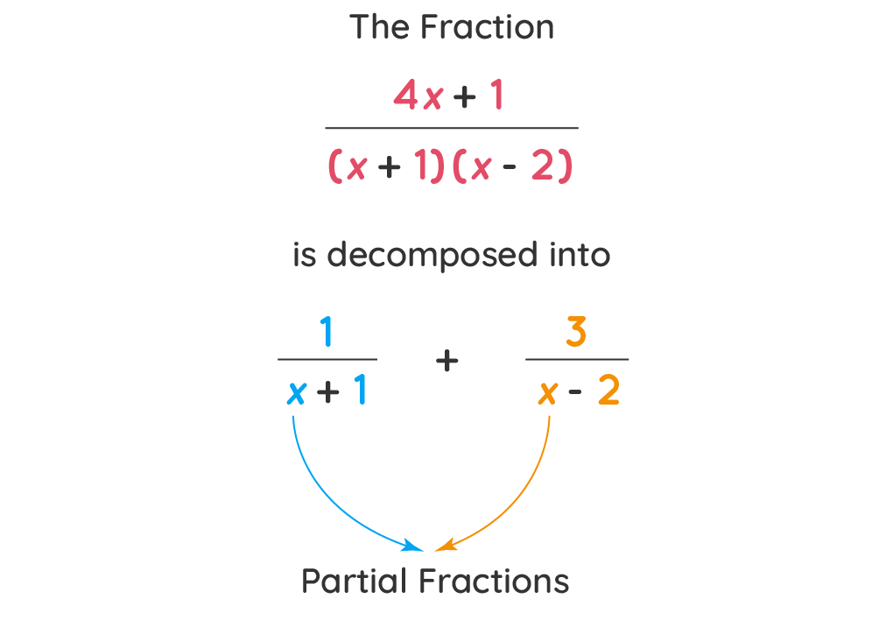
Partial Fraction
Partial Fraction is just a way to decompose fractional expression into two or more terms
For e.g.

Slide 8
Partial Fraction
In general, we must be able to factorize the denominator to be able to perform partial fractions
because we want to segregate the fraction into multiple fractions where the denominator is just the factor of each expression
Reason being, after we find the factors, we can decompose the fractions into these list of fractions (you will only learn up to cubic polynomial denominator) => In the next slide

Slide 9
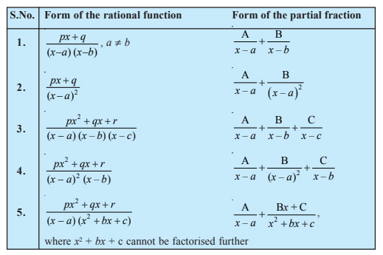
List of Partial Fraction (You will need this to refer to this table for exercises)

Slide 10
Partial Fraction
There are ways to methodologically decompose the fraction into partial fractions which I would explain here.
I would give the example for the first rule only, because the rest of the rule is very similar to this
just that the numerator may differ such as Bx + C instead of B where the quadratic factor cannot be factorized anymore

Slide 11
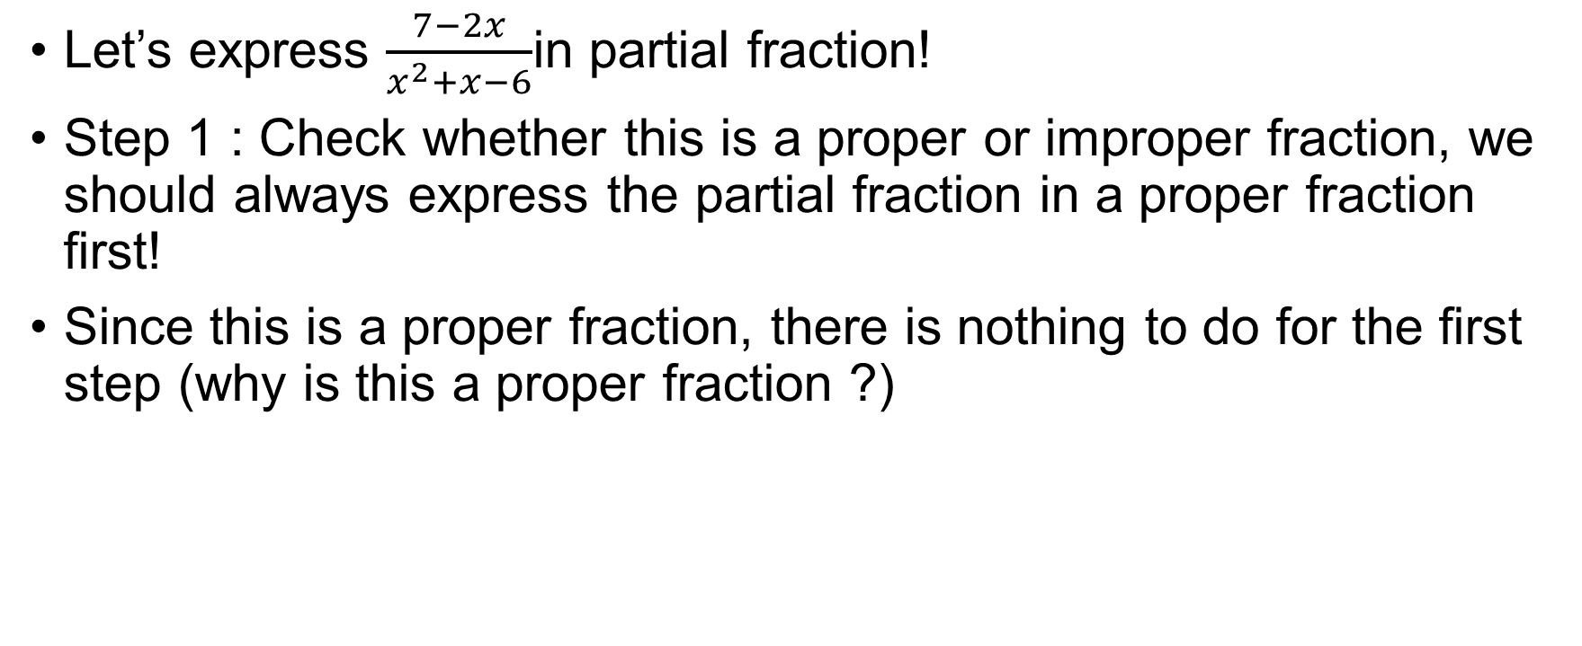
Example
Let’s express $\frac{7−2x}{x^{2}+x−6}$in partial fraction!
Step 1 : Check whether this is a proper or improper fraction, we should always express the partial fraction in a proper fraction first!
Since this is a proper fraction, there is nothing to do for the first step (why is this a proper fraction ?)

Slide 12
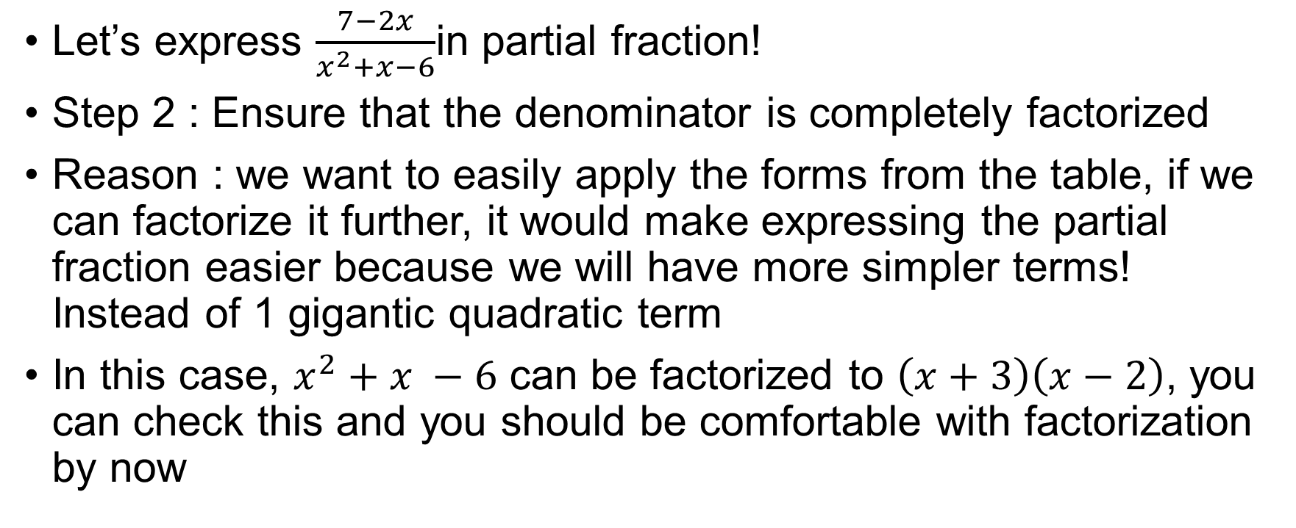
Example
Let’s express $\frac{7−2x}{x^{2}+x−6}$in partial fraction!
Step 2 : Ensure that the denominator is completely factorized
Reason : we want to easily apply the forms from the table, if we can factorize it further, it would make expressing the partial fraction easier because we will have more simpler terms! Instead of 1 gigantic quadratic term
In this case, $x^{2}+x −6$ can be factorized to $\left(x+3\right)\left(x−2\right)$, you can check this and you should be comfortable with factorization by now

Slide 13
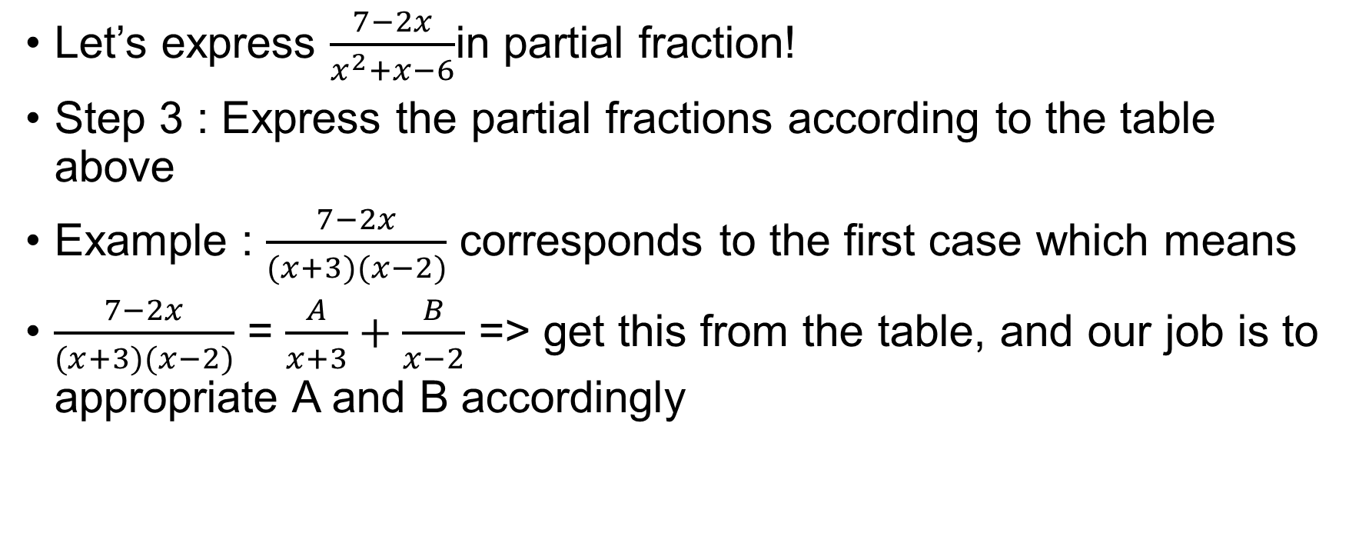
Example
Let’s express $\frac{7−2x}{x^{2}+x−6}$in partial fraction!
Step 3 : Express the partial fractions according to the table above
Example : $\frac{7−2x}{(x+3)(x−2)}$ corresponds to the first case which means
$\frac{7−2x}{(x+3)(x−2)}$ = $\frac{A}{x+3}+\frac{B}{x−2}$ => get this from the table, and our job is to appropriate A and B accordingly

Slide 14
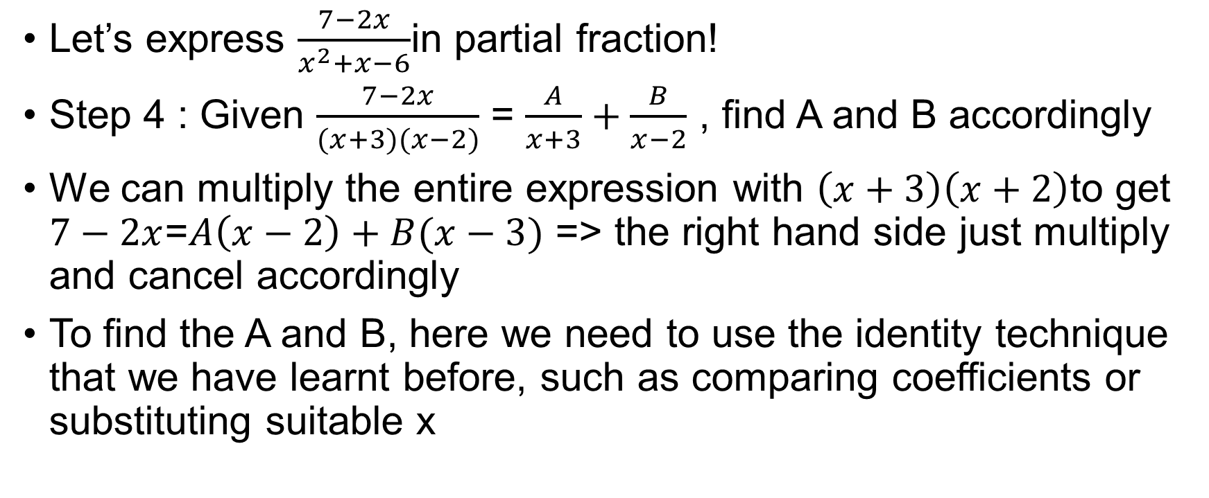
Example
Let’s express $\frac{7−2x}{x^{2}+x−6}$in partial fraction!
Step 4 : Given $\frac{7−2x}{(x+3)(x−2)}$ = $\frac{A}{x+3}+\frac{B}{x−2}$ , find A and B accordingly
We can multiply the entire expression with $\left(x+3\right)\left(x+2\right)$to get $7−2x$=$A\left(x−2\right)+B(x−3)$ => the right hand side just multiply and cancel accordingly
To find the A and B, here we need to use the identity technique that we have learnt before, such as comparing coefficients or substituting suitable x

Slide 15
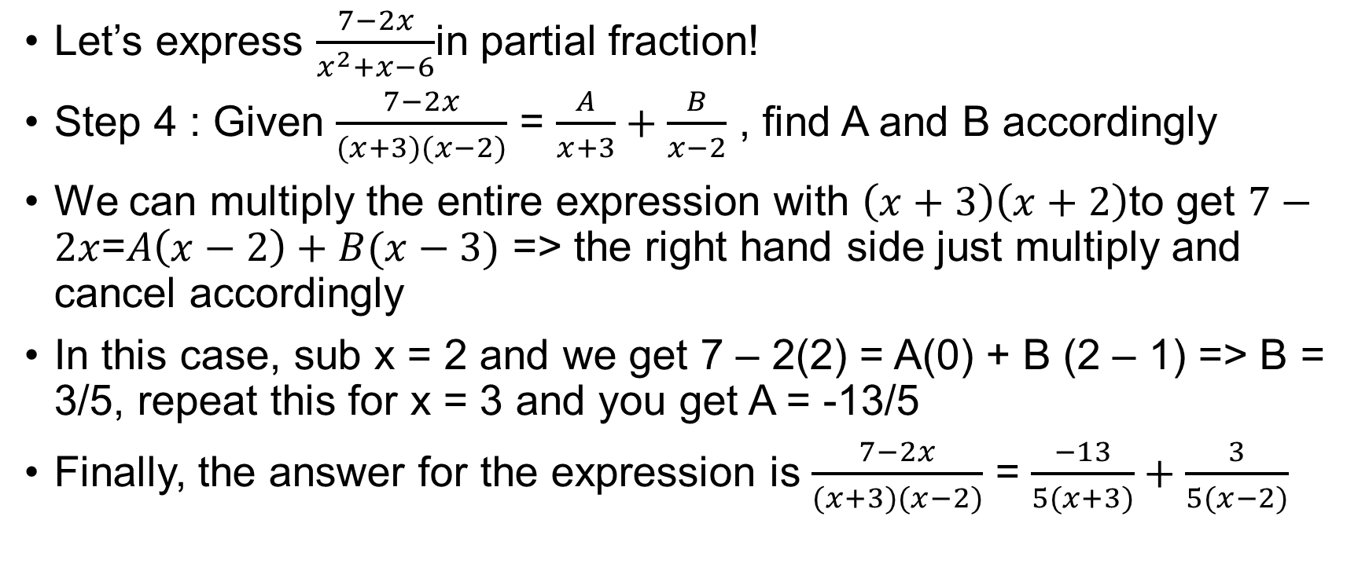
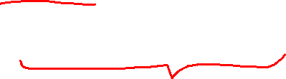
Example
Let’s express $\frac{7−2x}{x^{2}+x−6}$in partial fraction!
Step 4 : Given $\frac{7−2x}{(x+3)(x−2)}$ = $\frac{A}{x+3}+\frac{B}{x−2}$ , find A and B accordingly
We can multiply the entire expression with $\left(x+3\right)\left(x+2\right)$to get $7−2x$=$A\left(x−2\right)+B(x−3)$ => the right hand side just multiply and cancel accordingly
In this case, sub x = 2 and we get 7 – 2(2) = A(0) + B (2 – 1) => B = 3/5, repeat this for x = 3 and you get A = -13/5
Finally, the answer for the expression is $\frac{7−2x}{(x+3)(x−2)}$ = $\frac{−13}{5(x+3)}+\frac{3}{5(x−2)}$

Slide 16

Exercises
Express $\frac{x^{4}+9}{x^{3}+3x}$ in partial fractions
Express $\frac{9−4x}{\left(2x+3\right){\left(x−1\right)}^{2}}$ in partial fractions
Express $\frac{3x−1}{\left(x+3\right)(x−2) }$ in partial fractions
Notes:
X + 3/x – 6x/(x^2 +3 ) => factorize x^3 + 3x to x(x^2 +3)
A = 12/5 coeff of 2x+3, B = -6/5 coeff of x-1, C = 1 coeff of (x-1)^2
A = 2, B = 1

