Slide 1
A-math Quadratic Equation
Simon Julian Lauw
Full Info > simonjulianl.github.io

Slide 2
Table of Contents
Proper vs Improper Fractions
Partial Fractions
Exercise

Slide 3
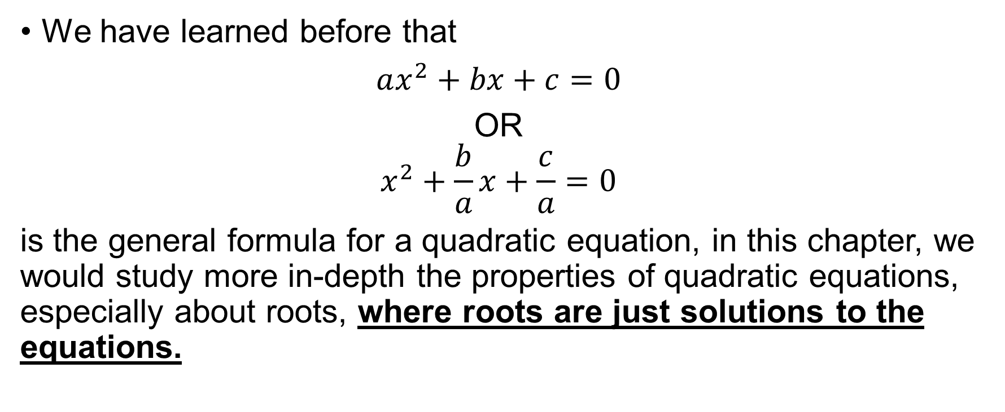
Relationship Between Roots and Coefficients of a Quadratic Equation
We have learned before that
$ax^{2}+bx+c=0$
OR
$$x^{2}+\frac{b}{a}x+\frac{c}{a}=0$$
is the general formula for a quadratic equation, in this chapter, we would study more in-depth the properties of quadratic equations, especially about roots, where roots are just solutions to the equations.

Slide 4
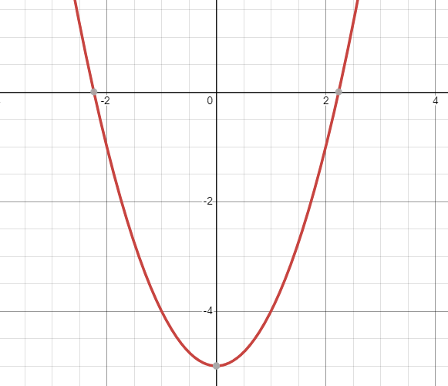

Roots Graphical Representation
Given $x^{2}−5=0$
The solution to that equation as shown by intersection with x-axis is the root

Slide 5
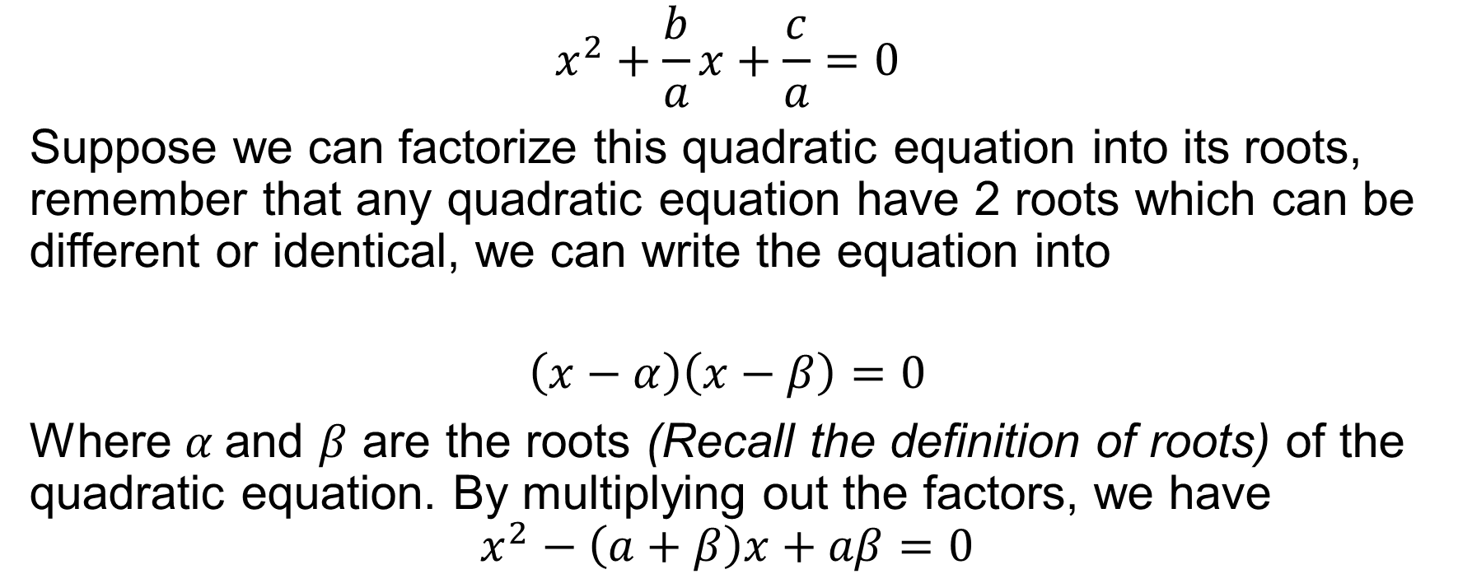
Relationship Between Roots and Coefficients of a Quadratic Equation
$$x^{2}+\frac{b}{a}x+\frac{c}{a}=0$$
Suppose we can factorize this quadratic equation into its roots, remember that any quadratic equation have 2 roots which can be different or identical, we can write the equation into
$$\left(x−α\right)\left(x−β\right)=0$$
Where $α$and $β$ are the roots (Recall the definition of roots) of the quadratic equation. By multiplying out the factors, we have
$$x^{2}−\left(a+β\right)x+aβ=0$$
Notes:
The root is just the solution to the equation. If the solution to the equation is a, we can write the equation into (x-a)Q(x) = 0 because x – a would give 0

Slide 6
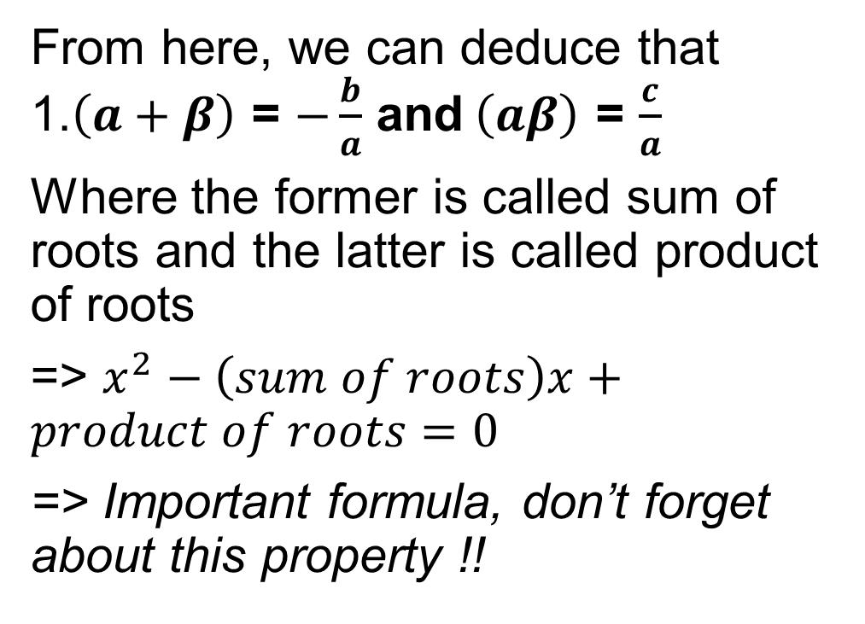
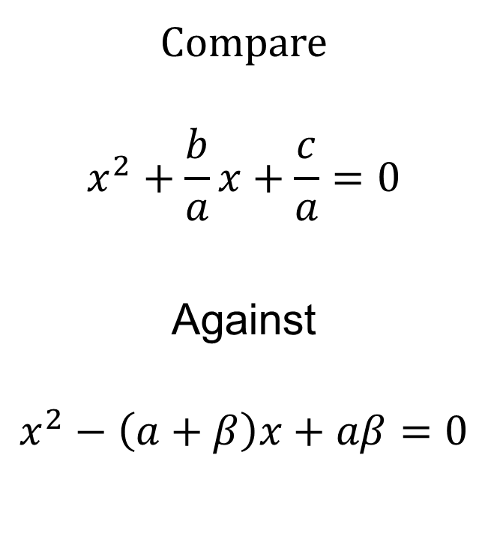
Relationship Between Roots and Coefficients of a Quadratic Equation
Compare
$$x^{2}+\frac{b}{a}x+\frac{c}{a}=0$$
Against
$$x^{2}−\left(a+β\right)x+aβ=0$$
From here, we can deduce that 1.$\left(a+β\right)$ = $−\frac{b}{a}$ and$\left(aβ\right)$ = $\frac{c}{a}$
Where the former is called sum of roots and the latter is called product of roots
=> $x^{2}−\left(sum of roots\right)x+product of roots=0$
=> Important formula, don’t forget about this property !!

Slide 7
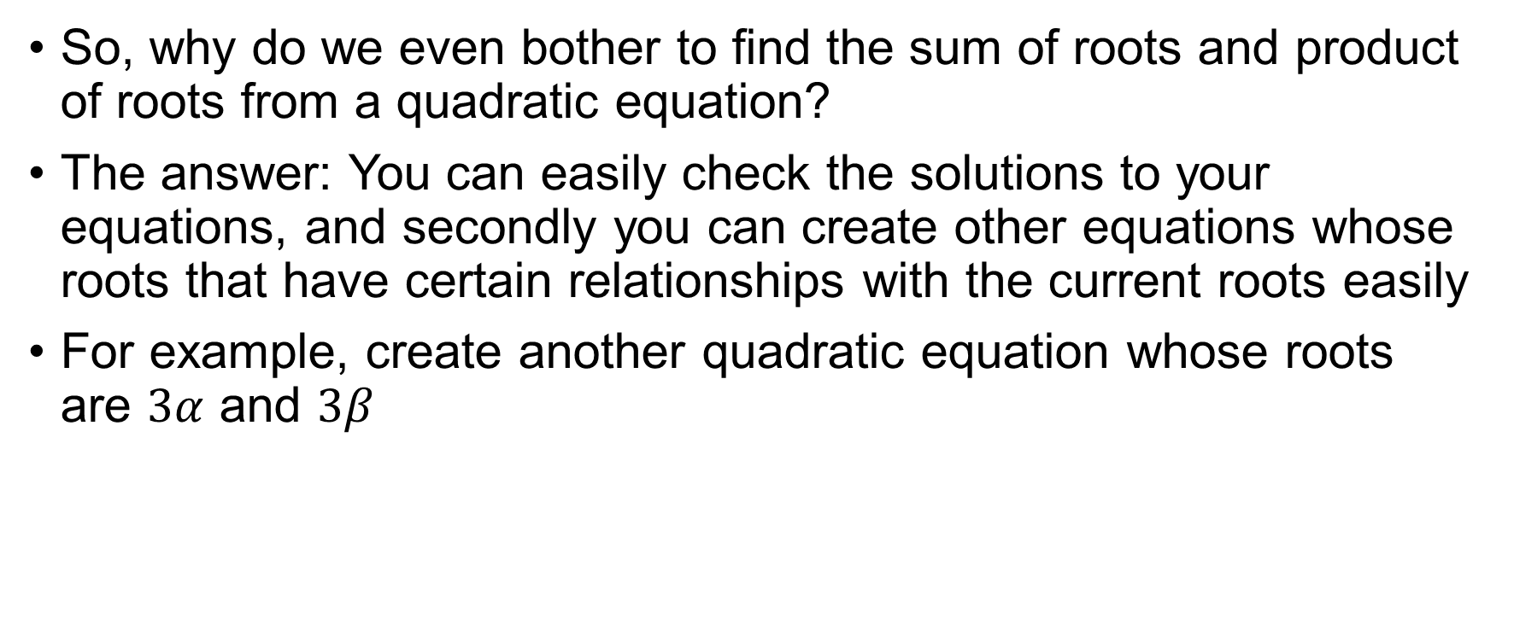
Sum of Roots and Product of Roots
So, why do we even bother to find the sum of roots and product of roots from a quadratic equation?
The answer: You can easily check the solutions to your equations, and secondly you can create other equations whose roots that have certain relationships with the current roots easily
For example, create another quadratic equation whose roots are $3α$ and $3β$

Slide 8
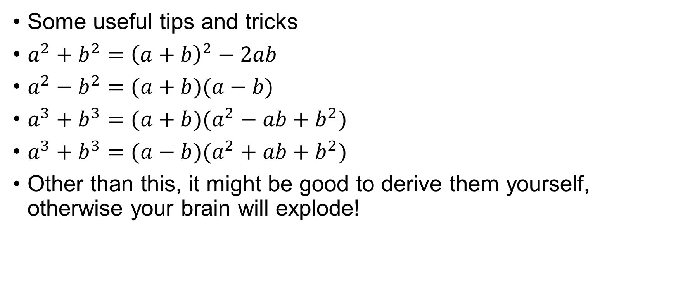
So to do so, we must be able to manipulate the roots well!
Some useful tips and tricks
$a^{2}+b^{2}={\left(a+b\right)}^{2}−2ab$
$a^{2}−b^{2}=(a+b)(a−b)$
$a^{3}+b^{3}=(a+b)(a^{2}−ab+b^{2})$
$a^{3}+b^{3}=(a−b)(a^{2}+ab+b^{2})$
Other than this, it might be good to derive them yourself, otherwise your brain will explode!

Slide 9

Roots Manipulation Exercise
Given $2x^{2}−4x−3=0$and $α>β$
Find
$\frac{1}{α}+\frac{1}{β}$
$α^{2} +β^{2}$
$α^{3} −β^{3}$
$α−β$

Slide 10
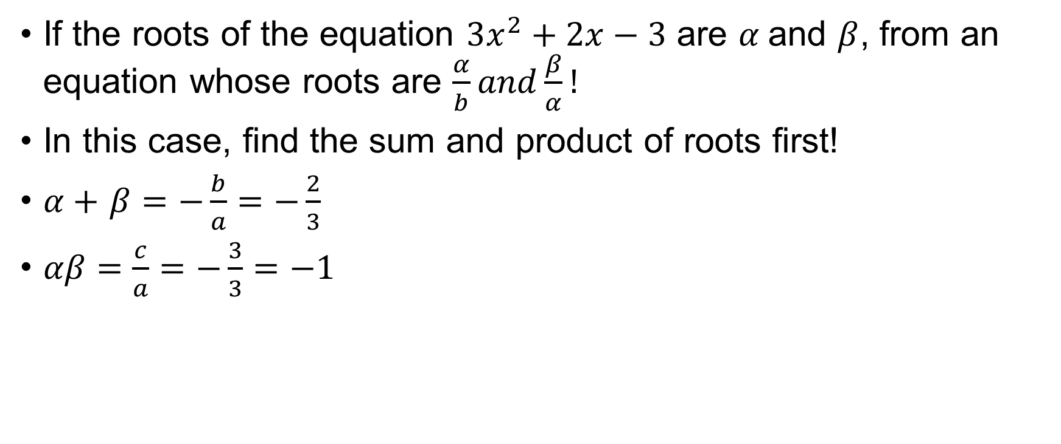
Quadratic Example
If the roots of the equation $3x^{2}+2x−3$ are $α$and $β$, from an equation whose roots are $\frac{α}{b}and\frac{β}{α}!$
In this case, find the sum and product of roots first!
$α+$ $β=−\frac{b}{a}=−\frac{2}{3}$
$αβ=\frac{c}{a}=−\frac{3}{3}=−1$

Slide 11
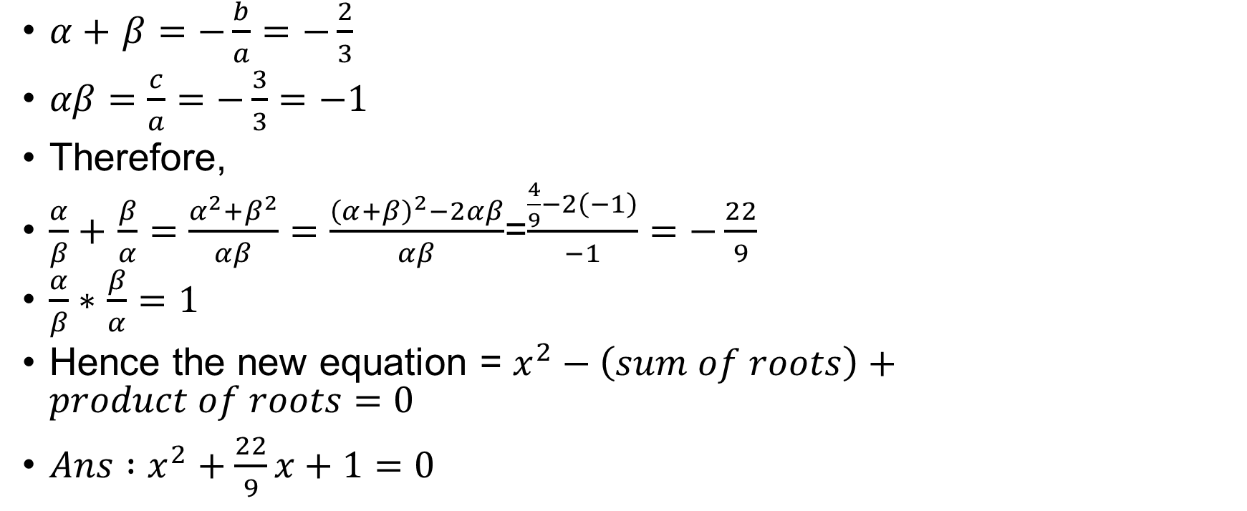
Quadratic Example
$α+$ $β=−\frac{b}{a}=−\frac{2}{3}$
$αβ=\frac{c}{a}=−\frac{3}{3}=−1$
Therefore,
$\frac{α}{β}+$ $\frac{β}{α}=\frac{α^{2}+β^{2}}{αβ}=\frac{{\left(α+β\right)}^{2}−2αβ}{αβ}$=$\frac{\frac{4}{9}−2\left(−1\right)}{−1}=−\frac{22}{9}$
$\frac{α}{β}∗$ $\frac{β}{α}=1$
Hence the new equation = $x^{2}−\left(sum of roots\right)+product of roots=0$
$Ans :x^{2}+\frac{22}{9}x+1=0$

Slide 12

Quadratic Exercise
Given that $3x^{2}−6x+1=0$ has roots $a$ and $b$
Find another quadratic equation whose roots are $\frac{1}{a}$ and $\frac{1}{b}$
Notes:
X^2 – 6x +3 = 0

