Slide 1
CS1101S Studio Session Week 4 HOF / Scope of Names
Simon Julian Lauw
Full Info > simonjulianl.github.io
30 August 2021
Acknowledgement (for his inspiring slides):
Niu Yunpeng

Slide 2
Table of Contents
More Wishful Thinking
Higher Order Functions
Scope of Names
Exercises

Slide 3
Before we start
Any question first about the lecture (Higher Order Function, Scope or other topics) ?
Today is the deadline for Functional Expressionism, it is a very interesting quest if you have tons of free time, otherwise ignore it.

Slide 4
Announcements
Quests are extra homework! If you are struggling with them, you are not obliged to touch them. You can get full marks even without doing the quests.
Contest Beautiful Rune will be closing tomorrow! Try to participate and make submission. (Note: it is not compulsory!)
Reading Assessment 1, Friday Week 4
Everything except order of growth
Recursion, substation model!!!
Mastery Check 1, before Friday Week 13

Slide 5
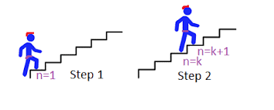
Wishful Thinking (More!)
Main idea :
Wish that function can solve whatever problem that you have defined
Break the problem into subproblem and current problem
If the function can solve subproblem, how do you construct the solution for current problem
Don’t forget the base case, when the subproblem is the smallest

Slide 6
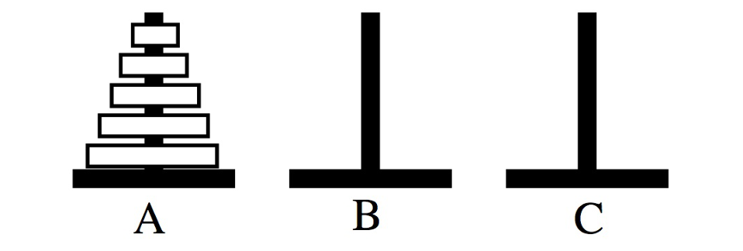
Exercise (Tower of Hanoi)
Given: a tower consisting of disks in increasing size
Goal: move all disks from A to C with the help of B
Constraint: never put a larger disk on top of a smaller one

Slide 7
Solution
Define the problem : Move the Hanoi Tower from first tower to second tower with the help of the third tower (slightly different formulation)

Slide 8
Solution
Define the problem : Move the Hanoi Tower from first tower to second tower with the help of the third tower (slightly different formulation)
Wish you have a function solveHanoi(n, first, second, third) that can solve the problem

Slide 9
Solution
Define the problem : Move the Hanoi Tower from first tower to second tower with the help of the third tower (slightly different formulation)
Wish you have a function solveHanoi(n, first, second, third) that can solve the problem
If I can solve the (n - 1)^{th} problem by using solveHanoi(n – 1, first, second, third), construct the current solution

Slide 10
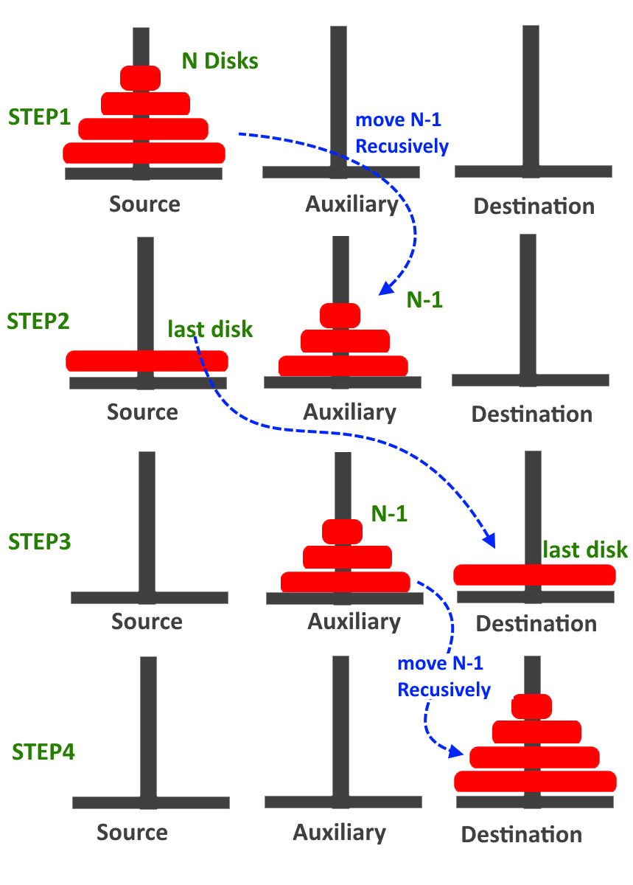

Slide 11
Solution
Define the problem : Move the Hanoi Tower from first tower to second tower with the help of the third tower (slightly different formulation)
Wish you have a function solveHanoi(n, first, second, third) that can solve the problem
If I can solve the (n - 1)^{th} problem by using solveHanoi(n – 1, first, second, third), construct the current solution!
Don’t forget the base case when n = 1, basically just move the disk from A to C

Slide 12


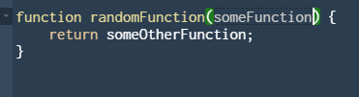
Higher Order Function (HOF)
HOF is just a function that does at least one of the following :
Takes at least a function as its parameter
Returns a function as its result

Slide 13
Lambda Expression
While we have construct using function keyword to define function, you will realize that this construct is very verbose (has tons of codes if you want to pass or return functions)
Therefore many languages including Source has this Lambda expression which is just shorthand notation for defining function
Syntax in Source :

Slide 14
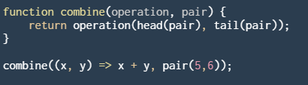
Why is HOF useful?
It provides a more complex means of abstraction
For example, in this generic function that combine two elements within a pair, you can supply an arbitrarily complex operation into operation and abstract it out as operation

Slide 15
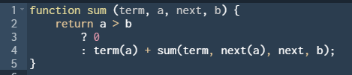
Why is HOF useful ?
For example, this function is very useful, you can use this to generate the sum of a list of integers of your choice!
Consecutive integers
Consecutive cubes

Slide 16
Scope of Names
Since last week, you have been introduced of local variables (constant declaration within the function scope)
The most important thing in determining how to substitute the value of the constants is :
The value of the name always refer to the closest surrounding declaration
Another important note is that the parameters and local variables are defined within the same scope
So you can’t declare a constant if the symbol is used by the parameter already

Slide 17
Scoping Rules
Form of declarations:
Pre-declared constants, e.g. math_floor, math_pow
Constant declarations, e.g. const x = 10;
Parameters of function declarations and lambda expressions, e.g. const f = x => x + 1;
Function name of function declarations, e.g. function f() {}

Slide 18
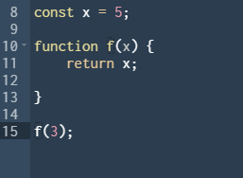
Let’s try Tons of Exercises
Indicate what each name refers to by drawing the arrow!

Slide 19
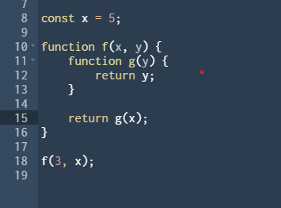
Let’s try Tons of Exercises
Indicate what each name refers to by drawing the arrow!

Slide 20
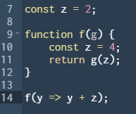
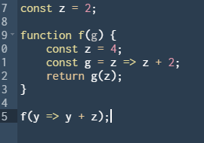
Let’s try Tons of Exercises
Indicate what each name refers to by drawing the arrow!

Slide 21
Studio Sheet

Slide 22
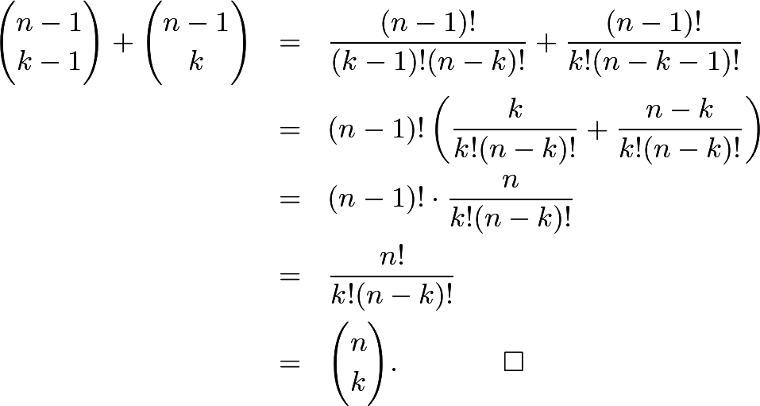
Pascal Triangle (Check this Pascal Identity)

