Slide 1
CS1101S Studio Session Week 5 Data Abstraction
Simon Julian Lauw
Full Info > simonjulianl.github.io
6 September 2021
Acknowledgement (for his inspiring slides):
Niu Yunpeng

Slide 2
Table of Contents
Data Abstraction
Data Structure
Pair and List
Exercises

Slide 3
Before we start
Hope your RA went well!
Any question first about the lecture (Data Abstraction, Pair, List, etc)
There are several useful functions for this SICP chapter 2:
display_list which show the list in list notation list(…)
draw_data
It can take multiple arguments
It can help to compare two structures and visualize it out for you
It’s helpful if you want to access elements within a deeply nested pair and you have trouble visualizing it

Slide 4
Data Abstraction
Starting with a big question, what is data in the first place ?

Slide 5
Data Abstraction
Starting with a big question, what is data in the first place ?
Data is information in the form that can be processed and can be passed from one place to another

Slide 6
Data Abstraction
Starting with a big question, what is data in the first place ?
Data is information in the form that can be processed and can be passed from one place to another
Recall what an abstraction is

Slide 7
Data Abstraction
Starting with a big question, what is data in the first place ?
Data is information in the form that can be processed and can be passed from one place to another
Recall what an abstraction is
It’s just a way to show to the users what’s necessary and hide the implementation details

Slide 8
Data Abstraction
Starting with a big question, what is data in the first place ?
Data is information in the form that can be processed and can be passed from one place to another
Recall what an abstraction is
It’s just a way to show to the users what’s necessary and hide the implementation details
Overall, data abstraction is
A way to represent information (state) and what we can do with them (behaviours)

Slide 9
Data Structure
Data are everywhere, and they are messy
We need a way to organize them, and there are many ways to organize/represent the same data
For example, if I want to store a sequence of 1 2 3 4 5, how will you store it ?

Slide 10
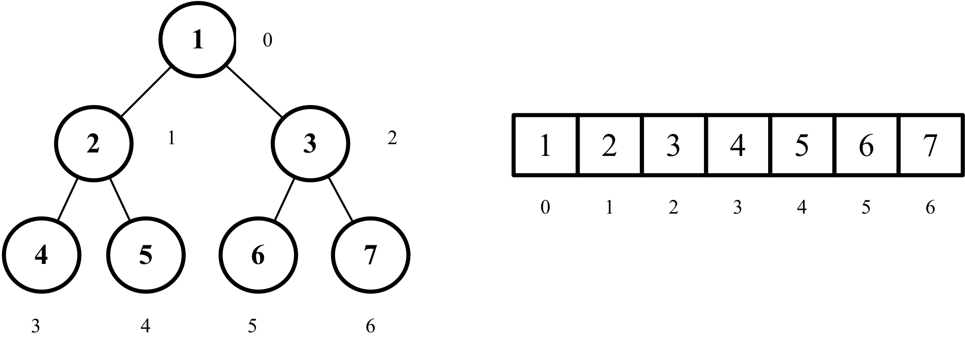
Data Structure
Data are everywhere, and they are messy
We need a way to organize them, and there are many ways to organize/represent the same data
For example, if I want to store a sequence of 1 2 3 4 5, how will you store it ?

Slide 11
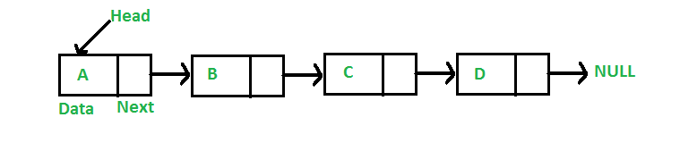
Data Structure
Data are everywhere, and they are messy
We need a way to organize them, and there are many ways to organize/represent the same data
For example, if I want to store a sequence of 1 2 3 4 5, how will you store it ?
Therefore, these ways to structure your data is called data structure (they are at the implementation level)

Slide 12
Data Structure in Source
In Source, a basic data structure that you have is Pair
A pair is just a node containing two items (head and tail, and they don’t need to be of the same type)
You can do these operations
head: (x, y) => x
tail : (x, y) => y
is_pair, etc
You can visualize them using box-and-pointer diagram (Demo) or using pair notations ( [x, y] square brackets, which is the same as the output in the interpreter )

Slide 13
Data Abstraction (Summary)
Forms compound data (state) with its own operations (behaviour)
Example: Pair
Composed of two elements
Operations are different e.g. head and tail defined for pairs but not for primitive data type
Learning Points:
How to construct the data structure?
How to create operations for the data structure?
Notes:
Hint: Consider if n === 1

Slide 14
Data Abstraction
Data Structure: Pair
How to construct ? (Constructor)
How to make head and tail operations ? (Selectors)
Hint: Higher-order Functions (Data Structure === Function)
Recall how a Curve : Number ---> Point

Slide 15
Data Abstraction
Constructor: (Point: String ---> Number)
function make_pair(x, y) {
return dimension => dimension === “x” ? x : y;
}
Selectors:
const x_of = p => p(“x”);
const y_of = p => p(“y”);

Slide 16
Data Abstraction
Constructor: (Point: Function ---> Number)
function make_pair(x, y) {
return f => f(x, y);
}
Selectors:
const x_of = p => p((x, y) => x);
const y_of = p => p((x, y) => y);
Note how both implementations work as expected => implementations don’t matter

Slide 17
Data Abstraction
Both implementations work as expected
Specific implementations don’t matter!
Idea: If it walks like a duck and quacks like a duck, then it is a duck.

Slide 18
Data Structure (List)
Of course to have a pair only is not really useful (if you want to store 1000 data)
Hence in Source, we have a list
A list is either null or a pair whose tail is a list (recursive definition) > (Demo)
Methods :
length,
reverse,
is_null, etc

Slide 19
Check Your Understanding
Is this a list?
null
pair(1, 2)
pair(1, null)
pair(1, pair(null, null))
Notes:
What is the result?

Slide 20
Check Your Understanding
Notations: Box notation, List notation, and Box and Pointer diagram
Convert the following to box notation and / or BnP diag.
list(1, 2, 3)
list(1, list(2, 3), list(4))
list(1, list(2), list(3), list(4))
list(1, list(2, list(3, list(4))))
Notes:
What is the result?

Slide 21
Studio Sheet

Slide 22
Tips / Extra Questions
For Qn 1 in-class sheet, exercise your wishful thinking ~
For Qn 2, can you write a solution with an iterative process ?
If you are too free, feel free to try this challenge : how do you write a binary tree* in Source using the available tools, and provide a method to find an item within a binary tree
AKA, implement search(x: T): T
*Binary Tree => is either null or a list where the first item is the data in the node, the second and third items are binary tree

Slide 23
Extra Questions
Draw box and pointer diagram for (by hand)
pair(pair(pair(3, 4), pair(1, 2)), pair(pair(3, 4), pair(1, null)))

Slide 24
Extra Section : Length of a List
Definition:
length of empty list is 0
length of non-empty list = 1 + length of tail
What is the length of these lists?
null
list(1, null)
list(1, 2, 3)
list(1, list(2, 3), list(4))
list(1, list(2), list(3), list(4))
list(1, list(2, list(3, list(4))))
Ans : 0,2,3,3,4,2
Notes:
What is the result?

