Slide 1
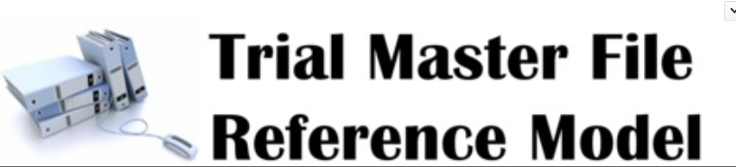
Overview and Version 3.1

Slide 2
What is the Trial Master File?
The sponsor and the investigator shall keep a clinical trial master file. The clinical trial master file shall at all times contain the essential documents relating to that clinical trial which allow verification of the conduct of a clinical trial and the quality of the data generated […]. It shall be readily available, and directly accessible upon request, to the Member States.
[EU Regulation 536/2014]

Slide 3
What are “Essential Documents”?
Essential documents are those documents that individually and collectively permit evaluation of the conduct of a trial and the quality of the data produced. These documents serve to demonstrate the compliance of the investigator, sponsor, and monitor with the standards of GCP and with all applicable regulatory requirements.
[ICH GCP, Section 8.1]

Slide 4
Why a TMF Reference Model?
ICH GCP Section 8.2 – 8.4
“The minimum list of essential documents that has been developed.....”
ICH GCP does NOT provide a comprehensive contents list for the TMF
Examples of missing documentation:
Electronic systems
Data management and statistical methodology
Safety monitoring

Slide 5


Origins of the TMF Reference Model Concept
Gap in Electronic Document Management (EDM) Reference Model identified for non-submission TMF documents
EDM scope is regulatory submissions:
Significant input to the EDM Reference Model is TMF Documents
Hence the creation of the TMF Reference Model
DIA Communities
Document & Records Management Community
EDM Reference Model

Slide 6
Defining the TMF Reference Model
Supporting files e.g. computer SDLC files; GMP manufacturing files; vendor selection files
Minimum list of essential documents, as defined by ICH GCP, Chapter 8
Usually considered outside the scope of the TMF
The Trial Master File
Other trial-related records that “permit evaluation of the conduct of the trial and quality of data produced”
Other business records

Slide 7
Benefits Gained by Implementation
Standardizes company content and structure and limits company customization
We all follow the same regulatory requirements
Inspectors are the same across companies
Company-specific requirements are often driven by tradition, legacy or personal opinion
Simplifies engagement of CROs and other third parties
Simplifies consolidation of disparate documents into a single TMF structure (in real time, at defined trial events and/or at study end)

Slide 8
TMF RM History and Management
Managed by a Steering Committee of 14 members
Change Control Board
Extended Group of over 700 members
Mar 2009: 1st Meeting
June 2010: Version 1.0- 11 zones w/ associated artifacts
Nov 2011: Version 1.2- Investigator Site File and 1st Intro slide set
~Dec 2012: Kick-off of many Work Groups that support the TMF manage-ment process
June 2015: Release of version 3
October 2018: Release of version 3.1
Feb 2011: Version 1.1- Regulator feedback
Feb 2014:
Establishment of the TMF RM Steering Committee
June 2018: Release of The Exchange Mechanism
June 2012: Version 2.0- Device, Process-based metadata, and IIS

Slide 9
Purpose of the TMF Reference Model
Standard Contents
Industry opinion on what is kept in a TMF
Standard Naming
Based on ICH E6 Sect. 8 & industry-accepted terminology
Standard Structure
To support paper and electronic systems
Standard Metadata
For eTMFs, minimum metadata at system and artifact level
21

Slide 10
Purpose – Standard Contents
Expands minimum list of documents found in ICH GCP
Consistent interpretation, based on peer opinion and regulator feedback
Avoids scope creep for TMF
Standard Contents
Industry opinion on what is kept in a TMF

Slide 11
Purpose – Standard Naming
Avoids one artifact being referred to using different terms within an organisation and between organisations
Avoids company-specific terms
Standard Naming
Based on ICH E6 Sect. 8 & industry-accepted terminology

Slide 12
Purpose – Standard Structure
Facilitates consistent filing and rapid retrieval
Helpful when responsibility for maintaining different sections of the TMF is distributed across several parties e.g. sponsor, CRO, consultants
Standard Structure
To support paper and electronic systems

Slide 13
Purpose – Standard Metadata
Encourages adoption of good practices to facilitate document retrieval
Encourages consistency across the industry for exchange of content
Standard Metadata
For eTMFs, minimum metadata at system and artifact level

Slide 14

Structure and Content of the Model
Data held in a simple Excel spreadsheet
Easy for non-technical people to use!
Hierarchical structure
11 Zones
48 Sections
249 Artifacts

Slide 15
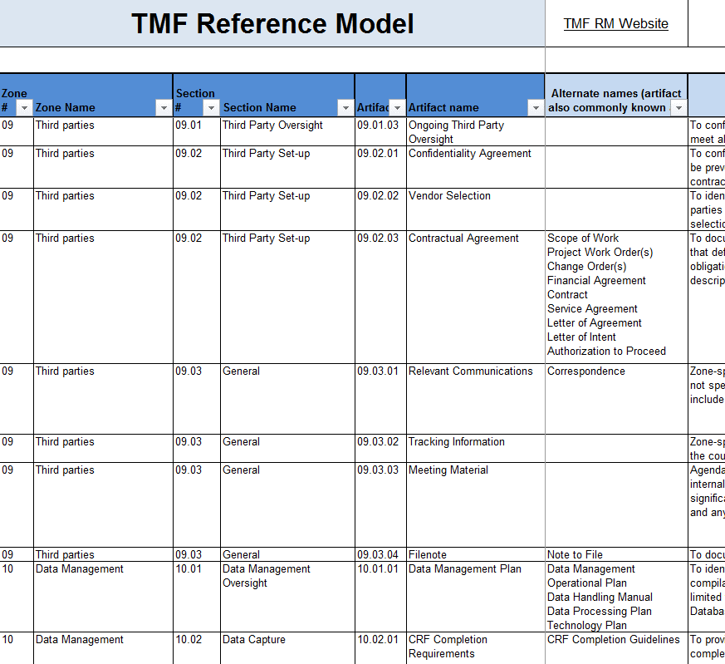
TMF Reference Model Zones
11 Zones
Trial Management
Central Trial Documents
Regulatory
IRB or IEC and other Approvals
Site Management
IP and Trial Supplies
Safety Reporting
Central and Local Testing
Third Parties
Data Management
Statistics
27

Slide 16
TMF Reference Model Sections
The contents of each zone are grouped into sections
Each section includes content that is relevant to a specified activity
Sections are helpful for classification and searching

Slide 17
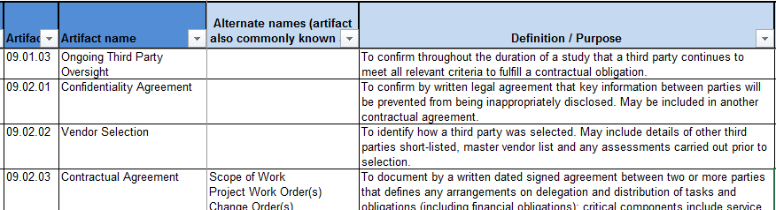
TMF Artifacts
Could include data files, documents, media, digitised content
Could be 1 document or multiple documents
Includes associated records e.g. approvals, translations, checklists, QC records, amendments

Slide 18
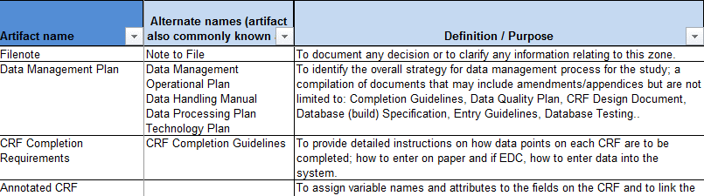
Artifact Definition
A description to explain the content of an artifact and/or the use and purpose of the artifact
Assists with ensuring a common interpretation of the model
Aligned with ICH definitions

Slide 19
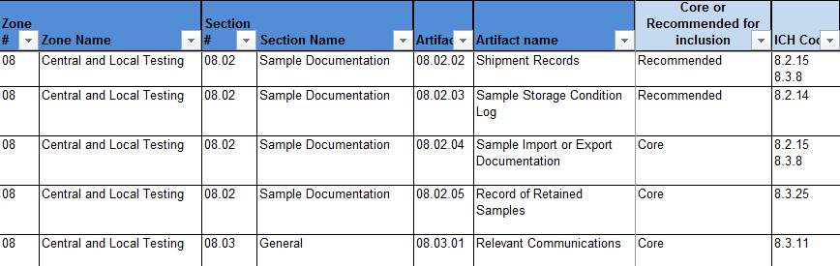
ICH Code
Reference to the ICH GCP Guidelines
Notice that other sections beyond E6 Section 8 are quoted
Includes indirect as well as direct references

Slide 20
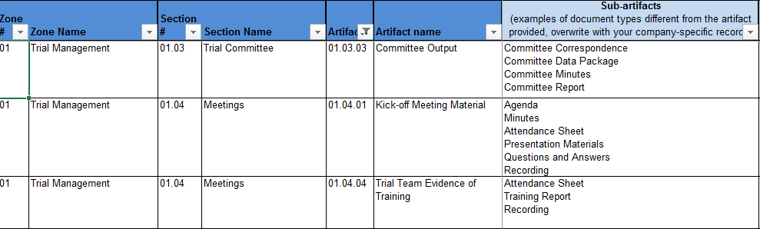
Sub-artifacts
When an artifact name does not explicitly refer to a single kind of record (e.g. Meeting Material), sub-artifacts provide a means to list all company-specific records that are expected for a given artifact.
Only examples are provided in the model but expected to be overridden as part of adopting the Reference Model for a company.
Current subgroup activity to refine

Slide 21
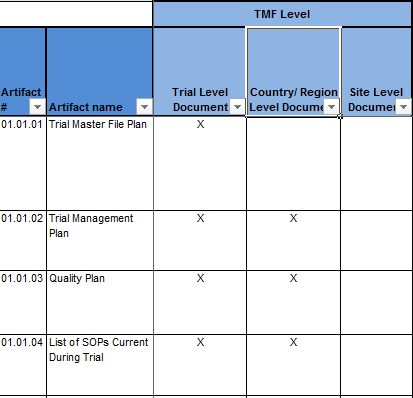
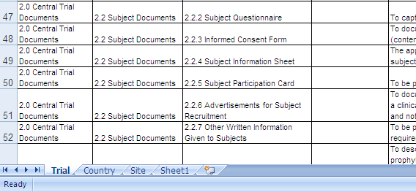
Paper TMF Application
To create a paper TMF, split the Model out to 3 spreadsheets, filtering for trial, country and site on each

Slide 22
Version Control
Maintenance release e.g. v3.0.1
e.g. minor typographic changes, clarification, sub-artifacts
Minor release e.g. v3.1
Substantial change in content but no compatibility issues e.g. additional optional column (milestones)
Major release e.g. v4.0
Change likely to have compatibility issues with prior version e.g. addition/removal of artifacts

Slide 23
TMF Reference Model 3.1.0
Documentation Delivered
TMF Reference Model Version 3.1.0
TMF Reference Model Version 3.1.0 Release Notes
Released on 10-Sep-2018 for preview
Effective as of 10-Oct-2018
https://tmfrefmodel.com/resources/
Change Requests ‘By the Numbers’
Total of 64 Change Requests Submitted since October 2015
23 Approved and included in release 3.1.0
18 Rejected
21 Deferred
Deferred to sub-teams, Steering Committee or next release

Slide 24
TMF Reference Model 3.1.0
Added deliverables already approved
Suggested dating conventions for each artifact (Feb 2017)
Recommended milestones/events (Jan 2018)
Also scheduled for assessment during 2019 to take account of industry feedback

Slide 25
TMF Reference Model 3.1.0
Four minor changes to artifact name
03.01.02 Regulatory Approval Notification…. Regulatory Approval Decision
03.02.02 Import or Export License…. Import or Export Documentation
03.03.01 Notification to Regulatory Authority of Safety or Trial Information…. Notification of Safety or Trial Information
10.03.10 Data QC or QA Plan and Results…. Data Review Documentation

Slide 26
TMF Reference Model 3.1.0
Eight minor changes to artifact definition/purpose
01.05.04 Filenote
02.01.01 Investigator’s Brochure
03.01.01 Regulatory Submission
03.03.01 Notification of Safety or Study Information
06.01.06 IP Transfer Documentation
08.02.05 Record of Retained Samples
11.03.02 Analysis QC Documentation
11.03.09 Final Analysis Datasets

Slide 27
TMF Reference Model 3.1.0
Sub-artifacts added for three artifacts
10.03.09 Dictionary Coding
10.03.10 Data QC or QA Plan and Results
02.03.01 Clinical Study Report
Further sub-artifacts currently under development by sub-artifact team…. for release in 2019

Slide 28
TMF Reference Model 3.1.0
Two artifacts with revised ICH codes
To correct a typographical error
02.01.02 Protocol
02.01.04 Protocol Amendment

Slide 29
TMF Reference Model 3.1.0
Three artifacts with additional filing level
Added study-level:
03.01.01 Regulatory Submission
03.01.02 Regulatory Approval Notification
Added site level:
06.03.02 IP Unblinding Plan

Slide 30
TMF Reference Model 3.1.0
Two artifacts with additional alternate names
To correct a typographical error
03.01.02 Regulatory Authority Decision
03.02.02 Import or Export Documentation

Slide 31
Feedback and Change Requests
If you have any feedback on the TMF Reference Model, including comments on existing artifacts, milestones, suggestions for additional artifacts or general comments about the TMF Reference Model, please use the link below to submit your feedback:
https://tmfrefmodel.com/feedback/

Slide 32
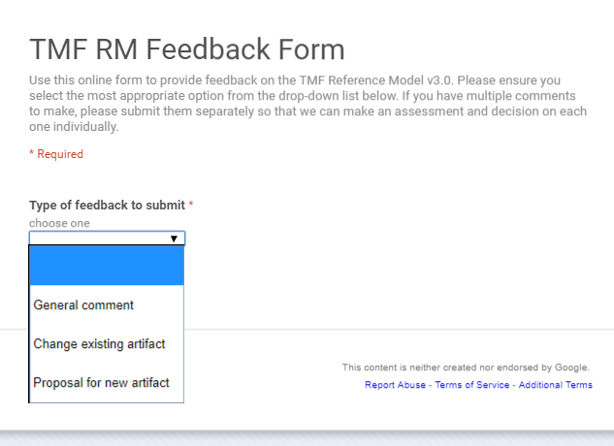
Feedback and Change Requests
Use online form for:
Making a suggestion for a general enhancement to the Reference Model
Suggesting a change to any metadata for an existing artifact
Suggesting a new artifact
Select the appropriate option and only make ONE suggestion per form submitted please.
Do not send general queries using this form.

Slide 33
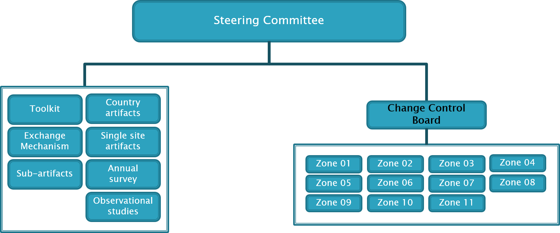
Get Involved!
Have a passion for the TMF? Are you an expert in a particular area? We are always looking for new members to join the zone teams!
Follow the instructions on the Join page or contact any member of the CCB team

Slide 34
TMF RM Version 3.1.0
What is the Impact?
Release notes give all details to assess impact
Minor release so minimal impact on overall structure
Artifact names may change BUT the artifact numbers do not change
Includes process aspects such as milestones and dating conventions – very customised by Sponsors / CROs

Slide 35
Future Releases
Minor/Maintenance release anticipated in 1Q 2019
Major release anticipated later in 2019 to incorporate deliverables from the following sub-teams:
Sub-artifact
Observational and Device

Slide 36
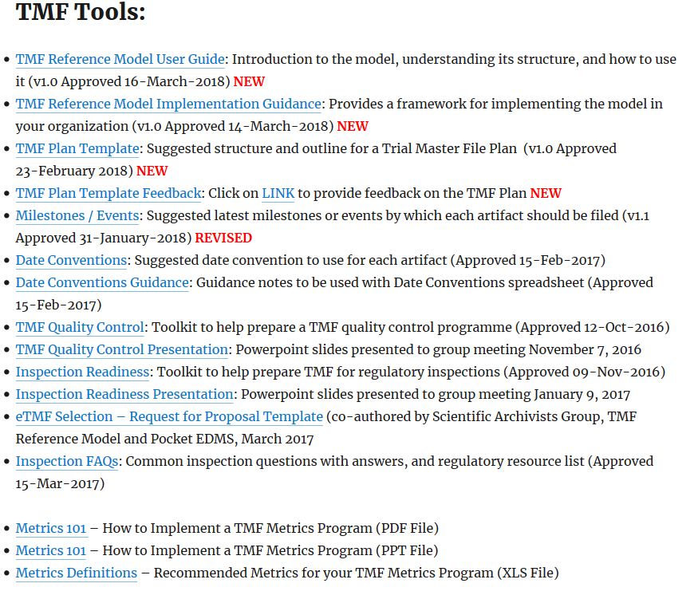
Deliverables to Date

Slide 37
Ongoing Subgroup Activities
Group | Aim
Metadata | To standardise the metadata collected – integrated into the Exchange Mechanism
Sub-artifacts | To standardise the subartifacts in the TMF RM
Country specific artifacts | Guide for country specific artifacts required (with links to relevant websites)
Device Studies | Device specific artifacts
JGCP | Mapping to Japanese GCP documents

Slide 38
QUESTIONS?
Join the TMF Reference Model Yahoo! Discussion Group
https://groups.yahoo.com/neo/groups/tmfrefmodel/info
Knowledge sharing
Networking
Too Much Fun!
Join the TMF Reference Model Project Team
http://tmfrefmodel.com/join

