Slide 1
TASH
(Tcl Ada SHell)
An Ada binding to Tcl/Tk
SIGAda 2000
November, 2000
Terry Westley
http://www.adatcl.com

Slide 2
Tutorial Outline
Introduction to Tcl/Tk and TASH
Scripting in Ada with TASH
GUI programming in Ada with TASH

Slide 3

What is Tcl/Tk?
Tool Command Language
  Simple, powerful, and extensible scripting language
  Compare to Bourne shell, C shell, Perl, awk
ToolKit
  Portable GUI toolkit extension of Tcl

Slide 4
Why I Like
Scripting Languages
Rapid development of small applications
Integration of several small applications into one larger coherent application
Operating system interfaces
Text processing facilities

Slide 5
Scripting Languages Capabilities
Regular expression pattern matching
and string substitution
Associative arrays
File and directory handling
Execute another program
  Send input to program
  Read its output

Slide 6
Why Tcl/Tk in Particular?
Platform independent
  Unix (X Windows), Windows, and Macintosh
Embeddable
Extensible
  Object oriented
  Widget libraries
  Oracle interface
Open Source

Slide 7
Sample Tcl Script
Identify Programming Language
Command line arguments
[] -- execute a command
foreach file $argv {
set extension [file extension $file]
switch -glob $extension {
".tcl" {puts "$file tcl"}
".ad[abs]" {puts "$file ada"}
".[ch]" {puts "$file c"}
default {puts "$file unknown"}
}
"glob" style pattern matching

Slide 8
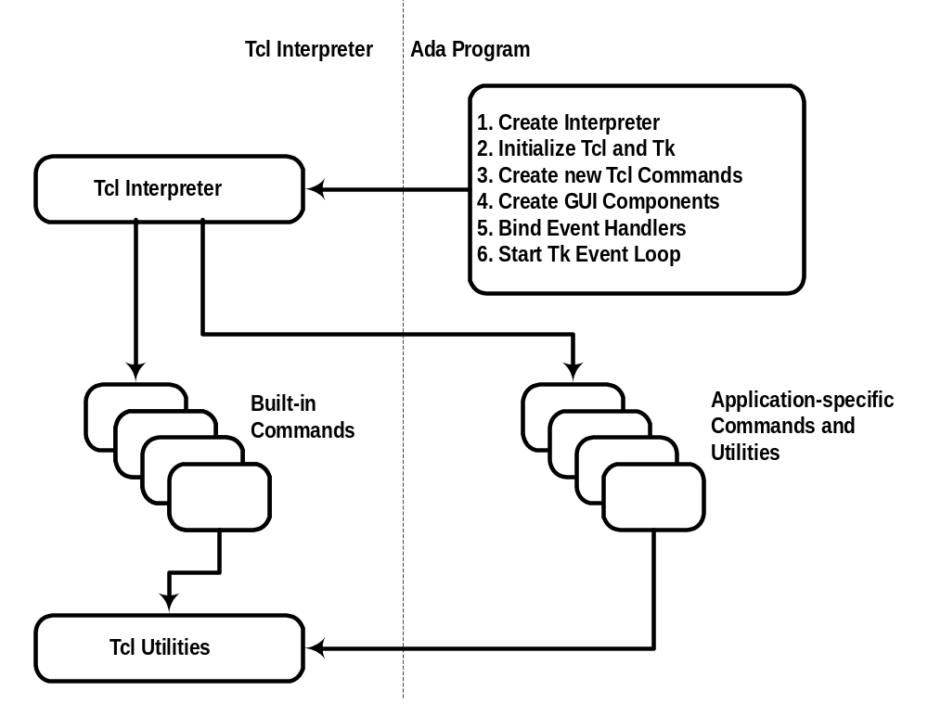
Tcl Interpreter Interaction
(Embedded Tcl)

Slide 9
Why I Don't Like
Scripting Lanuages
Lack of strong typing
Some scripting languages have very limited modularity facilities
Lack of module interface checks
Poor performance

Slide 10
What is TASH?
Free Ada binding to Tcl/Tk
TASH is not a scripting language with an Ada-like syntax

Slide 11
Why Use TASH?
To extend Tcl by adding new commands coded in Ada instead of C
To use Tcl capabilities in an Ada program
  Regular expression pattern matching
  Associative arrays
Platform independence
  Operating system interface
  GUI toolkit

Slide 12
Sample TASH Program
for I in 1..Ada.Command_Line.Argument_Count loop
declare
File_Name : constant String := Ada.Command_Line.Argument (I);
Extension : constant String := Tash.File.Extension (File_Name);
begin
if Extension = ".tcl" then
Ada.Text_IO.Put_Line (File_Name & " tcl");
elsif Tash.Regexp.Match (Extension, ".ad[sb]") then
Ada.Text_IO.Put_Line (File_Name & " ada");
elsif Tash.Regexp.Match (Extension, ".[ch]") then
Ada.Text_IO.Put_Line (File_Name & " c");
else
Ada.Text_IO.Put_Line (File_Name & " unknown");
end if;
end;
end loop;

Slide 13
Ada Binding
Thin binding
Thinner binding
Thick binding

Slide 14
Thinner Binding
Implements Tcl APIs (tcl.h)
  Subprograms and data types correspond one-to-one to C functions and Tcl data types
Uses Tcl return codes
Uses C data types (Interfaces.C)
Tcl and Tcl.Tk packages

Slide 15
Thin Binding
Implements Tcl APIs (tcl.h)
  Again: Subprograms and data types correspond one-to-one to C functions and Tcl data types
Uses exceptions in place of return codes
Uses Ada data types
Tcl.Ada and Tcl.Tk.Ada packages

Slide 16
Thick Binding
Interface to Tcl capabilities
  Not a one-to-one correspondance with C functions or Tcl data types
Uses tagged controlled types
Hides and protects access to
Tcl interpreter
Automatically initializes Tcl
Tash package and its children
C
Just say NO

Slide 17
Tutorial Outline
Introduction to Tcl/Tk and TASH
Scripting in Ada with TASH
GUI programming in Ada with TASH

Slide 18
Scripting vs Ada
Scripting good for
  small applications (< 1 KSLOC)
  where strings are chief data type
  integration of several programs into one application
  GUI front-end to command line program

Slide 19
Scripting vs Ada
Ada much better for
  larger applications
  non-string and complex data types
  higher performance

Slide 20
TASH Scripting Capabilities
List object
Regular expression pattern matching
Associative arrays
File and directory handling
File I/O
Executing other programs
C-style printf formatting
Platform information

Slide 21
TASH List Object
Based on Tcl lists
Zero or more elements in an ordered list
Each element may be a scalar type, a string or a list
Generic list package for handling
  integer types
  floating point types
Elements of different types may be stored in one list

Slide 22
Common List Functions
The
The
quick
brown
quick
brown
L
null
declare
L : Tash.Lists.Tash_List;
begin
L := Tash.Lists.To_Tash_List ("quick");
Tash.Lists.Append (L, "brown");
Tash.Lists.Insert (L, 1, "The");

Slide 23
Common List Functions
L
The
quick
brown
Tash.Lists.Head (L) = "The"
Tash.Lists.Tail (L) = "brown"
Tash.Lists.Get_Element (L, 2) = "quick"
Tash.Lists.Length (L) = 3
Tash.Lists.Is_Empty (L) = False
Tash.Lists.To_String (L) = "The quick brown"

Slide 24
Append Elements vs List
L
The
quick
brown
K
fox
jumps
over
Tash.Lists.Append_Elements (L, K);
L
The
quick
brown
fox
jumps
over
Tash.Lists.Append_List (L, K)
L
The
quick
brown
fox
jumps
over

Slide 25
Concatenate List & String
L
The
quick
brown
K
fox
jumps
over
J := L & K;
J
The
quick
brown
fox
jumps
over
J := J & "the" & "lazy" & "dog";
L
The
quick
brown
fox
jumps
over
the
lazy
dog

Slide 26
Delete List Elements
Tash.Lists.Delete_Element (L, 3);
Tash.Lists.Delete_Slice (L, 2, 4);
Over
Brown
L
L
The
The
quick
quick
brown
brown
fox
jumps
fox
fox
over
jumps
jumps
over
over
over

Slide 27
Replace List Elements
Tash.Lists.Replace_Element (L, 2, "slow");
Tash.Lists.Replace_Slice (L, 5, 6, "hops");
L
The
slow
quick
brown
fox
jumps
over
hops
Over

Slide 28
Push and Pop
Tash.Lists.Pop (L);
Tash.List.Push (L, "A");
L
quick
brown
fox
jumps
over
over
L
A
The
The
quick
quick
brown
brown
fox
fox
jumps
jumps
over
over

Slide 29
Sort A List
L := Sort (L);
L := Sort (L, Order => Decreasing);
L
quick
over
jumps
fox
brown
The
L
The
quick
brown
fox
jumps
over
L
The
brown
fox
jumps
over
quick

Slide 30
Split a String to Create a List
L := Tash.Lists.Split (
Str => "http://www.adatcl.com/docs/intro.htm",
Split_At => "/");
L
http:
www.adatcl.com
docs
intro.htm

Slide 31
Create a List from a String
L := Tash.Lists.To_Tash_List (
"{Terry Westley} twestley@acm.org");
L
Terry Westley
twestley@acm.org

Slide 32
Join the Elements of a List
L
Terry Westley
twestley@acm.org
Tash.Lists.Join (L, ",") =
"Terry Westley,twestley@acm.org"

Slide 33
Integer and Float List Elements
L
L
L
L
The
The
The
The
quick
quick
quick
quick
brown
brown
brown
brown
fox
fox
fox
fox
jumps
jumps
jumps
jumps
over
over
over
over
1.0
one
the
1
lazy
lazy
lazy
lazy
dog
dog
dog
dog
Tash.Lists.Replace_Element (L, 7, "one");
Tash.Integer_Lists.Replace_Element (L, 7, 1);
Tash.Float_Lists.Replace_Element (L, 7, 1.0);

Slide 34
TASH Scripting Capabilities
List object
Regular expression pattern matching
Associative arrays
File and directory handling
File I/O
Executing other programs
C-style printf formatting
Platform information

Slide 35
Regular Expression Query
Tash.Regexp.Match (
Source => "Tcl/Tk",
Pattern => "T[cC]") = True
Tash.Regexp.Match (
Source => "Tcl/Tk",
Pattern => "(Ada|Tk)") = True
For complete details on forming regular expressions, see Tcl documentation page re_syntax or IEEE 1003.2

Slide 36
Regular Expressions
Atom
  A character
  A character group, e.g. [a-zA-Z], [cC], [^0-9]
  Any single character: .
  A branch
Quantifier
  * = sequence of 0 or more atoms
  + = sequence of 1 or more atoms
  ? = 0 or 1 atom
Branch
  Match one of several patterns: (Tcl|Tk)

Slide 37
Regular Expression Examples
An Ada comment line:
^ *--+
An Ada identifier:
[A-Z][A-Za-z0-9_]*
A floating point number:
(+|-)?[0-9]+\.[0-9]+([eE](+|-)?[0-9]+)?

Slide 38
Regular Expression Example
(+|-)? [0-9]+ \. [0-9]+ ([eE](+|-)?[0-9]+)?
Sign: 0 or 1 of either + or -
Fore: 1 or more digits
Decimal point
Aft: 1 or more digits
Exponent: 0 or 1 of:
  e or E followed by an optional sign followed by 1 or more digits

Slide 39
Extract a Substring
L := Tash.Regexp.Match (
Source => "Tcl/Tk",
Pattern => "T[kK]$");
L
Tk

Slide 40
Match and Extract
Multiple Substrings
L := Tash.Regexp.Match (
Source => "Tcl/Tk",
Pattern => "(Tcl)/(Tk)"));
L
Tcl/Tk
Tcl
Tk

Slide 41
String Substitution
Tash.Regexp.Substitute (
Source => "Tcl/Tk",
Pattern => "(Tcl/|Tk)*",
Sub_Spec => "Use TASH") =
"Use TASH"

Slide 42
Other Regular Expression Features
Ignore case in source string
Search for strings in the elements of a list
  Going forward
  Going backward

Slide 43
TASH Scripting Capabilities
List object
Regular expression pattern matching
Associative arrays
File and directory handling
File I/O
Executing other programs
C-style printf formatting
Platform information

Slide 44
Associative Arrays
Based on Tcl arrays
Zero or more elements each indexed by a string
Each element value may be a scalar type, a string or a list
Generic array packages for handling
  integer types
  floating point types
Element values of different types may be stored in one array

Slide 45
Create an Array
declare
A : Tash.Arrays.Tash_Array;
begin
A := Tash.Arrays.To_Tash_Array (
"{New York} Albany Maryland Baltimore");
Indices
Values
A
New York
Albany
Maryland
Baltimore

Slide 46
Get Array Indices
A
New York
Albany
Maryland
Baltimore
L := Tash.Arrays.Get_Indices (A);
L
New York
Maryland
L := Tash.Arrays.Get_Indices (A, "Mary*");
L
Maryland

Slide 47
Glob-Style Pattern Matching
Not full regular expressions
Match any single character: ?
Match any sequence of zero or more characters: *
Character group: [A-Z], [0-9]
Alternation: {a,b,…}
For complete details on forming glob-style patterns, see Tcl documentation page glob

Slide 48
RE vs Glob Patterns
Regular Expressions are more powerful, resulting, often, in more complicated patterns
Regular Expressions can match a portion of a string
Glob-style patterns usually must match the whole string

Slide 49
Get Array Indices
A
New York
Albany
Maryland
Baltimore
Tash.Arrays.Get_Indices (A) =
"{New York} Maryland"
Tash.Arrays.Get_Indices (A, "Mary*") =
"Maryland"
Tash.Arrays.Get_Indices (A, "*[Yy]*") =
"{New York} Maryland"

Slide 50
Set Array Element
Tash.Arrays.Set_Element (
TArray => A,
Index => "Maryland",
Value => "Annapolis");
A
New York
Albany
Maryland
Baltimore
Annapolis

Slide 51
Set Array Element
Tash.Arrays.Set_Element (
TArray => A,
Index => "California",
Value => "Sacramento");
A
New York
Albany
Maryland
Annapolis
California
Sacramento

Slide 52
Set Array Elements
Tash.Arrays.Set_Elements (A,
"Oregon Portland Pennsylvania Harrisburg");
A
New York
Albany
Maryland
Annapolis
California
Sacramento
Oregon
Pennsylvania
Portland
Harrisburg

Slide 53
Delete Element
Tash.Arrays.Delete_Element (A, "Pennsylvania");
A
New York
Albany
Maryland
Annapolis
California
Sacramento
Oregon
Pennsylvania
Portland
Pennsylvania
Harrisburg
Harrisburg

Slide 54
Get Elements Sorted by Indices
A
New York
Albany
Maryland
Baltimore
L := Tash.Arrays.Get_Sorted_Elements (A);
L
Maryland
Baltimore
New York
Albany

Slide 55
Get Sorted Indices
A
New York
Albany
Maryland
Baltimore
L := Tash.Lists.Sort (
Tash.Arrays.Get_Indices (A));
L
Maryland
New York

Slide 56
Array Query Functions
A
New York
Albany
Maryland
Baltimore
Tash.Arrays.Is_Empty (A) = False
Tash.Arrays.Length (A) = 2
Tash.Arrays.Get_Element (A, "Maryland") = "Baltimore"
Tash.Arrays.Get_Elements (A, "Mary*") = "Baltimore"
Tash.Arrays.Get_Elements (A, "*[Yy]*") =
"Albany Baltimore"
Tash.Arrays.Exists (A, "Colorado") = False
Tash.Arrays.To_String (A) =
"{New York} Albany Maryland Baltimore"

Slide 57
Integer and Float Array Values
Tash.Integer_Arrays.Set_Element (A, "Int", 8000);
Tash.Float_Arrays.Set_Element (A, "Float", 3.14);
A
New York
Albany
Maryland
Annapolis
California
Sacramento
Int
Float
8000
3.14

Slide 58
TASH Scripting Capabilities
List object
Regular expression pattern matching
Associative arrays
File and directory handling
File I/O
Executing other programs
C-style printf formatting
Platform information

Slide 59
Get and Set
File Access and Modified Times
Tash.File.Get_Access_Time ("tash-file.ads)
Tash.File.Set_Access_Time ("tash-file.ads",
Calendar.Clock);
Tash.File.Get_Modified_Time ("tash-file.ads")
Tash.File.Set_Modified_Time ("tash-file.ads",
Calendar.Clock);

Slide 60
Get and Set File Attributes
Tash.File.Get_Attribute (
"tash-file.ads", ShortName)
Tash.File.Set_Attribute (
"tash-file.ads", Hidden, "0");

Slide 61
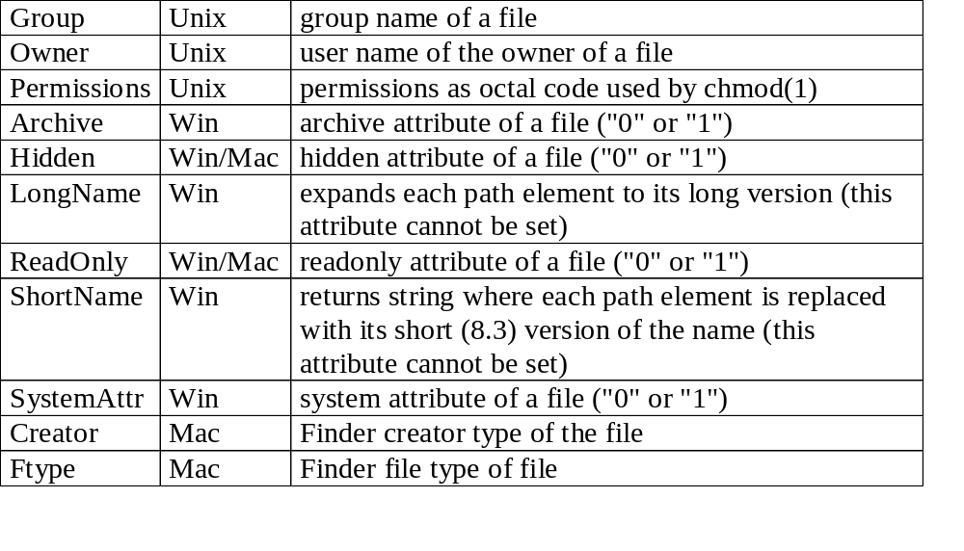
File Attributes

Slide 62
Extract File Name Portions
Tash.File.Directory_Name ("/usr/lib/libm.a") =
"/usr/lib"
Tash.File.Extension ("/usr/lib/libm.a") =
".a"
Tash.File.Root_Name ("/usr/lib/libm.a") =
"/usr/lib/libm"
Tash.File.Tail name ("/usr/lib/libm.a") =
"libm.a"

Slide 63
File and Directory
Query Functions
Determine if a file or directory
  Is a regular file
  Is executable
  Exists
  Is a directory
  Is readable by user
  Is writable by user
  Is owned by user
  Is a link

Slide 64
File and Directory
Query Functions
Get native name
Get path type (absolute, relative, or volume relative)
Get file name a link references
Get size of a file
Split a file name at its path separators

Slide 65
Get File Type
File
Directory
CharacterSpecial
BlockSpecial
Fifo
Link
Socket

Slide 66
File and Directory
Query Functions
Get volume names
  Unix: always ("/")
  Windows: ("a:/", "c:/", "d:/")
Get current working directory

Slide 67
File Name Pattern Matching
function Match (
Pattern : in String;
Directory : in String := "";
Path_Prefix : in String := "";
Type_List : in String := "")
return Tash.Lists.Tash_List;
Tash.File.Match ("*", Directory => "../bin")
L
../bin/clean.tcl
../bin/install.tcl

Slide 68
File and Directory
Modification Functions
Copy files and directories
Delete files and directories
Create a directory
Rename a file or directory

Slide 69
Other File and Directory Functions
Join strings to form a file name with proper platform-dependent path separator
Change current working directory

Slide 70
TASH Scripting Capabilities
List object
Regular expression pattern matching
Associative arrays
File and directory handling
File I/O
Executing other programs
C-style printf formatting
Platform information

Slide 71
TASH File I/O
Open
  File
  Serial port
  Command pipeline
Close
Flush
Get list of process IDs of a command pipeline

Slide 72
TASH File I/O
New Line
Get, Get_Line
Put, Put_Line
Get blocking mode
Get and set buffering mode
Get and set buffer size
Get and set translation mode

Slide 73
TASH Scripting Capabilities
List object
Regular expression pattern matching
Associative arrays
File and directory handling
File I/O
Executing other programs
C-style printf formatting
Platform information

Slide 74
Command Pipeline
declare
Pipe : Tash.File_IO.File_Type;
Line : String (1..1000);
Last : Natural;
begin
Tash.File_IO.Open (
File => Pipe,
Name => "| ps -ef | grep -i oracle",
Mode => Tash.File_IO.Read);
while not Tash.File_IO.End_Of_File (Pipe) loop
Tash.File_IO.Get_Line (Test_File, Line, Last);
Ada.Text_IO.Put_Line (Line (1..Last));
end loop;
Tash.File_IO.Close (Pipe);
end;

Slide 75
TASH Scripting Capabilities
List object
Regular expression pattern matching
Associative arrays
File and directory handling
File I/O
Executing other programs
C-style printf formatting
Platform information

Slide 76
C-Style Printf Formatting
Tash.Lists.Format (
"The result for %-15s is %5.2f (%04x)",
To_Tash_List("{a piece of pi}") & 3.14159 & 89) =
"The result for a piece of pi is 3.14 (0059)"

Slide 77
TASH Scripting Capabilities
List object
Regular expression pattern matching
Associative arrays
File and directory handling
File I/O
Executing other programs
C-style printf formatting
Platform information

Slide 78
Platform Information
Tash.Platform.Byte_Order =
"littleEndian" or "bigEndian"
Tash.Platform.Machine =
"intel", "PPC", "68k", or "sun4m"
Tash.Platform.OS =
"Windows 95", "Windows NT", "MacOS", or "SunOS"
Tash.Platform.OS_Version =
version number of the operating system
Tash.Platform.Platform =
"windows", "macintosh", or "unix"
Tash.Platform.User_Name =
identifies current user

Slide 79
Tcl Capabilities Missing from TASH Thick Binding
Windows registry editing
Windows Dynamic Data Exchange (DDE)
Communication protocols
  TCP, UDP, HTTP
Manipulate binary data
Time functions
File event handlers
Load binary library or Tcl package

Slide 80
Tutorial Outline
Introduction to Tcl/Tk and TASH
Scripting in Ada with TASH
GUI programming in Ada with TASH

Slide 81
Ada GUIs with TASH
TASH provides an alternative to using platform-dependent GUI APIs
  Windows API for GUI development on Windows 95/98/Me/NT/2000
  X Window system on Unix

Slide 82
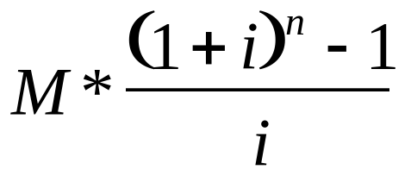
Sample GUI Application
A simple GUI application for computing future value of a series of fixed monthly investments will be demonstrated
Future Value =
where M = monthly investment
i = interest rate per month
n = number of months

Slide 83
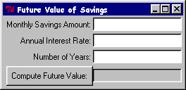
Sample Screenshot

Slide 84
Pattern of a TASH Program
Start Tcl Interpreter
Initialize Tcl and Tk
Create new Tcl commands
Create GUI components
Bind event handlers
Start Tk event loop

Slide 85
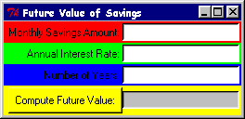
Create GUI Components
Window Manager
Entry
Frame
Label
Button

Slide 86

Create GUI Components
Frame, Label and Entry
Tcl.Tk.Create (Frame, ".amt", "-bd 2");
Tcl.Tk.Pack (Frame, "-side top -fill x");
Tcl.Tk.Create (Amt_Entry, ".amt.entry",
"-width 20 -bg white");
Tcl.Tk.Pack (Amt_Entry, "-side right");
Tcl.Tk.Create (Label, ".amt.label",
"-text {Monthly Savings Amount:}");
Tcl.Tk.Pack (Label, "-side right");

Slide 87

Create GUI Components
Frame, Button, and Label
Tcl.Tk.Create (Frame, ".fv", "-bd 2");
Tcl.Tk.Pack (Frame, "-side top -fill x");
Tcl.Tk.Create (Result, ".fv.result",
"-width 20 -relief sunken");
Tcl.Tk.Pack (Result, "-side right");
Tcl.Tk.Create (Button, ".fv.button",
"-text {Compute Future Value:} " &
"-command computeFutureValue");
Tcl.Tk.Pack (Button, "-side right");

Slide 88
Create GUI Components
Window Title and Focus
-- Add a window title
Tcl.Ada.Tcl_Eval (Interp,
"wm title . {Future Value of Savings}");
-- Set focus to the first entry field
Tcl.Ada.Tcl_Eval (Interp, "focus .amt.entry");

Slide 89
Create New Tcl Command
declare
package CreateCommands is new
Tcl.Ada.Generic_Command (Integer);
Command : Tcl.Tcl_Command;
begin
-- Create a new Tcl command to compute
-- future value.
Command := CreateCommands.Tcl_CreateCommand (
Interp, "computeFutureValue",
Compute_Future_Value_Command'access,
0, NULL);

Slide 90
Create New Tcl Command
Tcl calls Ada Subprogram
function Compute_Future_Value_Command (
ClientData : in Integer;
Interp : in Tcl.Tcl_Interp;
Argc : in C.Int;
Argv : in CArgv.Chars_Ptr_Ptr
) return C.Int;
pragma Convention (C, Compute_Future_Value_Command);
-- Declare a procedure, suitable for creating a
-- Tcl command, which will compute the Future Value.

Slide 91
Create New Tcl Command
Get the “Monthly Savings Amount”
begin -- Compute_Future_Value_Command
-- get the monthly investment amount from its text entry
-- field, evaluate it in case it is an expression,
-- and make sure it is not less than zero
Amount := Money (
Tcl.Ada.Tcl_ExprDouble (Interp, Tcl.Tk.Get (Amt_Entry)));
if Amount < 0.0 then
return Tcl.TCL_OK;
end if;

Slide 92
Create New Tcl Command
Get the “Annual Interest Rate”
-- get the annual interest rate from its text entry
-- field, evaluate it in case it is an expression,
-- and make sure it is not less than zero
Annual_Rate := Float (
Tcl.Ada.Tcl_ExprDouble (
Interp, Tcl.Tk.Get (Rate_Entry)));
if Annual_Rate < 0.0 then
return Tcl.TCL_OK;
end if;

Slide 93
Create New Tcl Command
Compute and Display Future Value
-- compute the monthly interest rate
Rate := Annual_Rate / 1200.0;
-- compute the number of months
Months := Years * 12;
-- compute future value
Future_Value := Money (
Float (Amount) * ((1.0 + Rate)**Months - 1.0)/Rate);
-- put the future value into the result label
Tcl.Tk.Configure (Result, "-text " &
Money'image (Future_Value));

Slide 94
Bind Event Handlers
-- Bind Return to the button command.
-- If Button has focus, pressing Return will
-- execute Tcl command, computeFutureValue
Tcl.Tk.Bind (Button, "<Return>", "computeFutureValue");

Slide 95
Start Tcl Interpreter and
Initialize Tcl and Tk
-- Create Tcl interpreter
Interp := Tcl.Tcl_CreateInterp;
-- Initialize Tcl
if Tcl.Tcl_Init (Interp) = Tcl.TCL_ERROR then
Text_IO.Put_Line ("FutureValue: Tcl_Init failed: " &
Tcl.Ada.Tcl_GetResult (Interp));
return;
end if;
-- Initialize Tk
if Tcl.Tk.Init (Interp) = Tcl.TCL_ERROR then
Text_IO.Put_Line ("FutureValue: Tcl.Tk.Init failed: " &
Tcl.Ada.Tcl_GetResult (Interp));
return;
end if;

Slide 96
Start Tk Event Loop
-- Loop inside Tk, waiting for events to occur and
-- thus commands to be executed.
-- When there are no windows left or when we execute
-- “exit” command, Tcl.Tk.MainLoop returns.
Tcl.Tk.MainLoop;

Slide 97
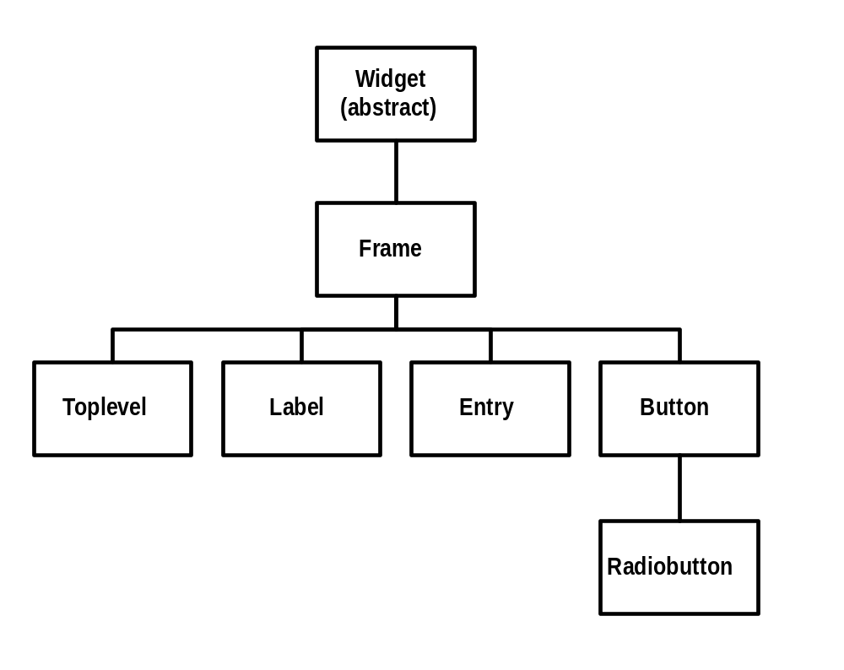
TASH GUI Components
Inheritance Hierarchy

Slide 98
Conclusion: Use TASH
Use TASH when you want scripting language features in Ada
Use TASH's Tk interface when
  Building a small, simple GUI
  Using TASH already for its scripting language features
You'll be glad you did!

