Slide 1
TASH
An Alternative to the Windows API
TRI-Ada ‘97
Terry J. Westley
twestley@acm.org
http://www.ocsystems.com/xada/tash

Slide 2
Premise
Through a binding to Tcl/Tk, TASH provides the Ada programmer with an alternative to using the Windows 95 API:
A free, platform-independent, graphical user interface development toolkit
Supports native “look and feel” for the X Window System (Unix), Windows 95, and Macintosh.

Slide 3
Outline
What is TASH?
What is Tcl/Tk?
Why would I want to use TASH?
Example of a using TASH to develop a GUI application in Windows 95

Slide 4
What is TASH?
TASH stands for Tcl Ada SHell
An Ada 95 binding to Tcl/Tk 8.0
A layered approach:
  Complete thin binding
  Experimental thick binding

Slide 5
What is Tcl/Tk?
Tcl is a simple, powerful, and extensible scripting language similar to Unix shell scripting languages
Tk is a GUI toolkit extension of Tcl
Tk was originally targeted to X Window System, but now also supports Windows 95 and Macintosh native “look and feel”
There is also a Tcl/Tk plugin for Web browsers

Slide 6
Why use Tcl/Tk?
Rapid development
  Tcl is an interpreted language
  Tk is a specialized extension for writing GUIs
Platform independence
System integration
  Scripting languages, especially Tcl, are excellent for gluing together several programs and applications
End-user programming
  Tcl is an interpreted language
  Tcl has a very simple syntax

Slide 7
What does TASH do?
Most importantly, it is a binding from Ada 95
Allows a Tcl program to use Ada in place of C to implement Tcl commands
Makes the Tcl library functions available to an Ada program:
  string and list handling
  regular expression matching
  hash tables
  and, GUI development

Slide 8
Why use TASH?
Together with GNAT, it provides a free GUI development environment for Windows 95
Your code and interface design are completely portable to Unix and Macintosh

Slide 9
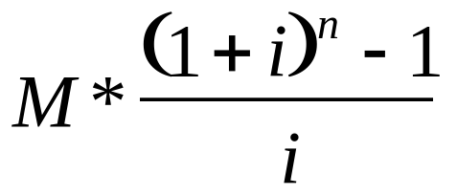
Sample GUI Application
A simple GUI application for computing future value of a series of fixed monthly investments will be demonstrated
Future Value =
where M = monthly investment
i = interest rate per month
n = number of months

Slide 10
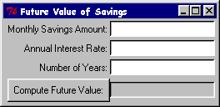
Sample Screenshot

Slide 11
Pattern of a TASH Program
Start Tcl Interpreter
Initialize Tcl and Tk
Create new Tcl commands
Create GUI components
Bind event handlers
Start Tk event loop

Slide 12
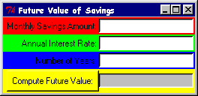
Create GUI Components
Window Manager
Frame
Entry
Label
Button

Slide 13

Create GUI Components
Frame, Label and Entry
Tcl.Tk.Create (Frame, ".amt", "-bd 2");
Tcl.Tk.Pack (Frame, "-side top -fill x");
Tcl.Tk.Create (Amt_Entry, ".amt.entry",
"-width 20 -bg white");
Tcl.Tk.Pack (Amt_Entry, "-side right");
Tcl.Tk.Create (Label, ".amt.label",
"-text {Monthly Savings Amount:}");
Tcl.Tk.Pack (Label, "-side right");

Slide 14

Create GUI Components
Frame, Button, and Label
Tcl.Tk.Create (Frame, ".fv", "-bd 2");
Tcl.Tk.Pack (Frame, "-side top -fill x");
Tcl.Tk.Create (Result, ".fv.result",
"-width 20 -relief sunken");
Tcl.Tk.Pack (Result, "-side right");
Tcl.Tk.Create (Button, ".fv.button",
"-text {Compute Future Value:} " &
"-command computeFutureValue");
Tcl.Tk.Pack (Button, "-side right");

Slide 15
Create GUI Components
Window Title and Focus
-- Add a window title
Tcl.Ada.Tcl_Eval (Interp,
"wm title . {Future Value of Savings}");
-- Set focus to the first entry field
Tcl.Ada.Tcl_Eval (Interp, "focus .amt.entry");

Slide 16
Create New Tcl Command
declare
package CreateCommands is new
Tcl.Ada.Generic_Command (Integer);
Command : Tcl.Tcl_Command;
begin
-- Create a new Tcl command to compute
-- future value.
Command := CreateCommands.Tcl_CreateCommand (
Interp, "computeFutureValue",
Compute_Future_Value_Command'access,
0, NULL);

Slide 17
Create New Tcl Command
Tcl calls Ada Subprogram
function Compute_Future_Value_Command (
ClientData : in Integer;
Interp : in Tcl.Tcl_Interp;
Argc : in C.Int;
Argv : in CArgv.Chars_Ptr_Ptr
) return C.Int;
pragma Convention (C, Compute_Future_Value_Command);
-- Declare a procedure, suitable for creating a
-- Tcl command, which will compute the Future Value.

Slide 18
Create New Tcl Command
Get the “Monthly Savings Amount”
begin -- Compute_Future_Value_Command
-- get the monthly investment amount from its text entry
-- field, evaluate it in case it is an expression,
-- and make sure it is not less than zero
Amount := Money (
Tcl.Ada.Tcl_ExprDouble (Interp, Tcl.Tk.Get (Amt_Entry)));
if Amount < 0.0 then
return Tcl.TCL_OK;
end if;

Slide 19
Create New Tcl Command
Get the “Annual Interest Rate”
-- get the annual interest rate from its text entry
-- field, evaluate it in case it is an expression,
-- and make sure it is not less than zero
Annual_Rate := Float (
Tcl.Ada.Tcl_ExprDouble (Interp, Tcl.Tk.Get (Rate_Entry)));
if Annual_Rate < 0.0 then
return Tcl.TCL_OK;
end if;

Slide 20
Create New Tcl Command
Computing and Displaying Computed Future Value
-- compute the monthly interest rate
Rate := Annual_Rate / 1200.0;
-- compute the number of months
Months := Years * 12;
-- compute future value
Future_Value :=
Money (Float (Amount) * ((1.0 + Rate)**Months - 1.0)/Rate);
-- put the future value into the result label
Tcl.Tk.Configure (Result, "-text " & Money'image (Future_Value));

Slide 21
Bind Event Handlers
-- Bind Return to the button command.
-- If Button has focus, pressing Return will
-- execute Tcl command, computeFutureValue
Tcl.Tk.Bind (Button, "<Return>", "computeFutureValue");

Slide 22
Start Tcl Interpreter and
Initialize Tcl and Tk
-- Create Tcl interpreter
Interp := Tcl.Tcl_CreateInterp;
-- Initialize Tcl
if Tcl.Tcl_Init (Interp) = Tcl.TCL_ERROR then
Text_IO.Put_Line ("FutureValue: Tcl_Init failed: " &
Tcl.Ada.Tcl_GetResult (Interp));
return;
end if;
-- Initialize Tk
if Tcl.Tk.Init (Interp) = Tcl.TCL_ERROR then
Text_IO.Put_Line ("FutureValue: Tcl.Tk.Init failed: " &
Tcl.Ada.Tcl_GetResult (Interp));
return;
end if;

Slide 23
Start Tk Event Loop
-- Loop inside Tk, waiting for events to occur and
-- thus commands to be executed.
-- When there are no windows left or when we execute
-- “exit” command, Tcl.Tk.MainLoop returns.
Tcl.Tk.MainLoop;

Slide 24
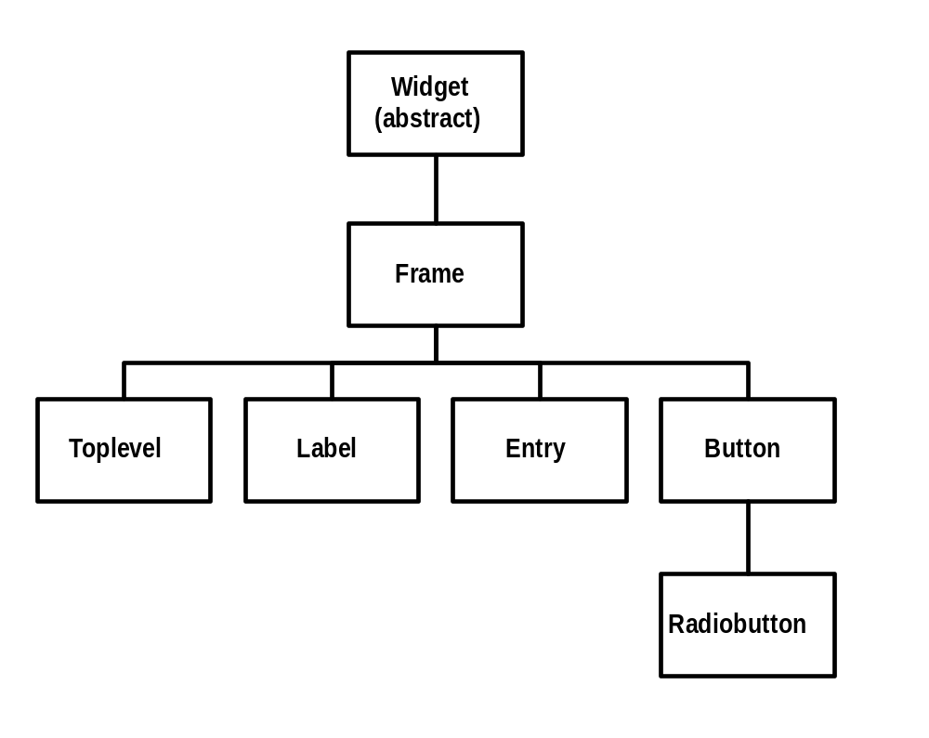
TASH GUI Components
Inheritance Hierarchy

Slide 25
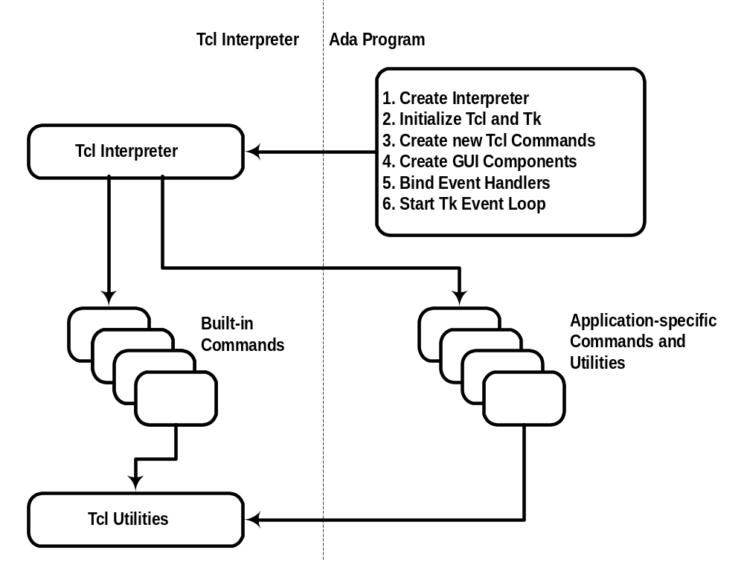
Tcl Interpreter Interaction

Slide 26
Summary
TASH provides an alternative to using the Windows API for GUI development on Windows 95
Additional benefit: Tcl, a powerful, extensible scripting language
  registry searching and editing tool
  full set of file handling utilities
  network programming, including http protocols
Additional benefit: platform independence

