Slide 1
Introduction to Multimedia Systems

Slide 2
The Term “Multimedia”
Composed of 2 parts:
Multi (multus) : “numerous, multiple”
Media (medium): “middle, center” – agent for something. Used for dissemination (distribute) and representation of information.
In general, multimedia could be defined as the usage of multiple agent (text, audio, video, images) for disseminating and presenting information to audience (target user)

Slide 3
The Term “Media”
Can be categorized based on a few criteria:
Perception media
Representation media
Presentation media
Storage media
Transmission media

Slide 4
Perception Media
“How do humans perceive information”
We perceive information from what we see and what we hear
Visual media:
Text, graphics, images, video
Auditory media:
Music, sound and voice

Slide 5
Representation Media
“How in information encoded in the computer”
Referring to how the information is represented internally to the computer.
The encoding used is of essential importance.
Several options:
Text is encoded in ASCII
An audio data stream in PCM (Pulse Coded Modulation)
Image in JPEG format
Video in MPEG format

Slide 6
Presentation Media
“Which medium is used to output information from the computer or input in the computer”
Refers to physical means used by systems to reproduce information for humans, e.g: audio and visual devices
Input:
Keyboards, cameras, microphone, Head Mounted Device (for VR input)
Output:
Paper, monitors, loudspeakers

Slide 7
Storage Media
“Where is information stored”
Refer to various physical means for storing computer data, such as magnetic tapes, magnetic disks, or digital optical disks (CD-ROM, CD, DVD)

Slide 8
Transmission Media
“Which medium is used to transmit data”
Refers to the physical means – cable of various type (coaxial cable, twisted pair, fiber optics), radio tower, satellite – that allow the transmission of telecommunication signals.
The difference between transmission media and storage media is the capability of transferring data continuously over networked computers.

Slide 9
Definition: Multimedia Systems
The American Heritage® Dictionary of the English Language: Fourth Edition. 2000.
1. The combined use of media, such as movies, music, lighting, CD-ROMs, and the Internet, as for education or entertainment
Multimedia is the presentation of a (usually interactive) computer application, incorporating media elements such as text graphics, video, animation, and sound, on a computer.
It is the melding of the sensory power of television with the data manipulation and interactive capabilities of computer

Slide 10
Definition: Multimedia Systems
The presentation of a computer application, usually interactive, that incorporates media elements such as text, graphics, video, animation, and sound on a computer. Multimedia melds the sensory power of television with the data manipulation and interactive powers of computer.
A multimedia system is characterized by computer-controlled, integrated production, manipulation,presentation, storage and communication of independent information,which is encoded at least through continuous (time-dependent) and a discrete (time-independent) medium.

Slide 11
Key Properties of a Multimedia Systems
Discrete and Continuous Media
At least one discrete and continuous media
Independent Media
Separate each media independently
Computer-Controlled Systems
Integration

Slide 12
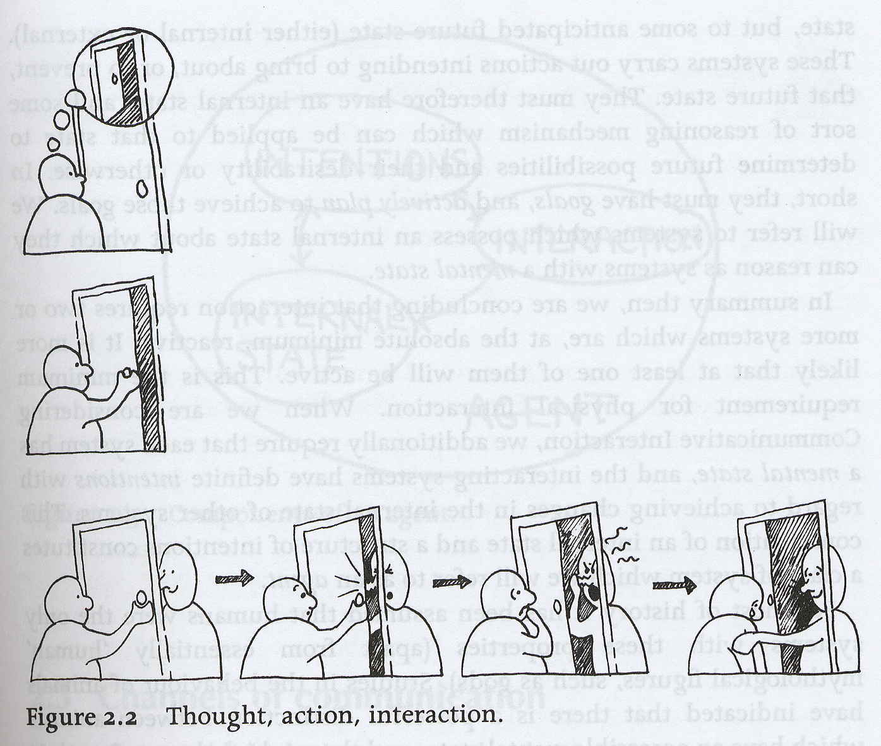
Interactive Multimedia Systems
Interaction
Thought - Something that you do to yourself ~ internal process (mental state)
Action - Something you do to an object in the world. The effect is that something in the world has changed. E.g.: pressing key, clicking mouse button
Interaction - Involves the participant in going outside the individual. Two way process. E.g.: give a query to search engine which can return an outcome of my search.
Properties
Various media integration
High level degree of interactivity between user and computer
Digital environment

Slide 13
Application Areas of IMS
Education
Computer Aided Learning (CAL)
E-Learning (World Wide Web)
Training
Point of Sales Information (Kiosk)
Direct visitors around the large complexes
News Delivery, Broadcasting and Advertising
Commerce and Business Applications
Virtual Reality (Games)

Slide 14
The History of Multimedia
1972 – A Game of Pong (first commercial multimedia product)
1973 – ATARI (laser disc, used in game cartridges)
1973 – IBM Discovision (first multimedia interactive kiosk products)
1978 – Apple II (with floppy drive)
1981 – Microsoft and IBM (IBM PC)
Christmas 1981 – Nintendo hit the market (30 million machines)
1982 – Apple II had voice synthesis capability

Slide 15
The History of Multimedia
1980s – mouse was invented by Xerox Corp.
1984 – Macintosh using mouse
1984 – Virtual Reality was invented by NASA, input devices using HMD (Head-Mounted Display) and Dataglove
1985 – Macromind (Macromedia) produced VideoWorks, later changed to Director (the most widely used cross-platform multimedia authoring tool)
1986 – first electronic encyclopedia, first international conference on multimedia, first CD-ROM
1987 – Mac II (first color GUI)
1988 – CD-R (CD-Record)
1989 – Creative Labs (Sound Blaster sound card)

Slide 16
The History of Multimedia
1990s – Adobe released Photoshop.
1990s – Windows 3.0 multimedia enabled by Microsoft
1992 – first children ‘s interactive book title “Just Grandma and Me”
1993 – double speed CD-ROM drives as a multimedia standard
1993 – Web Browser Mosaic
1994 – Web Browser Netscape
1995 – Multimedia PC, 32 bit, Windows 95. Later followed by Windows 98, Windows 2000

Slide 17
Input Devices
Keyboard, mouse (track balls, joysticks, etc)
graphics tablets - drawing
Scanner – capture image from printed material
Digital camera - capture and transform image into digital form
Touch screen for kiosk application
Analogue audio input from microphone and audio player
Networking support for fail distribution
modem

Slide 18
Output Devices
High resolution screen, 256 colors (at least) – output video
Speakers, amplifier or tape devices - Output audio
Network with capacity at 10 millions bit/second
Analog modem at 28 800 bit/second speed. ISDN digital modem at speed 128 000 bit/second.
Printer

Slide 19
Storage Requirements
At least 32MB RAM to produce good quality of graphics, audio, video, etc
VRAM (Video Random Access Memory) to support high color definition
Hard disk at high volume capacity with good drive system speed to support graphics, video, audio, and animation processing.
Secondary storage CD-ROM, Magnetic Tape, etc

Slide 20
Hypermedia
Hypermedia is a way of organizing multimedia information by linking media elements.
Hypermedia has grown out of a fusion between hypertext and multimedia.
Hypertext was developed to provide a different structure for basic text in computer systems :
text is essentially sequential in nature, even though its structure is hierarchical (chapters, sections, subsections, paragraphs)
hypertext was developed to permit more random access between components of text documents, or between documents, to allow a greater degree of flexibility and cross-referencing than a purely linear or sequential model would allow.

Slide 21
Hypermedia
Chap.1
Chap.2
Chap.3
Chap.4
Chap.5
Chap.6
A sequential text
Chap.3
Chap.1
Chap.5
Chap.2
Chap.6
Chap.4
A linked, self-referencing text

Slide 22
Hypermedia
The structure of a hypermedia organizations is called a hypermedia web, which consists of a number of multimedia elements or nodes with links between them.
Links represent semantic relationships, thus when a link exists between two nodes they must be related in some fashion :
a digital image linked to a textual description of it
a slide-show linked to an audio commentary
Most widely used hypermedia tools are hypermedia browsers, which let users view nodes and traverse links between them, and markup languages, such as HTML, which allow users to create hypermedia webs as structured documents.

Slide 23
Hypermedia
Image Node
Text Node
Audio Node
A Simple Hypermedia Web

Slide 24
Why is multimedia so hot?
Technology Push
More processing power per chip
Progress in storage capacity
Personal computer revolution
Progress in networking
Progress in user interfaces, and software
Progress in compression techniques
Market Pull
Large market - Revolutionizing film/video industry
Application challenges and competition
Market opportunities
Customer demand and comfort

