Slide 1
Computer Graphics
An Introduction

Slide 2
What’s this course all about?
We will cover…
Graphics programming and algorithms
Graphics data structures
Colour
Applied geometry, modelling and rendering
Lecture 1

Slide 3
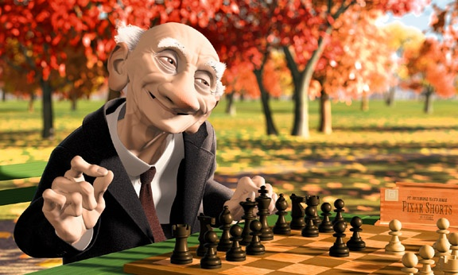
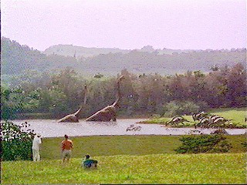
Computer Graphics is about animation (films)‏
Major driving force now
Lecture 1

Slide 4
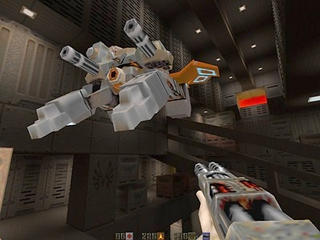
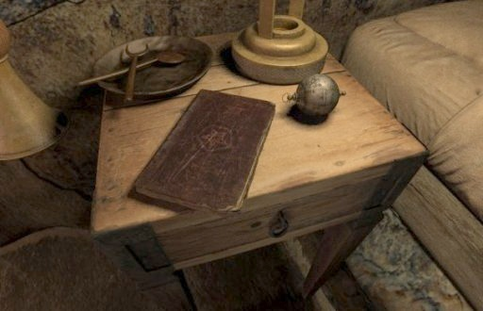
Games are very important in Computer Graphics
Lecture 1

Slide 5
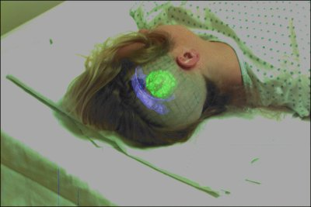
Medical Imaging is another driving force
Lecture 1

Slide 6
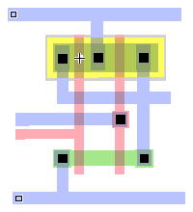
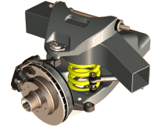
Computer Aided Design too
Lecture 1

Slide 7
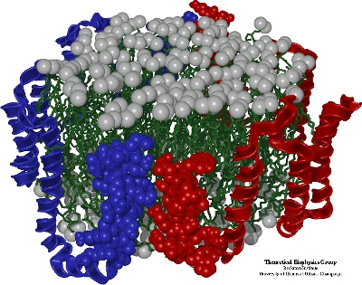
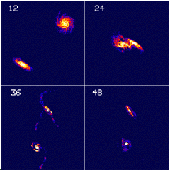
Scientific Visualisation
To view below and above our visual range
Lecture 1

Slide 8
First Lecture
The graphics processes
  What we will cover on this course
Some definitions
  Fundamental units we use in these processes
First Practical
Lecture 1

Slide 9
Overview of the Course
Graphics Pipeline (Today)‏
Modelling
  Surface / Curve modelling
(Local lighting effects) Illumination, lighting, shading, mirroring, shadowing
Rasterization (creating the image using the 3D scene)
Ray tracing
Global illumination
Curves and Surfaces
Lecture 1

Slide 10
Graphics/Rendering Pipeline
Graphics processes generally execute sequentially
Pipelining the process means dividing it into stages
Especially when rendering in real-time, different hardware resources are assigned for each stage
Lecture 1

Slide 11
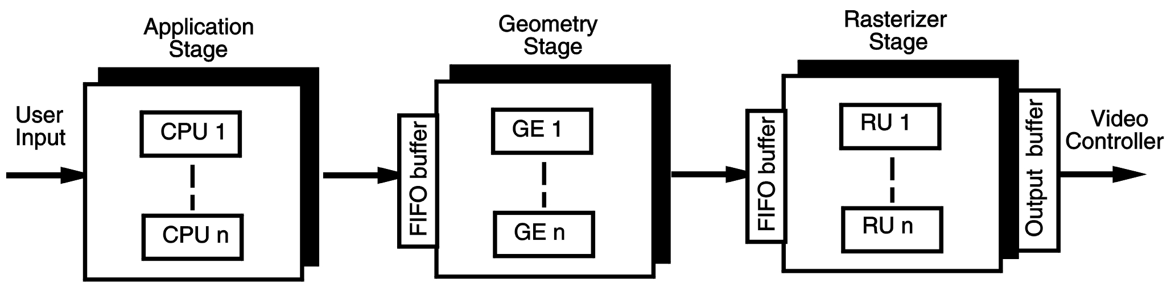
Graphics / Rendering Pipeline
There are three stages
  Application Stage
  Geometry Stage
  Rasterization Stage
Lecture 1

Slide 12
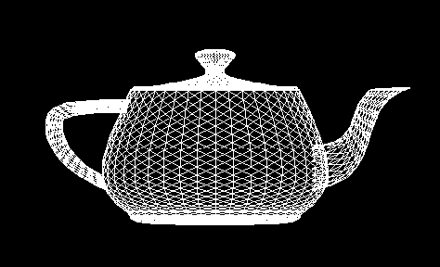
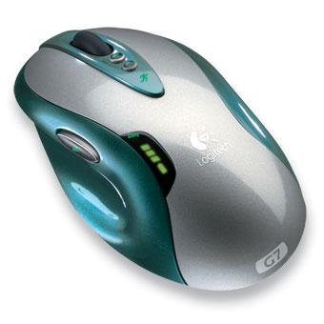
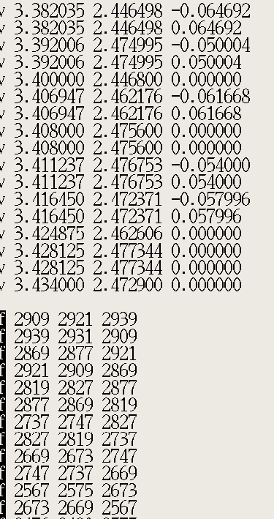
Application stage
Entirely done in software by the CPU
Read Data
  the world geometry database,
  User’s input by mice, trackballs, trackers, or sensing gloves
In response to the user’s input, the application stage change the view or scene
Lecture 1

Slide 13
Geometry Stage
Modeling: shapes
Model Transformation
Transformation: viewing
Hidden Surface Elimination
Rasterization Stage
Shading: reflection and lighting
Lecture 1

Slide 14
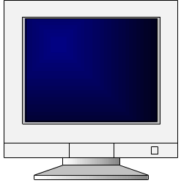
Rasterization Stage
Geometry Stage
Rasterization and Sampling
Texture Mapping
Image Composition
Intensity and Colour Quantization
Framebuffer/Display
Lecture 1

Slide 15
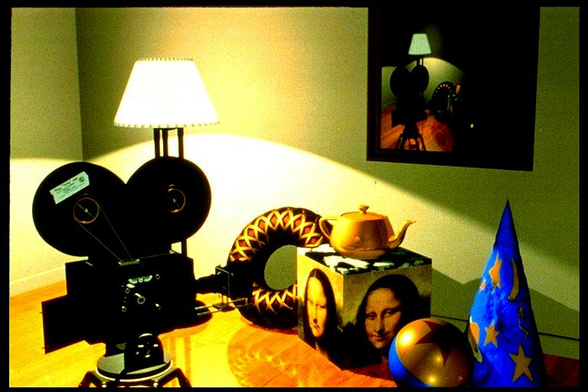
An example thro’ the pipeline…
The scene we are trying to represent:
Images courtesy of Picture Inc.
Lecture 1

Slide 16
Geometry Pipeline
Loaded 3D Models
Model Transformation
Transformation: viewing
Hidden Surface Elimination
Imaging
Shading: reflection and lighting
Pipeline
Lecture 1

Slide 17
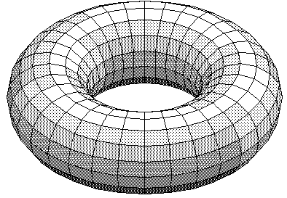
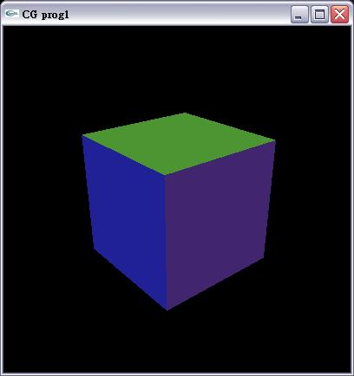
Preparing Shape Models
Designed by polygons, parametric curves/surfaces, implicit surfaces and etc.
Defined in its own coordinate system
Lecture 1

Slide 18
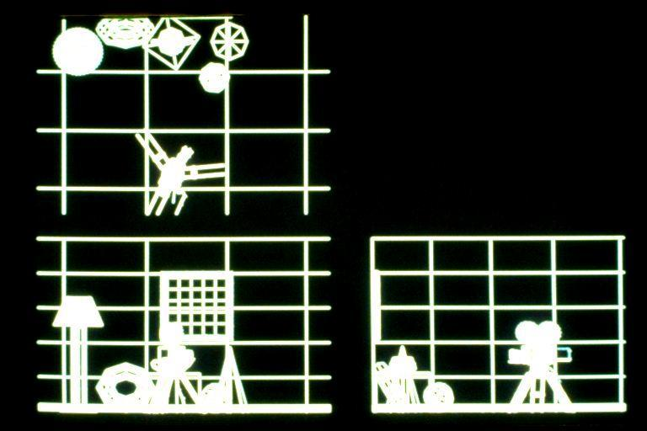
Model Transformation
Objects put into the scene by applying translation, scaling and rotation
Linear transformation called homogeneous transformation is used
The location of all the vertices are updated by this transformation
Lecture 1

Slide 19
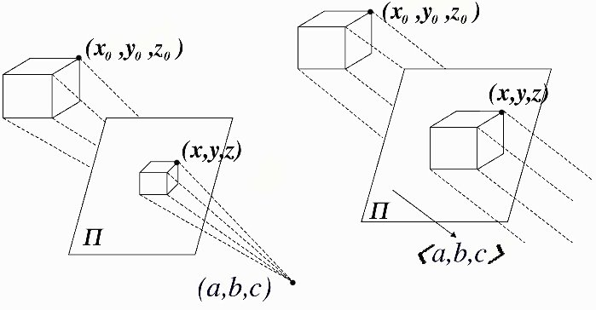
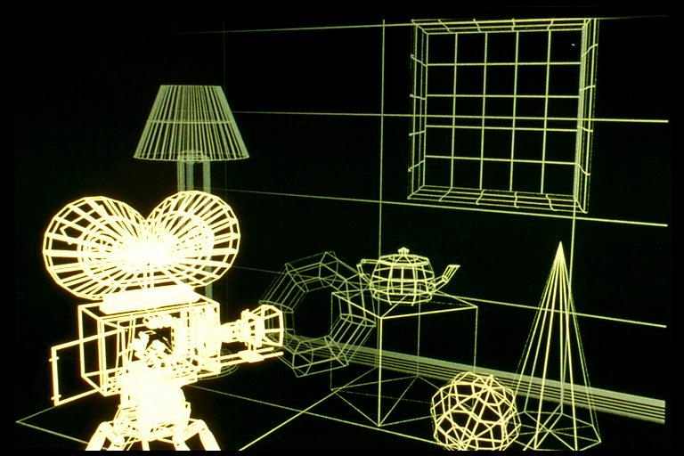
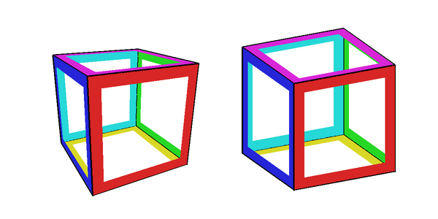
Perspective Projection
We want to create a picture of the scene viewed from the camera
We apply a perspective transformation to convert the 3D coordinates to 2D coordinates of the screen
Objects far away appear smaller, closer objects appear bigger
Lecture 1

Slide 20
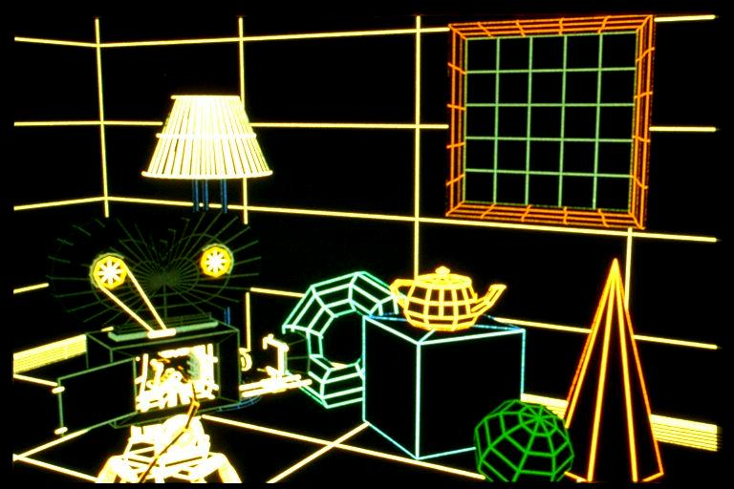
Hidden Surface Removal
Objects occluded by other objects must not be drawn
Lecture 1

Slide 21
Shading
Now we need to decide the colour of each pixels taking into account the object’s colour, lighting condition and the camera position
point light source
Object
Lecture 1

Slide 22
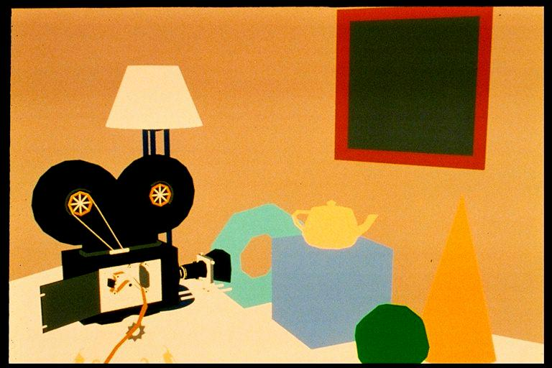
Shading : Constant Shading - Ambient
Objects colours by its own colour
Lecture 1

Slide 23
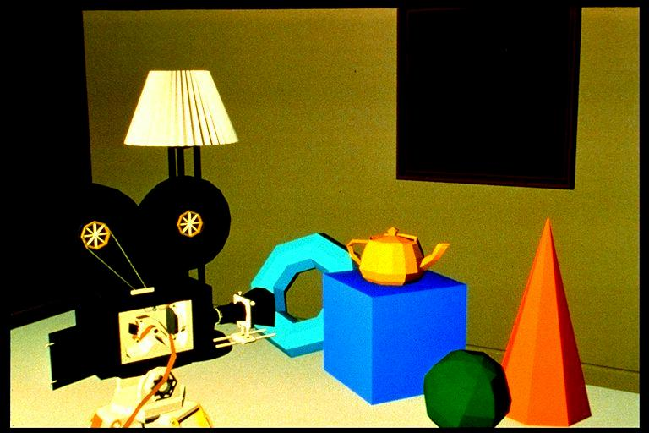
Shading – Flat Shading
Objects coloured based on its own colour and the lighting condition
One colour for one face
Lecture 1

Slide 24
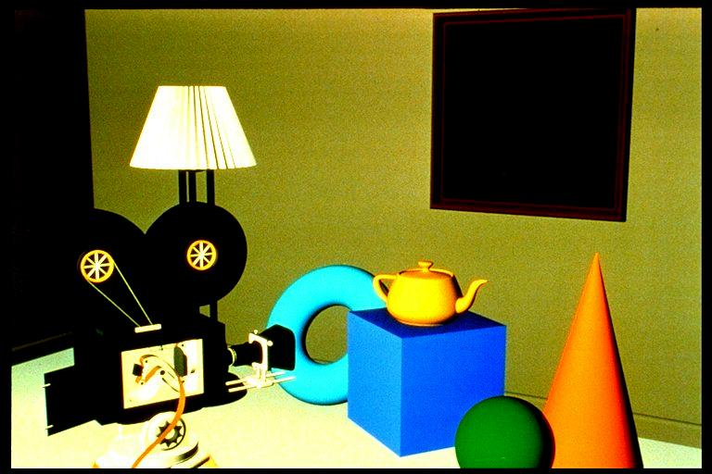
Gouraud shading, no specular highlights
Lighting calculation per vertex
Lecture 1

Slide 25
Shapes by Polynomial Surfaces
Lecture 1

Slide 26
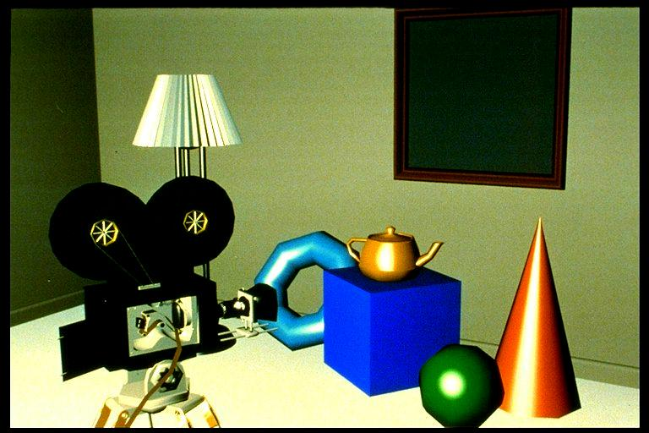
Specular highlights added
Light perfectly reflected in a mirror-like way
Lecture 1

Slide 27
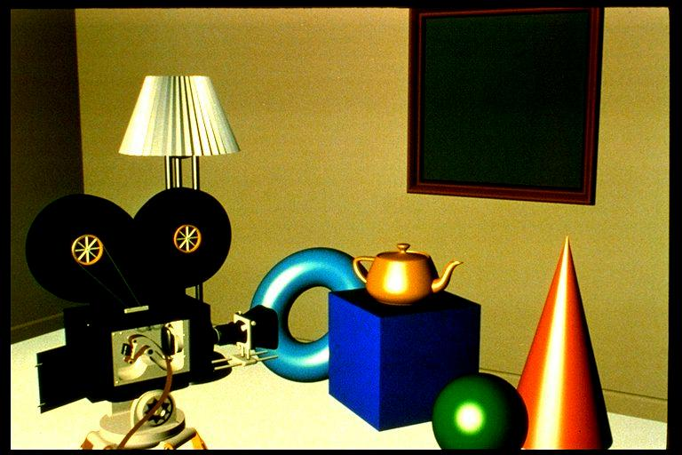
Phong shading
Lecture 1

Slide 28
Next, the Imaging Pipeline
Geometry
Rasterization and Sampling
Pipeline
Texture Mapping
Image Composition
Intensity and Colour Quantization
Framebuffer/Display
Lecture 1

Slide 29
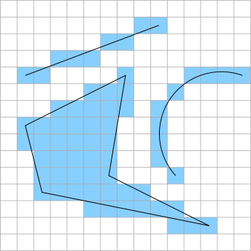
Rasterization
Converts the vertex information output by the geometry pipeline into pixel information needed by the video display
Aliasing: distortion artifacts produced when representing a high-resolution signal at a lower resolution.
Anti-aliasing : technique to remove aliasing
Lecture 1

Slide 30
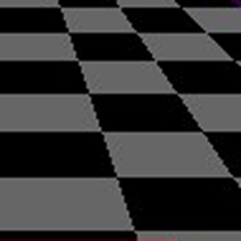
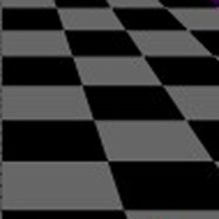
Anti-aliasing
Aliased polygons
(jagged edges)‏
Anti-aliased polygons
Lecture 1

Slide 31
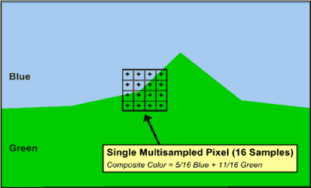
How is anti-aliasing done? Each pixel is subdivided
(sub-sampled) in n regions, and each sub-pixel has a color;
Compute the average color value
Lecture 1

Slide 32

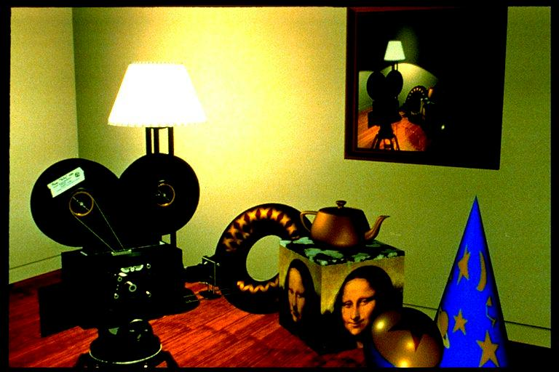
Texture mapping
Lecture 1

Slide 33
Other covered topics:
Reflections, shadows & Bump mapping
Lecture 1

Slide 34
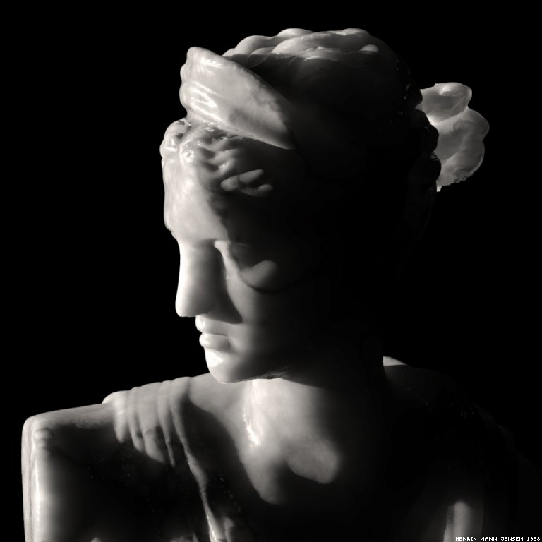
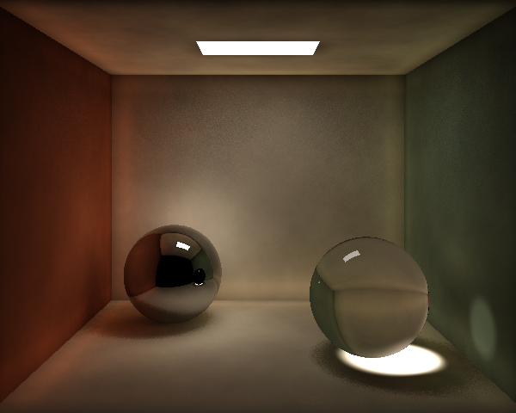
Other covered topics:
Global Illumination
Lecture 1

Slide 35
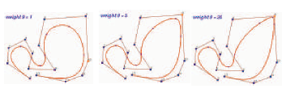

Polynomial Curves, Surfaces

Slide 36
Graphics Definitions
Point
  a location in space, 2D or 3D
  sometimes denotes one pixel
Line
  straight path connecting two points
  infinitesimal width, consistent density
  beginning and end on points
Lecture 1

Slide 37
Graphics Definitions
Vertex
  point in 3D
Edge
  line in 3D connecting two vertices
Polygon/Face/Facet
  arbitrary shape formed by connected vertices
  fundamental unit of 3D computer graphics
Mesh
  set of connected polygons forming a surface (or object)‏
  :
Lecture 1

Slide 38
Graphics Definitions
Rendering : process of generating an image from the model
Framebuffer : a video output device that drives a video display from a memory containing the color for every pixel
Lecture 1

Slide 39
Course support resources
Graphics course website
http://www.inf.ed.ac.uk/teaching/courses/cg
  lecture material,
  lecture log with general summary and recommended reading,
  Links to support material for lectures and projects,
  Practical description and resources
Lecture 1

Slide 40
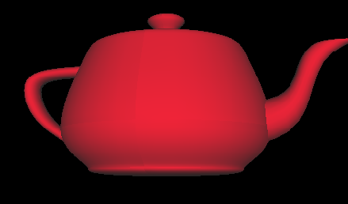
First Practical
Write a program that renders an image of a teapot and outputs it into an image file
I prepared a demo program to load a 3D model and draw the edges
You update it so that the surface appears shaded
See the course website for the details
Lecture 1

Slide 41
Some notifications
16 lectures in total
I need to visit Japan in the beginning of October so no lecture on 5th October
Need to attend conferences on 16th and 26th of November so no lectures there

Slide 42
Summary
The course is about algorithms, not applications
  Lots of mathematics
Graphics execution is a pipelined approach
Basic definitions presented
Some support resources indicated
Lecture 1

