Slide 1

1 Introduction to Multimedia
1.1 What is Multimedia?
1.2 Multimedia and Hypermedia
1.3 World Wide Web
1.4 Overview of Multimedia Software Tools

Slide 2
1.1 What is Multimedia?
When different people mention the term multimedia, they
often have quite different, or even opposing, viewpoints.
- A PC vendor: a PC that has sound capability, a DVD-ROM drive,
and perhaps the superiority of multimedia-enabled microprocessors
that understand additional multimedia instructions.
- A consumer entertainment vendor: interactive cable TV with hundreds of digital channels available, or a cable TV-like service delivered
over a high-speed Internet connection.
- A Computer Science (CS) student: applications that use multiple
modalities, including text, images, drawings (graphics), animation,
video, sound including speech, and interactivity.
Multimedia and Computer Science:
- Graphics, HCI, visualization, computer vision, data compression, graph
theory, networking, database systems.

Slide 3
Components of Multimedia
Multimedia involves multiple modalities of text, audio, images, drawings, animation, and video. Examples of how these
modalities are put to use:
1. Video teleconferencing.
2. Distributed lectures for higher education.
3. Tele-medicine.
4. Co-operative work environments.
5. Searching in (very) large video and image databases for
target visual objects.
6. “Augmented” reality: placing real-appearing computer
graphics and video objects into scenes.

Slide 4
7. Including audio cues for where video-conference participants are located.
8. Building searchable features into new video, and enabling
very high- to very low-bit-rate use of new, scalable multi-
media products.
9. Making multimedia components editable.
10. Building “inverse-Hollywood” applications that can re-
create the process by which a video was made.
11. Using voice-recognition to build an interactive environment, say a kitchen-wall web browser.

Slide 5
Multimedia Research Topics and Projects
To the computer science researcher, multimedia consists of
a wide variety of topics:
1. Multimedia processing and coding: multimedia content
analysis, content-based multimedia retrieval, multimedia
security, audio/image/video processing, compression, etc.
2. Multimedia system support and networking: network
protocols, Internet, operating systems, servers and clients,
quality of service (QoS), and databases.
3. Multimedia tools, end-systems and applications: hypermedia systems, user interfaces, authoring systems.
4. Multi-modal interaction and integration: “ubiquity”
web-everywhere devices, multimedia education including Computer Supported Collaborative Learning, and design and applications of virtual environments.

Slide 6
Current Multimedia Projects
Many exciting research projects are currently underway. Here
are a few of them:
1. Camera-based object tracking technology: tracking of
the control objects provides user control of the process.
2. 3D motion capture: used for multiple actor capture so
that multiple real actors in a virtual studio can be used
to automatically produce realistic animated models with
natural movement.
3. Multiple views: allowing photo-realistic (video-quality)
synthesis of virtual actors from several cameras or from a
single camera under differing lighting.
4. 3D capture technology: allow synthesis of highly realistic facial animation from speech.

Slide 7
5. Specific multimedia applications: aimed at handicapped persons with low vision capability and the elderly - a rich field of endeavour.
6. Digital fashion: aims to develop smart clothing that can
communicate with other such enhanced clothing using wireless communication, so as to artificially enhance human interaction in a social setting.
7. Electronic Housecall system: an initiative for providing
interactive health monitoring services to patients in their
homes
8. Augmented Interaction applications: used to develop
interfaces between real and virtual humans for tasks such as augmented storytelling.

Slide 8
Hypermedia and Multimedia
A hypertext system: meant to be read nonlinearly, by following links that point to other parts of the document, or to other documents
(Figure 1.1)
HyperMedia: not constrained to be text-based, can include
other media, e.g. graphics, images and especially the continuous media - sound and video.
- The World Wide Web (WWW) - the best example of a hypermedia application.
Multimedia means that computer information can be represented through audio, graphics, images, video, and animation in addition to traditional media.

Slide 9
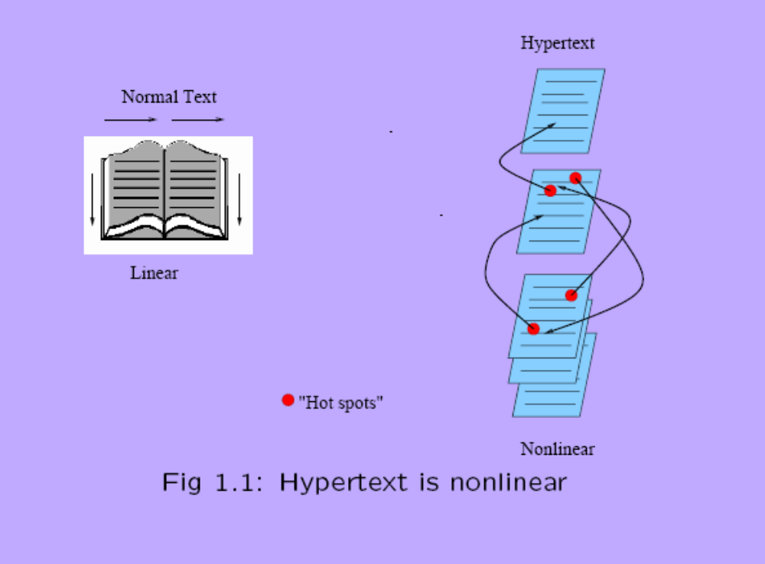

Slide 10
Examples of typical present multimedia applications include:
Digital video editing and production systems.
Electronic newspapers/magazines.
World Wide Web.
On-line reference works: e.g. encyclopedias, games, etc.
Home shopping.
Interactive TV.
Multimedia courseware.
Video conferencing.
Video-on-demand.
Interactive movies.

Slide 11
1.3 World Wide Web
The W3C has listed the following goals for the WWW:
1. Universal access of web resources (by everyone everywhere).
2. Effectiveness of navigating available information.
3. Responsible use of posted material.
History of the WWW (1960s-today)

Slide 12
1.4 Overview of Multimedia Software Tools
The categories of software tools briefly examined here are:
1. Music Sequencing and Notation (Cakewalk, Cubase, Macromedia Soundedit)
2. Digital Audio (Cool Edit, Sound Forge, Pro Tools)
3. Graphics and Image Editing (Adobe Illustrator, Adobe Photoshop, Macromedia Fireworks, Macromedia Freehand)
4. Video Editing (Adobe Premiere, Adobe After Effects, Final Cut Pro)
5. Animation (Java3D, DirectX, OpenGL, 3DStudio Max, Softimage XSI, Maya, RenderMan)
6. Multimedia Authoring (Macromedia Flash, Macromedia Director, Authorware, Quest)

