Slide 1

CAREER STUDIO
Career Studio
Product handoff
Product pitch and launch plan
September 9, 2026
For the next engineer and product owner
Pilot foundation
Career Studio · Product handoff · September 9, 2026
1 / 29
Notes:
Sources and scope: README.md; docs/OPERATIONS.md; docs/ENGINEERING_HANDOFF.md; docs/SALES_PLAYBOOK.md. The accepted launch model uses the operator’s OpenAI API account. Customer subscription linking is deferred. The current deck preserves 29 slides: navigation on 2–3, product and customer experience on 4–13, implementation and launch on 14–22, pilot and selling plan on 23–29. The September 9 clarification makes every entered skill, including custom skills, part of the detailed interview.
Product scope updated September 9, 2026. Dated integration checks retain their original review dates. Product paths are relative to the new repository root. Screenshots show fictional demo data, with scripted AI. This deck describes a pilot foundation, not a paid production service.

Slide 2
CAREER STUDIO · PRODUCT HANDOFF
EVERYONE
Start here
Two readers, two paths. Pick yours, then read the part that answers your questions first.
READ THESE FIRST
THEN OPEN
15 · What is built and what remains
docs/
ENGINEERING_HANDOFF.md
ENGINEER
18 · The current system
19 · Where the next engineer works
21 · The pilot hosting model
FIRST ACTION
22 · Launch work in dependency order
Start gate 01 · Transfer
Who are you?
READ THESE FIRST
THEN OPEN
5 · The problem and where it came from
docs/SALES_PLAYBOOK.md
PRODUCT OWNER
17 · AI access at launch and later
24 · Known risks and how the pilot tests them
25 · The first customer experiment
FIRST ACTION
27 · Packaging and pricing experiments
Choose the pilot audience
EVERYONE
Slides 4–13 explain the problem and the customer experience. Read them first if Career Studio is new to you.
Career Studio · Product handoff · September 9, 2026
2 / 29
Notes:
Navigation slide added in this version. It tells each of the two readers which slides to read first and which guide to open, so a new reader is never left guessing where to start.
Product scope updated September 9, 2026. Dated integration checks retain their original review dates. Product paths are relative to the new repository root. Screenshots show fictional demo data, with scripted AI. This deck describes a pilot foundation, not a paid production service.

Slide 3
CAREER STUDIO · PRODUCT HANDOFF
EVERYONE
What this deck covers
Three parts: what the product does, what is built and how to run it, how to pilot and sell it.
01
02
03
What the product does
What is built and how to run it
How to pilot and sell it
Slides 4 – 13
Slides 14 – 22
Slides 23 – 29
The problem, the customer journey and the product itself.
The launch plan, the system, the code map and the gates.
Risks, the pilot experiment, the demo, pricing and measures.
Career Studio · Product handoff · September 9, 2026
3 / 29
Notes:
Navigation slide added in this version. It sets the three-part shape of the deck and the slide range for each part, so a reader can jump straight to the part they need.
Product scope updated September 9, 2026. Dated integration checks retain their original review dates. Product paths are relative to the new repository root. Screenshots show fictional demo data, with scripted AI. This deck describes a pilot foundation, not a paid production service.

Slide 4

01
IN THIS PART
5 · The problem and where it came from
6 · Why not just use ChatGPT?
What the
product does
7 · The customer journey
8 · The signed-in dashboard
9 · Detailed questions for every skill
10 · The interview proposes facts
11 · Resumes keep the customer in control
12 · Job reviews explain evidence and gaps
The problem, the customer journey and the product itself.
13 · The tracker preserves the next step
Career Studio · Product handoff · September 9, 2026
4 / 29
Notes:
Navigation slide added in this version. It opens Part 1 and lists the slides in it, so the reader can see the product story as one block.
Product scope updated September 9, 2026. Dated integration checks retain their original review dates. Product paths are relative to the new repository root. Screenshots show fictional demo data, with scripted AI. This deck describes a pilot foundation, not a paid production service.

Slide 5
PART 1 · WHAT THE PRODUCT DOES
EVERYONE
The problem and where it came from
A skill name alone tells us little about the tasks a person can actually do.
THE PROBLEM
THE ORIGIN
“AI,” “accounting,” “programming” or “Excel” tells us little about someone’s work. Which tasks can they repeat independently, and where do they need help?
The details behind each skill should inform the resume and the jobs the customer considers.
The founder wanted to turn a personal job-search CRM and resume interview into a product.
The requirement: ask detailed follow-ups for every entered skill, then reuse customer-reviewed evidence in resumes, job reviews and the tracker.
Career Studio · Product handoff · September 9, 2026
5 / 29
Notes:
Sources and scope: User product brief and September 9, 2026 clarification; README.md; docs/SALES_PLAYBOOK.md. This is the founder’s problem hypothesis and proposed positioning, not a measured market finding. Excel illustrated the original requirement. Any entered skill is in scope, with AI, accounting and programming explicitly named by the founder. No customer traction, revenue, or hiring outcomes have been established. Suggested spoken pitch: “Start with your resume or a blank page. We ask what you actually did for every skill you add, help you build a resume you can explain, and keep your job search organized.”
Product scope updated September 9, 2026. Dated integration checks retain their original review dates. Product paths are relative to the new repository root. Screenshots show fictional demo data, with scripted AI. This deck describes a pilot foundation, not a paid production service.

Slide 6
PART 1 · WHAT THE PRODUCT DOES
EVERYONE
Why not just use ChatGPT?
You can. Career Studio tests one hypothesis, and the pilot decides whether it holds.
THE HYPOTHESIS
CHATGPT DIRECTLY
A valid option for drafting and discussing your experience in conversation.
You can use ChatGPT directly.
Career Studio tests whether a reviewed record of what you can actually do, kept in one workflow, saves enough effort to be worth paying for.
RESUME DOCUMENTS
Customers can create and maintain their own resumes with familiar tools.
JOB LISTINGS
Customers can find opportunities and compare the requirements themselves.
CAREER STUDIO
A reviewed profile of every skill feeds resume versions, job reviews and the tracker.
Career Studio · Product handoff · September 9, 2026
6 / 29
Notes:
Sources and scope: docs/SALES_PLAYBOOK.md, “Why the workflow matters” and the objection “Why not just use ChatGPT?”. The slide compares workflow choices and states the intended advantage as a pilot hypothesis. Capabilities differ across chat, resume and job-search products. Do not claim they cannot ask follow-ups, retain information or compare job requirements. No comparative study or proven superiority exists. Honest answer: “You can use ChatGPT directly. We are testing whether this structure saves enough effort to be worth paying for.”
Product scope updated September 9, 2026. Dated integration checks retain their original review dates. Product paths are relative to the new repository root. Screenshots show fictional demo data, with scripted AI. This deck describes a pilot foundation, not a paid production service.

Slide 7
PART 1 · WHAT THE PRODUCT DOES
EVERYONE
The customer journey
Six steps, from the experience the customer already has to a search they can keep track of.
01
02
03
04
05
06
Bring your experience
Upload a resume or begin with a blank profile.
Add the details
Record jobs, schools, projects and preferences.
Explain every skill
Answer follow-ups on tasks, tools, help and examples.
Review your resume
Approve the facts and preserve a resume version.
Review opportunities
Compare requirements with supported experience.
Track the search
Save jobs, follow-ups and the resume used.
BUILD THE REVIEWED PROFILE
USE IT IN THE SEARCH
Career Studio · Product handoff · September 9, 2026
7 / 29
Notes:
Sources and scope: README.md, Customer journey; public/app.js; lib/resume-model.js; lib/ai.js. Supported upload formats are text-based PDF, DOCX and TXT. Scanned/image-only resumes require manual text or a future OCR feature. Import and AI outputs remain subject to customer review.
Product scope updated September 9, 2026. Dated integration checks retain their original review dates. Product paths are relative to the new repository root. Screenshots show fictional demo data, with scripted AI. This deck describes a pilot foundation, not a paid production service.

Slide 8
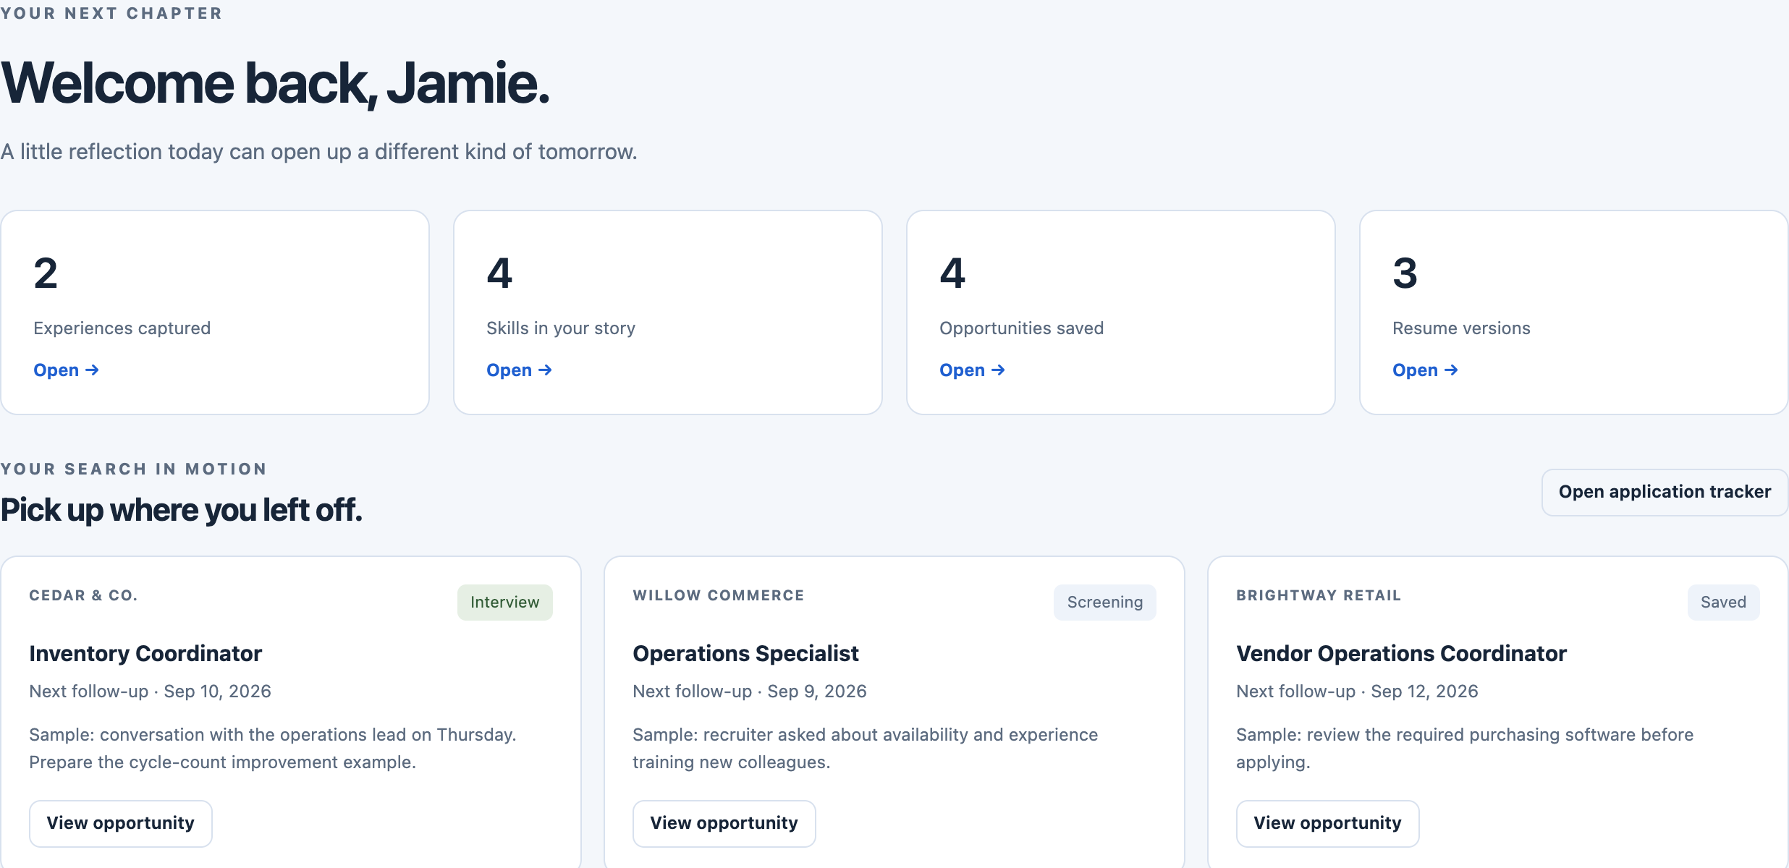
PART 1 · WHAT THE PRODUCT DOES
EVERYONE
The signed-in dashboard
A populated overview brings the career profile, resume versions and next actions together.
WHAT TO LOOK AT
1
Profile counts: experiences, skills, saved opportunities, resume versions.
1
2
The opportunities the customer left in progress.
2
3
3
Each one carries its stage, note and next follow-up date.
Career Studio · Product handoff · September 9, 2026
Fictional demo. AI examples are simulated.
8 / 29
Notes:
Sources and scope: Actual localhost /demo screenshot; public/app.js demoActivity; public/demo.js. Jamie Morgan and all employers/openings are fictional. The demo uses in-memory data and makes no /api requests. Reload restores the sample. Real customer records require authentication and persist in SQLite. Demo: http://127.0.0.1:4174/demo while the local server is running.
Product scope updated September 9, 2026. Dated integration checks retain their original review dates. Product paths are relative to the new repository root. Screenshots show fictional demo data, with scripted AI. This deck describes a pilot foundation, not a paid production service.

Slide 9
PART 1 · WHAT THE PRODUCT DOES
EVERYONE
Detailed questions for every skill
AI, accounting, programming, Excel or a custom skill: each gets detailed follow-ups.
HOW WE ASK
AI
Which tools and workflows? How do you check the output? What needs help?
For each skill, ask about tasks, tools, recent use and a real example.
Record independent work, assisted work and learning separately.
ACCOUNTING
Which tasks and software? Reconciliations, entries or closing? What needs review?
PROGRAMMING
Which languages and projects? What did you write, test or debug yourself?
ANY OTHER SKILL
Add a custom skill. Describe its tasks, when you used it and a concrete example.
Career Studio · Product handoff · September 9, 2026
9 / 29
Notes:
Sources and scope: User clarification, September 9, 2026; lib/resume-model.js skill task catalog and custom skill support; lib/ai.js interview instructions; public/app.js skill interview. Excel is one example, not the product’s scope. For all entered or imported skills, ask about specific tasks, tools, independence or assistance, recent use, scale, outcomes and a concrete example. Ask relevant follow-ups in manageable steps. A person can use AI well without independently knowing the underlying programming or accounting task. Preserve both capabilities accurately. Assistance may come from a colleague, documentation or AI. Self-reported levels are not certified assessments. These questions are illustrative, not facts about Jamie.
Product scope updated September 9, 2026. Dated integration checks retain their original review dates. Product paths are relative to the new repository root. Screenshots show fictional demo data, with scripted AI. This deck describes a pilot foundation, not a paid production service.

Slide 10
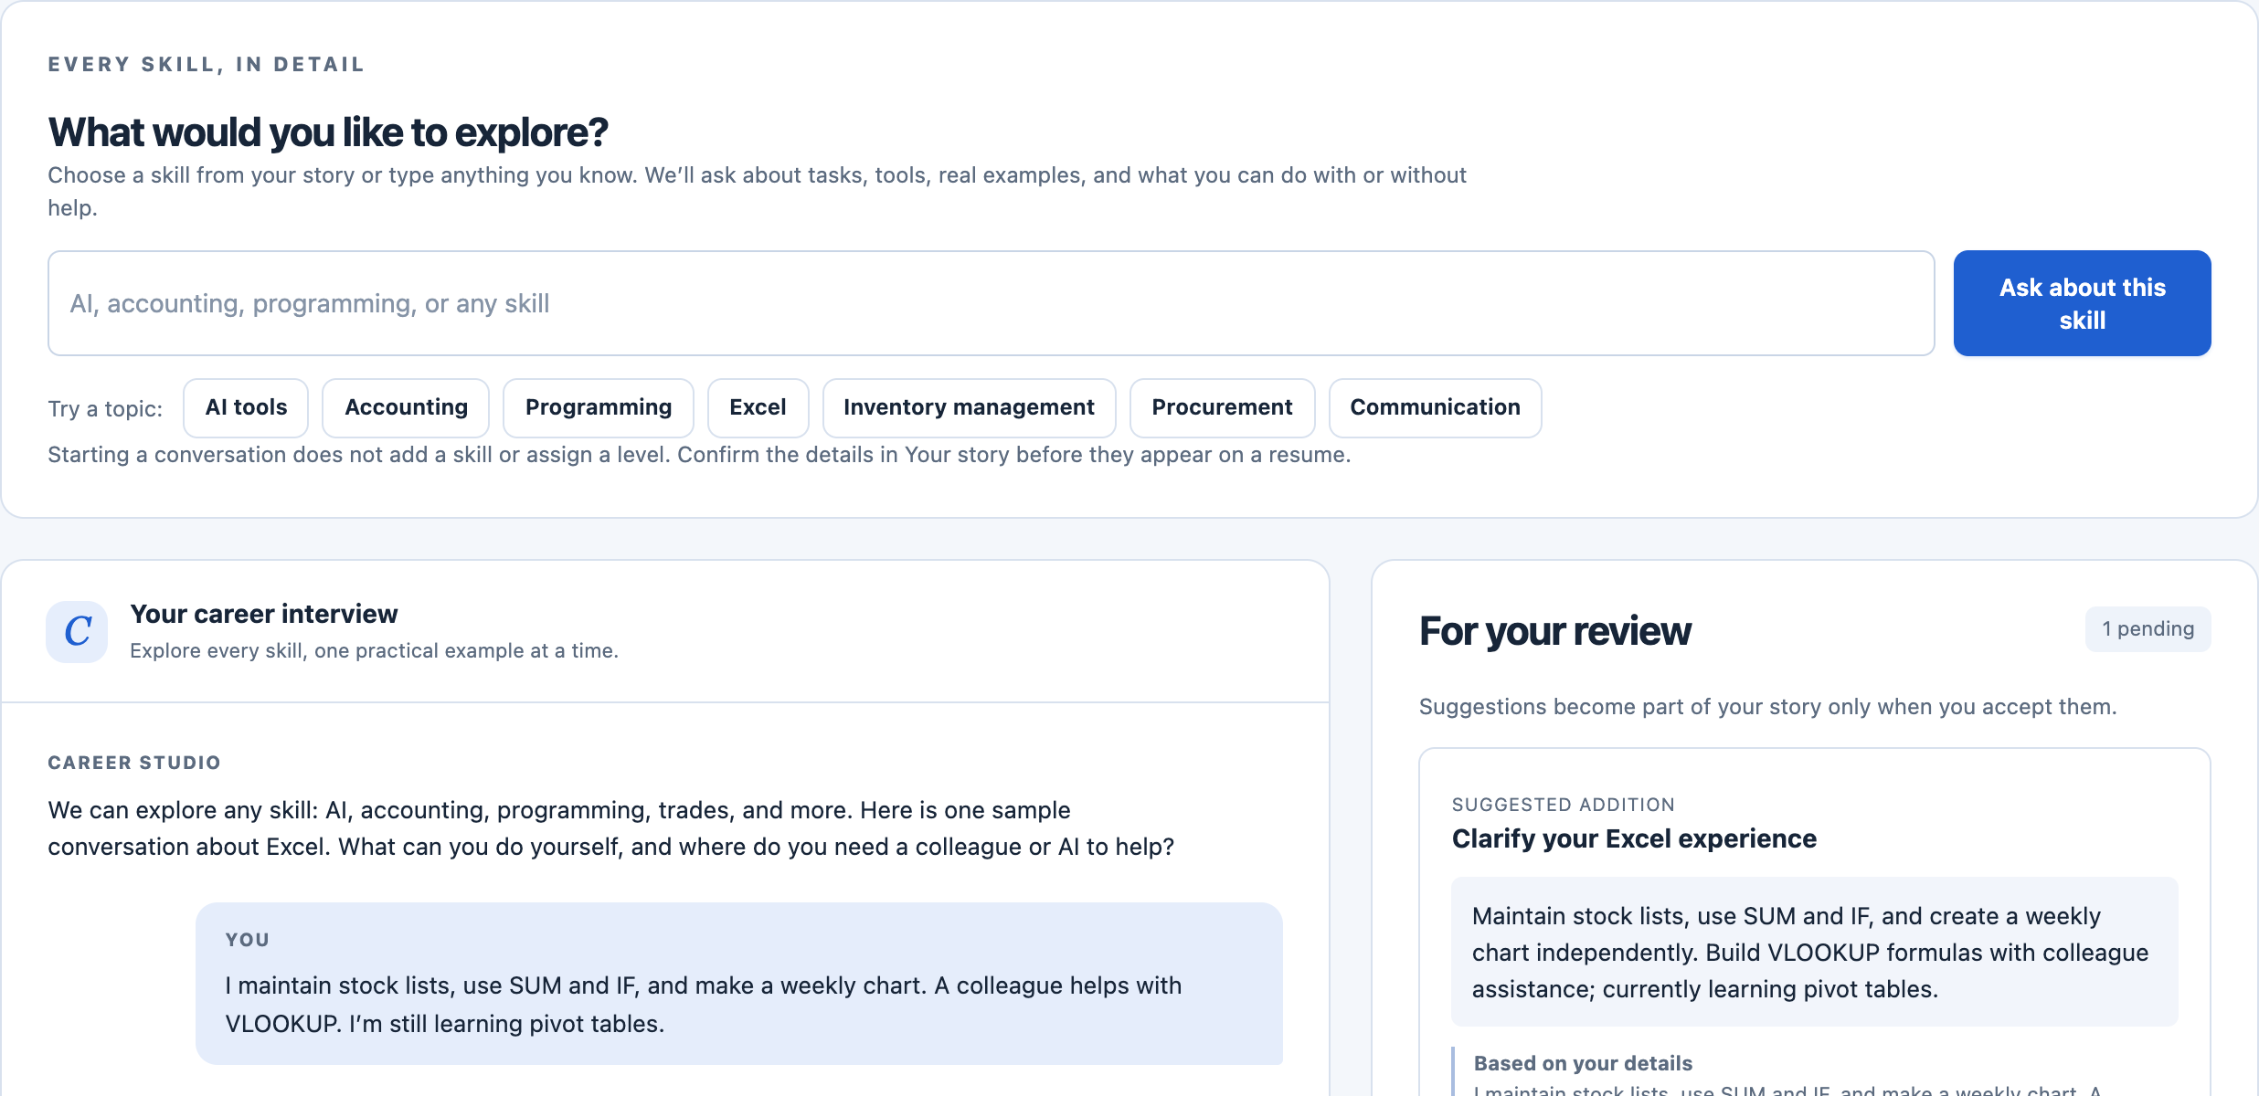
PART 1 · WHAT THE PRODUCT DOES
EVERYONE
The interview proposes facts for review
Choose any skill, explore what the customer actually does, then review each proposed fact.
WHAT TO LOOK AT
1
Choose an existing skill or type any skill. Examples start questions, not claims.
1
2
Questions explore tasks, tools, assistance and evidence for the chosen skill.
3
3
Review the supporting detail before accepting a proposed fact.
2
Career Studio · Product handoff · September 9, 2026
Fictional demo. AI examples are simulated.
10 / 29
Notes:
Sources and scope: Actual /demo interview screenshot; public/app.js skill chooser; lib/ai.js interview and applyProposals; server.js proposal routes. Select an entered skill or type another skill for detailed follow-ups. AI, accounting and programming quick examples make the breadth visible. Choosing an example starts a question and does not save a profile claim. Demo replies are scripted. The real adapter sends consented career context to OpenAI and returns structured proposed changes with evidence. Separate independent work, assisted work and learning for each task, with recent examples. Customers accept or reject each suggestion. Validation checks allowed fields, supporting quotes and revisions. Human review is still required. Accepting a suggestion marks the profile unreviewed. Review again before generating a resume.
Product scope updated September 9, 2026. Dated integration checks retain their original review dates. Product paths are relative to the new repository root. Screenshots show fictional demo data, with scripted AI. This deck describes a pilot foundation, not a paid production service.

Slide 11
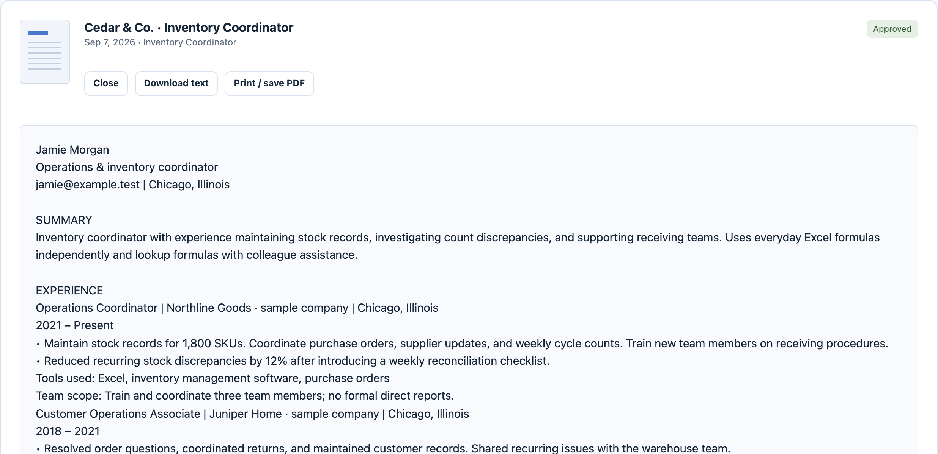
PART 1 · WHAT THE PRODUCT DOES
EVERYONE
Resumes keep the customer in control
Create a draft, edit its wording, approve it and keep the exact version used for an application.
1
WHAT TO LOOK AT
2
An approved version keeps its text and cannot be overwritten.
1
3
2
Download or print the version that was approved.
3
The text comes from the reviewed profile; tailoring stays a draft.
Career Studio · Product handoff · September 9, 2026
Fictional demo. AI examples are simulated.
11 / 29
Notes:
Sources and scope: Actual /demo resume screenshot; server.js resume routes; lib/documents.js; public/app.js. The authenticated product exports approved versions to DOCX and supports browser print/PDF. The demo substitutes a local sample text download. Approved versions cannot be overwritten. Tailoring draws on the reviewed profile and remains a draft. Demo tailoring is simulated. No ATS performance or hiring outcome guarantee.
Product scope updated September 9, 2026. Dated integration checks retain their original review dates. Product paths are relative to the new repository root. Screenshots show fictional demo data, with scripted AI. This deck describes a pilot foundation, not a paid production service.

Slide 12
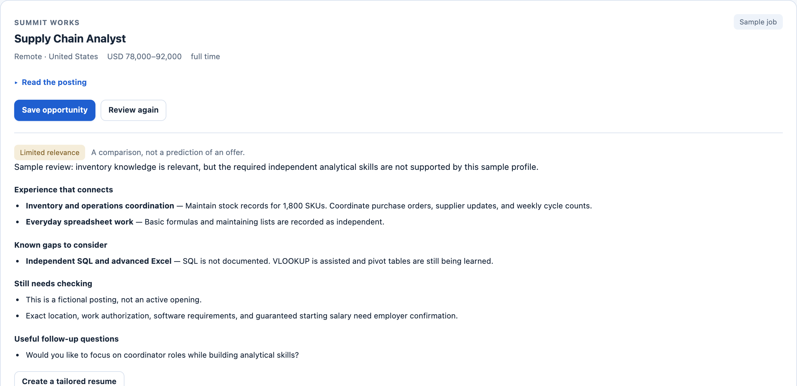
PART 1 · WHAT THE PRODUCT DOES
EVERYONE
Job reviews explain the evidence and gaps
A useful review separates supported experience, missing skills and questions to confirm.
WHAT TO LOOK AT
1
A comparison, not a prediction of an offer.
1
2
2
Supported experience, tied to what the profile records.
3
3
Known gaps name the skill and how it was recorded.
Career Studio · Product handoff · September 9, 2026
Fictional demo. AI examples are simulated.
12 / 29
Notes:
Sources and scope: Actual /demo job review screenshot; lib/ai.js assess; lib/jobs.js. “Job review” is the product’s own term for comparing a posting with the reviewed profile; it is not an employer review. Fictional listings have no apply URLs. Real discovery currently uses public Remotive remote postings and user-pasted job descriptions, not a comprehensive local job index. Source conditions checked September 8, 2026: https://github.com/remotive-com/remote-jobs-api . Public feed has source-link/attribution requirements and a 24-hour delay. Keep public access. Relevance is not employer eligibility verification.
Product scope updated September 9, 2026. Dated integration checks retain their original review dates. Product paths are relative to the new repository root. Screenshots show fictional demo data, with scripted AI. This deck describes a pilot foundation, not a paid production service.

Slide 13
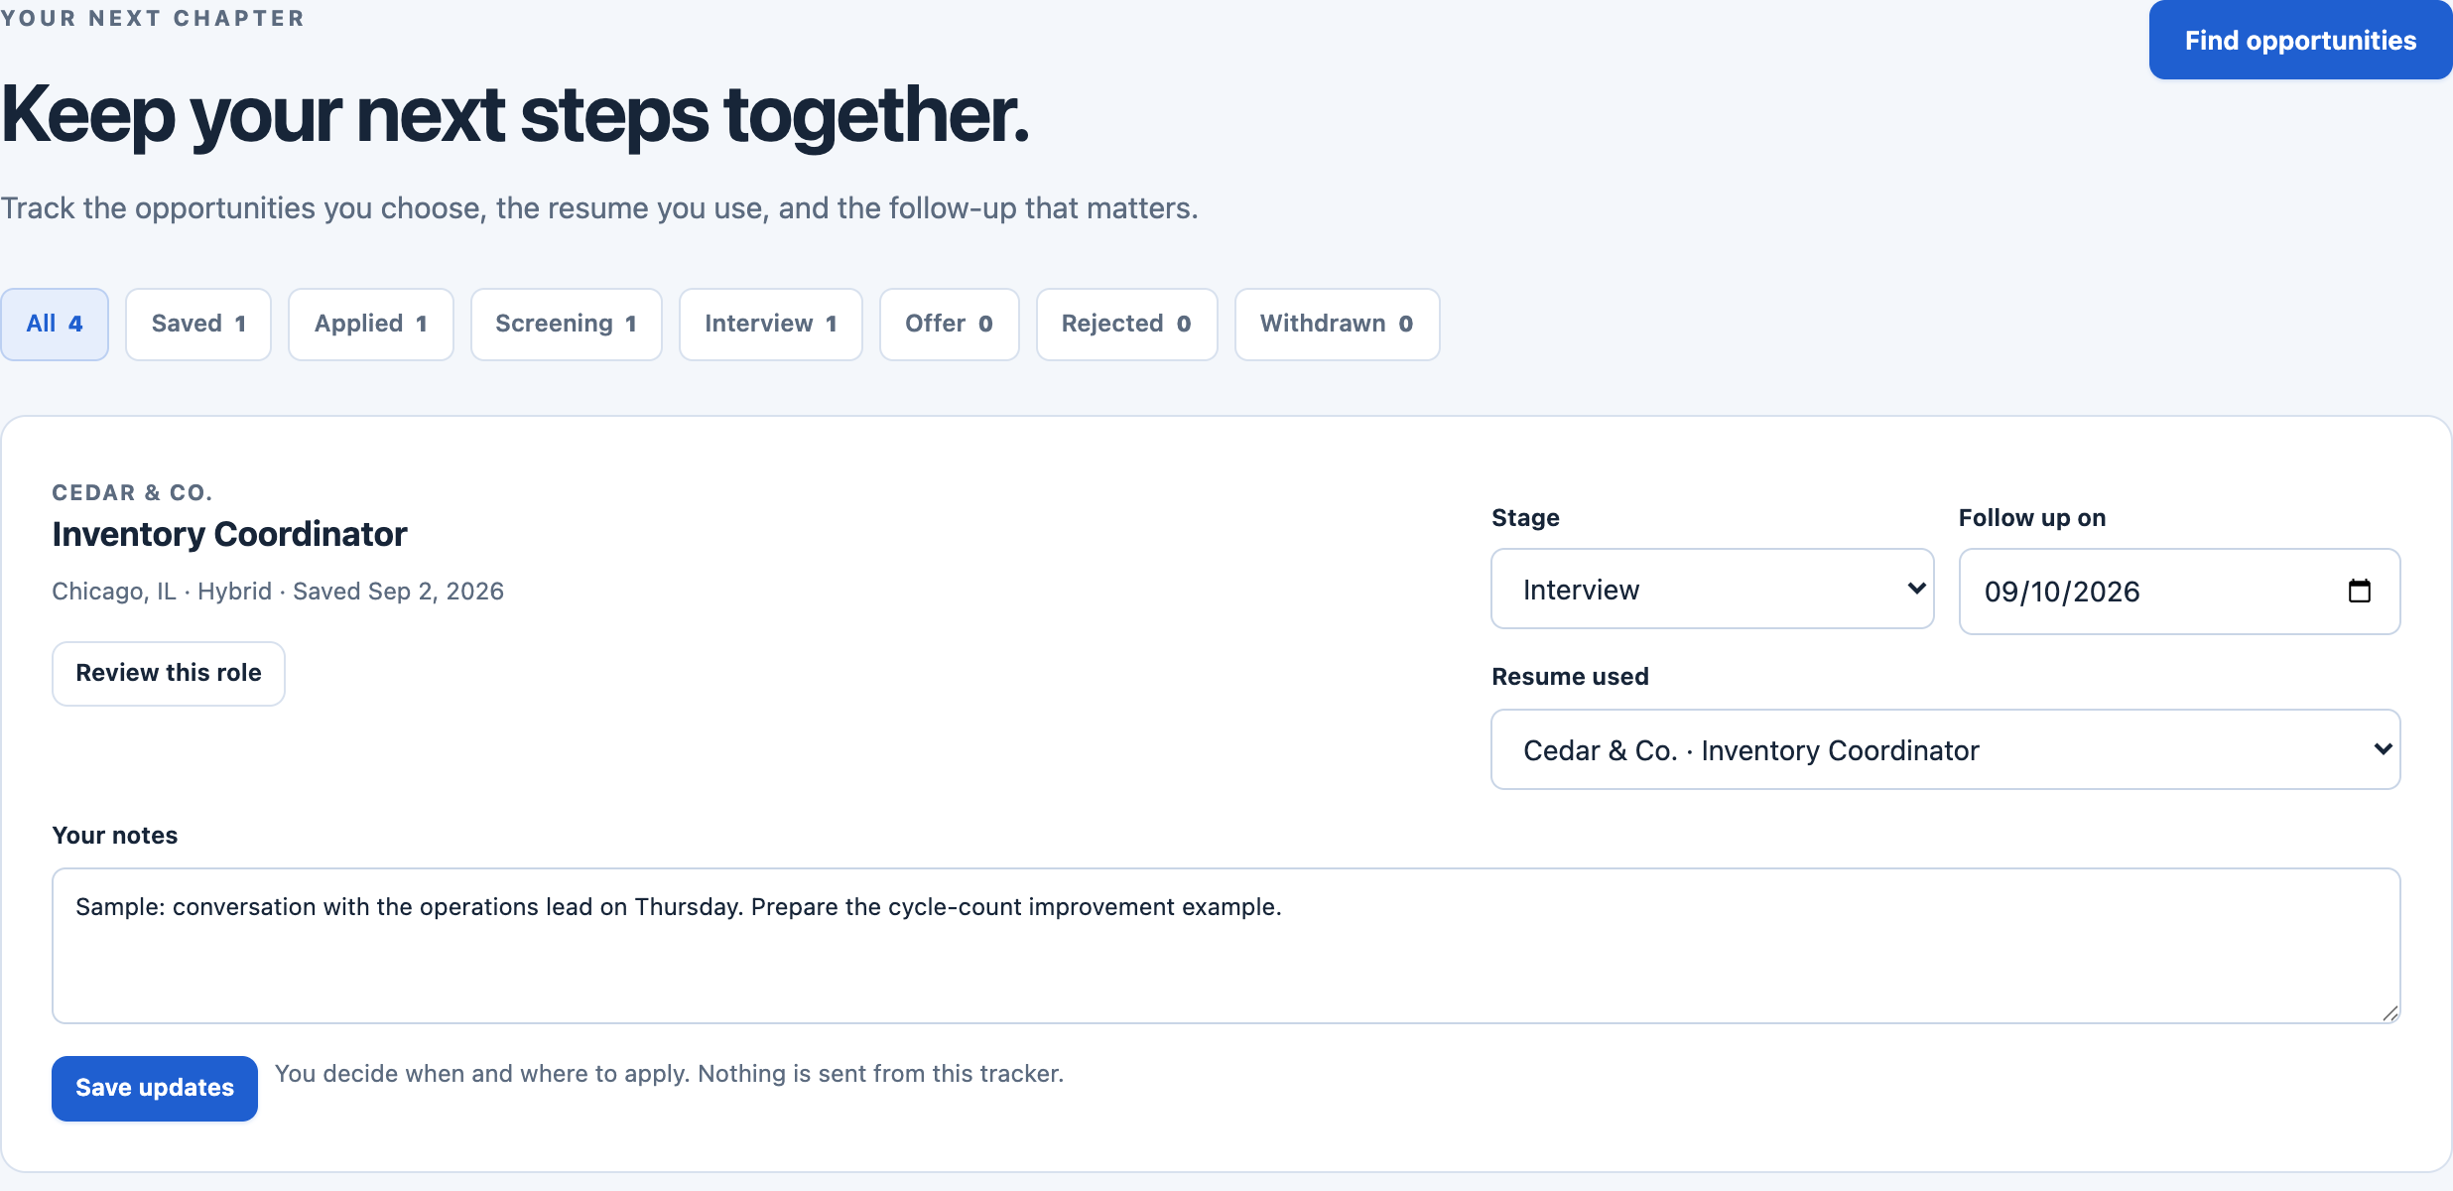
PART 1 · WHAT THE PRODUCT DOES
EVERYONE
The tracker preserves the next step
Save an opportunity with its stage, notes, follow-up date and approved resume version.
WHAT TO LOOK AT
1
Stages represent customer-entered progress.
1
2
The stage and next follow-up date stay with the opportunity.
2
3
3
The approved resume version used is recorded.
Career Studio · Product handoff · September 9, 2026
Fictional demo. AI examples are simulated.
13 / 29
Notes:
Sources and scope: Actual /demo applications screenshot; server.js application routes; lib/store.js. Stages represent customer-entered progress. The product does not submit applications, email employers or verify that an application occurred. External actions need separate authorization and are outside the current build.
Product scope updated September 9, 2026. Dated integration checks retain their original review dates. Product paths are relative to the new repository root. Screenshots show fictional demo data, with scripted AI. This deck describes a pilot foundation, not a paid production service.

Slide 14

02
IN THIS PART
15 · What is built and what remains
16 · The accepted launch plan
What is built
and how
to run it
17 · AI access at launch and later
18 · The current system
19 · Where the next engineer works
20 · Rules to preserve in every refactor
21 · The pilot hosting model
22 · Launch work in dependency order
The launch plan, the system, the code map and the gates.
Career Studio · Product handoff · September 9, 2026
14 / 29
Notes:
Navigation slide added in this version. It opens Part 2 and lists the build-and-run slides, the block the next engineer should read closely.
Product scope updated September 9, 2026. Dated integration checks retain their original review dates. Product paths are relative to the new repository root. Screenshots show fictional demo data, with scripted AI. This deck describes a pilot foundation, not a paid production service.

Slide 15
PART 2 · WHAT IS BUILT AND HOW TO RUN IT
EVERYONE
What is built and what remains
Six capabilities are implemented in the product. Six more are launch work.
IMPLEMENTED IN THE PRODUCT
REQUIRES LAUNCH WORK
Accounts and private records
Live AI and hosted validation
Resume intake and detailed profiles
Monitoring and recovery operations
AI adapter with approval steps
Customer privacy and support flows
Resume versions and job reviews
Broader licensed job coverage
Application tracker and backups
Billing and paid entitlements
Account-free demo
Email verification and reset
Career Studio · Product handoff · September 9, 2026
15 / 29
Notes:
Sources and scope: README.md; docs/OPERATIONS.md; docs/ENGINEERING_HANDOFF.md; tests/*.test.js. The automated suite passed on September 9, 2026. See docs/ENGINEERING_HANDOFF.md for the current test count and validation details. AI tests use a mock provider. The included Dockerfile and CI workflow require execution in the destination environment. Tests do not certify production security or commercial readiness. Authentication currently uses passwords and one-time recovery codes, with unverified email identifiers.
Product scope updated September 9, 2026. Dated integration checks retain their original review dates. Product paths are relative to the new repository root. Screenshots show fictional demo data, with scripted AI. This deck describes a pilot foundation, not a paid production service.

Slide 16
PART 2 · WHAT IS BUILT AND HOW TO RUN IT
PRODUCT OWNER
The accepted launch plan
The sequence represents dependency gates, not promised dates.
NOW
01
02
03
FIRST
AFTER VALIDATION
OPTIONAL LATER
Private pilot
Paid release
Further integrations
Operator funds bounded AI use. Verify reliability, usefulness and real costs.
Add billing, clear allowances and the operating processes to support customers.
Revisit ChatGPT linking and broader job sources after support and demand checks.
Career Studio · Product handoff · September 9, 2026
16 / 29
Notes:
Sources and scope: README.md Chosen product model; docs/ENGINEERING_HANDOFF.md launch gates. Sequence represents dependency gates, not promised dates or engineering estimates. User accepted the staged product-funded API approach after discussing subscription linking. Customer API keys and ChatGPT subscriptions are not launch prerequisites.
Product scope updated September 9, 2026. Dated integration checks retain their original review dates. Product paths are relative to the new repository root. Screenshots show fictional demo data, with scripted AI. This deck describes a pilot foundation, not a paid production service.

Slide 17
PART 2 · WHAT IS BUILT AND HOW TO RUN IT
PRODUCT OWNER
AI access at launch and later
Customers should be able to use the product without managing an API key or buying a separate ChatGPT plan.
CHOSEN FOR LAUNCH AI runs through the product’s own API account.
Customer browser
Customers never handle a key or buy a separate plan.
Product server
Operator stores the API key on the server. Per-customer allowances bound every request.
OpenAI API
Measure real costs before setting paid plans.
Authenticated HTTPS requests
Bounded requests
DEFERRED · NOT IMPLEMENTED
CHATGPT LINK, LATER
Customer’s own ChatGPT subscription
A research track, not a launch feature.
Explore an official account connection only.
Resolve production support and isolation first.
Provide disconnect and limit recovery.
Subscription linking is not implemented and is not included in launch claims.
Career Studio · Product handoff · September 9, 2026
17 / 29
Notes:
Sources and scope: README.md; docs/OPERATIONS.md. Official integration status checked September 8, 2026: https://learn.chatgpt.com/docs/app-server describes embedding, but labels app-server and WebSocket experimental and unsupported for production workloads. https://learn.chatgpt.com/docs/auth documents authentication. The proposed link is a research track, not a production-approved integration. Never collect OpenAI passwords, browser cookies or copied tokens. Do not silently switch a connected customer to billed API usage.
Product scope updated September 9, 2026. Dated integration checks retain their original review dates. Product paths are relative to the new repository root. Screenshots show fictional demo data, with scripted AI. This deck describes a pilot foundation, not a paid production service.

Slide 18
PART 2 · WHAT IS BUILT AND HOW TO RUN IT
ENGINEER
The current system
One authenticated Node.js service controls access and stores the customer’s approved work.
Browser
Profile, interview, resumes and CRM. Demo uses a separate in-memory adapter.
Node server
Sessions, ownership, consent, quotas and validated writes.
SQLite
Private profiles, interviews, proposals, resumes and applications.
Authenticated HTTPS requests
Owner-scoped rows
Consent and quotas
Cached public feed
EXTERNAL SERVICE
EXTERNAL SERVICE
OpenAI
Bounded requests.
Remotive feed
Shared public feed cache.
Model responses never decide account ownership. Every private read and write is scoped to the signed-in owner.
Career Studio · Product handoff · September 9, 2026
18 / 29
Notes:
Sources and scope: server.js; lib/store.js; lib/ai.js; lib/jobs.js; public/app.js; public/demo.js. Customer browser sends authenticated HTTPS requests to the product server. The server queries owner-scoped rows and makes bounded provider calls. Imported documents are processed by workers in lib/documents.js. SQLite schema version 2 and file-backed quotas assume one app process. AI is stateless at the provider interface, with product-owned conversation persistence.
Product scope updated September 9, 2026. Dated integration checks retain their original review dates. Product paths are relative to the new repository root. Screenshots show fictional demo data, with scripted AI. This deck describes a pilot foundation, not a paid production service.

Slide 19
PART 2 · WHAT IS BUILT AND HOW TO RUN IT
ENGINEER
Where the next engineer works
Each row points at existing code, not a new implementation task.
PATH IN THE REPOSITORY | WHAT IT OWNS
server.js | Routes, identity and request controls
lib/store.js + auth.js | Owner-scoped data, sessions and recovery
lib/ai.js | Interview, review, tailoring and evidence checks
lib/resume-model.js | Profile, skill catalog and resume text
lib/documents.js + jobs.js | Document workers and job feed
public/ + tests/ | Customer UI, demo and behavioral checks
Career Studio · Product handoff · September 9, 2026
19 / 29
Notes:
Sources and scope: README.md; docs/ENGINEERING_HANDOFF.md. Paths are relative to product/ after it becomes the new repository root. Each row points to code, not a new implementation task. Additional operations instructions: docs/OPERATIONS.md.
Product scope updated September 9, 2026. Dated integration checks retain their original review dates. Product paths are relative to the new repository root. Screenshots show fictional demo data, with scripted AI. This deck describes a pilot foundation, not a paid production service.

Slide 20
PART 2 · WHAT IS BUILT AND HOW TO RUN IT
ENGINEER
Rules to preserve in every refactor
Four behaviours must survive any rewrite of the code beneath them.
CUSTOMER
OWNERSHIP
BOUNDED AI WORK
FACT APPROVAL
PRESERVED
VERSIONS
Request
Owner check
Consent and quota
Provider call
Proposal
Customer approval
Write
1
CUSTOMER OWNERSHIP
2
BOUNDED AI WORK
Every private operation checks the signed-in owner. Test with two accounts.
Consent, request limits and replay protection apply before provider calls.
3
FACT APPROVAL
4
PRESERVED VERSIONS
Model output stays a proposal. Customer corrections and profile revisions govern writes.
An approved resume keeps its text when the career profile changes.
Career Studio · Product handoff · September 9, 2026
20 / 29
Notes:
Sources and scope: lib/auth.js; lib/store.js; lib/ai.js; server.js; tests/server.test.js and tests/ai.test.js. Also preserve prompt-injection boundaries: uploads and job postings are untrusted data, not instructions or authority. Best-effort redaction does not anonymize career history. Never expose secrets, raw provider errors or resume contents in diagnostics.
Product scope updated September 9, 2026. Dated integration checks retain their original review dates. Product paths are relative to the new repository root. Screenshots show fictional demo data, with scripted AI. This deck describes a pilot foundation, not a paid production service.

Slide 21
PART 2 · WHAT IS BUILT AND HOW TO RUN IT
ENGINEER
The pilot hosting model
One HTTPS-fronted Node process, a private SQLite volume, and recovery tested before pilot access.
ONE APPLICATION PROCESS
RECOVERY AND OPERATIONS
HTTPS proxy, one Node process and a private persistent SQLite volume.
Monitor service failures, disk space, provider usage and backup age.
Configure server secrets and a verified API model.
Schedule encrypted backups off the host.
Keep the application port private.
Test restart and restore before pilot access.
Confirm customer ownership checks on the host.
Design shared storage and limits before adding replicas.
Career Studio · Product handoff · September 9, 2026
21 / 29
Notes:
Sources and scope: docs/OPERATIONS.md; Dockerfile; .env.example; scripts/backup.js. Use Node 24 or newer. Production requires an HTTPS APP_ORIGIN, a pilot invitation code at least 16 characters, and exact trusted proxy IPs. Preserve Host/Origin. Proxy must overwrite X-Forwarded-For with one actual client IP. Bind app port privately. Default daily attempt limits are 40 per customer, 400 service-wide, and 3 concurrent AI requests. They are not a dollar-spend cap. Backups need scheduling, encryption, off-host transfer, retention and restore testing.
Product scope updated September 9, 2026. Dated integration checks retain their original review dates. Product paths are relative to the new repository root. Screenshots show fictional demo data, with scripted AI. This deck describes a pilot foundation, not a paid production service.

Slide 22
PART 2 · WHAT IS BUILT AND HOW TO RUN IT
ENGINEER
Launch work in dependency order
Four milestones group the eight launch gates. No dates are committed.
YOU ARE HERE
01
02
03
04
Transfer
Fresh private repository with product source only.
Verify
Live AI, job access and privacy flows work on the host.
Pilot
Observe customer sessions and measure useful outcomes.
Charge
Billing and operating commitments match the offer.
ACCEPTANCE
ACCEPTANCE
ACCEPTANCE
ACCEPTANCE
Clean install
Real API test
Costs recorded
Entitlements
Checks pass
Source rights checked
Friction logged
Cancellation
No private data
Isolation and restore
Support ready
Refunds and support
Career Studio · Product handoff · September 9, 2026
22 / 29
Notes:
Sources and scope: docs/ENGINEERING_HANDOFF.md contains eight detailed launch gates with acceptance criteria and owners. This slide groups them into four milestones. Founder owns commercial, source and privacy decisions. Engineer owns implementation and technical verification. No dates are committed.
Product scope updated September 9, 2026. Dated integration checks retain their original review dates. Product paths are relative to the new repository root. Screenshots show fictional demo data, with scripted AI. This deck describes a pilot foundation, not a paid production service.

Slide 23

03
IN THIS PART
24 · Known risks and the pilot tests
25 · The first customer experiment
How to pilot
and sell it
26 · The sales conversation and demo
27 · Packaging and pricing experiments
28 · Measures for the pilot decision
29 · A verified pilot is the next milestone
Risks, the pilot experiment, the demo, pricing and measures.
Career Studio · Product handoff · September 9, 2026
23 / 29
Notes:
Navigation slide added in this version. It opens Part 3 and lists the pilot and commercial slides, the block the product owner has to decide on.
Product scope updated September 9, 2026. Dated integration checks retain their original review dates. Product paths are relative to the new repository root. Screenshots show fictional demo data, with scripted AI. This deck describes a pilot foundation, not a paid production service.

Slide 24
PART 3 · HOW TO PILOT AND SELL IT
PRODUCT OWNER
Known risks and how the pilot tests them
The founder’s current assessment. Each risk has something the pilot can measure.
The cost per active customer is unmeasured.
Job coverage is remote-only and 24 hours delayed.
ECONOMICS
COVERAGE
Default controls cap attempts, not dollars: 40 per customer per day, 400 service-wide, 3 concurrent.
Operations and coordinator roles are often local.
Record tokens and cost per customer before any price is set.
Test pasted postings and evaluate licensed local coverage before a discovery pitch.
AI can still overstate what a customer has done.
The first session may be too long to finish.
ACCURACY
EFFORT
Evidence checks and approval reduce errors; they cannot prove truth.
Measure time to a first approved resume.
Count corrections per draft and investigate every invented fact.
Review friction after three participants and shorten the first-use path.
Career Studio · Product handoff · September 9, 2026
24 / 29
Notes:
Sources and scope: docs/OPERATIONS.md (AI_DAILY_LIMIT 40, AI_GLOBAL_DAILY_LIMIT 400, AI_CONCURRENCY 3; attempt counts are not dollar caps); docs/ENGINEERING_HANDOFF.md job-discovery boundary and gate 6 measures; docs/SALES_PLAYBOOK.md friction review after three participants and the claim-accuracy measure. These are the founder’s current assessment, not a formal risk register. Add an owner and a numeric threshold to each risk before the cohort starts. Single-process hosting is a known constraint covered on slide 21, not a pilot risk.
Product scope updated September 9, 2026. Dated integration checks retain their original review dates. Product paths are relative to the new repository root. Screenshots show fictional demo data, with scripted AI. This deck describes a pilot foundation, not a paid production service.

Slide 25
PART 3 · HOW TO PILOT AND SELL IT
PRODUCT OWNER
The first customer experiment
Proposed pilot: recruit 8–12 active job seekers in operations and coordinator roles.
01
02
03
04
Recruit
Use founder relationships and invited career-coach referrals.
Observe
Watch one resume review, one skills interview and one saved opportunity.
Learn
Ask where the workflow helped, confused or overstated their experience.
Decide
Revise the product and offer using measured usefulness, effort and cost.
Next cohort
This is a research cohort, not current traction.
Begin live customer intake only after the pilot readiness and privacy gates.
Career Studio · Product handoff · September 9, 2026
25 / 29
Notes:
Sources and scope: docs/SALES_PLAYBOOK.md. Proposed experiment, not validated market demand or committed partnership. Begin live customer intake only after pilot readiness and privacy gates. Avoid mass outreach. The current remote-only feed may not serve local operations roles well, so test user-pasted postings and evaluate licensed local coverage. Accessible onboarding, mobile usability and support effort belong in pilot research.
Product scope updated September 9, 2026. Dated integration checks retain their original review dates. Product paths are relative to the new repository root. Screenshots show fictional demo data, with scripted AI. This deck describes a pilot foundation, not a paid production service.

Slide 26
PART 3 · HOW TO PILOT AND SELL IT
PRODUCT OWNER
The sales conversation and demo
One question opens the conversation. A five-minute demo answers it.
OPEN WITH THIS
“What part of your experience is hardest to explain on a resume?”
0:00
0:40
1:30
2:40
3:25
The overview
Story and skills
Choose a skill, review a fact
Resume versions
Job review, then tracker
THEN SHOW THESE FIVE THINGS
Choose a skill the customer wants to explain.
Record the next step in the tracker.
Show tasks, tools, help and a real example.
Connect the example to a resume claim.
Explain one job match and one gap.
Career Studio · Product handoff · September 9, 2026
26 / 29
Notes:
Sources and scope: docs/SALES_PLAYBOOK.md for the full five-minute demo and discovery questions. Open /demo, use Reset demo, and disclose that Jamie, jobs and interview replies are fictional/scripted. Show the skill chooser and an example such as AI, accounting or programming. The same process applies to every entered skill, including custom skills. Example prompts start questions and never save claims automatically. Show tasks, tools, assistance and evidence. The initial Excel suggestion remains an independent-versus-assisted example. Accept that supported suggestion, then use Your story > Review > accuracy checkbox > Save before another assessment. Show an approved resume and application note. Ask what the customer would use again and propose observing a pilot session after readiness gates. Never present a sample job as an opening or offer application submission.
Product scope updated September 9, 2026. Dated integration checks retain their original review dates. Product paths are relative to the new repository root. Screenshots show fictional demo data, with scripted AI. This deck describes a pilot foundation, not a paid production service.

Slide 27
PART 3 · HOW TO PILOT AND SELL IT
PRODUCT OWNER
Packaging and pricing experiments
Sell the reviewed profile and the organized search. Prices remain a decision after pilot evidence.
EXPERIMENT A
EXPERIMENT B
A monthly plan for an active search, with a stated AI allowance and clear cancellation terms.
A fixed 30-day search package that starts with resume setup.
WHAT IT TESTS
WHAT IT TESTS
Whether the offer is understood.
Completion of a first approved resume.
Willingness to pay and repeat use.
Preference tied to expected search length.
Reasons for cancelling.
Support demand per customer.
Billing is not built. Hosting, AI, job data, processing and support remain operator costs until pilot evidence sets a price.
Career Studio · Product handoff · September 9, 2026
27 / 29
Notes:
Sources and scope: docs/SALES_PLAYBOOK.md pricing hypotheses table. These are proposed packaging experiments, not established pricing. Compare willingness to pay with measured contribution margin: collected revenue less AI, job-data, processing, hosting allocation, payment fees and support costs. Set actual prices only after measuring representative heavy use and failure/retry costs. Preserve export and customer access expectations. Do not claim unlimited AI, comprehensive jobs or guaranteed interviews.
Product scope updated September 9, 2026. Dated integration checks retain their original review dates. Product paths are relative to the new repository root. Screenshots show fictional demo data, with scripted AI. This deck describes a pilot foundation, not a paid production service.

Slide 28
PART 3 · HOW TO PILOT AND SELL IT
PRODUCT OWNER
Measures for the pilot decision
Proposed instrumentation and research measures, not current product analytics.
MEASURE | WHAT IT RECORDS
Activation | Approved resume + useful saved opportunity
Time to value | Time and help needed to complete that journey
Accuracy | Corrections to proposed claims and skill levels
Search usefulness | Saved opportunities the customer would pursue
Return use | Customers who update the tracker next week
Economics | AI usage, support time and willingness to pay
Career Studio · Product handoff · September 9, 2026
28 / 29
Notes:
Sources and scope: docs/SALES_PLAYBOOK.md. Metrics are proposed instrumentation and research measures, not current product analytics. Set targets before the cohort. Collect metadata and consented feedback instead of raw resume text in analytics. Track sample size and denominators. Application/interview outcomes are customer-reported and cannot establish causal hiring impact in a small pilot.
Product scope updated September 9, 2026. Dated integration checks retain their original review dates. Product paths are relative to the new repository root. Screenshots show fictional demo data, with scripted AI. This deck describes a pilot foundation, not a paid production service.

Slide 29
CAREER STUDIO · PRODUCT HANDOFF
EVERYONE
A verified pilot is the next milestone
Two week-one instruction flows, one for each reader.
ENGINEER, WEEK ONE
Guide: docs/ENGINEERING_HANDOFF.md
Unzip the source
npm ci
Copy
.env.example
to .env
npm run check and npm test
npm start
Open /demo
Follow gate 01
PRODUCT OWNER, WEEK ONE
Guide: docs/SALES_PLAYBOOK.md
Pick the pilot audience
Write privacy and support commitments
Recruit 8–12 invitees
Observe one session each
Decide
Career Studio · Product handoff · September 9, 2026
29 / 29
Notes:
Sources and scope: README.md; docs/ENGINEERING_HANDOFF.md; docs/OPERATIONS.md; docs/SALES_PLAYBOOK.md. Begin by unpacking career-studio-source.zip into a fresh private repository with new history. Do not transfer the parent personal job-search repository or its Git history. Run npm ci, copy .env.example to private .env, npm run check, npm test and npm start. Browser tests require Chromium or CHROMIUM_PATH. /demo needs no account or provider key. Then complete the engineering handoff launch gates. Full guides accompany this deck under docs/. No GitHub transfer or server deployment has occurred as part of deck creation.
Product scope updated September 9, 2026. Dated integration checks retain their original review dates. Product paths are relative to the new repository root. Screenshots show fictional demo data, with scripted AI. This deck describes a pilot foundation, not a paid production service.

