Slide 1
ES6 – The future of JS

Slide 2
JS – A walk down the time
Created in 10 days in May 1995 by Brendan Eich
Originally called Mocha
In 1995 – changed to Livescript
96-97 Formed ECMA (European Computer Manufacturers Association)
1999 - ECMAScript 3. The baseline for JS
2009 - ECMA 5, 2011 – ECMA 5.1
2015 - ECMA 6

Slide 3
ECMA 6 – What to expect?
Not just a modest set of new APIs
Completely re-written rules and syntax
Browser support:
Chrome: 90+%
Edge: 80%
Safari: 54%
Android: 31%
iOS: 54%
Transpiling
Shims/Polyfills

Slide 4
JS – What future holds?
ECMA 7 or ECMA 2016
Browsers will continue to evolve and adopt features in parts
Best to start supporting things now
Link to shims

Slide 5
Javascript Hoisting
Declarations are hoisted
Assignments are not hoisted
https://www.w3schools.com/js/js_hoisting.asp

Slide 6
Block scope declarations
Let declarations
Implicit and explicit declaration
Declare at the top of the block
TDZ error
Let-for
Const declaration
Explicit initialization
Just the assignment is restricted

Slide 7
Block scope functions
Specification meets reality
Functions are hoisted
Not available outside the scope

Slide 8
Rest/Spread
Spread: spreads an array inside the context
Arguments inside a function
Array inside an array
Rest: gathers the rest of the arguments
Default values and rest/spread

Slide 9
Destructuring
Array destructuring
Object destructuring
Computed expression in destructuring
Destructuring and rest
Default value and destructuring
Nested destructuring

Slide 10
Object literal
Concise properties
Concise methods
A discussion on concise methods and recursion
Getter and setter
Computed property name
Setting Prototype
Object super

Slide 11
Object literal - II
Template literals/interpolated string literals
Interpolation expressions
Tagged template literals
Raw strings

Slide 12
Arrow functions
When to use it?
Short, single-statement inline function expression, where the only statement is a return of some computed value, and that function doesn’t already make a this reference inside it
An inner function expression that’s relying on a var self = this hack
For everything else, avoid it

Slide 13
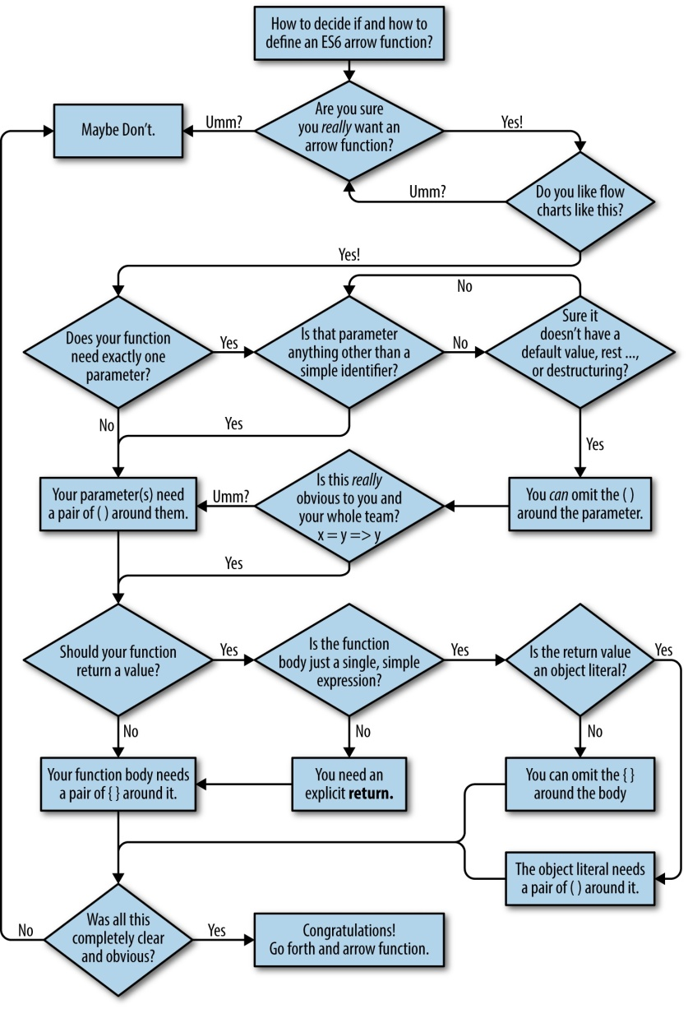
To use it or not to …

Slide 14
For-of loop
Used to iterate through values
Can be used to parse strings
For-of and destructuring

Slide 15
Modules
ES6 rules
One module per file
API of an ES6 module is static
ES6 modules are singletons
The properties and methods you expose on a module’s public API are actual bindings
Importing a module is the same thing as statically requesting it to load (if it hasn’t already)
Loaded preemptively
Loading handled by Browser/server

Slide 16
Modules
The new way
Named Export
Single default export as opposed to multiple exports
Mixing named and default exports
Import
Modules should be defined and used as static types
Import declarations are hoisted

Slide 17
Classes
Similar to function objects

