Slide 1


Mena Sales & Marketing overview| 19oct–23oct 2026

Slide 2
10.WEEKLY ACTIVITY REPORT — MENA GRANITE LIMITED
Submitted by:
Daniel fetewi
Role:
Acting Sales & Marketing
Report date:
25-OCT-2026
1.COMMERCIAL SUMMARY
Metric | This Week | Month | Comment
Visitors | 12
Site visits completed | 4
Quotes issued | 10
Orders confirmed | 8
Orders lost | 1 |  | 4 Inch out off stock
Revenue confirmed (UGX) | 130,553,381.77 |  | Credit Customers only, no access to cash data for reporting

Slide 3
1.GRANITE SALES PERFORMANCE
Product volume, revenue and revenue contribution
GRANITE COLOR / PRODUCT | VOLUME (m) | TOTAL REVENUE (UGX) | (%) share
ROYAL RED | 15.00 | 1,875.000.00 | 9.2%
GREEN SPOTTED | 4.36 | 751.965.99 | 3.7%
SPOTTED GREEN / BLACK | 66.99 | 15,044,455.34 | 74.0%
SPOTTED BROWN WITH BLACK | 11.19 | 1,679,100.00 | 8.3%
DRAGONFIRE | 10.02 | 989,836.44 | 4.9%
VICOUNT WHITE | 0.0 | 0.0 | 0.0%
BLACK GALAXY | 0.0 | 0.0 | 0.0%
TOTAL | 107.56 | 20,340,357.77 | 100%
Revenue % = Product revenue ÷ Total revenue × 100 .

Slide 4
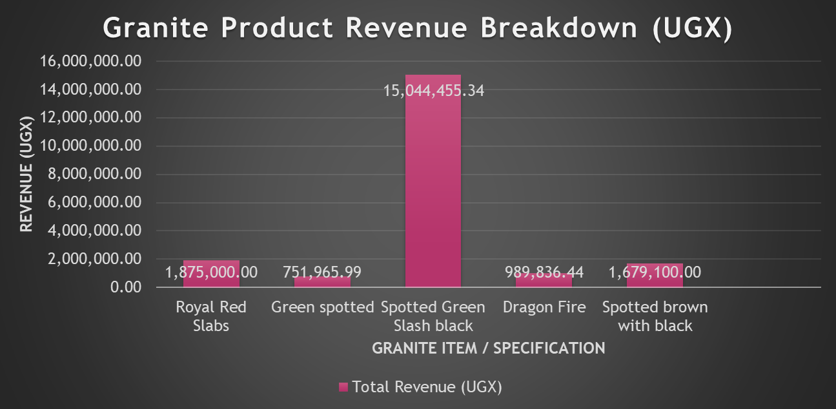
ROYAL RED • GREEN SPOTTED • SPOTTED GREEN/ BLACK • DRAGON FIRE SPOTTED BROWN WITH BLACK
2.REVENUE COMPUTATION ACCORDING TO COLOUR GRANITE SALES & CUSTOMER INSIHGTS
GRANITE SALES AND CUSTOMER INSIGHT
SALES ACHIEVEMENT—
We successfully convinced a client to change their preferred color of 67 m2 Viscount white to an alternative option spotted green slash black, resulting in a successful sale and securing the order.
KEY OBSERVATION
Viscount White and black galaxy is the most preferred granite color among customers. However, the current stock shortage is affecting our ability to meet customer demand and secure sales. I recommend prioritizing restocking this product to avoid losing potential customers and revenue.

Slide 5
3. GRANITE SALES COMPARISION
GRANITE SALES UPDATE
As projected in the above slide even though we have shortage of most preferrable color, whoever this week we have made 20 Million in sales in cash on hand and we are gradual increase in profit margin expansion
SALES OPPORTUNITY – GRANITE
We secured a potential customer requiring 6,000 m² of granite. A site visit was conducted, and 5,120 m² has been measured so far. The remaining will be measured once the area is cleared. We will complete the assessment and follow up to convert this opportunity into a confirmed order. Besides this customer also preferred granite color was viscount white however we convince him to Royal Red.
LAST 3 WEEKS GRAPH •

Slide 6
4.AGGREGATE SALES PERFORMANCE
Product volume, revenue and revenue contribution
AGGREGATE / PRODUCT ITEM | VOLUME (TON) | TOTAL REVENUE (UGX) | (%) share
1 INCH AGGREGATE | 640.00 | 35,140,000.00 | 34.1%
½ INCH AGGREGATE | 400.00 | 22,600,000.00 | 21.9%
CRR AGGREGATE | 137.00 | 4,579,003.00 | 4.4%
STONE DUST | 1,083.00 | 37,389,511.00 | 36.3%
STONE BASE | 80.00 | 3,264,510.00 | 3.3%
CRS AGGREGATE | 0.0 | 0.0 | 0.0%
HARD CORE | 0.0 | 0.0 | 0.0%
TOTAL | 2340.00 | 102,973,024.00 | 100%
Revenue % = Product revenue ÷ Total revenue × 100

Slide 7
1INCH AGG • ½ AGG • CCR AGG • STONE DUST STONE BASE CRS AGG HARD CORE
5.AGGREGATE AND CRUSHER PRODUCT REVENUE COMPARISON
As we can see in the graph, stone dust has been speaking up because GM and Teklit encountered two customers while traveling kayunga toward Nakifuma last week Therefore, we need to search for customers around Nakifuma area, as customers we find there might make purchases due to reduced transportation challenges.

Slide 8
6. AGGREGATE SALES COMPARISION
AGGREGATE SALES UPDATE
The decrease in aggregate sales this week was because we completed our work cleanly and on time for the 5,000 tons of aggregate requested by ACME. They had paused operations for three days to make internal adjustments, but now they have restarted and we have agreed to supply them with 240 tons per day."
LAST 3 WEEKS GRAPH

Slide 9
7.BLOCKS SALES PERFORMANCE
Product volume, revenue and revenue contribution
BLACKS / PRODUCT ITEM | QUANTITY (PCS) | TOTAL REVENUE (UGX) | (%) share
HOLLOW BLACK 8 INCH | 2.900.00 | 6.190,000.00 | 85.5%
HOLLOW BLACK 6 INCH | 0.00 | 0.00 | 0.0%
HOLLOW BLACK 4 INCH | 700.00 | 1,050,000.00 | 14.5%
SOLID BLACK 8 INCH | 0.00 | 0.00 | 0.0%
SOLID BLACK 6 INCH | 0.00 | 0.00 | 0.0%
SOLID BLACK 4 INCH | 0.0 | 0.0 | 0.0%
PAVEMENT | 0.0 | 0.0 | 0.0%
TOTAL | 3,600.00 | 7.240,000.00 | 100%
Revenue % = Product revenue ÷ Total revenue × 100

Slide 10
8.HOLLOW BLACK PRODUCT REVENUE COMPARISON
8 INCH HBC • 6 INCH HBC • 4 INCH HBC • SOLID 8 INCH SOLID 6 INCH SOLID 4 INCH

Slide 11
9.HOLLOW BLACK SALES COMPARISION
HOLLOW BLACK SALES PERFORMANCE:
HBC Sales – Temporary Customer Suspension
Some hollow block customers temporarily suspended their orders due to limited unloading space. they informed us that deliveries can resume once the space is reorganized and made available.
Lost Sales Due to Stock Shortage
- Product: 4-inch hollow blocks
- Lost sales quantity: 1,000 pieces
- Reason: Product out of stock.
- Recommended action: Improve stock planning to prevent future lost sales and meet customer demand.
LAST 3 WEEKS GRAPH

Slide 12

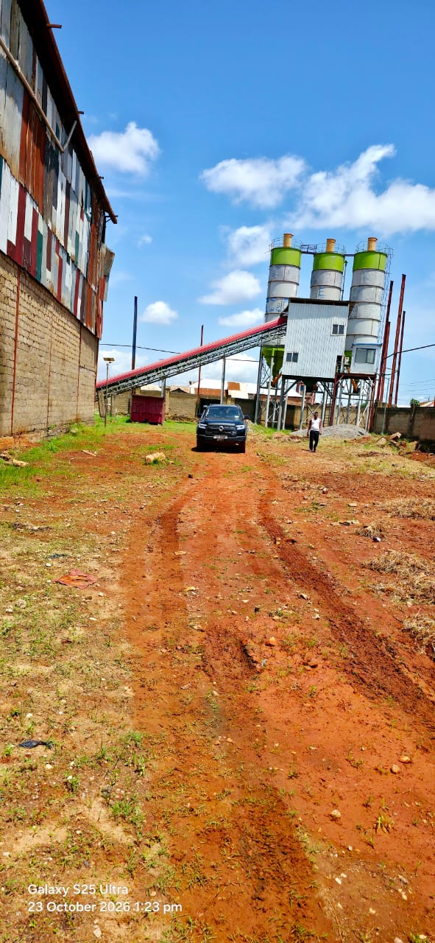
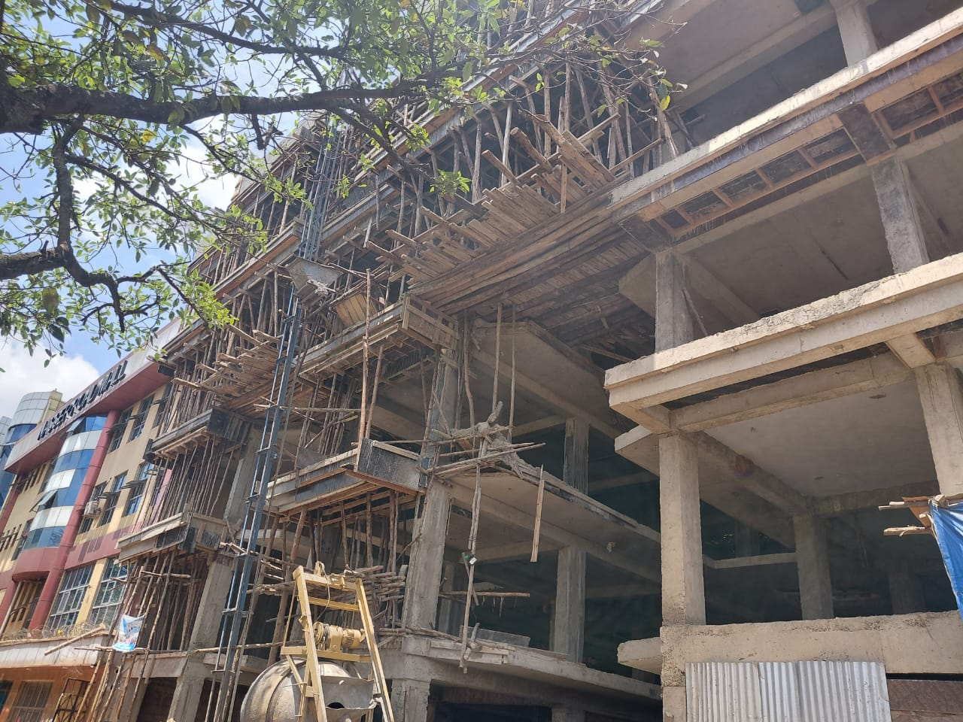
11. Marketing update
Visiting the following office & Sites
Motaengil service ltd
KKM mall Nasser road
Mr kalungi moss batching plants
Movi’t production ltd visit us

Slide 13

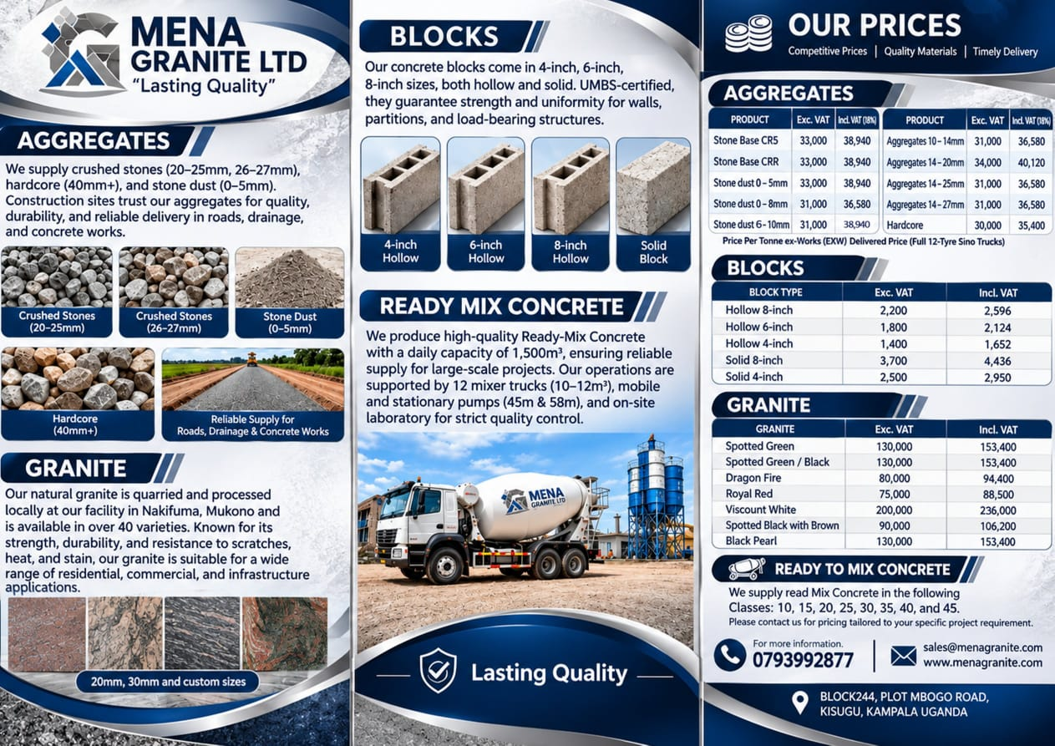
12.Activity: Social Media Marketing and Flyer Design
Summary: During the past week, the Sales and Marketing Department worked on creating social media content and designing promotional flyers to advertise the company’s products, including granite, aggregates, concrete blocks, ready-mix concrete, and white sand.
Objective: To increase brand awareness, attract new customers, and generate more sales through digital marketing and promotional materials.
Action: Publish the content on social media platforms and distribute flyers to potential customers.

Slide 14
13 | GRANITE PROJECT OPPORTUNITY
Customer visits — Kalungi Moss
Customer: Mr Kalungi Moss • Opportunity: Granite, Aggregates and sand works for two large malls
Progress Achieved
Business Potential
The team visited the customer in person to review two major mall projects planned for the future.
A verbal agreement has been reached for granite works on one mall. Site measurements have also been taken.
The projects present a strong opportunity to secure granite supply and build a long-term customer relationship.
NEXT ACTION
Follow up closely with the customer, confirm project requirements and quantities, and move the verbal agreement toward a formal order.

Slide 15
14 | FOLLOW-UP ACTION PLAN
Priorities for the coming week
No.
Customer / Activity
Next Action
Priority
1
Kalungi Moss — Mall projects
Follow up on the granite agreement and confirm scope, quantities and timeline.
High
2
Site measurements
Review measurements taken and identify any remaining areas requiring measurement.
High
3
Mr. Futsum — 10,000 blocks
Confirm specifications, delivery requirements and order documentation.
High
4
Customer relationship
Maintain regular communication and progress each opportunity toward sales conversion.
Medium
Overall focus: maintain customer engagement, formalize agreements and convert opportunities into confirmed orders.

