Slide 1


Mena Sales & Marketing overview| 19oct–23oct 2026

Slide 2
10.WEEKLY ACTIVITY REPORT — MENA GRANITE LIMITED
Submitted by:
Daniel fetewi
Role:
Acting Sales & Marketing
Report date:
02-NOV-2026
1.COMMERCIAL SUMMARY
Metric | This Week | Month | Comment
Visitors | 13
Site visits completed | 5
Quotes issued | 8
Orders confirmed | 6
Orders lost | 4 |  | Transportation price, due to price Out of stock
Revenue confirmed (UGX) | 110,687,739.29 |  | Credit Customers only, no access to cash data for reporting

Slide 3
1.GRANITE SALES PERFORMANCE
Product volume, revenue and revenue contribution
GRANITE COLOR / PRODUCT | VOLUME (m²) | MOLDING (m) | TOTAL (m²) | REVENUE (%)
Royal Red | 7.88 | 0.0 | 754,687.50 | 8.4%
Green Spotted | 46.44 | 0.0 | 6,007,200 | 67.2%
Green Spotted / Black | 1.15 | 0.0 | 149,500 | 1.7%
Green Spotted with Black | 0.0 | 0.0 | 0.0 | 0.0%
Dragon Fire | 0.93 | 0.0 | 123,333.03 | 1.4%
Vicount white | 3.50 | 0.0 | 1,108,331 | 12.4%
Skirting Line | 1.35 | 0.0 | 276,582.96 | 3.1%
Molding Service | 0.93 | 51.9 | 519,200 | 5.8%
TOTAL | 61.25 | 51.92 | 8,938,834.49 | 100%
Revenue % = Product revenue ÷ Total revenue × 100 .

Slide 4
ROYAL RED • GREEN SPOTTED • SPOTTED GREEN/ BLACK • DRAGON FIRE SPOTTED BROWN WITH BLACK
2.REVENUE COMPUTATION ACCORDING TO COLOUR GRANITE SALES & CUSTOMER INSIHGTS
GRANITE SALES AND CUSTOMER INSIGHT
KEY OBSERVATION
Currently, Green Spotted granite—one of our salable product — is out of stock, which is significantly impacting our granite market performance. However, shortage variety color of our stock is affecting our ability to meet customer demand and secure sales.

Slide 5
3. GRANITE SALES COMPARISION
GRANITE SALES UPDATE
As I mentioned earlier, the shortage of essential colors is affecting the market; however, we are doing everything we can to guide our clients toward alternative options."
LAST 3 WEEKS GRAPH •

Slide 6
4.AGGREGATE SALES PERFORMANCE
Product volume, revenue and revenue contribution
AGGREGATE / PRODUCT ITEM | VOLUME (TON) | TOTAL REVENUE (UGX) | (%) share
1 INCH AGGREGATE | 491.90 | 27,299,500 | 28%
½ INCH AGGREGATE | 120 | 6,320,000 | 6.6%
CRR AGGREGATE | 0.0 | 0.0 | 0.0
STONE DUST | 1,624 | 53,889,604.80 | 56.4%
STONE BASE | 0.0 | 0.0 | 0.0
CRS AGGREGATE | 0.0 | 0.0 | 0.0%
HARD CORE | 160 | 7,977,800 | 0.0%
TOTAL | 3,395.90 | 95,486,904.80 | 100%
Revenue % = Product revenue ÷ Total revenue × 100

Slide 7
1INCH AGG • ½ AGG • CCR AGG • STONE DUST STONE BASE CRS AGG HARD CORE
5.AGGREGATE AND CRUSHER PRODUCT REVENUE COMPARISON

Slide 8
6. AGGREGATE SALES COMPARISION
AGGREGATE UPDATE
The reason for the drop in the aggregates market is that our main clients have temporarily paused their orders due to space adjustments. However, we have not stopped checking in on them, and we are also working hard to find similar clients, with promising opportunities already emerging."
LAST 3 WEEKS GRAPH

Slide 9
7.BLOCKS SALES PERFORMANCE
Product volume, revenue and revenue contribution
BLACKS / PRODUCT ITEM | QUANTITY (PCS) | TOTAL REVENUE (UGX) | (%) share
HOLLOW BLACK 8 INCH | 10 | 22,000 | 0.2%
HOLLOW BLACK 6 INCH | 3800 | 6,840,000 | 69.4%
HOLLOW BLACK 4 INCH | 200 | 3,000,000 | 30.4%
SOLID BLACK 8 INCH | 0.0 | 0.0 | 00%
SOLID BLACK 6 INCH | 0.0 | 0.00 | 0.0%
SOLID BLACK 4 INCH | 0.0 | 0.0 | 0.0%
PAVEMENT | 0.0 | 0.0 | 0.0%
TOTAL | 4010 | 9,862,000.00 | 100%
Revenue % = Product revenue ÷ Total revenue × 100

Slide 10
8.HOLLOW BLACK PRODUCT REVENUE COMPARISON
8 INCH HBC • 6 INCH HBC • 4 INCH HBC • SOLID 8 INCH SOLID 6 INCH SOLID 4 INCH

Slide 11
9.HOLLOW BLACK SALES COMPARISION
HOLLOW BLACK SALES PERFORMANCE:
The fluctuation in our blocks market is due to our pricing not being able to meet the target prices of some customers. We are actively working to improve this by inquiring about other market rates and discussing with GM & OM.
LAST 3 WEEKS GRAPH

Slide 12
LOST SALES OPPORTUNITIES
Summary of customers and products not secured
Customer | Lost Product(s) | Reason / Remarks
Uganda Police | lost Block deal with Uganda police because of transportation cost, as there are other block manufactures near the sites | Due to price
ACME | White Sand | Due to price
Canaanze Construction | White Sand they get lower price from Turkish company called Alifey by 1,800,000 ugx however our price is 2,200,000 ugx with out transportation. | Due to price
Mr. Paul | Spotted Green and Vicount White | Out of stock

Slide 13

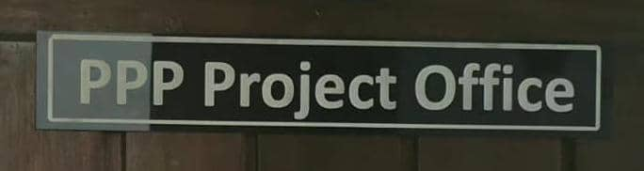

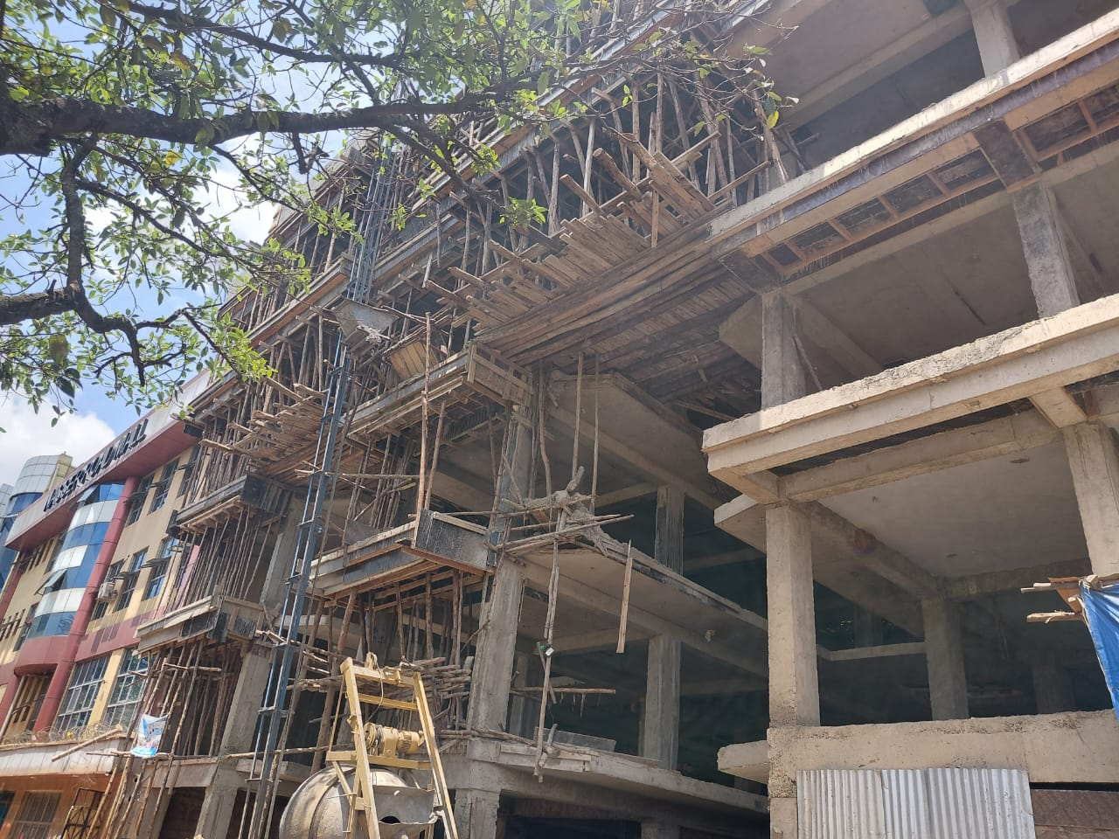
11. Marketing update
Visiting the following office & Sites
UGANDA POLICE
CANAANZE CONSTRACTION LTD
TONZA HODING
KKM MALL Nasser rd
MUKONO BUILDINGS

Slide 14
MARKET UPDATE
Sales pipeline – customer engagement, quotations and follow-up
Customer | Market Update | Current Status / Next Action
Uganda Police | We presented our products and explained our offering. They may consider us for six projects if pricing is agreed: Like Jinja police station, Bweyogere, police station, Kireka Wembule, police station, Naguru Apartment police station, Nsambya police station and Entebbe Police Stations. | Quotation submitted. Awaiting feedback and following up.
Canaanze Construction Ltd. | Presented our products and offered a more competitive price than other suppliers, giving us a strong opportunity to win the business. | Quotation submitted. Awaiting their response.
Tonza Holding | Showed interest in our granite products. | Quotation submitted. Follow-up ongoing.
KMM Mall | Previously indicated a requirement of approximately 6,000 m² of granite. | Close follow-up ongoing to secure the order.
Priority: Maintain customer contact and follow up on all submitted quotations.

Slide 15
MARKET UPDATE – SALES PROGRESS
Confirmed agreement and upcoming customer engagement
Customer | Opportunity / Progress | Status / Next Action
Mr. Fitsum | Previously had a verbal understanding for the supply of 10,000 concrete blocks. An agreement has now been reached and a contract has been signed. | Customer has paid a deposit of UGX 10,000,000.
Mukono Building | Expressed interest in our granite products. | Appointment scheduled to discuss the requirement.
KEY ACHIEVEMENT | 10,000 concrete blocks secured under contract • UGX 10,000,000 deposit received
Next focus: Convert pending quotations into confirmed orders and progress the scheduled granite discussion.

Slide 16
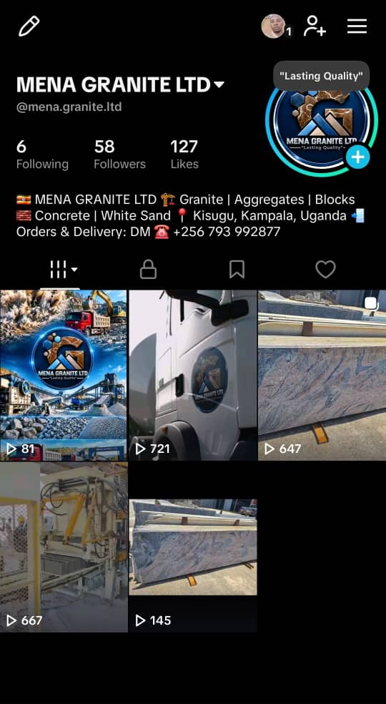
DIGITAL MARKETING UPDATE
Marketing activities, platform development and customer response
1. Previous activity
A new marketing flyer was prepared as part of our earlier marketing activities.
2. Tik Tok activation
We have continued our digital marketing efforts by starting product promotion on Tik Tok.
3. Content development
We have begun publishing selected product videos supported by AI-assisted posts. The initiative is still at an early stage.
4. Expansion plan
We plan to strengthen our digital marketing and expand our activities on Facebook and Instagram.
Focus: Build consistent online visibility and present our construction materials to a wider audience.

Slide 17
DIGITAL MARKETING – RESULTS & NEXT STEPS
Early response from TikTok and planned follow-up
NEXT ACTIONS
• Continue publishing product videos and AI-supported posts.
• Strengthen consistency on Tik Tok.
• Expand product promotion on Facebook and Instagram.
• Follow up on reseller inquiries and convert interest into sales.
EARLY POSITIVE RESPONSE
Tik Tok has started generating positive engagement.
We are receiving inquiries, particularly from resellers interested in our products.
Management comment: Digital marketing is beginning to create visibility, engagement and potential reseller opportunities.

Slide 18
MARKETING OBJECTIVES
Customer service, quotation follow-up and sales conversion
1. Strengthen customer relationships
Maintain regular contact with all customers we have visited and engaged, and understand their requirements.
2. Deliver excellent service
Continue improving the quality, efficiency and speed of our customer service.
3. Follow up on quotations
Closely follow up with customers who have received quotations and respond promptly to their questions.
4. Convert opportunities into sales
Make every reasonable effort to secure orders and turn customer interest into confirmed business.
Overall objective: Build customer confidence, strengthen relationships and increase sales conversion.

Slide 19
MARKETING ACTION PLAN
Key priorities to achieve our marketing objectives
Priority | Planned Action | Expected Outcome
Customer engagement | Maintain regular communication with visited and existing customers. | Stronger customer relationships
Service quality | Provide timely, efficient and professional service. | Higher customer satisfaction
Quotation follow-up | Contact customers who received quotations and address their feedback. | Faster customer decisions
Sales conversion | Negotiate, resolve concerns and follow up until a decision is reached. | More confirmed orders
Management focus: Deliver reliable service and turn submitted quotations into confirmed orders.

