Slide 1

Social Data Science M3 - Deep Learning
SDS – Group 1

Slide 2

Intro
Our project
Data Cleaning, EDA & Sentiment analysis
Supervised Machine Learning Binary
Neural Network Binary
Multiclass models

Slide 3


Data cleaning & EDA
First steps of our analysis
Objectives
Problem statement
The opportunity to use newly acquired abilities within Machine Learning, Network Analysis & NLP and Deep Learning to investigate a given problem statement
Based on the M1, M2 and M3 courses, we will try to carry out an analysis which contains elements of data manipulation, exploration, machine learning, natural language processing and deep learning
Use these acquired techniques to investigate whether we can make a NN-model and a ML-model predict the sentiment of a song given the lyrics of this song
In addition, we would like to investigate whether it is possible to predict this using a Multiclass model given these lyrics

Slide 4

Data cleaning & EDA
Data acquisition
Relevant for our problem statement
Through Kaggle we were able to ﬁnd a relevant dataset
The data contains 13 columns/features, which describes different characteristics for selected songs eg. genre and lyrics

Slide 5

Data cleaning & EDA
Data preparation process
The most essential variables
This includes three character strings
Feature engineering
The variable genre describes which genre or several genres a given movie belongs to
In order to make the analysis more applicable only the three most common genres (Pop, Rock and Pop/Rock) are used
name assign each song with the respective artist and name of the song
text contains a text that refers to the lyrics of each song
genre describes which genre or several genres a given song belongs to

Slide 6
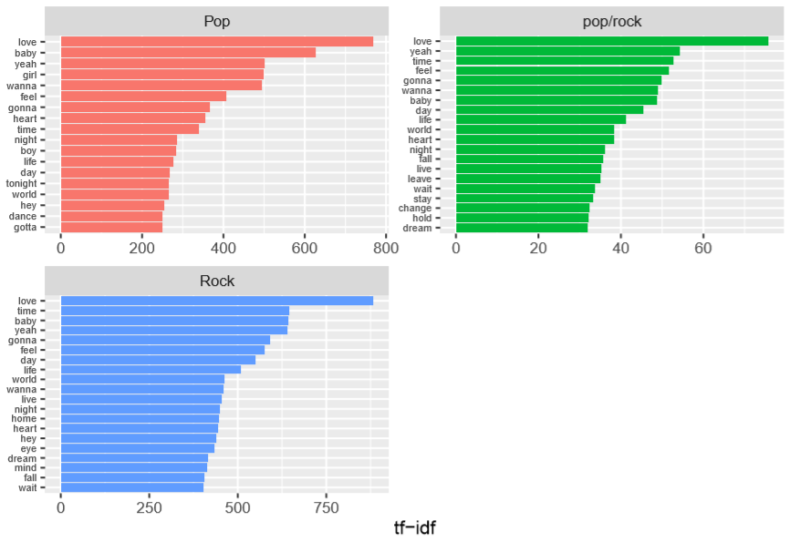
Data cleaning & EDA
Data preparation process
From these we extracted the most common words in the 3 genres
First, we tokenized the data – converting lyrics into a list of words
Second, we removed short words (>2) and stop words
Third, we use the “hunspell package” to stem our data – reducing a word to its “root” word
Then we weighted these words using tf-idf and plotted the 20 most used words within each genre

Slide 7
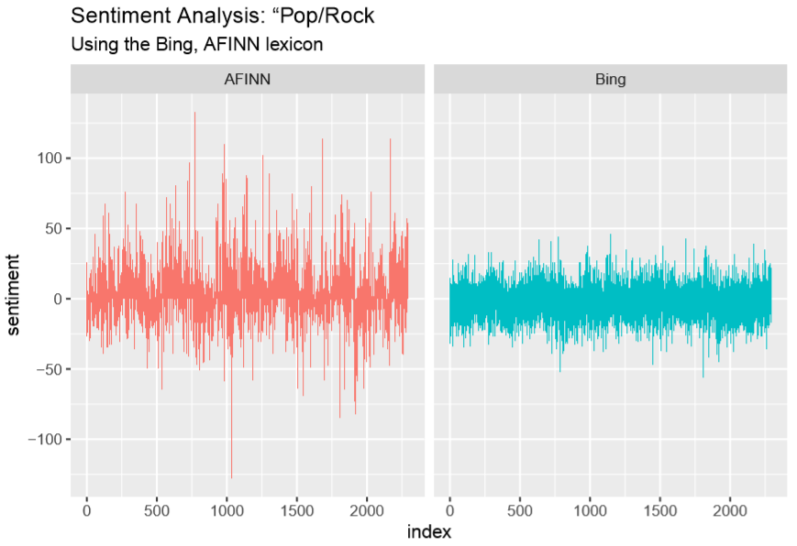
Data cleaning & EDA
Data visualization
In order to further visualize the words within these genres we did a sentiment analysis based on the words within each genre – Pop/Rock to the right
We used the lexicons “bing” and “afinn” to distinguish between positive and negative words
We only used words which were also found in the lexicons – via function: “inner_join”
We then created a plot for the distribution between negative and positive words within the Pop/Rock genre
We observe a predominance of positive laden words

Slide 8
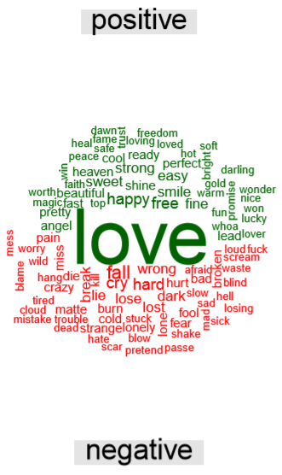
Data cleaning & EDA
Data visualization
We also created a word cloud, which compares the 50 most frequently used positive and negative words within the Pop/Rock genre
Here, “love” and “fall” are the most dominant words respectively

Slide 9
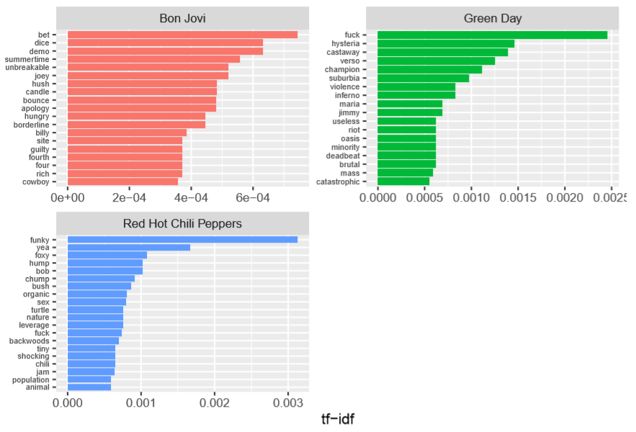
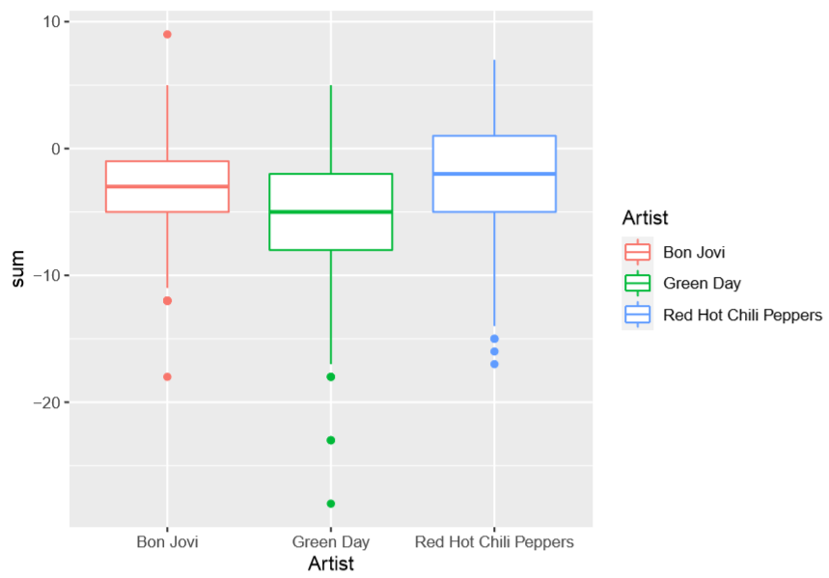
Data cleaning & EDA
Data visualization
Band analysis
We pick the top 3 artists (in our opinion) Green day, Bon Jovi and Red Hot Chili Peppers
We plot the 20 most used words within the lyrics of the 3 artists
Songs of the 3 artists
We observe that the overall sentiment of the songs seems to be negative for all 3 artists
It seems RHCP has the most positive songs on average

Slide 10
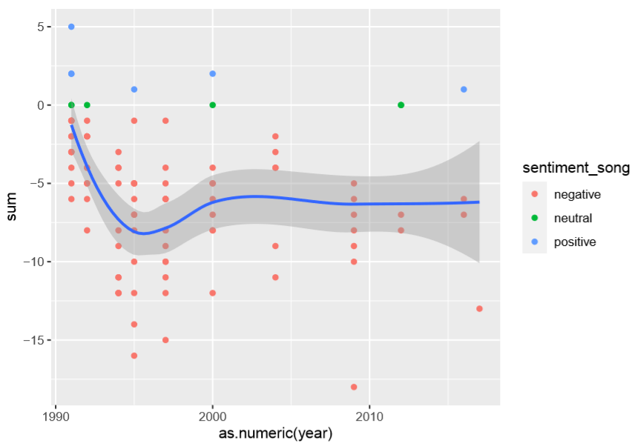
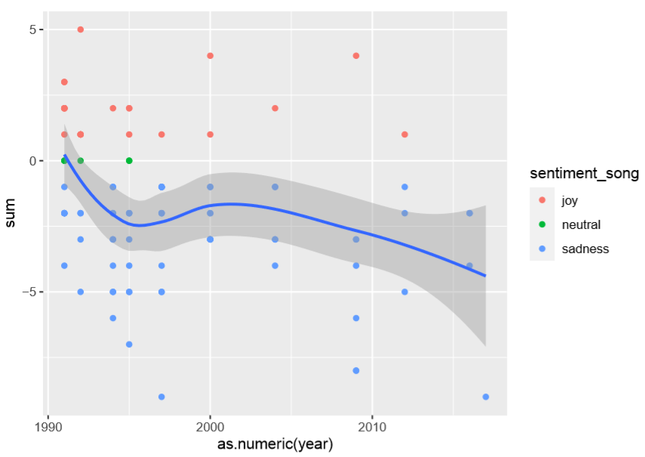
Data cleaning & EDA
Data visualization
Band sentiment over time
We found a dataset including release date for songs on Spotify
Again, we pick the same 3 artists
We connect the Spotify dataset – via function: “inner_join”
We then plot the development over time for the sentiment of the songs – Green Day to the right
Sentiment between positive and negative songs
Sentiment between joyful and sad songs

Slide 11
Supervised Machine Learning
Binary classification model
Predicting sentiment of a song based on lyrics
Positive - negative
Data:
Stemmed and removed stopwords and numbers
Embedded data
TF-IDF weights
Models:
Logistic Regression
uses a logistic function to model a binary dependent variable like ours
K-Nearest Neighbor
The KNN algorithm assumes that similar things are close to each other
Decision Tree
Splits data in categories based on features and decisions (making a tree)
Random forest
Multiple decision trees, where the prediction of the random forest is the prediction of the majority of the decision trees.
Notes:
We have created two supervised machinelearning models a Binary and multicalss classification model.
Binary:
Only predicting Drama or Not Drama based on the description.
Data is embeddings wheighted by TF-IDF score. And then taken the mean for each movie.
Before emddings the data is Stemmed, Stopwords are removed, and numbers are removed.
Models: We use 4 models:
Logistic regression model (S-shaped curve)
Decision tree
KNN
Random forest
Multiclass model:
Now we predict if a movie is within the Drama, Horror, Comedy or Thriller class.
Data: We now use 3 different recipies where we:
Embedding → using glove6B
TF-IDF → ?
TextHash → ??
We use three models which should be explained now.

Slide 12
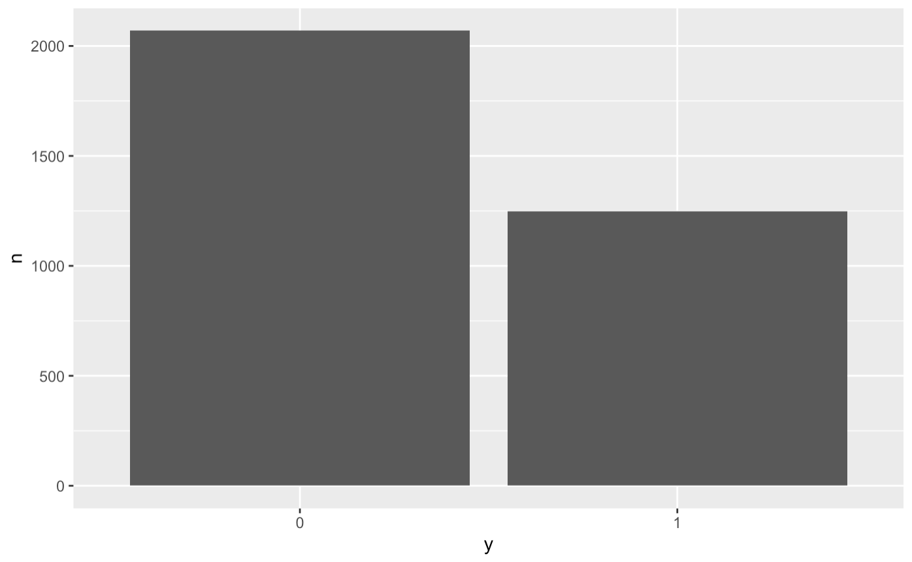
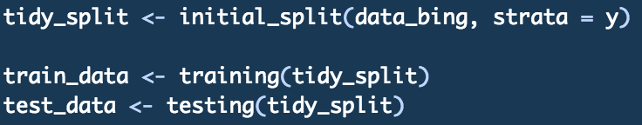
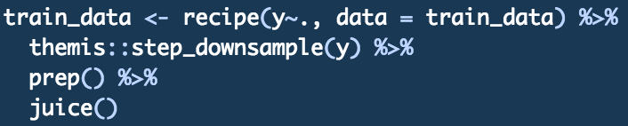
Training and test data
Split the data in training and test data
Downsample (see picture)
Notes:
First we split the data into test and training data, we set the strata=y to keep the same ratio between the 4 classes in both the test and training data.
We can see the 4 classes are not equaly represented in the data, so we use downsampling on the training data which will randomly remove observations from the 3 larges classes so alls classes are of the same size.

Slide 13
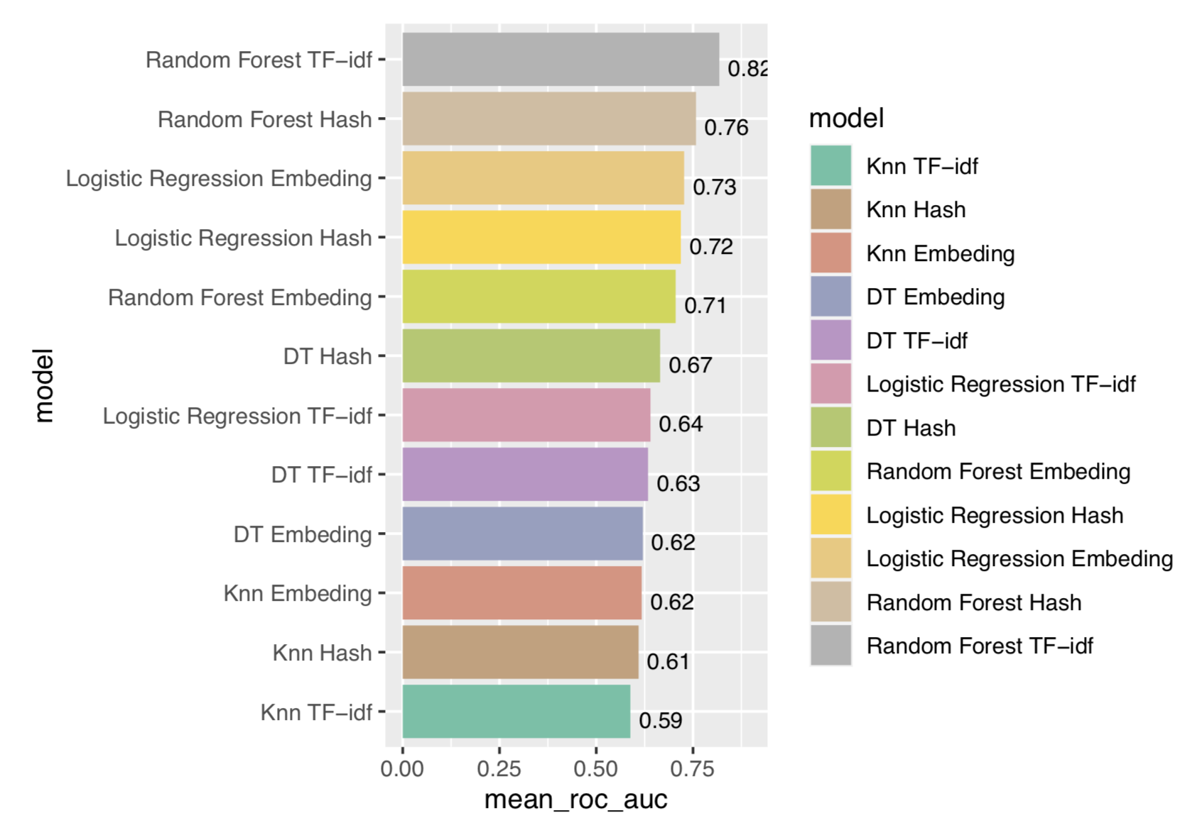
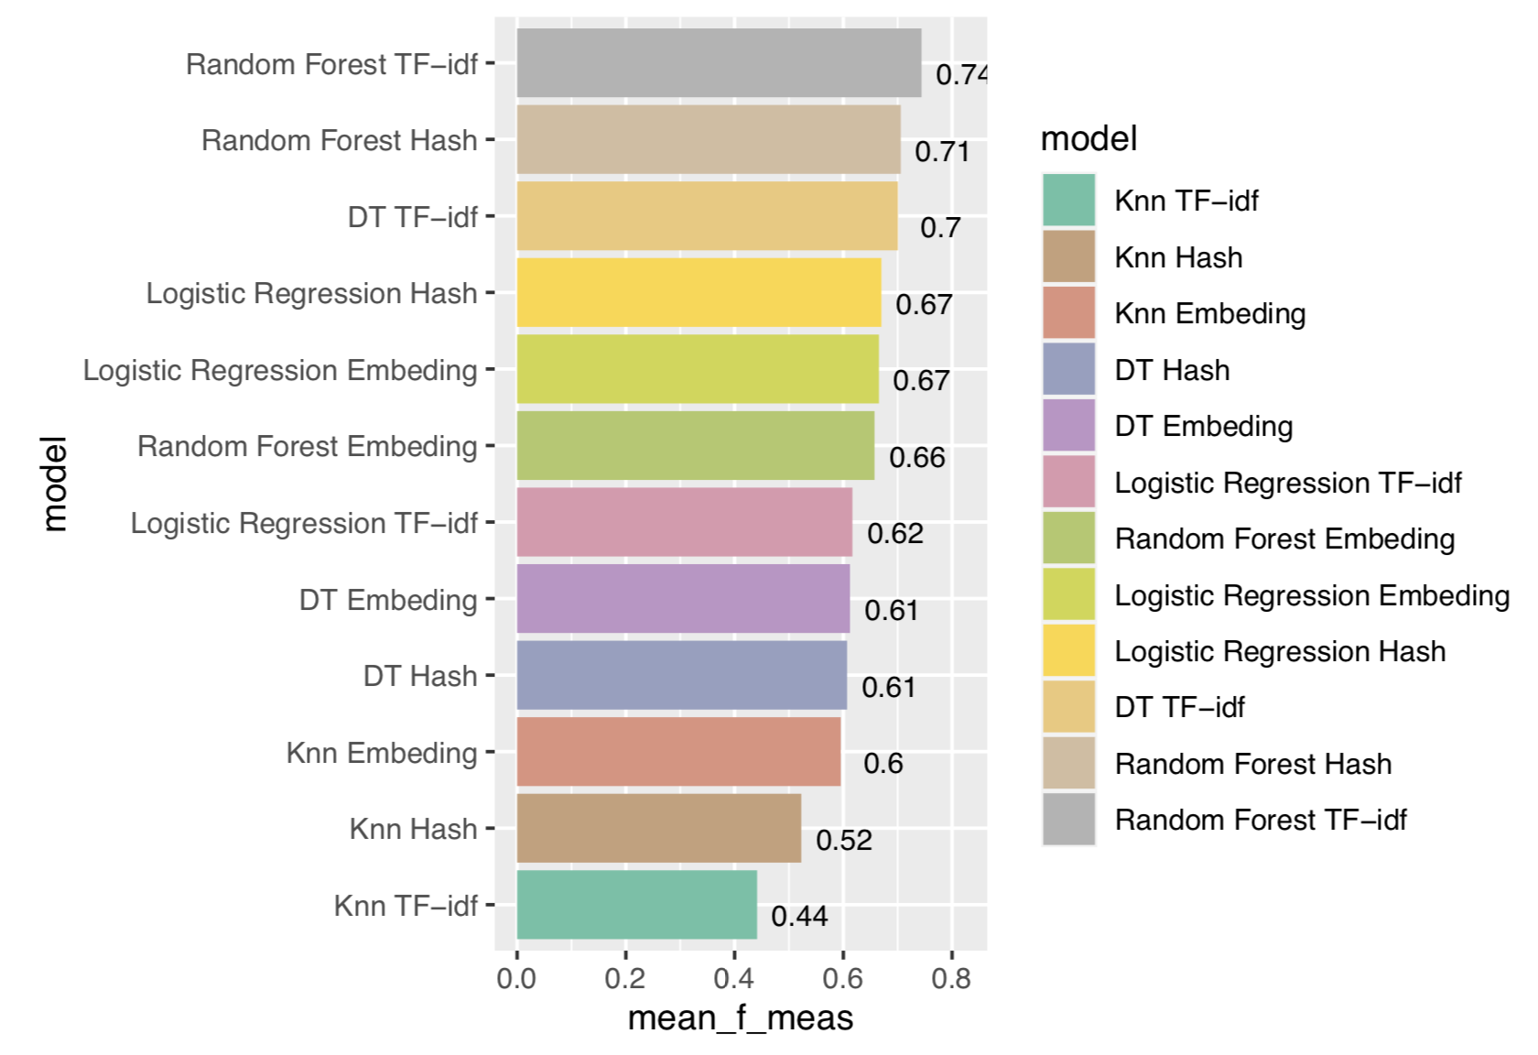
Model fitting
Evaluating the models
Hypertuning on resampled data for the logistic regression model and KNN model for each of the three recipes.
Using best parameters for optimizing accurucy
Fit the models using resampled data and optain metrics.
We can now show the results
Mean_roc_auc
Mean_f_meas score
We choose the Random Forest model (TF-IDF weighted) and Random Forest (Hash embedding).
Notes:
Accurucy → True positive + True Negative/ All positive + All Negative → how often is the model correct. → of all the predictions what is the procent of correct prediction
Mean_f_meas score → Precision quantifies the number of positive class predictions that actually belong to the positive class. Recall quantifies the number of positive class predictions made out of all positive examples in the dataset. F-Measure provides a single score that balances both the concerns of precision and recall in one number.
Mean_roc_auc → plots the true positive rate against (Sensitivity) the false positives rate (1- specificity)
Y axis: how much do i categorise right → on x axis how much do i categorice wrong. → jo mere ”nemt” vi vælger at gøre det at få true → jo støre andel af true positives vil vi fange
We want a model when we increase the thresshold of positives by a little we get many more true positives and not tha many false positives.
The area under the curve → if the area is 1 it would categorice everything right all the time.
tf-idf → is a weighting system that assigns a weight to each word in a document based on its term frequency (tf) and the reciprocal document frequency (tf) (idf).
Embedding → Ideally, an embedding captures some of the semantics of the input by placing semantically similar inputs close together in the embedding space. An embedding can be learned and reused across models – in this case with the glove6b package.
Hashing → If we feed the same input to a hash function, it will always give the same output. The choice of hash function determines the range of possible outputs, i.e. the range is always fixed (e.g. numbers from 0 to 1024).

Slide 14
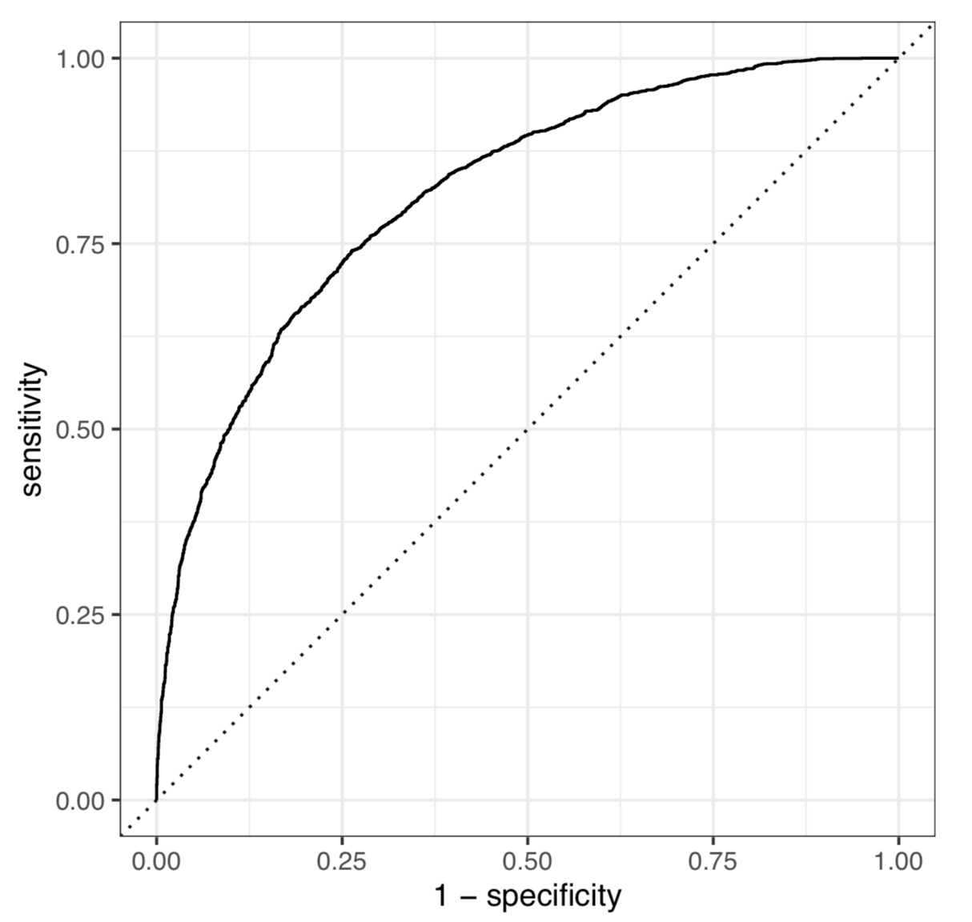
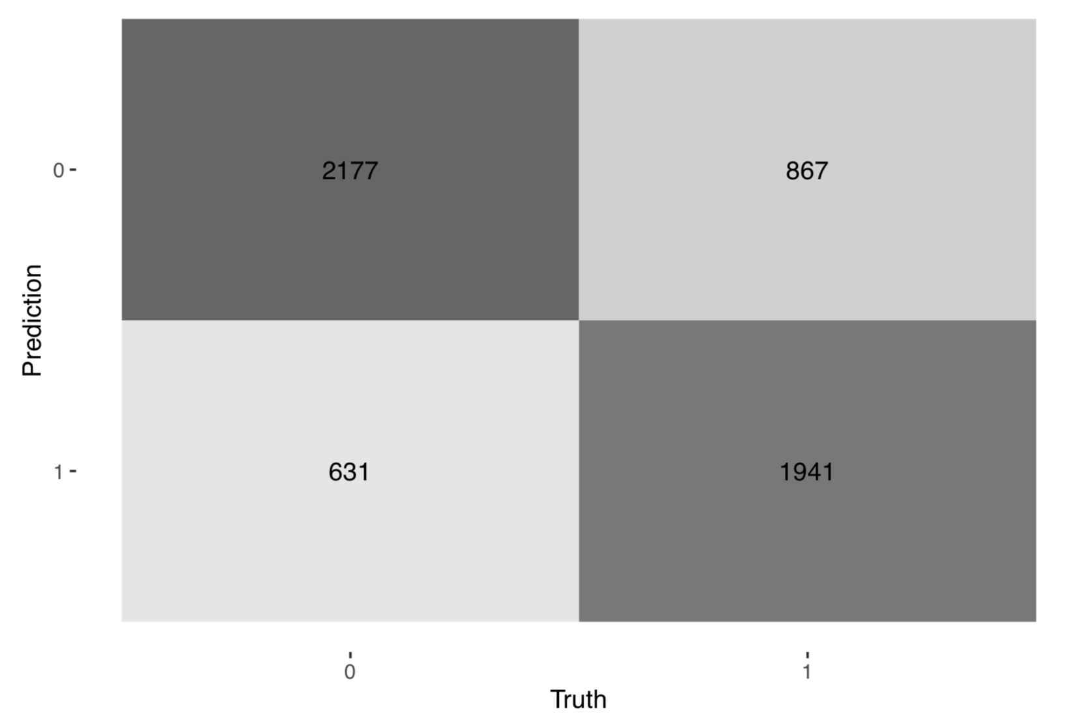
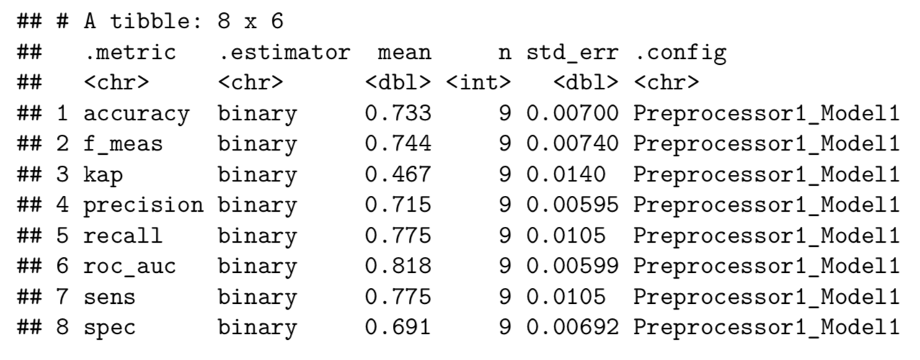
Results
Random forest model (TF-IDF) on re-sampled data.
Notes:
Specificity is high → Also called Selectivity or true negative rate → As this is a multiclass model it can be calculated in different ways → here we use macro which means each class is given the same wheight which is also good here as the classes are of the same size
De steder den bruger multiclass er det fordi den godt kan regne det uden at skal tage et gennemsnit
De stedder den skriver makro er det fordi den har taget et gennemsnit hvor alle classes har været positive og derefter taget gennemsnit. (Hvis det skal være vægtet efter antal observationer i class skal vi bruge mikro i stedet. )

Slide 15
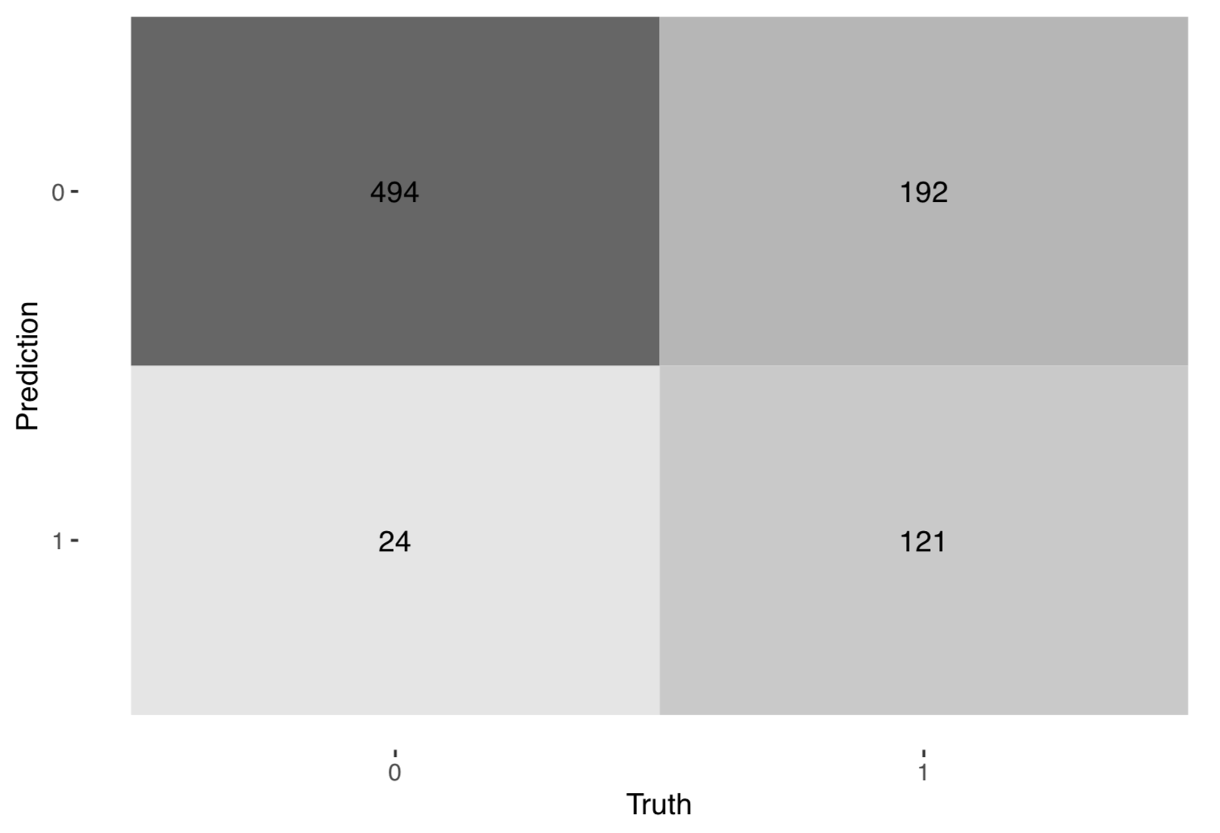
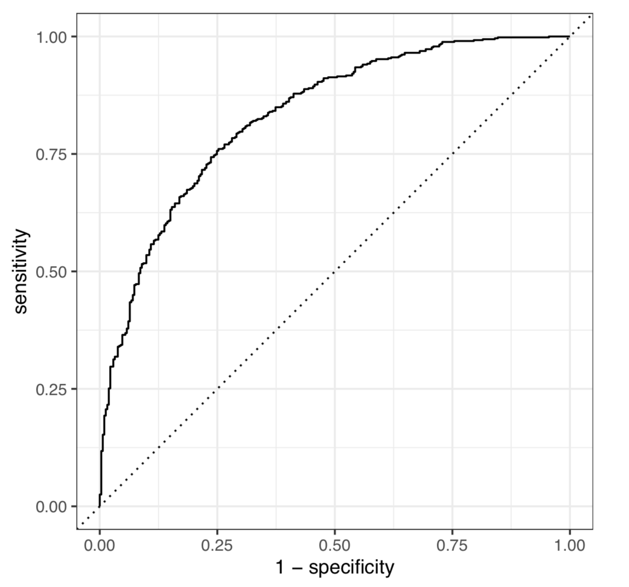
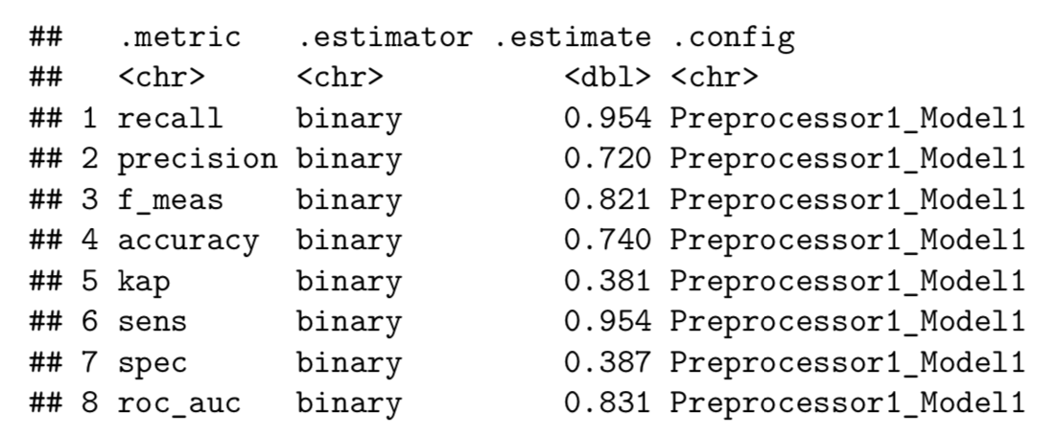
Results
Random forest model (TF-IDF) on test data.
Notes:
Here it would maybe had been better to use Micro.

Slide 16
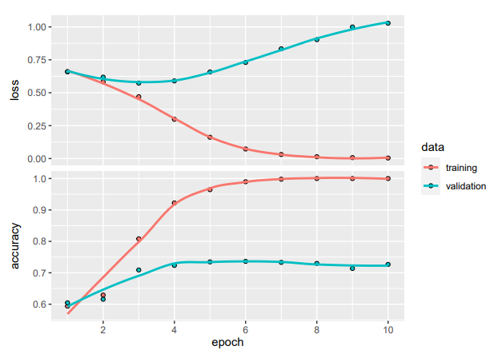
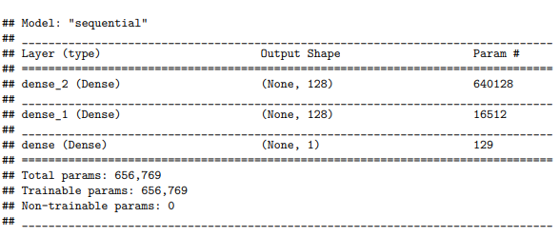

Neural networks
ANN - ANN is known as a Feed-Forward Neural network because inputs are processed only in the forward direction

Slide 17
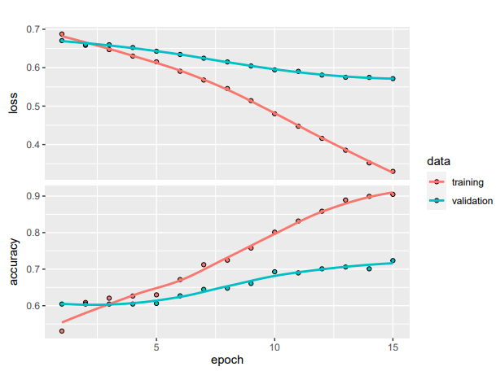
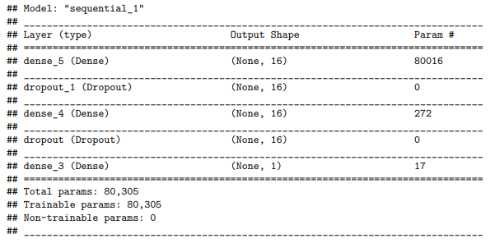

Neural networks
ANN - tuned

Slide 18
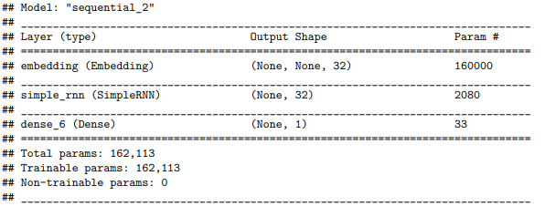
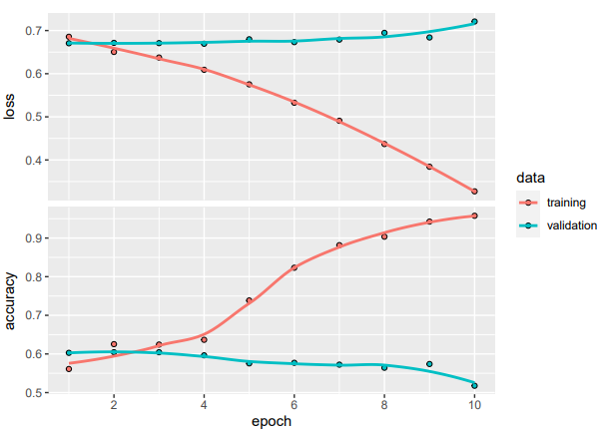

Neural networks
RNN - They save the output of processing nodes and feed the result back into the model (they did not pass the information in one direction only). This is how the model is said to learn to predict the outcome of a layer.

Slide 19
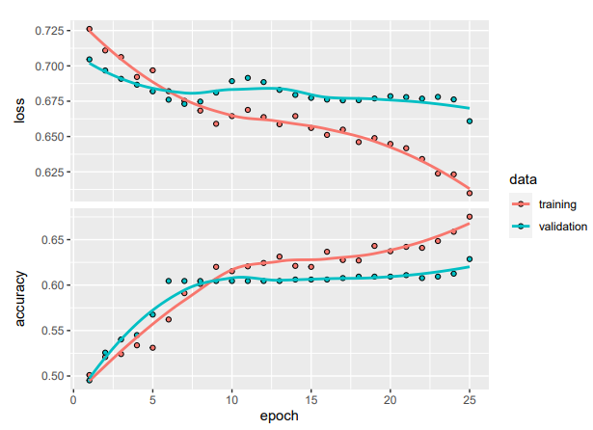
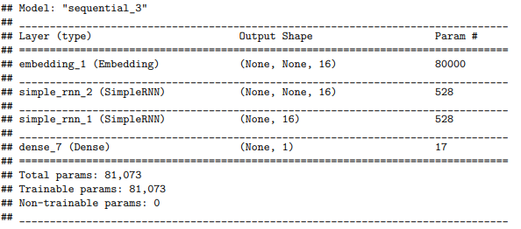

Neural networks
RNN - tuned

Slide 20
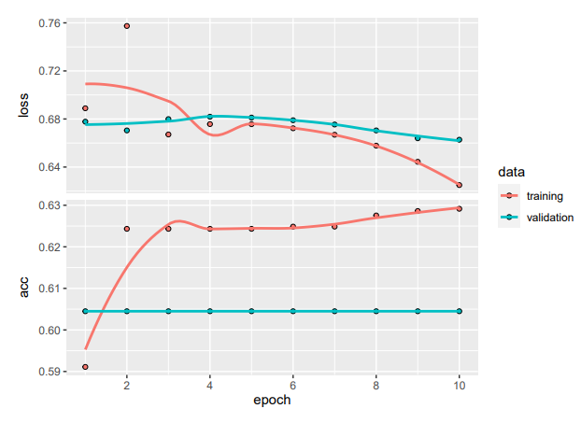
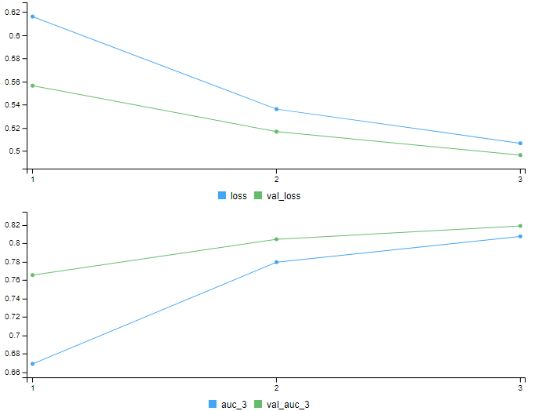
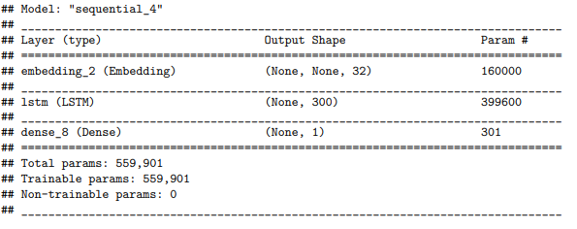

Neural networks
LSTM

Slide 21

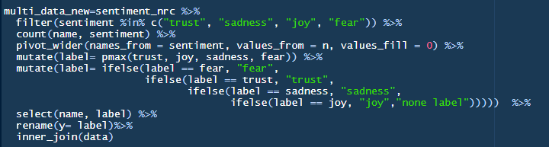
Multiclass models
Creating the labels
Using NRC lexicon to get sentiments
4 categories: Joy, Sadness, Fear and Trust.
Count(name, sentiment)
Assigning 1 genre to each song using ”pmax”
Select name and label and join on the dataset.
Notes:
We first inner_join the text_tidy, which shows the stemmed words used for every songs → stopwords removed.
We then create multi_data_new → filter only the 4 genres we want.
Count the sentiment corresponding to each words for the songs.
We can then use pmax to create a label printing the highest value in the row
We then make some ifelse arguments to label each row if the former label value equals to one of them before.
We can than remove all variables but name and label and inner_join on the dataset,

Slide 22
Multiclass models
The models
Neural Network models
Supervised machine learning models
Predicting sentiment of a song based on lyrics
Only Rock songs
In the document:
Simple ANN
No embeddings
Top 10000 words
Not in the document (took forever to run)
Bidirectional GRU model
Top 10000 words
Pre-trained embeddings Gloveb6
Predicting sentiment of a song based on lyrics
Only Rock songs
Downsampled data
Data: Embedding, TF-IDF, and TextHash
Tokenize -> Stemming -> Stopwords -> max_tokens=1000.
Models: Logistic regression, KNN and Random forest.
Notes:
ANN forklaret inden
GRU:
En nyere udgave af RNN som ikke lider af short term memory
LSTM introducere long term memory
GRU har kun to gits/streger hvor LSTM har 3 → dermed en lightwheight udgave af LSTM
GRU består af af update gate og Reset gate
GRU gemmer de vigtigeste ting der kommer i løbet af teksten
Måske sige noget med LSTM tager lang tid at køre hvor GRU er meget hurtigere
GRU og LSTM er long-term Short-term models. So we can both save and forget things over time → remember helpfull information and discard unhelpgull info
Bidirectional models are often used in NLP:
Der tilføjes et lstm eller GRU layer som hver procces the input in only one direction
Med bidirectional tager den både kronologisk rækkefølge og anti kronologisk rækkefølge og merger så disse

Slide 23
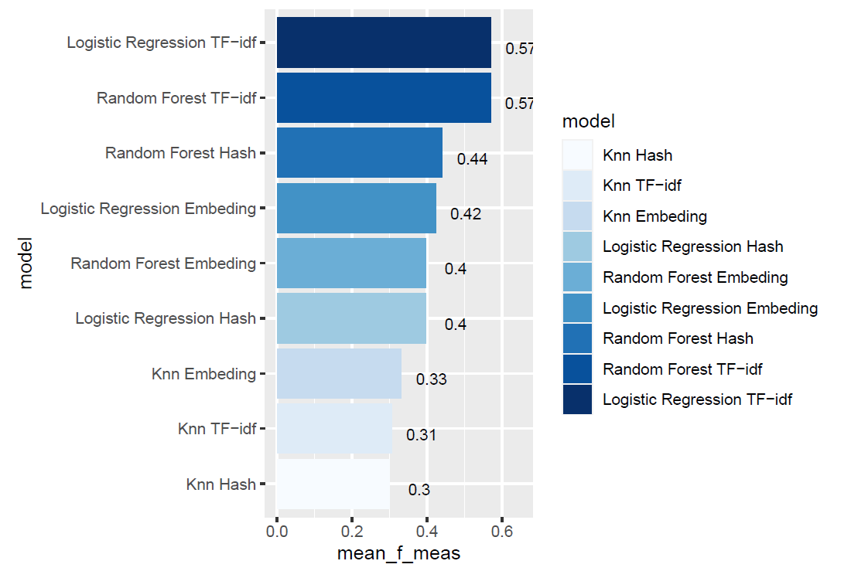
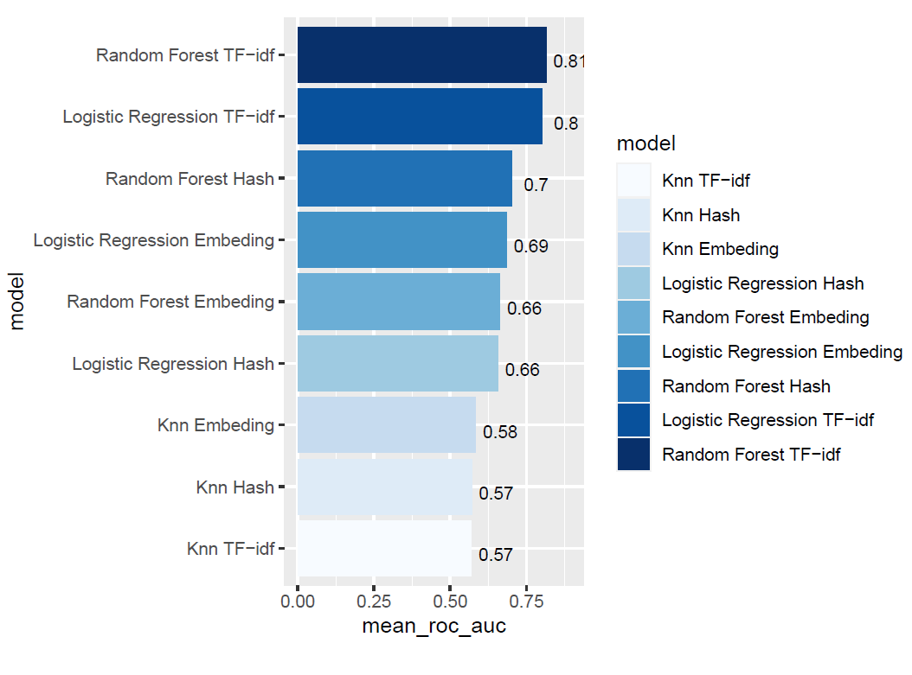
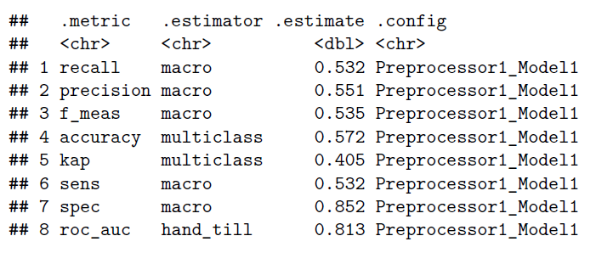
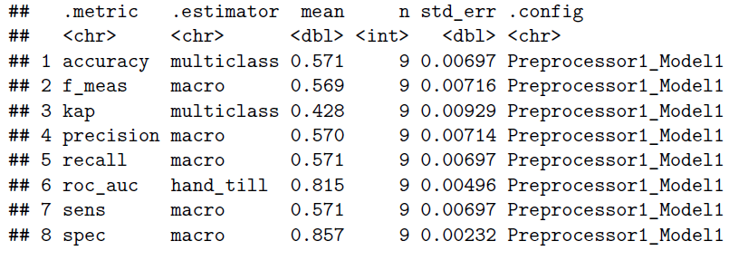
Baseline model ML
process
Best Mean_roc_auc (resampled data)
Random Forest using tf_idf
Best mean_f_meas (resampled data)
Logistic regression, random forest bot using tf_idf
Random forest model on train and test data:
Notes:
Accurucy → True positive + True Negative/ All positive + All Negative → how often is the model correct. → of all the predictions what is the procent of correct prediction
Mean_f_meas score → Precision quantifies the number of positive class predictions that actually belong to the positive class. Recall quantifies the number of positive class predictions made out of all positive examples in the dataset. F-Measure provides a single score that balances both the concerns of precision and recall in one number.
Mean_roc_auc → plots the true positive rate against (Sensitivity) the false positives rate (1- specificity)
Y axis: how much do i categorise right → on x axis how much do i categorice wrong. → jo mere ”nemt” vi vælger at gøre det at få true → jo støre andel af true positives vil vi fange
We want a model when we increase the thresshold of positives by a little we get many more true positives and not tha many false positives.
The area under the curve → if the area is 1 it would categorice everything right all the time.

Slide 24
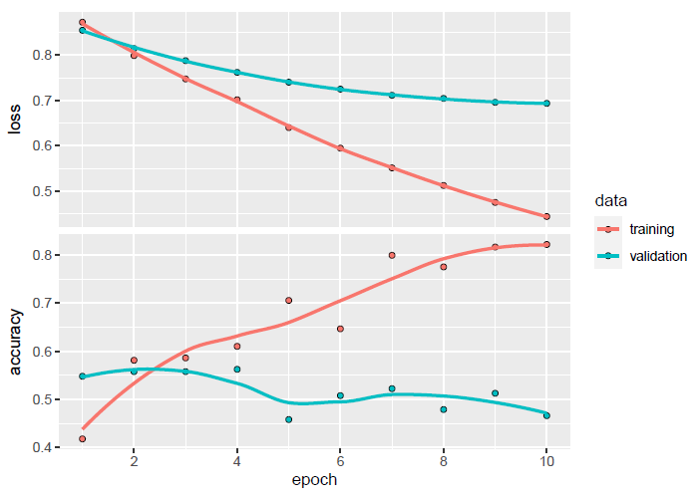
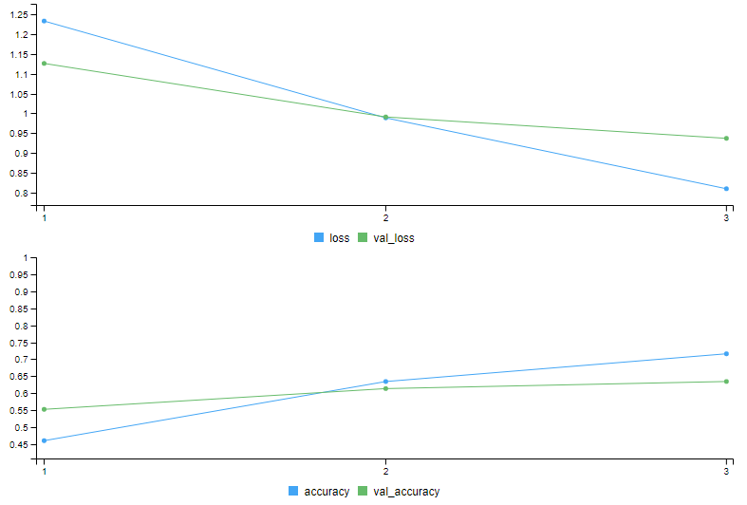
Neural network model
ANN, Bidirectional GRU model
ANN:
2 Dense layers with unit=16, activation= ”relu”
1 output dense layer unit=4, activation = ”softmax”
Resultat 3 epochs: Train= 71%, validation =63%, test=39%
Notes:
Embedding:
Learn word embeddings jointly with the main task you care about (such as document classification or sentiment prediction). In this setup, you start with random word vectors and then learn word vectors in the same way you learn the weights of a neural network.
Load into your model word embeddings that were precomputed using a different machine-learning task than the one you're trying to solve. These are called pretrained word embeddings.
When you instantiate an embedding layer, its weights (its internal dictionary of token vectors) are initially random, just as with any other layer. During training, these word vectors are gradually adjusted via backpropagation, structuring the space into something the downstream model can exploit.
Relu activation:
Linear but flat at 0
Softmax → Takes the exponential(z)/ sum(Exp(z_j) → output summere derfor til 1.

Slide 25
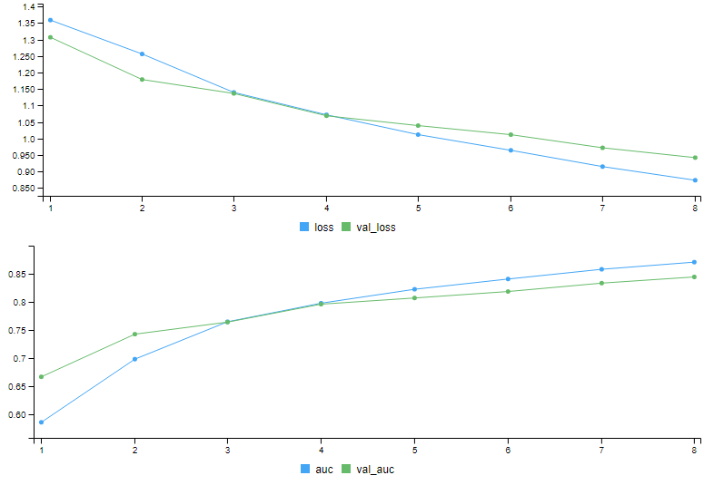
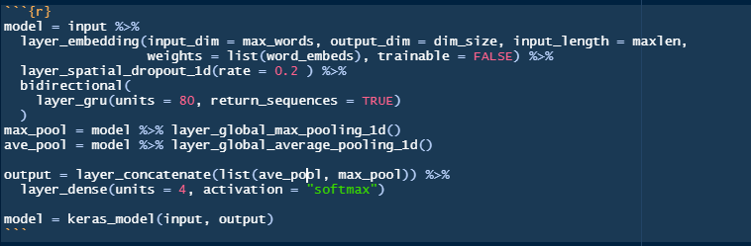
Neural network model
ANN, Bidirectional GRU/LSTM model
Embedding layer didn’t perform very well
Now using a pretrained embedding layer
Bidirectional GRU/LSTM model
Input
Max_pool
Ave_pool
Output
Results after 4 epochs:
Training= 80%
Validation= 80%
Test = 60%
So better than the ML model!
Notes:
The models we tried seemed to get stuck so we thought about changing learning rates and different optimizers
Pre-trained embedding:
Input layer:
First we have the new embedding layer, the difference now is that we set weights= list(word_embeds) which is a list of te embedded data using glove6b and we set trainable= False so the wheights doesnt update!
We add a spatial_dropout layer with a rate =0.2 → forskellen fra almindelig dropout er ”it drops entire 1D feature maps instead of individual elements” → If adjacent frames within feature maps are stongly correlated this dropout will not reqularize the activations → this will promote independence between features
Bidirectional forklaret tidligere.
We then use a GRU/LSTM layer → Gru much faster and gives the same results. Use sequence=True
Max pooling:
Common in NLP → Takes the max values from the sequence preduced by the GRU/LSTM
Ave_pool:
we take the average of each feature map, and create a vector.
Output:
We take the max_pool and average_pool and feed it into a softmax layer.
We still use adam for optimizer, loss function = "categorical_crossentropy"
Results:

Slide 26


Thanks
Andreas Methling
Kristoffer Herrig Thorndal
Mikkel Bak Lyngø
Simon Fløj Thomsen

