Slide 1
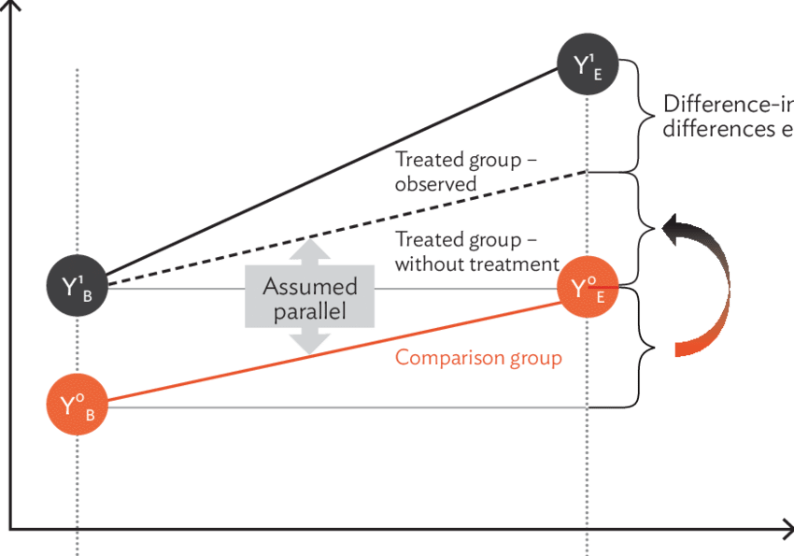
Outcome Y
Difference-in-differences
Expected trend in
treated group
Baseline difference
between treated
and control group
Time trend
in control group
Before
treatment
After
treatment
Time

