Slide 1
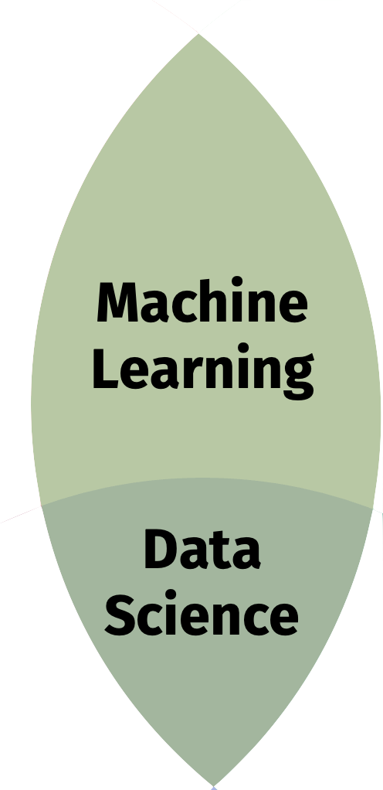

Slide 2
Substantive Expertise

Slide 3
Hacking Skills
Machine
Learning
Data
Science
Danger Zone!
Substantive Expertise

Slide 4
Ethics and Philosophy
Skills
Data Science Skills
Moral Machine
Data Science Ethics
Applied Data Science
Applied Ethics
Substantive
(and legal?) Expertise

Slide 5
Machine
Learning
Data
Science

Slide 6
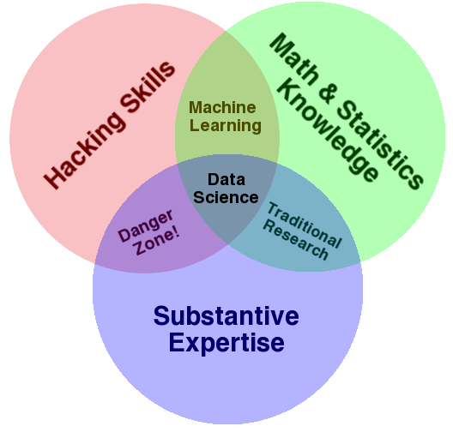

Slide 7
Substantive
Expertise

Slide 8
Math & Statistics
Knowledge
Traditional Research
Substantive
Expertise

Slide 9
Data Science Skills
Math & Statistics
Knowledge
Applied Data Science
Traditional Research
Substantive
Expertise

Slide 10
Data Science Skills
Math & Statistics
Knowledge
Machine
Learning
Applied Data Science
Traditional Research
Substantive
Expertise

Slide 11
Data Science Skills
Math & Statistics
Knowledge
Machine
Learning
Data Science
Applied Data Science
Traditional Research
Substantive
Expertise

