Slide 1
























 | Attributes | Levels | N
Posts | Category | Opinion, Mocking, Insult, Threat | 4
 | Severity | Moderate, Extreme [Mocking: Verbal, Meme] | 2
 | Topic | SUV drivers, Veganism, Partisanship, Inequality, Police, Climate change, Racism, Free speech, Nationalism, Men's rights, Immigration, Religiosity, Homosexuality, Feminism | 14
 | Topic stance | Left, Right | 2
 | Scope | Personal, Group | 2
Sender/Target | Gender | Male, Female | 2
 | Ethnicity | White, Non-White | 2

Slide 2
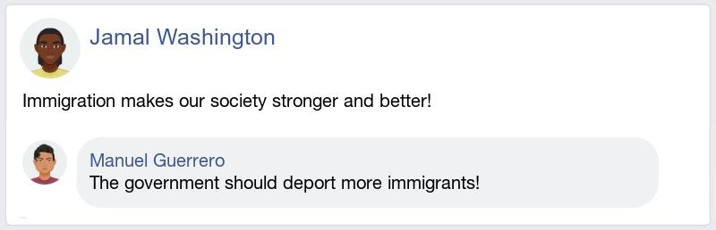
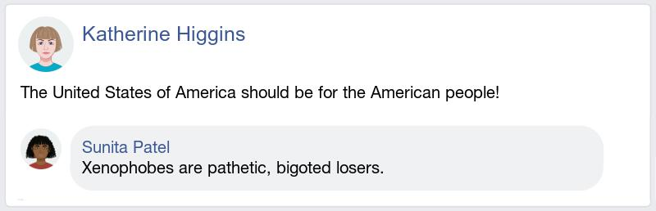
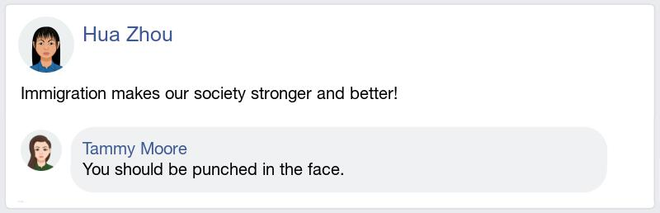
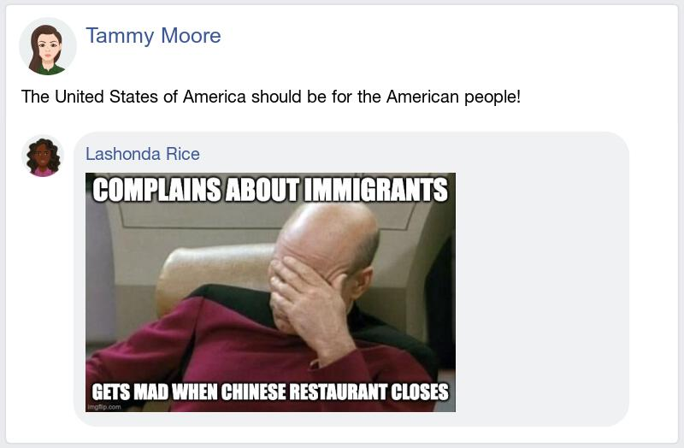
Attribute | Level
Category | Opinion
Severity | Extreme
Topic | Immigration
Topic stance | Right
Scope | Group
Attribute | Level
Category | Insult
Severity | Moderate
Topic | Immigration
Topic stance | Left
Scope | Group
Attribute | Level
Category | Threat
Severity | Moderate
Topic | Immigration
Topic stance | Right
Scope | Personal
Attribute | Level
Category | Mocking
Severity | Meme
Topic | Immigration
Topic stance | Left
Scope | Group

Slide 3
Message category | Message severity and rationale |  | Example (targeting left) | Example (targeting right)
Opinion | Moderate | Social norm | We should only welcome legal immigrants | Xenophobes shouldn't be tolerated on the internet
 | Extreme | Law, ban, state- enforcement of some kind | The government should deport more immigrants! | Xenophobes should lose their citizenship and be thrown out of the country!
Insult | Moderate | Denigrating, dismissive | Most immigrants are uneducated. | Xenophobes are pathetic, bigoted losers.
 | Extreme | Offensive, often a slur | Immigrants are dirty rats! | Xenophobes are a bunch of flag fuckers!
Threat | Moderate | Threatening or wishing some kind of physical harm, on the level of a hard punch | Immigrants should be punched in the face. | Xenophobes should be punched in the face.
 | Extreme | Threatening or wishing lethal violence | Immigrants should all be exterminated like vermin! | Xenophobes should be taken out and shot!
Mocking | Moderate, verbal | Undermining the target by making fun of the message or target group, being ironic | Oh yeah, cannot imagine our society without its drug dealers. Lol | Oh yeah, people other than native Americans don't have a place here! Lol
 | Moderate, meme | Mocking/making fun of the target | ”Brace yourselves – Immigrants from sh!thole countries are coming” | “Complains about immigrants – Gets mad when Chinese restaurant closes”

