Slide 1


Slide 2


Slide 3
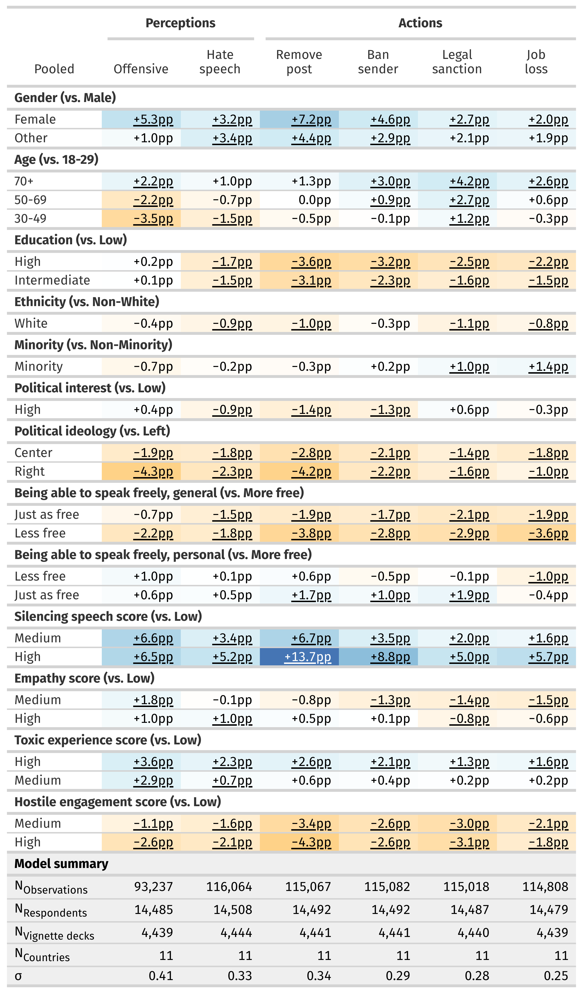

Slide 4

What’s going on here?

