Slide 1
  Secure Component Delivery using WebCom.
  Simon N. Foley, Thomas B. Quillinan,
  John P. Morrison.
  Department of Computer Science
  University College,
  Cork, Ireland.

Slide 2
Overview
The WebCom distributed component system.
Security issues with WebCom.
Secure WebCom
Discussion and Conclusion.
1

Slide 3
Overview
The WebCom distributed component system.
Security issues with WebCom.
Secure WebCom
Discussion and Conclusion.
1

Slide 4
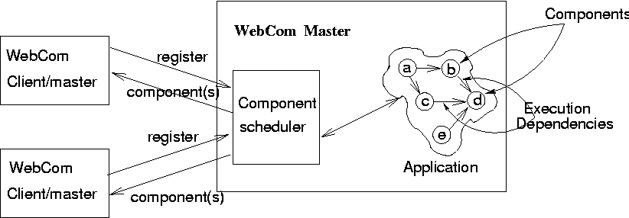
WebCom
WebCom is a system that distributes computational components over a network.
It is a client/server system where clients register with the master. The master schedules components to the clients, who execute them and return results.
WebCom applications are built as connected nodes (computational components) into a Condensed Graph.
1

Slide 5
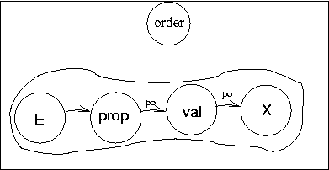
Condensed Graphs
An application in WebCom is described in terms of a Condensed Graph.
Nodes in a Condensed Graph represent an executable software component, or another Condensed Graph.
Example:
Condensed node order defines a condensed graph that defines the sequencing constraints of the proposing and validation of orders.
prop and val are software components
Condensed node order could be part of a larger graph.
A Condensed Graph is a type of dataflow graphs but, they are more expressive in that demand driven and control driven dependicies may be represented within the graph.
1

Slide 6
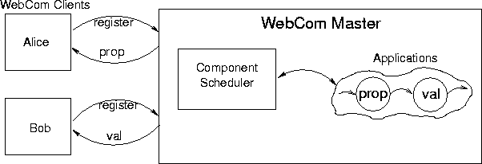
WebCom Architecture
Executable components (prop, val) are scheduled by the master to available clients, based on the dependicies in the application graph.
For example, Alice is scheduled prop, which she executes and then returns a result to the master. Bob is then scheduled val, which he executes and returns the result.
Clients can be masters – Master might schedule the entire graph to Alice, who in turn will schedule its components to clients.
1

Slide 7
WebCom Applications
Condensed Graph nodes can be applications, component objects (such as COM or CORBA) or primitive operations (e.g. + or -).
WebCom provides framework for building general applications in terms of a condensed graph.
Workflow Applications – Condensed graphs define sequencing constraints between workflow tasks.
Distributed computing / Metacomputing – Condensed graph's implicit parallelism in a computation means they are good for large distributed computations.
1

Slide 8
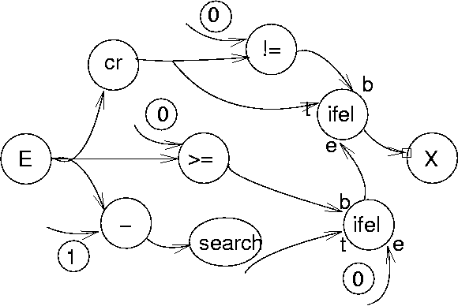
Key Cracking Application
1

Slide 9
Overview
The WebCom distributed component system.
Security issues with WebCom.
Secure WebCom
Discussion and Conclusion.
1

Slide 10
Security Concerns in WebCom
Authentication:
    Masters and clients using the system need to authenticate each other.
Authorisation:
    Clients must determine whether they can trust masters for the components that they schedule.
    Masters must ensure that they only schedule components to clients that can be trusted to execute them.
1

Slide 11
Overview
The WebCom distributed component system.
Security issues with WebCom.
Secure WebCom
Discussion and Conclusion.
1

Slide 12
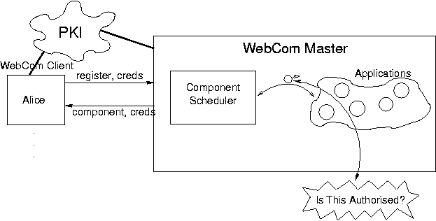
Secure WebCom
Authentication:
    Masters & clients are identified by their public key and not by name.
    SSL is used to establish secure authenticated connections between masters and clients. We are not interested in Identity authentication.
    Authorisation:
      Clients and masters exchange delegation credentials to prove authorisation.
      The KeyNote trust management scheme supports checking of authorisation.
1

Slide 13
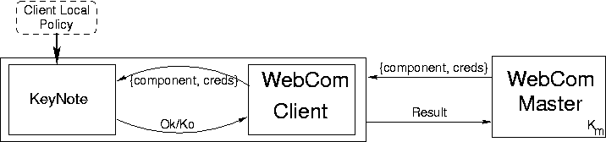
Client Authorisation
When a Client receives a software component, it uses the KeyNote evaulator to check that the Master's credentials authorise the scheduling of the component.
If the query results with a positive answer, the component is executed and the result returned.
1

Slide 14
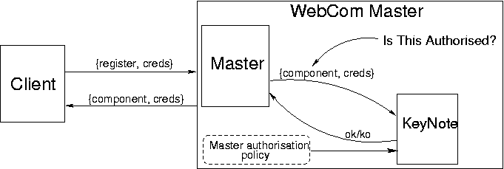
Master Authorisation
The scheduler consults KeyNote when attempting to schedule a component.
Client credentials are checked to find a suitably authorised client.
When such a client is found, the component is scheduled to that client.
1

Slide 15
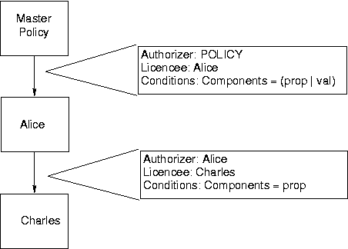
Delegation and Decentralised Authorisation
Example:
The system has given Alice permission to execute both prop and val.
Alice has delegated the authority to execute prop to Charles.
Charles can now connect to the master and can be scheduled prop components.
Delagation credentials allow transfer of permissions between principals in the system.
This promotes a decentralised approach.
1

Slide 16
Overview
The WebCom distributed component system.
Security issues with WebCom.
Secure WebCom
Discussion and Conclusion.
1

Slide 17
Conclusions
WebCom is a general purpose distributed architecture which allows distribution of computational components over a network.
A security architecture was required to allow principles in the system to be confident of the identity and trustworthiness of one another. Secure WebCom was introduced to address these issues.
Using KeyNote with WebCom is a novel application of a trust management system. This shows the flexibility of KeyNote, and the use of trust management systems.
Applications no longer need to embed calls to KeyNote system to check authorisation. This is achieved transparently by Secure WebCom.
1

Slide 18
Discussion
Secure WebCom only addresses the component name of each node for authorisation purposes. Work is currently being undertaken to provide the ability to perform authorisation checks based on the function parameters and the destination of the component.
There currently exists a development environment which allows Condensed Graphs, and their associated credentials to be created.
We have also implemented a “hash-chain” micropayments system with Secure WebCom, using KeyNote credentials and the trust management system to pay clients for components executed.
1

Slide 19
Application Glue
Example: Trusted Application Fragment
// given authenticated request to carry out an operation op:
authoriser= key making this request;
attribset= {appdomain=''OrderApp'', operation=op};
policy= policy credential for OrderApp above;
credentials= as provided by requester;
rslt= knquery(..,authoriser, attribse, policy, credentials);
if (rslt==''true'' && op==''prop'')
{process an order proposal..... }
else
if (rslt==''true'' && op==''OK'')
{allow validation of order..... }
else
{reject request}
This is the standard method used to provide trust management support in applications.
With Secure WebCom, applications don't need to worry about the security code – this is handled by the scheduler.

