Slide 1
HT
Dùng mảng hằng
Dùng xâu hằng
x[i] = (s[i] == 'H'); 0/1
for i = 1 -> 38
inc (a[4*x[i] + 2*x[i+1] + x[i+2]])

Slide 2
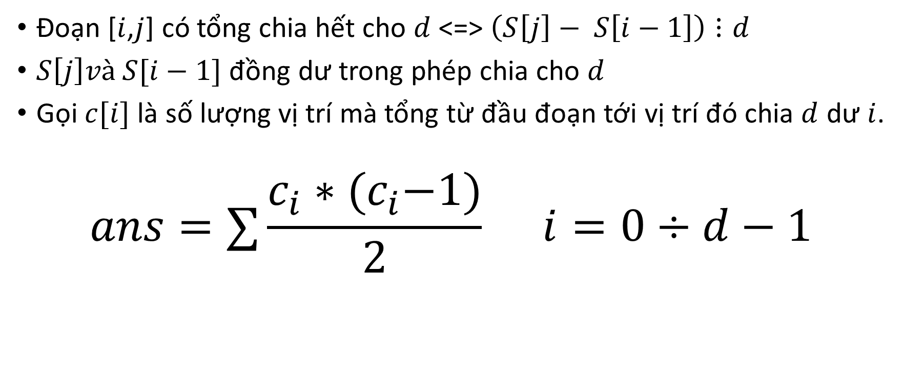
DIVSEQ

Slide 3
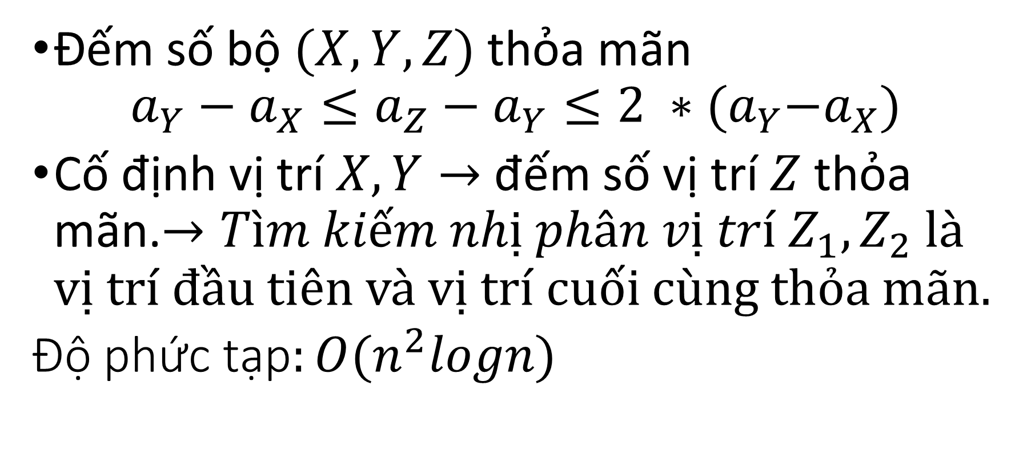
Running

Slide 4
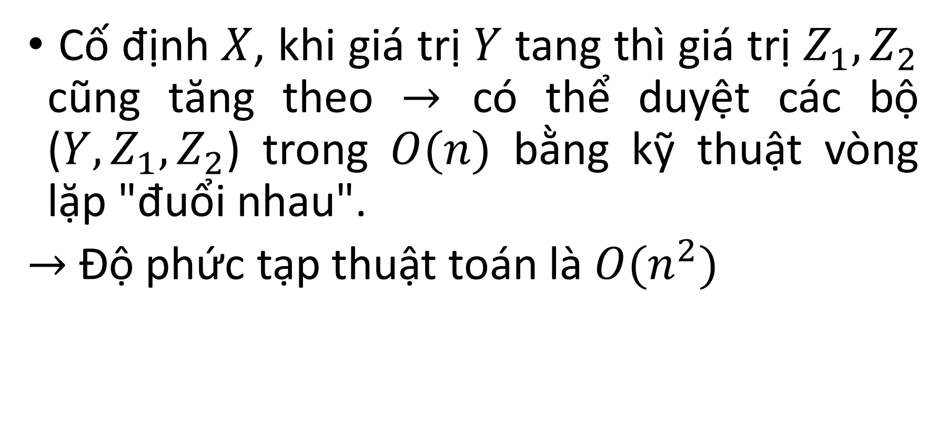
Running

Slide 5
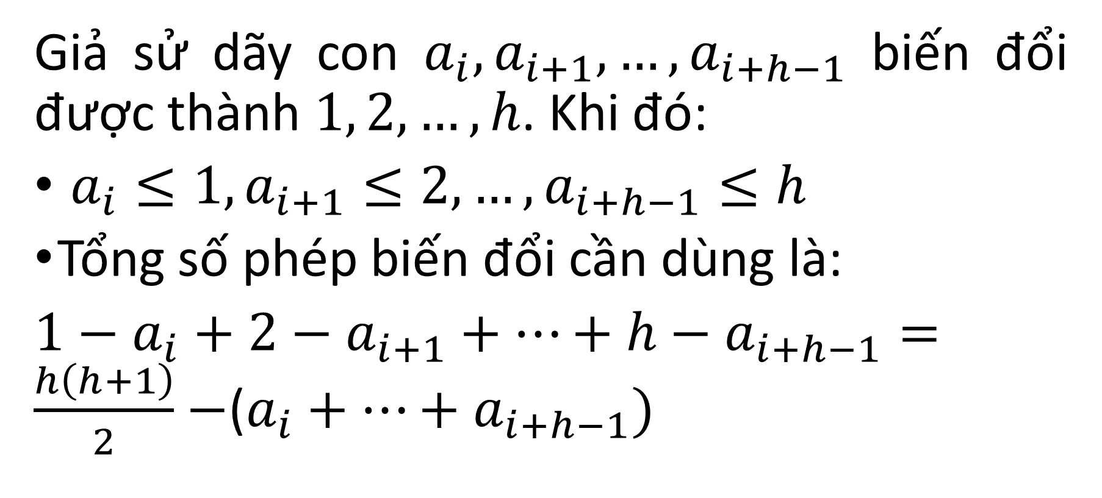
INCREASING

Slide 6
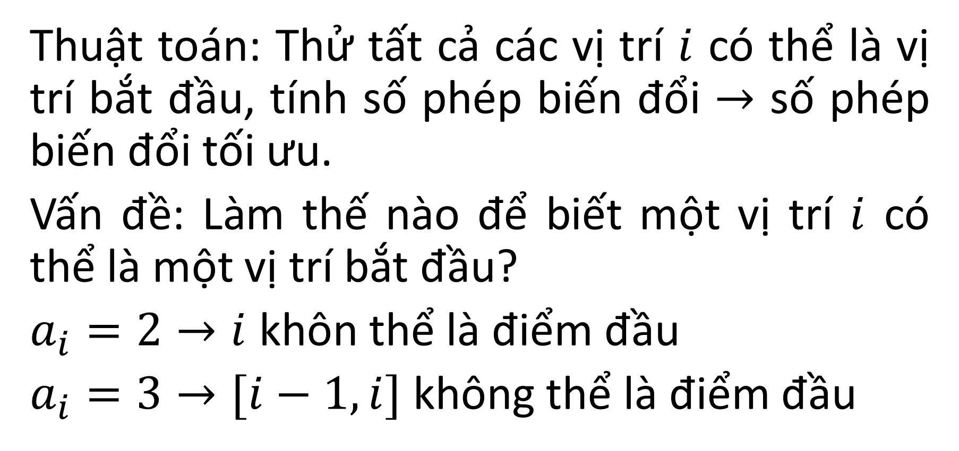
INCREASING

Slide 7
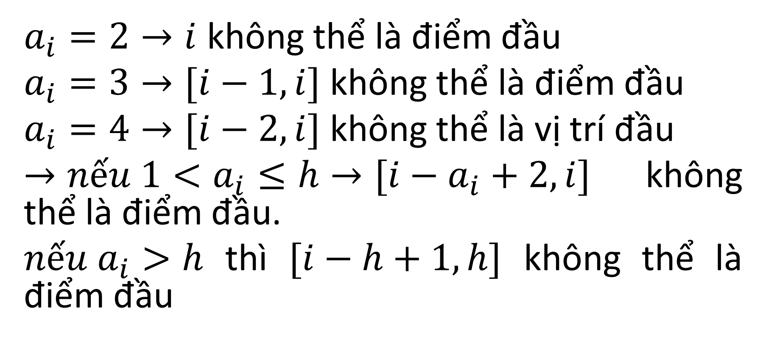
INCREASING

Slide 8
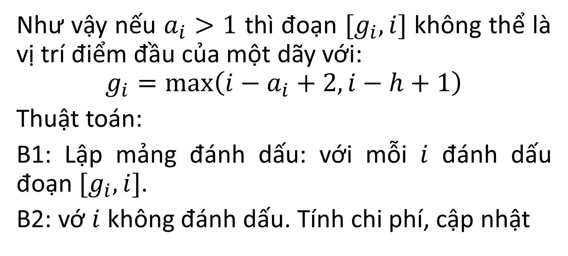
INCREASING

Slide 9
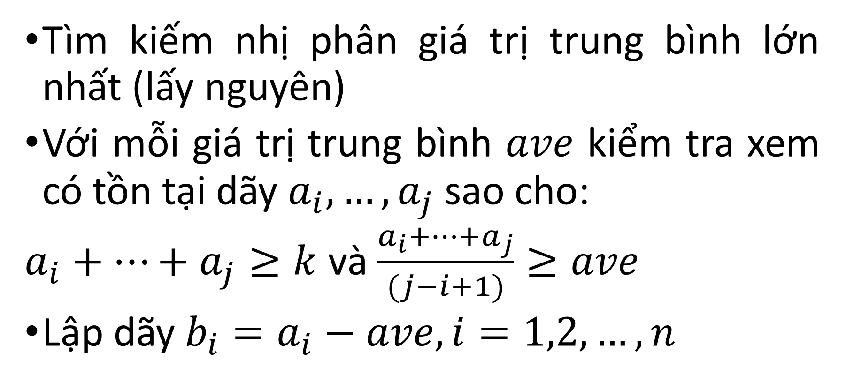
SEQUENCE

Slide 10
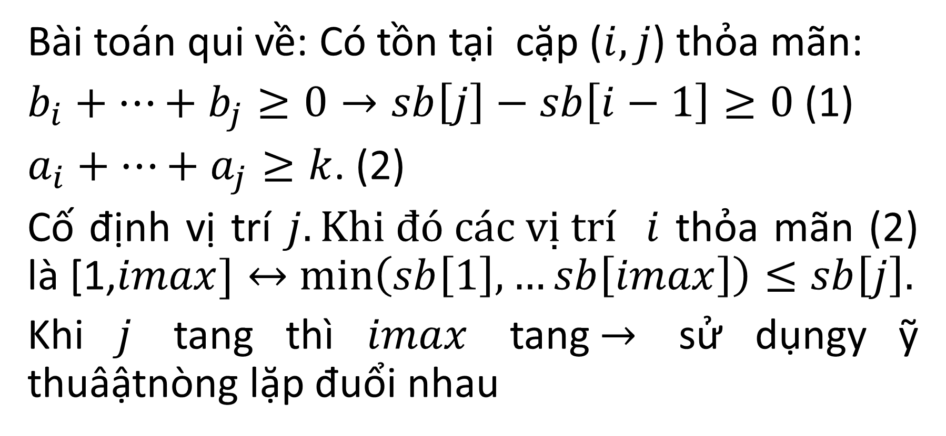
SEQUENCE

