Slide 2
Agenda
Introduction
Data Exploration
Data Preparation
Methods
Model Creation
Model Prediction
Model Evaluation
Challenges
Conclusion

Slide 3
Introduction
The goal of the project is to build a recommendation system for books based on user ratings. A user is asked to rate a fixed number of books from our dataset and based on the user’s rating for these selected books and ratings given to them by other individuals, our recommendation system recommends other books from our dataset that matches user’s interest based on ratings.

Slide 4
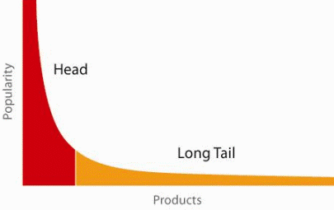
Introduction
When does a Recommendation System do its job well?
"Recommend widely unknown items that users might actually like!"
20% of items accumulate 74% of all positive ratings
Recommend items from the long tail

Slide 5
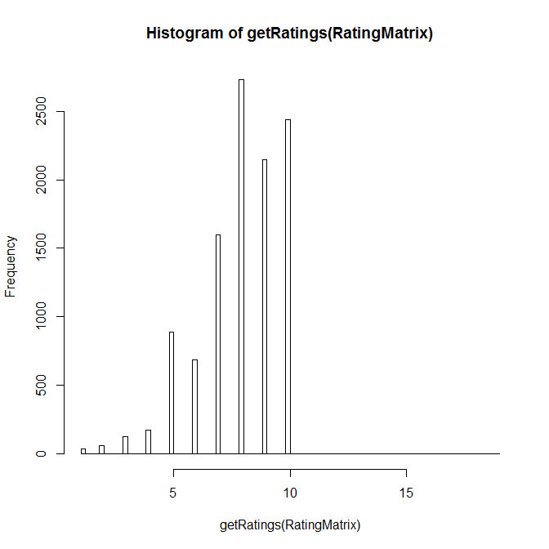
Data Exploration

Slide 6
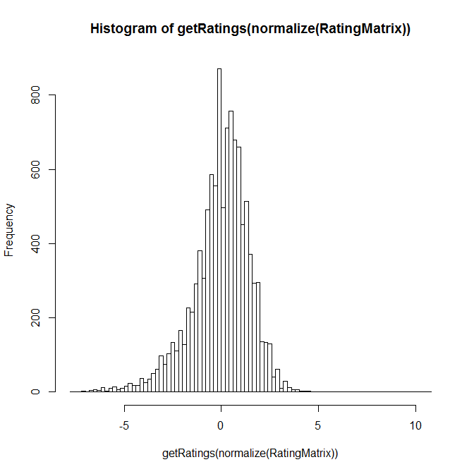
Data Exploration

Slide 7
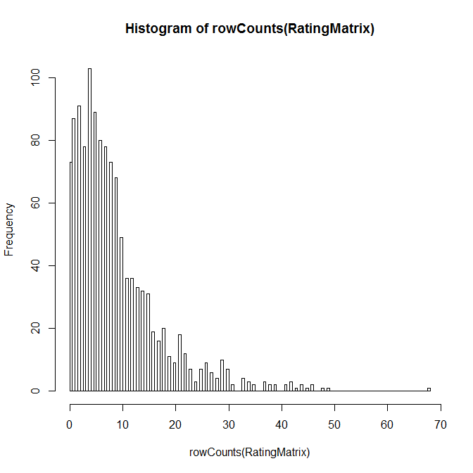
Data Exploration

Slide 8
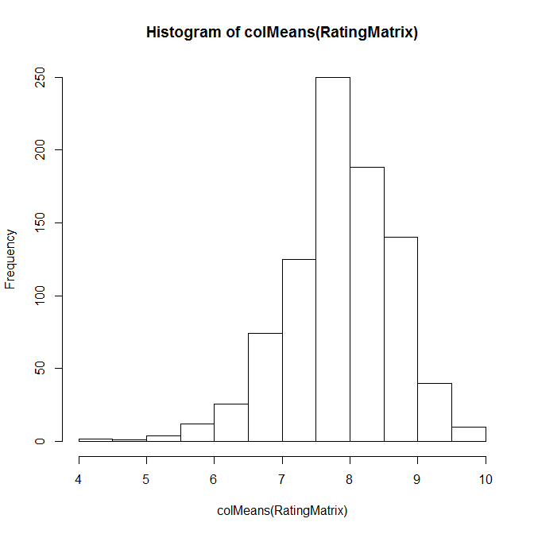
Data Exploration

Slide 9
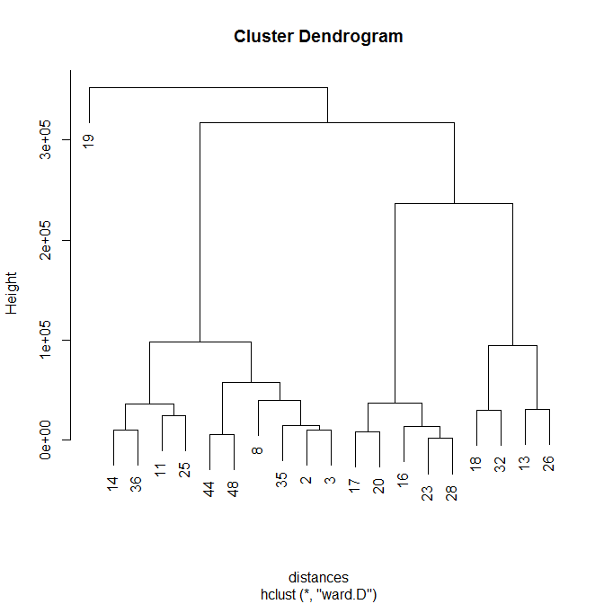
Data Exploration

Slide 10
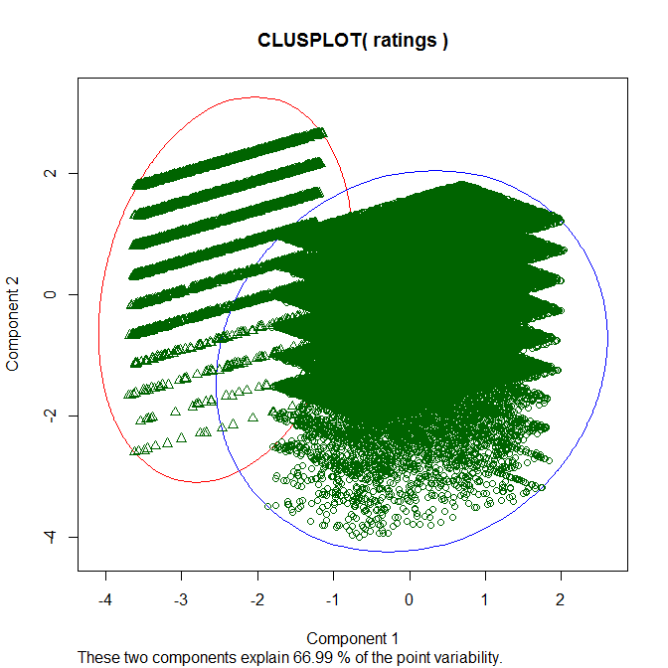
Data Exploration

Slide 11
Data Preparation

Slide 12
Methods
- We used Sparklyr Package to interface with Spark
- We used the Alternating Least Squares (ALS) matrix factorization to reduce our rating matrix.
- We used Collaborative Filtering.

Slide 13
Model Creation

Slide 14
Model Prediction

Slide 15
Model Evaluation

Slide 16
Challenges

Slide 17
Conclusion

