Slide 2
Agenda
Introduction
Data Exploration
Data Preparation
Methods
Model Creation
Model Evaluation
Challenges
Conclusion

Slide 3
Introduction
The goal of the project is to build a recommendation system for books based on user ratings. A user is asked to rate a fixed number of books from our dataset and based on the user’s rating for these selected books and ratings given to them by other individuals, our recommendation system recommends other books from our dataset that matches user’s interest based on ratings.

Slide 4
Data Exploration
Book Crossing Dataset:
Users = 278,860 rows
Books = 271,380 rows
Rating = 1,149,781 rows
users
User.ID
Location
Age
Rating
User.ID
ISBN
Book.Rating
Books
ISBN
Book.Title
Book.Author
Year.Of.Publication
Publisher
Image.URL.S
Image.URL.M
Image.URL.L

Slide 5
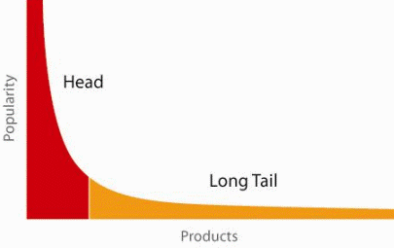
Data Exploration
When does a Recommendation System do its job well?
"Recommend widely unknown items that users might actually like!"
20% of items accumulate 74% of all positive ratings
Recommend items from the long tail

Slide 6
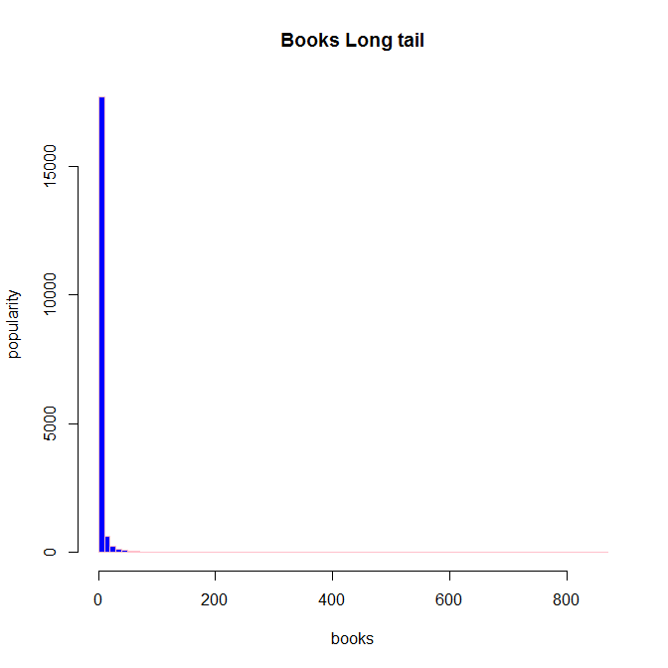
Data Exploration
Recommend items from the long tail

Slide 7
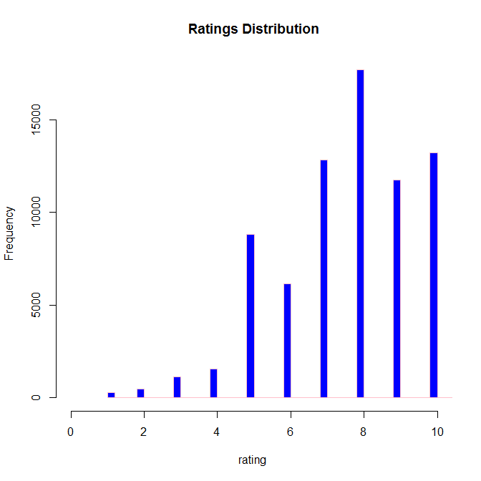
Data Exploration

Slide 8
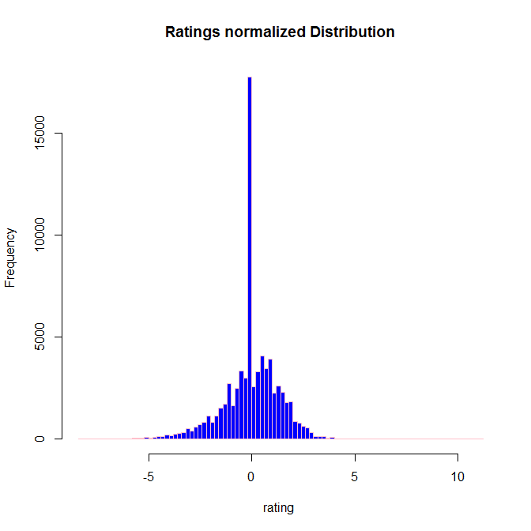
Data Exploration

Slide 9
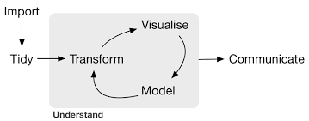
Data Preparation
Our data preparation methodology follows the below approach:

Slide 10
Data preparation Challenges
Data load challenges
Data size challenges (data imports, etc..)
Bad delimiter, missing Newline feed
ISBN datatype issue

Slide 11
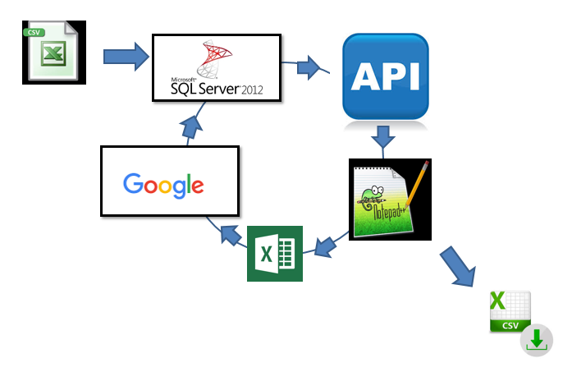
Data Import and Cleansing Process

Slide 12
Methods
- We used Sparklyr Package to interface with Spark
- We used the Alternating Least Squares (ALS) matrix factorization to reduce our rating matrix.
- We used Collaborative Filtering.

Slide 13
Model Creation
Since our real rating matrix is a sparse matrix as it has 89890 rows and 212931 columns with only 965290 ratings; which is about 0.00522 %, we chose to use collaborative filtering along with ALS for matrix factorization.

Slide 14
Model Evaluation
We use RMSE (root mean square error) to evaluate our model against regularization
And with regularization learning rate of 0.1, our RMSE is 1.348361; however, with .2, our RMSE is 1.459424

Slide 15
Conclusion
Our recommendation

